Slide 1
Get the Mass Out: How to Help Organizations Move at the Speed of Information
January 25, 2020

Slide 2
Deloitte is a multinational professional services firm with over 300,000 employees worldwide. Providing industry-leading audit, consulting, tax and advisory services, Deloitte aids many of the world’s most admired brands in solving their toughest business challenges.

Slide 3
Why is a tax firm talking about MBSE?

Slide 4
Digital

Slide 5
Digital
Transformation
Image: Sid Mosdell¹

Slide 6
Digital Transformation

Slide 7
What exactly does Digital Transformation mean?
dig·i·tal
/ˈdijidl/
trans·for·ma·tion
/ˌtran(t)sfərˈmāSH(ə)n/
Involving or relating to the use of computer technology.²
A thorough or dramatic change in form or appearance.³

Slide 8
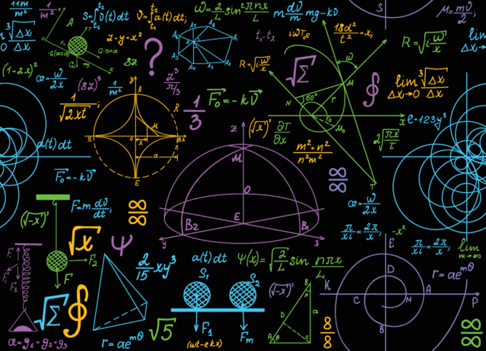
Copyright © 2020 by Deloitte Consulting LLP. Permission granted to INCOSE to publish and use.
Get the Mass Out: How to Help Organizations Move at the Speed of Information
8

Slide 9
Things that possess great amounts of mass require proportionally large amounts of energy in order to move at significantly high speeds

Slide 10
Things that possess great amounts of mass require proportionally large amounts of energy in order to move at significantly high speeds
Things that have no mass move at the speed of light

Slide 11
Things that possess great amounts of mass require proportionally large amounts of energy in order to move at significantly high speeds
Things that have no mass move at the speed of light
To move at greater speeds with less energy you need to GET THE MASS OUT!

Slide 12
How can a business have “mass”?

Slide 15
Image: InWay⁴

Slide 16
How can a business “get the mass out”?

Slide 17
How can a business “get the mass out”?
010110101010110110
Physical
Digital

Slide 18
1. Establish a Digital Record
Physical → Digital
Capture information from the physical world to create a digital record of the physical supply chain
Physical
Digital

Slide 19
1. Establish a Digital Record
Physical → Digital
Capture information from the physical world to create a digital record of the physical supply chain
2. Analyze and Visualize
010110101010110110
Digital → Digital
Machines talk to each other to share information, allowing for advanced analytics and visualizations with real-time data from multiple sources.
Physical
Digital

Slide 20
1. Establish a Digital Record
Physical → Digital
Capture information from the physical world to create a digital record of the physical supply chain
2. Analyze and Visualize
010110101010110110
Digital → Digital
Machines talk to each other to share information, allowing for advanced analytics and visualizations with real-time data from multiple sources.
Physical
Digital
3. Use Information to Generate Physical Movement
Digital → Physical
Apply algorithms and automation to translate decisions and actions from the digital world into movements in the physical world

Slide 21
Image: ITU Pictures⁵

Slide 22
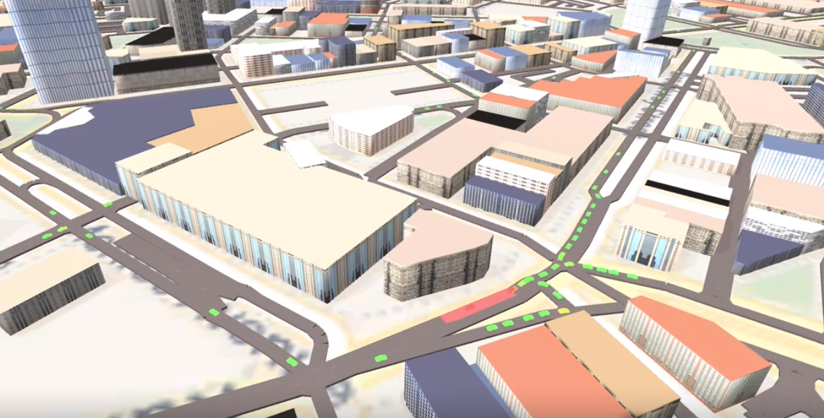
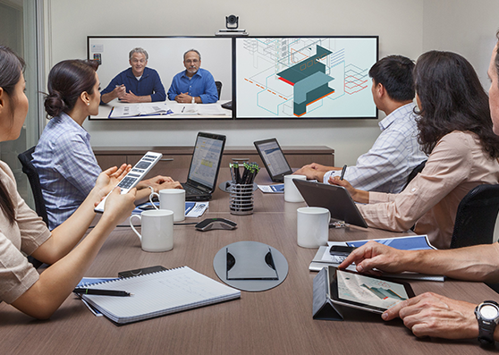
Image: Polycom⁶

Slide 23
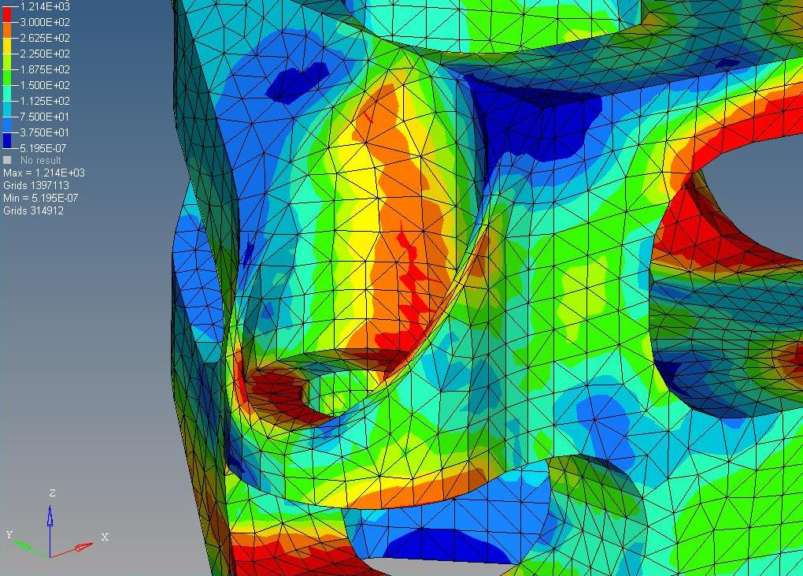
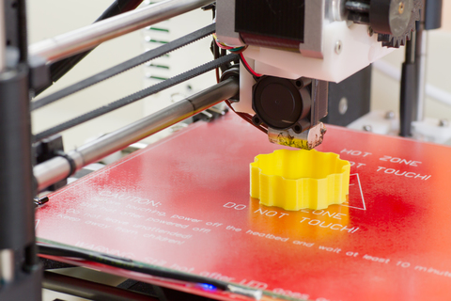
Image: PyCAE⁷

Slide 24
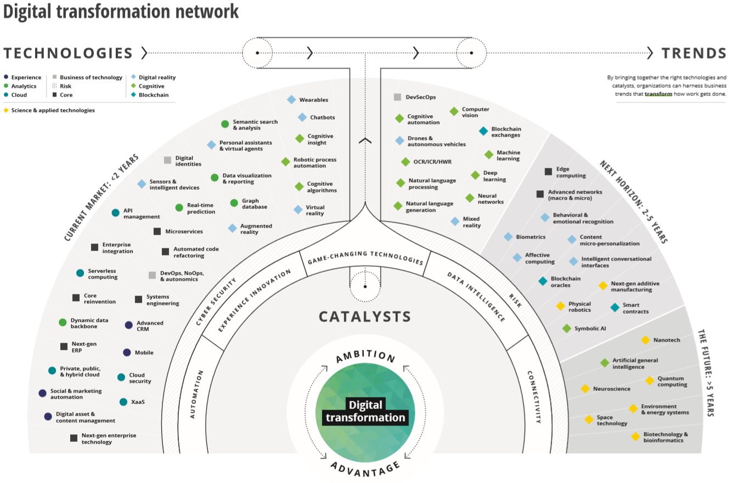
Digital Transformation Network

Slide 25
Is your organization ready?

Slide 26
It’s critical to move beyond just ‘doing’ digital
Don’t get stuck here
Many organizations swirl in an endless loop of ‘doing’ digital things – an illusion of being digital – rather than making changes to their digital mindset and their business, operating, and customer models
Being
Business, operating, and customer models are optimized for digital and profoundly different from prior business, operating, and customer models
Becoming
Leverage digital technologies—becoming more synchronized and less siloed—with more advanced changes to current business, operating, and customer models
Doing
Leverage digital technologies to extend capabilities, but still largely the same business, operating, and customer models
Exploring
Leverage traditional technologies to automate existing capabilities. Dabbling with digital. No real change to the organization

Slide 27
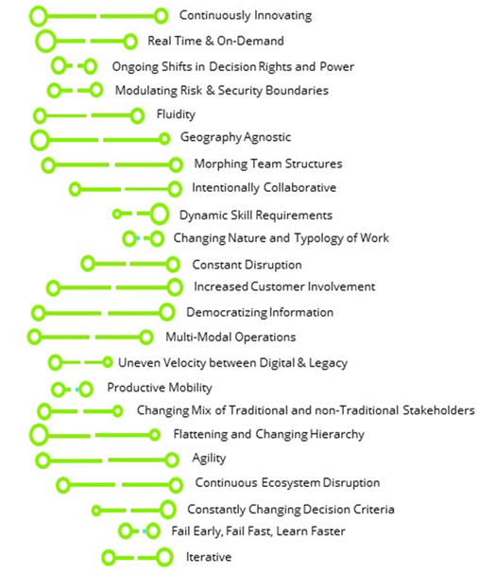
Do you have Digital DNA?
Step 1: Assess
Digital Maturity & Key Traits
Map your organization’s Digital DNA against 23 traits proven to be differentiators in the digital age to understand your perceived digital maturity and clarify what is most valuable for your organization to focus on.
Step 2: Enable
Unblocking & Structuring Change
Bring your leaders together to explore and identify the Minimum
Viable Changes (MVCs) that will allow your organization to start changing now.
Step 3: Transform
Embracing Digital & Creating Value
Organize MVCs tailored to your organization into playbooks and sprints, allowing your team to plan and monitor progress in a way that leads to real, on-the-ground results with strong buy-in across the organization.
Copyright © 2017 Deloitte Development LLC. All rights reserved.

Slide 28
$$M=Mass$$
$$E=Energy$$
$$V=Velocity$$
$$DT =Digital Transformation$$
$M_{DT}<$ $M_{0} ∴$ $E_{DT}$ < $E_{0}$ $⟹$ $V_{DT}$ > $V_{0}$
Get the Mass Out! $⟹$ Move at the Speed of Information!
Q.E.D

Slide 29
“It is time to move beyond the frontier of random acts of digital.”
DELOITTE⁸
Copyright © 2020 by Deloitte Consulting LLP. Permission granted to INCOSE to publish and use.
Get the Mass Out: How to Help Organizations Move at the Speed of Information
29

Slide 30
References
¹ Caterpillar to Chrysalis by Sid Mosdell is licensed under CC BY 2.0
² https://www.lexico.com/en/definition/digital
³ https://www.lexico.com/en/definition/transformation
⁴ Laser Cut Metal Spark Laser by InWay is licensed under CC BY 2.0
⁵ 1st Forum on Artificial Intelligence and the Internet of Things in Smart Sustainable Cities in Latin America by ITU Pictures is licensed under CC BY 2.0
⁶ Image used solely with permission from Polycom; https://www.polycom.com/products-services/resources/using-video-and-telepresence.html
⁷ FEA Methods by PyCAE is licensed under CC BY-NC-ND 2.0
⁸ Deloitte. 2019. “Beyond the Digital Frontier: Mapping Your Future.” Tech Trends 2019.

Slide 31
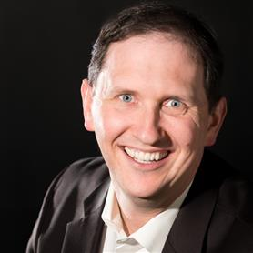
About the Speaker…
Devon Clark is a Systems Engineer with 20 years of experience in Systems Engineering, Integration, and Test. He holds a Bachelors degree in Physics from Georgia Tech and a Masters degree in Systems Engineering from the Naval Postgraduate School. Devon has 18 years of experience engineering Command and Control systems for Naval Sea Systems Command (NAVSEA). Devon is currently part of Deloitte Consulting’s Mission Systems Engineering (MSE) Community of Practice (CoP) and the lead for Model-Based Systems Engineering development at Deloitte (and an avid karaoke-er).

Slide 32
About Deloitte
Deloitte refers to one or more of Deloitte Touche Tohmatsu Limited, a UK private company limited by guarantee (“DTTL”), its network of member firms, and their related entities. DTTL and each of its member firms are legally separate and independent entities. DTTL (also referred to as “Deloitte Global”) does not provide services to clients. In the United States, Deloitte refers to one or more of the US member firms of DTTL, their related entities that operate using the “Deloitte” name in the United States and their respective affiliates. Certain services may not be available to attest clients under the rules and regulations of public accounting. Please see www.deloitte.com/about to learn more about our global network of member firms.
This publication contains general information only and Deloitte is not, by means of this publication, rendering accounting, business, financial, investment, legal, tax, or other professional advice or services. This publication is not a substitute for such professional advice or services, nor should it be used as a basis for any decision or action that may affect your business. Before making any decision or taking any action that may affect your business, you should consult a qualified professional advisor. Deloitte shall not be responsible for any loss sustained by any person who relies on this publication.
Copyright © 2020 Deloitte Consulting LLP. All rights reserved.
RITM0356672 Designed by CoRe Creative Services

