Slide 1
Systems Modeling and Simulation WG (SMSWG )
September 10, 2019
Systems Modeling and Simulation*:
The use of interdisciplinary functional, architectural, and behavioral models (with physical, mathematical, and logical representations) in performing MBSE to specify, conceptualize, design, analyze, verify and validate an organized set of components, subsystems, systems, and processes.
*SMSWG – Terms & Definitions: https://www.nafems.org/about/technical-working-groups/systems_modeling/smstermsdefinitions/s-u/

Slide 2
Agenda
Renewal of NAFEMS and INCOSE MoU – Roger Burkhart
Report out from the joint NAFEMS/INCOSE meeting from the NWC ’19 – Rod Dreisbach
Roadmap Focus Team: update – Frank Popielas
Terms and Definitions Focus Team: update and presentation of the 7 finalized definitions – Ed Ladzinski
Q&A / Other topics / Next SMSWG Call
Notes:
This image does not belong to NAFEMS
Suggested image http://www.istockphoto.com/photo/carbon-fiber-11978554?st=7c03dc0

Slide 3
Integrating Modelling & Simulation at all Levels of Engineering: Element, System, System-of-Systems
Joint Panel Session with
International Council on Systems Engineering (INCOSE)
&
International Association for Engineering Modelling, Analysis & Simulation (NAFEMS)
June 19, 2019

Slide 4
INCOSE-NAFEMS Joint SMS Panel Program
Towards New Collaboration Schemes Through Digital Twins
Panellist 1: Ralf Hartmann (Airbus, DE)
A Bridge Between Two Worlds – Simulation & MBSE
Panellist 2: Eric Landel (Renault, Fr)
Interoperability Standards
Panellist 3: Peter Coleman (Airbus, UK)
What is Simulation Governance & Management?
Panellist 4: Rod Dreisbach (formerly Boeing, US)
Discussion Time
Moderator: Kerry Lunney (Thales, Au)

Slide 5
Discussion Attendees
Peter Coleman - peter.coleman@airbus.com
Rod Dreisbach - roddreisbach@comcast.net
Ralf Hartmann - ralf.hartmann@airbus.com
Eric Landel - eric.landel@renault.com
Kerry Lunney - kerry.lunney@thalesgroup.com.au – INCOSE President-Elect
Garry Roedler – (Lockheed Martin Corp.) - INCOSE President
Prof. Heinz Stoewer - (Space Associates)
Costas Stavrinidis – NAFEMS Chairman
Tim Morris – NAFEMS CEO
Ian Symington – NAFEMS Technical Officer

Slide 6
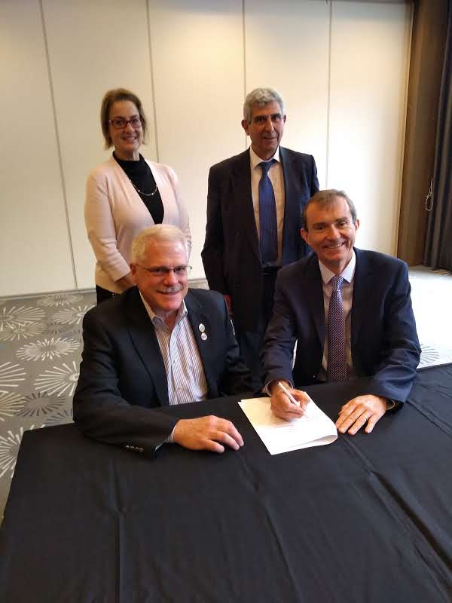
NWC19 SMS Summary: Peter Coleman
Special session with INCOSE – NAFEMS leadership and SMS WG + lively panel discussion with audience, exploring issues around integration of SE and ES all along the lifecycle
12 papers on Systems topics presented in 3 sessions (1C, 2C, 3C)
Some impressions
Interesting mix between practical use of system simulation in industry and tools capabilities
Good surprise to see Systems topics well represented
Suggestion for next NWC – short training course(s) on system simulation and MBSE
Renewed MoU signing on June 19, 2019 between INCOSE and NAFEMS to continue our collaborations on Systems Engineering
and Engineering Simulation!

Slide 7
Roadmap Focus Team - Update
Frank Popielas

Slide 8
Topics / Focus 2019
The flyer is the foundation – completed
Providing a better focus around “What is Model-Based…?”
Working together with T&D Focus Team to update / create proper definitions: 7 definitions finalized, will be circulated to SC and introduced to SMSWG at next meeting
Create a joint NAFEMS/INCOSE flyer on this topic: include the various model definitions when writing it (where needed)
Solicit people who can help drafting it – our focus team takes the lead
Outline: September 2019
Draft: December 2019
Final: January 2019 (to be available for IW 2020) – content finalized
Start to roll out the SMS Presentation Topics and combine with company experiences (use cases from end users)
Will identify the sequence of the various topics (see next slide)
Provide those as part of the SMSWG meeting and make the material available to the group

Slide 9
SMS Presentations Topics
“Digital Twin – Its Role and structure within a modern Systems Engineering Approach” (Frank Popielas): completed March 12, 2019
Model-Based Engineering - Challenges for Management (Frank Popielas)
Presented - “Systems Engineering – Deployment Challenges”: completed April 9, 2019
Added the following presentations
“Implementing MBSE with Arcadia and Capella: Rationale, Status and Perspectives”; Stephane Bonnet from Thales: completed May 14, 2019
“Semantic MBD Workflows – Why QIF Matter (A Roadmap for Digital Manufacturing)”; Daniel Campbell, Tomasz Luniewski, Capvidia: completed June `11, 2019

Slide 10
Events Support by SMSWG
Model-Based Engineering: What Is It & How Will It Impact Engineering Simulation? – October 1, 2019; Columbus, OH
https://www.nafems.org/events/nafems/2019/model-based-engineering/
Frank Popielas, Ed Ladzinski, Rod Dreisbach
Abstracts reviewed
Preliminary agenda available
Simulation in the Automotive Industry: Creating the Next Generation Vehicle – November 14, 2019; Troy, MI
https://www.nafems.org/events/nafems/2019/simulation-in-the-automotive-industry-creating-the-next-generation-vehicle-2019/
Frank Popielas
Abstracts reviewed
Grid being worked on next
INCOSE IW 2020; Torrance, CA; January 25-28, 2020
https://www.incose.org/iw2020/home/when-where
Roger Burkhart
CAASE 2020: June 16-18, 2020; Indianapolis, IN
https://www.nafems.org/events/nafems/2020/caase20/
Frank Popielas, Rod Dreisbach, Ed Ladzinski
Frank and Roger in contact with Matt Ladzinski to represent SMSWG and provide input what we would like to do as WG
“SMS Vision 2025 and beyond”

Slide 11
SMSWG Roadmap – high level
Defining a new Culture → Shifting toward a comprehensive advanced virtual engineering environment
SMS Vision 2025 and beyond…
Issue additional flyers on specific topics of interests
SMS Flyer
Membership reached:
> 100 members
> 75 companies
FMI Flyer
Presentation / best practices series
Published online 1st issue of T&D
Joint NAFEMS/INCOSE Modified MoU signed; 2019
Provide more forums for SMS (MBSE, MBE,…)
SMSWG
Begins work
SMS Sessions integral part now
(NAFEMS Americas 2018)
Terms & Definitions Focus Team regular update releases
1st own session within the IW ‘15 in MBSE track
Established:
Bylaws
Framework of activities
Website
Focus on Emerging SMS Standards
(IW 2019)
SMS Sessions
(NAFEMS Americas 2016)
Focus Teams announced
(IW 2018)
Joint NAFEMS/INCOSE MoU signed; 2012
3 sessions during
NWC 2015
SMSWG Roadmap
Terms & Definitions
Emerging SMS Standards
Coordinated by the SMS Standards Focus Team
Identify key integration technologies between areas
Identify / support emerging standards
2013 2014 2015 2016 2017 2018 2019 2020 …beyond….

Slide 12
Terms & Definitions Focus Team - Update
Ed Ladzinski

Slide 13
Terms & Definitions finalized

Slide 14
Next T&D being worked on
Model Based Development
Democratization of Simulation
Engineering Simulation
Engineering Simulation Digital Twin
Digital Twin
Generative Design
Simulation Governance

Slide 15
Other Topics / Q&A / Upcoming Calls

Slide 16
Events 2019
Model-Based Engineering: What Is It & How Will It Impact Engineering Simulation?
Date: October 1st, 2019 Location: Columbus, OH (USA)
https://www.nafems.org/events/nafems/2019/model-based-engineering/
Preliminary Agenda available
Registration is open
Simulation in the Automotive Industry: Creating the Next Generation Vehicle –
Date: November 14, 2019
Location: Troy, MI (USA)
https://www.nafems.org/events/nafems/2019/simulation-in-the-automotive-industry-creating-the-next-generation-vehicle-2019/
Abstracts reviewed

Slide 17
Upcoming SMSWG Meetings - Planned
October:
MBSE 2.0 by Vitec and Zuken
November:
Combine: MBSE High Level View for Newcomers and Introduction to MBSE (How We Explain MBSE without using the Traditional “V Model”) (Ed)

Slide 18
Q & A
Open discussion

