Slide 1
How Model Curation Influences Model Duration
Donna H. Rhodes
Massachusetts Institute of Technology
rhodes@mit.edu

Slide 2
models enrich our thinking
SHORTER DURATION
working out a problem

Slide 3
model curation
….the lifecycle management, control, preservation and active enhancement of models and associated information to ensure value for current and future use, as well as repurposing beyond initial purpose and context

Slide 4
integrity
credibility
composability
modularity
duration
trust
elegance
value

Slide 5
SHORTER DURATION
LONGER DURATION
problem solving
design
develop
test
Curation necessitates differentiation of shorter duration models from longer duration models.

Slide 6
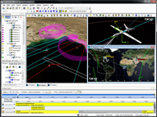
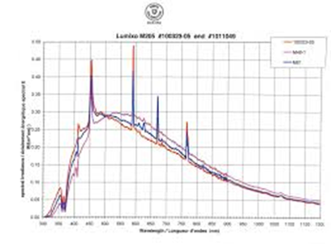
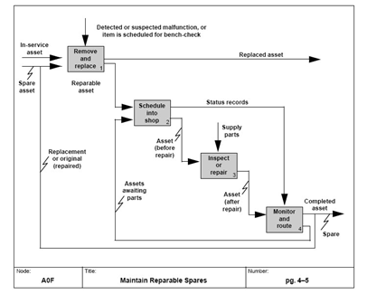
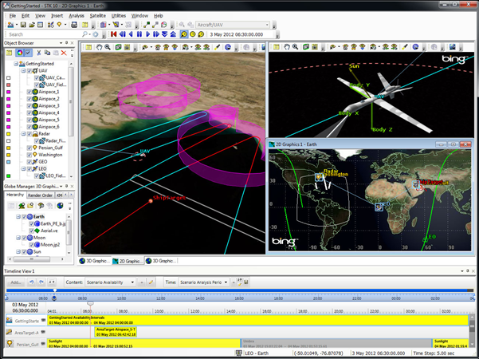
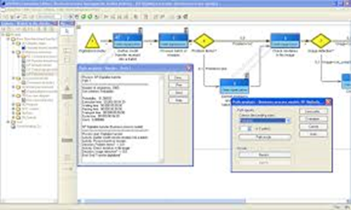
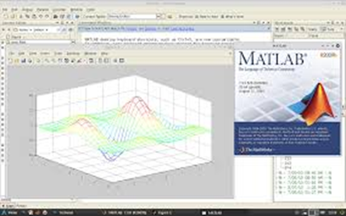
model accessioning
Formal process of accepting models (sets of models) into enterprise level model collection
establish legal ownership, IP, verifies integrity, validates pedigree, etc.
de-accessioning is equally important formal process
enterprise collection
models

Slide 7
MODEL REUSE
THROUGH LIFESPAN
(digital twin)
design
develop
operate
Longer Duration

Slide 8
a benefit of model curation
…. increases the potential for effective reuse of a model on a future program, as the model and associated information (metadata, technical data, and pedigree) will be available to assess its fitness for purpose and context

Slide 9
model pedigree
A model pedigree contains all of the information about a model, its origins and use over time
PURPOSE
…enable the decision maker to determine the model’s status with respect to past achievements, theoretical and methodological state of the art, and the expert advice that went into its development
Gass & Joel (1980)

Slide 10
across the enterprise
Modeling competency across individuals and programs, but not strategically managed at enterprise level
Models exist at all levels of enterprise (individual, program, business unit) but seldom managed as enterprise collection
Reymondet, L., Rhodes, D.H., and Ross, A.M., "Considerations for Model Curation in Model-Centric Systems Engineering," 10th Annual IEEE Systems Conference, Orlando, FL, April 2016

Slide 11
a new leadership role
model curator
enterprise model accessions
valuation of model and digital artifacts
oversight of model collection activities
strategies for model-centric future
leadership for model demonstrators
strategic loan/acq of models
set model collection policy/practices
Image Credit: DNV GL Annual Report, 2015

Slide 12
model curation research priorities (2019)
Model curation implementation practices
Precursors, enablers and barriers to model curation
Innovation through new technologies and methods
Competencies, roles and responsibilities

Slide 13
Donna H. Rhodes
Massachusetts Institute of Technology
rhodes@mit.edu
This material is based upon work supported, in whole or in part, by the U.S. Department of Defense through the Systems Engineering Research Center (SERC) under Contract HQ0034-13-D-0004. SERC is a federally funded University Affiliated Research Center managed by Stevens Institute of Technology. Any opinions, findings and conclusions or recommendations expressed in this material are those of the authors and do not necessarily reflect the views of the United States Department of Defense.

