Slide 1
DEIXWG Digital Viewpoint Model (DVM) Concept Model – CDR Team Vendor Challenge
Leqi (Ken) Zhang
DEIXWG CDR Lead
leqiken.zhang@l3harris.com
L3Harris Technologies

Slide 2
Objectives
Provide guidance material for enabling vendors to conceptualize the most effective mean to convey Digital Views per the Digital Viewpoint Model (DVM) Concept
Focus on the perspective of the Acquirer for Interface Design Compliance and Assurance of Test Readiness
Assume CDR level maturity
Purpose is provide guidance on the “what” instead of “how” to provide freedom for vendors to develop the views and artifacts

Slide 3
DVM Concept Model
Stakeholder Ontology
Will provide guidance on the objectives of Digital Views; vendors have the freedom to decide how to develop the Digital Artifacts to meet the objectives
Will provide definitions and objectives of stakeholders
Product Ontology
Process to develop the artifacts to be chosen by the vendors
Process Ontology

Slide 4
DVM Concept Model - CDR Digital View Vendor Challenge Stakeholder Ontology Definition
Perspective describes what the Acquirer is looking for from the Supplier
Will provide definitions and objectives of stakeholders
User Stories provides more details in refining the desire of the Acquirer
Vendor team to provide digital artifacts across different domains to demonstrate the product is compliant per Acquirer's needs

Slide 5
DVM Concept Model - CDR Digital View Vendor Challenge Stakeholder User Story Decomposition
Per stakeholder perspective and associated use stories, identify digital view that are required to demonstrate the compliance

Slide 6
DVM Concept Model - CDR Digital View Vendor Challenge Stakeholder User Story Decomposition
Describe how the identified digital view can meet the need of each user story
Further define the different instantiation of digital view per domain
An example for conceptualize Digital Views; vendor has the freedom to develop own concept to best meet the needs of the user stories with Digital Views
Identify relationships to applicable standards

Slide 7
DVM Concept Model - CDR Digital View Vendor Challenge Stakeholder User Story Decomposition
CM/DM process to be identified by vendor to demonstrate the presented material is the authoritative source of truth. Vendor can also reference to standards instead of specifying particular tool or procedures.
Vendor to define the format and presentation of digital information to compile as part of the identified digital views
Vendor to define work product development process

Slide 8
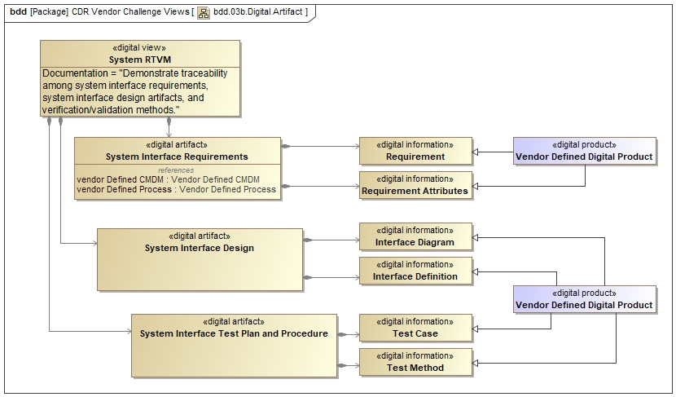
DVM Concept Model - CDR Digital View Vendor Challenge Desirable Attributes of Digital View Concepts
Acceptable
Desirable
It’s a challenge to the vendor to maximize efficiency and effectiveness in using fewer types of refined Digital Products to meet needs of multiple Digital Views.

Slide 9
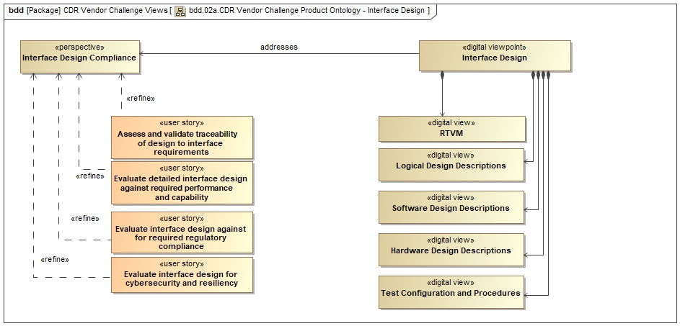
DVM Concept Model - CDR Digital View Vendor Challenge Desirable Attributes of Digital View Concepts
Interoperable
Digital View concepts should emphasize interoperability to enable effective Digital Information exchange. For example, the delivery should follow standard digital dynamic formats, instead of proprietary or static formats such as pictures

Slide 10
DVM Concept Model - CDR Digital View Vendor Challenge Stakeholder User Story Decomposition
Digital View work process should be standardized so it’s usable within multiple different Systems Engineering methodologies (e.g. OOSEM, SDL, etc.), and not only be applicable using a proprietary methodology.

