Slide 1
Model-based RAMS
Model-based RAMS for mission / safety critical systems
Unrestricted
Notes:
Today I would like to speak with you about the safety and reliability of your products – and how you can ensure that you are meeting customer, community and certification requirements for these attributes.
As you are developing mission and safety critical systems you are already conducting these analyses, but I will talk about new technology that enables you to conduct these analyses more efficiently and effectively – which has a direct relation to the speed and efficiency of your design processes, and the quality of the end product.

Slide 2
Presentation Structure
PHM Technology Overview
What is RAMS?
Trends impacting RAMS
What is wrong with RAMS today?
RAMS for Systems Engineering
The MADe solution
What MADe does
How model-based RAMS is different
Model-based RAMS for Systems Engineering
Benefits of Model-based RAMS
Closing the loop for RAMS
Summary
Notes:
MADe is the next generation RAMS analysis solution – a model-based tool that integrates all of the analysis in a single tool chain that is integrated with Teamcenter.
From your perspective, as an executive, you simply need to know that it has cost, schedule and technical advantages over the current tools that you are using – which means that your team will be able to design safe products faster, that are optimised for cost of ownership.

Slide 3
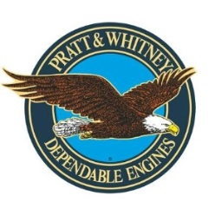
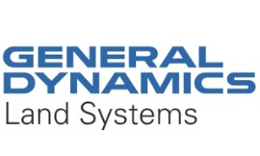
PHM Technology Overview
Develop the Maintenance Aware Design environment (MADe)
MADe is a RAMS & CBM analysis solution with the cost, schedule and engineering process benefits of a model-based technology
Global customer base in Aerospace and Defence
Siemens OEM Partner for Safety and Reliability
Established 2006, HQ in Melbourne, Australia
Notes:
So why should you be looking to implement MADe?
It has a unique model-based architecture and functionality that generates significant cost, schedule and technical benefits to the design process.
It is being used for some of the most complex safety / mission critical systems in the world, by some of the most demanding customers (US Air Force, US Army, Pratt & Whitney).
You should also know that, after a review of the RAMS solutions available globally, Siemens decided to invest in the company. In other words, we found the solution so good we bought into the company!

Slide 4
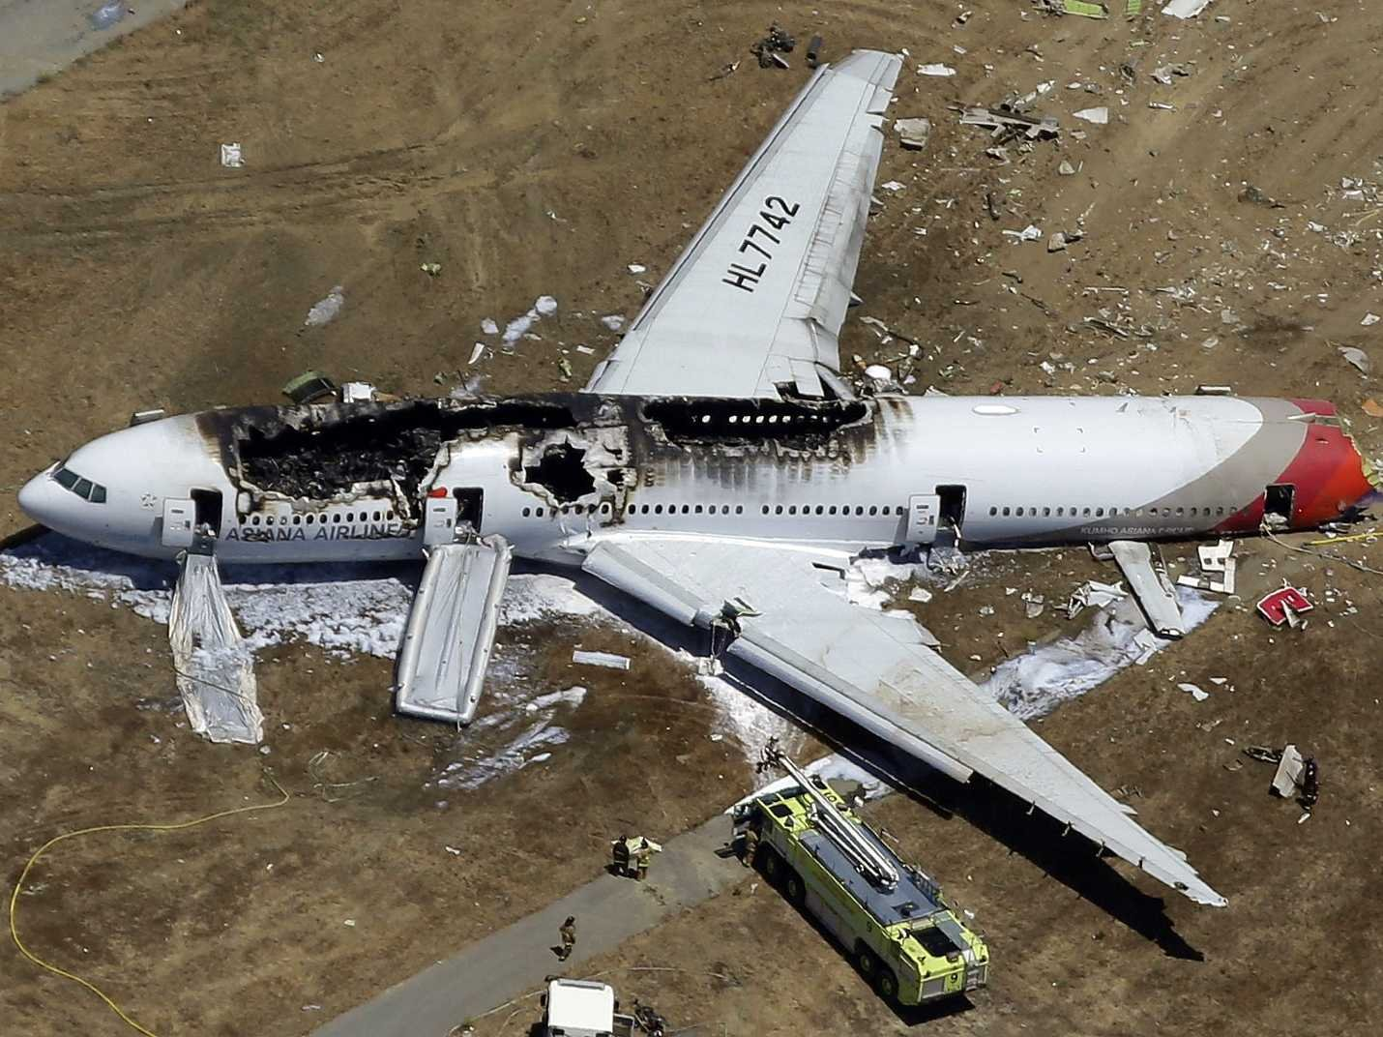
What is RAMS?
Reliability &
Availability
Maintainability
Safety
Notes:
To make sure we are on the same page… what is RAMS? For any product that you design, the user expects that it will be:
Reliable: able to perform its intended function
Available: ready to use when it is needed
Maintainable: efficient and cost effective to look after
Safe: will not cause harm to the user or the environment
None of these things happen by chance – there are engineering principles and processes that are supported by proven analysis techniques to effectively identify, understand and manage the technical risk associated with any design configuration.
So RAMS (Reliability, Availability, Maintainability & Safety) is the term to describe a range of integrated and inter-dependent technical engineering analyses that directly contribute to the efficiency and accuracy of the design process and output.

Slide 5
Trends impacting RAMS
Increasing
complexity
Distributed Design
(data / analysis synchronicity)
Design / Certification (schedule & costs rising)
Notes:
So why do you need to change the way that you conduct RAMS? There are three key trends that are driving the requirement for a model-based approach to RAMS.
Firstly, the increasing complexity of systems means that it is no longer reasonable to rely on a manual process to identify all of the potential failures in a system – and this is the approach that you are currently using. This is very important because if you cant identify a potential failure (a risk) then it is impossible to mitigate it (either with a design change, appropriate maintenance action or sensor).
Secondly, the design process for complex systems is usually conducted with a number of suppliers (or ‘design partners’) that have responsibility for providing specific sub-systems or assemblies for the system. This means that the OEM must use RAMS information generated by their suppliers in generating the system level analysis – and therefore that the quality of the data outputs, process consistency and outputs from a supplier’s RAMS analysis has a direct impact on the safety and reliability of the design configuration. If the supplier doesn’t get it’s RAMS analysis correct – or doesn’t provide the RAMS analysis early enough, it can result in significant safety and reliability issues for the system.
Finally – there is continuous pressure to reduce the Cost of Ownership of systems. Whether it is to gain advantage in the sales process, or because the OEM is seeking to provide the in-service support and needs to accurately assess the expected cost of maintenance (a significant driver in the A&D industries where sustainment represents approximately 75% of total ownership cost, but more and more prevalent across many industry sectors from transport to mining to medical devices). This requires that the service requirements of a system be analysed during the design process while it is still cost-effective to make a change – either you “design for support”, or end up supporting a design that has not been optimized for cost.

Slide 6
What’s wrong with RAMS today?
Current tools (commercial / in-house):
Subjective process – complexity of systems a problem
Manual approach – authoring not generating the data
Lack of integration – analyses must be manually combined
Lack of consistency – terminology /methodology
Lack of configuration management – design / PLM
Limited reusability of data
Limited knowledge capture / transfer
Result: significant resources, schedule and cost to generate any analysis –
does not consistently achieve design optimization
Notes:
Subjective process – cant keep up with increasing complexity of systems (e.g. dependency mapping)
Manual approach – authoring not generating the data (quality impact - what happens when the grey beards go?)
Consistency - functional / failure descriptions vary (taxonomy issues)
Lack of configuration management (don’t integrate with PLM / fleet data)
Limited reusability of data (other analysis - other designs - other programs)
Lack of data visualization (standardized reporting and graphical outputs)
Limited knowledge capture / transfer (based on implicit instead of explicit data presented in a GUI)
Result: often conducted post factum as the manual approach does not readily support iterative concurrent analysis with the design process , so it is generally conducted once the design has been largely completed - which leads to a compliance bias instead of informing design decisions before they become “locked in” - and therefore effectively documents the issues rather than enabling them to be solved by the design engineer

Slide 7
RAMS for Systems Engineering
How do we reduce the Total Cost of Ownership?
How do we objectively identify, analyze and mitigate all engineering risks?
How can we improve the accuracy and reduce the cost of conducting RAMS analysis?
How can we improve operational reliability?
How to capture / transfer system knowledge and lessons learned for long-life programs?
How can we leverage diagnostics / the IoT?
Is technology available that can improve /
automate RAMS analyses?
Is there a business case to support an improved process / technology?
Notes:
So why do you need to conduct RAMS? To ensure that you have the optimal design process and product.
These are the types of questions that RAMS is used to address – ranging from specific technical issues (e.g. what engineering risks are present in a design configuration) to process considerations (can we introduce automation to improve the efficiency and quality of identifying these risks) to the culture of your organization (how can we leverage lessons learnt across the life of the platform and in future projects).

Slide 8
The MADe Solution
The Maintenance Aware Design environment (MADe)is a model-based engineering analysis and decision support solution with an integrated tool chain that is integrated with PLM.
MADe uses functional simulation to consistently identify and mitigate engineering risk based on the potential technical, capability and economic consequences.
MADe optimizes engineering processes by enabling concurrent analyses to ensure design and sustainment decisions are technically valid and economically justified.
Notes:
MADe is the next generation RAMS analysis solution – a model-based tool that integrates all of the analysis in a single tool chain that is integrated with Teamcenter.
From your perspective, as an executive, you simply need to know that it has cost, schedule and technical advantages over the current tools that you are using – which means that your team will be able to design safe products faster, that are optimised for cost of ownership.

Slide 9
What MADe does
Notes:
What are the specific applications of MADe? In essence, what it does is:
Define – what is the use case (mission profile) for the system? Will it be something that you use once a week or 24 hours a day? Will you be operating the system in a remote area?
Model – what is the design solution (logical /physical) that has been generated to meet the use case requirements? What specific failures can you expect from that configuration? [based on failure simulation] What is the expected reliability of each of the components in the system and how does this translate to system level reliability? [based on Reliability Block Diagrams]
Validate – automatically generate the technical analysis artefacts required [including FMEA, FMECA and Fault Tree Analysis]
Analyse / Mitigate – structured workflows to identify the most appropriate failure prevention strategy [based on Reliability Centred Maintenance], whether that be condition-based, preventative or scheduled
Calculate – aggregate the identified failure mitigation actions to understand the service requirements and their associated scheduling and cost

Slide 10
How Model-Based RAMS is different…
The benefits of MADe:
Objective process – handles increasing complexity
Automated approach – generating not authoring data
Integrated – common source of truth across a project
Consistency – defined workflows
Configuration management of analysis with PLM
Libraries ensure reusability of data
Data visualization enables knowledge capture / transfer
Result: concurrent , automated analysis enables input from all departments to support design optimization

Slide 11
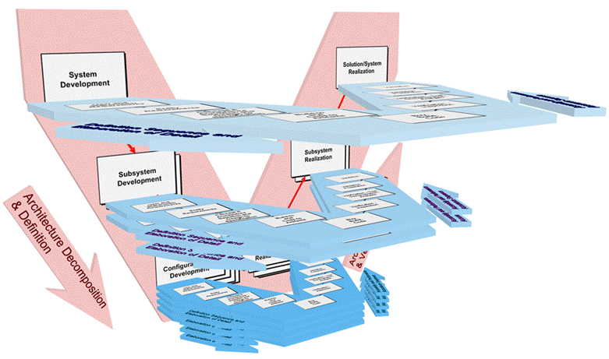
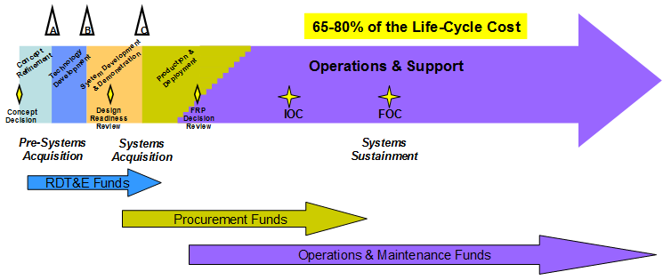
Model-based RAMS for Systems Engineering
Concurrent
verification and certification
Integrated design
Design for Support
(optimize LCC)
Notes:
So why do you need to change the way that you conduct RAMS? There are three key trends that are driving the requirement for a model-based approach to RAMS.
Firstly, the increasing complexity of systems means that it is no longer reasonable to rely on a manual process to identify all of the potential failures in a system – and this is the approach that you are currently using. This is very important because if you cant identify a potential failure (a risk) then it is impossible to mitigate it (either with a design change, appropriate maintenance action or sensor).
Secondly, the design process for complex systems is usually conducted with a number of suppliers (or ‘design partners’) that have responsibility for providing specific sub-systems or assemblies for the system. This means that the OEM must use RAMS information generated by their suppliers in generating the system level analysis – and therefore that the quality of the data outputs, process consistency and outputs from a supplier’s RAMS analysis has a direct impact on the safety and reliability of the design configuration. If the supplier doesn’t get it’s RAMS analysis correct – or doesn’t provide the RAMS analysis early enough, it can result in significant safety and reliability issues for the system.
Finally – there is continuous pressure to reduce the Cost of Ownership of systems. Whether it is to gain advantage in the sales process, or because the OEM is seeking to provide the in-service support and needs to accurately assess the expected cost of maintenance (a significant driver in the A&D industries where sustainment represents approximately 75% of total ownership cost, but more and more prevalent across many industry sectors from transport to mining to medical devices). This requires that the service requirements of a system be analysed during the design process while it is still cost-effective to make a change – either you “design for support”, or end up supporting a design that has not been optimized for cost.

Slide 12
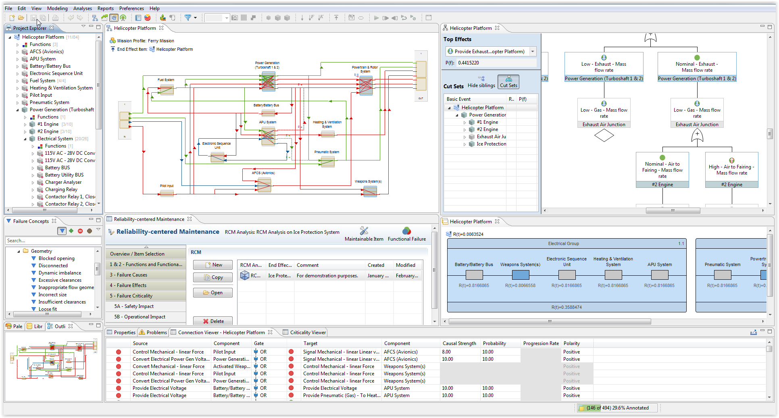
Benefits of Model-based RAMS
Data structures and processes to enable synchronous distributed design
Objective, integrated technical risk management concurrent with each iteration of the design
Reduce the cost of design and support based on RAMS
Notes:
These outcomes all provide economic advantage.
We would welcome the opportunity to demonstrate how MADe can achieve these outcomes for you.
NEXT STEPS? – based on the specific meeting plan for the customer

Slide 13
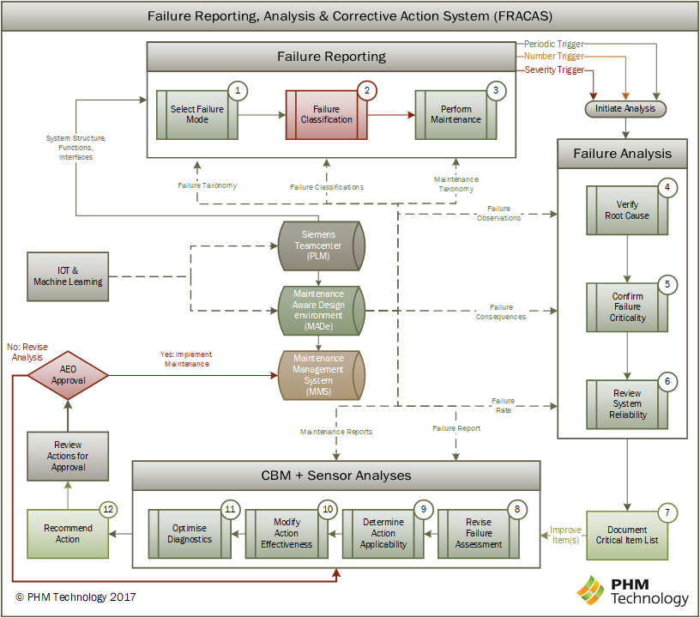
Closing the Loop for RAMS

Slide 14
Summary
Model-based RAMS has cost / schedule / engineering benefits.
Implementation of model-based RAMS enables the Digital Twin.
Support optimization (sustainment / asset management) requires model-based RAMS – ideally from the concept design stage – but alternatively when the asset is in service.
Additional information is available from:
cstecki@phmtechnology.com
ken.oister@siemens.com / mark.sampson@siemens.com
www.phmtechnology.com
Notes:
MADe is the next generation RAMS analysis solution – a model-based tool that integrates all of the analysis in a single tool chain that is integrated with Teamcenter.
From your perspective, as an executive, you simply need to know that it has cost, schedule and technical advantages over the current tools that you are using – which means that your team will be able to design safe products faster, that are optimised for cost of ownership.

