Slide 1
Multi-Domain Model-Based Engineering
Hans Peter de Koning (ESA/ESTEC, The Netherlands)

Slide 2
Glossary of Terms
Domain = (short for) Domain of Expertise ≈ Discipline
Multi-Domain ≈ Multi-Disciplinary
Universe of Discourse = Domain of Discourse
“Scope taken into account”
Systems Engineering (INCOSE) = System Engineering (ECSS)

Slide 3
Background of this presentation
Standardisation work on ECSS E-TM-10-23 and E-TM-10-25
Model based system engineering conceptual data models for European space
Co-organisation of 14 annual NASA-ESA Product Data Exchange Workshops
Contributions to SysML v1.2 and v1.3 (QUDV)
Standardisation work on ISO 10303 (STEP) and related standards
Cross-industry & multi-disciplinary
15 years chair of Dutch normalisation committee for “Industrial automation”
MBSE Panel at INCOSE IS11 (Denver)
Work on ESA space projects in general and ESA’s Concurrent Design Facility in particular
Development lead on ESA’s Open Concurrent Design Tool (OCDT)
New multi-domain conceptual modelling environment (in progress)

Slide 4
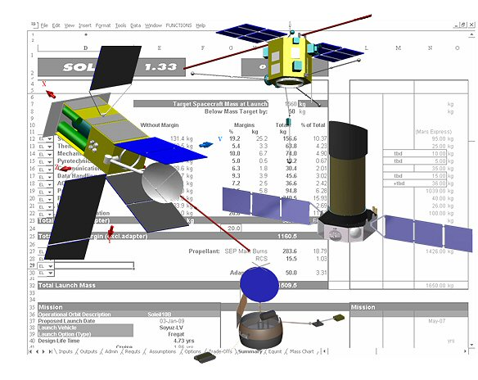
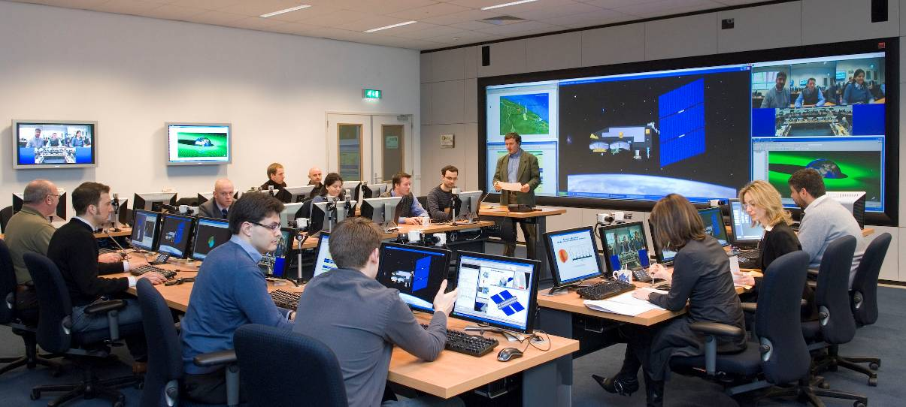
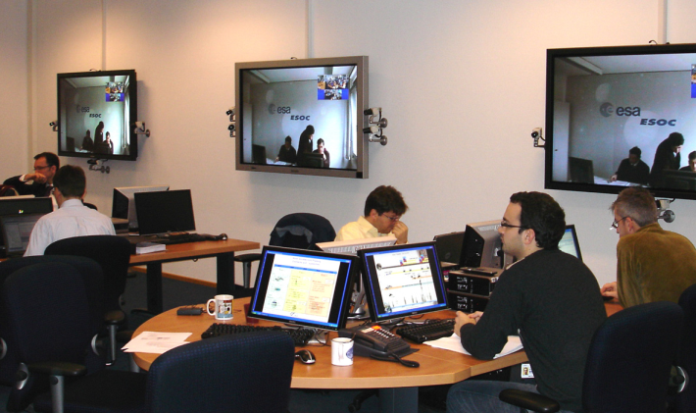
ESA Concurrent Design Facility (CDF)
Concurrent engineering of conceptual design of all candidate ESA missions
including risk, cost, programmatics
10 to 15 studies per year
For details see http://www.esa.int/SPECIALS/CDF/

Slide 5
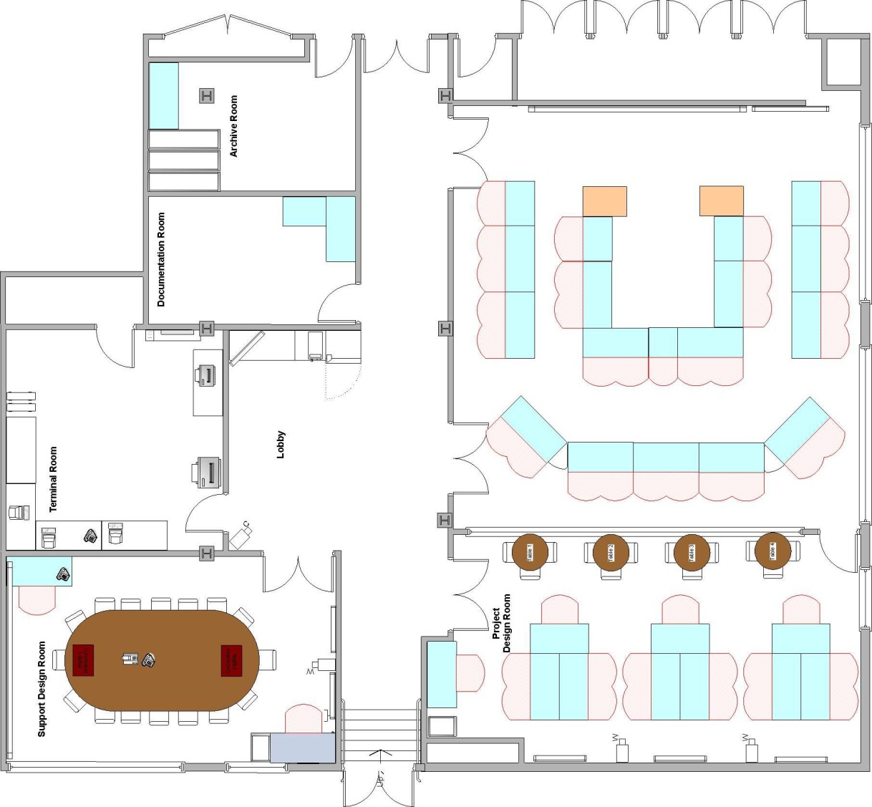
CDF Layout
Integrated audio & video: all inputs / output switchable
Video conferencing at each seat
Big screen
Main CDF room
Glass pane
Meeting room
Break out room

Slide 6
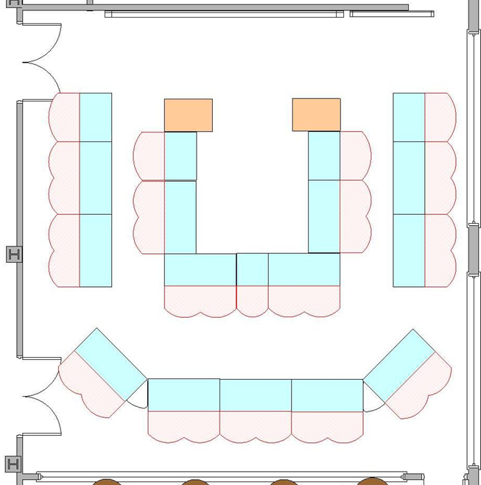
CDF Typical Domain Seats 22 typical in full study / 32 max
Customer
Team Leader
System Eng.
Technical Author
SE Assistent
AOCS
GNC
Cost Analysis
Power
Risk Assessment
(Remote, ESOC)
Programmatics
Instruments
Mission Analysis
Functional
Simulation
Propulsion
Ground Systems & Ops
Structural
Communications
Thermal Control
Configuration (3D)
Data Handling
Mechanisms

Slide 7
Systems Engineering: 3 Main Areas of Concern & 1 Central Task
Facilitate lead and control collaboration between all disciplines and parties
Specify
the Problem
Requirements
E-ST-10C: "Requirements engineering" and “Analysis”
Coordination and
Control
Customer
Define
the Solution
Supplier
Realise
the Product
Design
E-ST-10C: "System engineering integration and control"
Manufacturing,
Assembly & Integration,
Verification & Validation
E-ST-10C: "Design and configuration“ and “Analysis”
E-ST-10C: "Verification" and "MAIT"

Slide 8
Concurrent (System) Engineering
Requirements
…
Requirements
Attitude & Orbit Control
Requirements
Thermal
Requirements
Comms
Requirements
Propulsion
Requirements
Power
Requirements
System
Design
Manufacturing,
Integration,
Verification,Validation
Design
Manufacturing,
Integration,
Verification,Validation
Design
Manufacturing,
Integration,
Verification,Validation
Design
Manufacturing,
Integration,
Verification,Validation
Design
Manufacturing,
Integration,
Verification,Validation
Collaborate,
Coordinate and
Control
Iterate between
Requirements,
Design, and MAIV&V
Iterate across
Disciplines
Design
Manufacturing,
Integration,
Verification,Validation
Design
Manufacturing,
Assembly & Integration,
Verification & Validation

Slide 9
System Engineering in the Supply Chain (Product Tree / WBS)
Requirements
Top Customer
Customer
Supplier
Design
M,
A & I,
V & V
Prime Contractor
Requirements
Requirements
Requirements
Customer
Supplier
Design
M,
A & I,
V & V
Design
M,
A & I,
V & V
Design
M,
A & I,
V & V
1st Tier Subcontractors
Requirements
Requirements
Customer
Supplier
Design
M,
A & I,
V & V
Design
M,
A & I,
V & V
2nd Tier Subcontractors
n^{th} Tier Subcontractors

Slide 10
Effort along the System Life-Cycle
effort
Design
Requirements
Define the Solution
Manufacturing,
Assembly & Integration,
Verification & Validation
Specify
the Problem
Realise the Product
MDR
PRR
SRR
PDR
CDR
QR
FAR
Phase 0 A B C D
time

Slide 11
Model Based System Engineering (MBSE)
Specify
the Problem
Provide all needed views and all needed reports
on all system data
from a consistent source model
Requirements
Requirements Models
including traceability links
Coordination and
Control
Customer
Define
the Solution
Supplier
Realise
the Product
Data Common to all Disciplines
Interfaces between Disciplines
Configuration Control & Baselines
Design
Manufacturing,
Assembly & Integration,
Verification & Validation
System / Architectural Design Model
Trade-offs & Design Rationale
Structure and Behaviour Models
Analysis and Simulation Results
M, A & I Models (including Logistics)
V & V Models (procedures,
testcases, results, NCRs, waivers, close-out, VCDs)

Slide 12
“Model Based Engineering” is actually not new at all …
Has been done for almost all (non-SE) disciplines for a long time
Methods and tools for all domains of expertise are mature
Mechanical engineering analysis and simulation
Electrical engineering analysis and simulation
Functional, Control and Communication analysis and simulation
MAIT & Operations preparation
Cost and Complexity analysis
Human Factors and Ergonomics simulation
…
Traditionally modelling focus is primarily on design … and some on verification … (too) little on problem specification / requirements

Slide 13
“Model Based Engineering” is actually not new at all … but there are problems
The big problem is integration across all domains/disciplines
Sharing the right information at the right time
across all domains ⇒ interoperability between all tools & models
achieving high data consistency and quality across all models
achieving information consistency ⇒ consistent data interpretation
achieving across-domain configuration control
Modelling requirements specifications precisely for early validation
most specs are too informal, too imprecise for early validation
validation in the sense of “Are we very clear about what problem to solve?” and “Do we have a complete and consistent problem specification (for the current stage of development)?”
Access to MAIV&V results data for model based V&V

Slide 14
Role and Benefit of MBSE “Data Hub”
Natural hub for data common to all domains / disciplines
Assists in performing SE coordination and control task across all domains
Data Hub does not necessarily need to be physical – can be virtual / distributed
May have some data warehousing features
Can be used to compute / report continuous development “dashboard”
Main budgets (mass, power, …)
Key performance indicators
Measures of Effectiveness
We need a top-down vision and a bottom-up realisation of the MBSE Data Hub

Slide 15
Need for Standard Semantic Data Model
MBE requires a shared underlying Semantic Data Model, aka Conceptual Data Model, (upper) Ontology
Provides authoritative, precise definition of data and its meaning
Expressed in commonly agreed (formal) data modelling language
Should be based on formal logic
With controlled natural language to support review and validation by all stakeholders
Defines data structure, population constraints, validation rules, …
Must be completely independent from any (IT) implementation technology
Should be modular and extensible
Foundational modules for e.g. generic property types / quantities / scales / units, composite structure (function tree, product tree, WBS), version control, identification / naming / labelling, …
Also called “building blocks”, “resource libraries”, “upper ontologies”
Sufficiently rich as source for model transformation / code generation

Slide 16
Standardise on Single Tool Set?
No single tool vendor (however large) can possibly master all methods and tools for all domains
to a required level of excellence and price/performance level
Industrial consortia / supply chains not static, but differ per project
Engineering analysis, simulation and modelling tools are non-trivial and require substantial investments in training, licences, reusable components
Healthy competition between tool vendors is beneficial for end-user and promotes innovation
Even with a single tool suite, there will be different versions creating interface problems at a smaller scale
So, not a good idea …

Slide 17
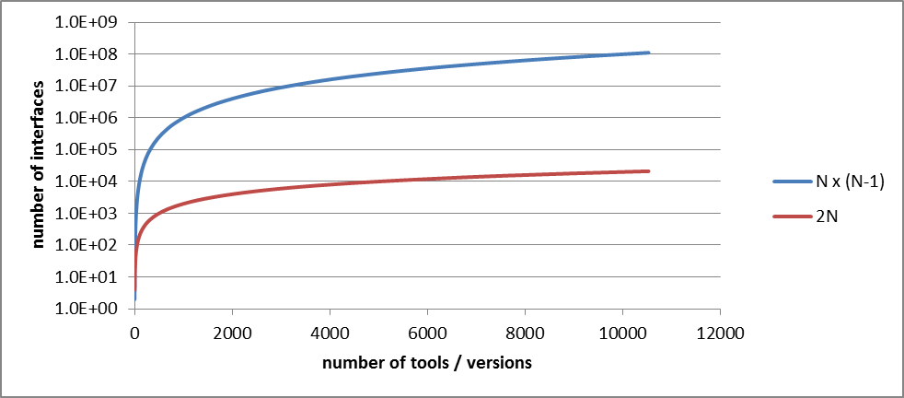
Point-to-point vs Standard-based Data Interfaces
Point-to-point
Standard-based
standard
format /
protocol
N x (N-1) interfaces
2N interfaces

Slide 18
Data Model Layers and Automated Transformation (MDA-like)
e.g.
- UML with dedicated Profile,
Fact Based Modeling
RDF/OWL
Express
Eclipse EMF / Ecore
…
Conceptual Model
Semantic Data Model for
Space Systems Engineering
Logical Model
Relational
Logical Data Model
Hierarchical
Logical Data Model
Object-Oriented
Logical Data Model
Physical Model
Relational Data Model
Hierarchical Data Model
Object-oriented
Data Model
e.g. Oracle SQL, Hibernate, …
e.g. XSD, DTD
e.g. Java, Javascript, .NET C#, Python, …

Slide 19
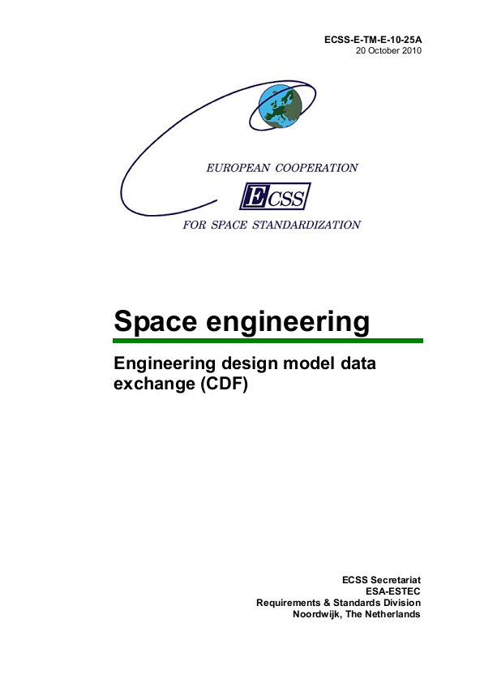
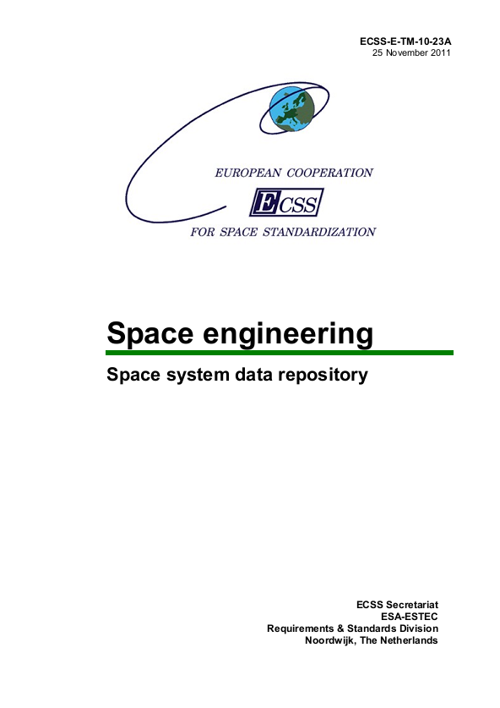
Evolving ECSS Semantic Data Models in support of MBSE
E-TM-10-25
E-TM-10-23
Focuses on conceptual models
in early life cycle phases (0, A)
Focuses on detailed models
in later life cycle phases (B, C, D, E)
Developed in tandem
Where possible common approach and semantics
Defined in UML2/OCL
Where possible aligned with OMG SysML (including QUDV)
E-TM-10-25A made available Oct 2010
E-TM-10-23A made available Nov 2011
Intended future merge to single real standard

Slide 20
Concurrent Engineering in Early Phases vs Collaborative Engineering in Later Phases
Early Phases (0, A)
Later Phases (B, C, D, E)
baseline
Transition around SRR (first half Phase B)
Tens of users
One or few organisations
Near-real-time data sharing in minutes, hours
Trade studies / Strawman models
Requirements in state of flux
Support decision making / programme formulation
Few relatively small models
Fine-grained version control (object level)
time
Hundreds of users
Tens of organisations
Synchronisation times in days, weeks, months
Formal configuration/version control
Strict requirements baseline
Formal, detailed V&V
Orders of magnitude more models/data
Coarser-grained version control (“dataset” level)

Slide 21
Standards validated through tool implementations and pilot projects
E-TM-10-25 → Open Concurrent Design Tool (OCDT)
Validation of E-TM-10-25 data model w.r.t. to CDF-like CE process
Three–tier architecture: Client / REST Webservice / Persistent Data Store
Entirely built on open source components
Community Open Source Software (for ESA Member States)
Extensive use of model-based software engineering / code generation
Main client integrated with Excel for lowest possible learning curve
Designed for distributed design sessions
Software Development Kit for Domain Specific Tool adapters
E-TM-10-23 → Virtual Spacecraft Design (VSD)
Validation of E-TM-10-23 data model with GOCE Phase B design
Sophisticated generation of code and GUI directly from data model
Successful use of Eclipse Modeling Framework as a platform
Client / Server architecture built on open source components
Follow-up in Astrium and Thales-Alenia Space for use in projects

Slide 22
Standards and Tool Implementations
Semantic Data Model Standard
Semantic Data Model
“Master Definition of Concepts”
addresses “what” not “how”
“Reference Data Libraries (RDLs) “
Runtime loadable
predefined objects,
including QUDV and Categories
Automated transformations
Runtime use
Generated
Software Implementations
Interoperable tools and databases
(including adapters around existing tools)
Database
Database
Tool
Derived Logical and
Physical Data Models
Database
Tool
Tool

Slide 23
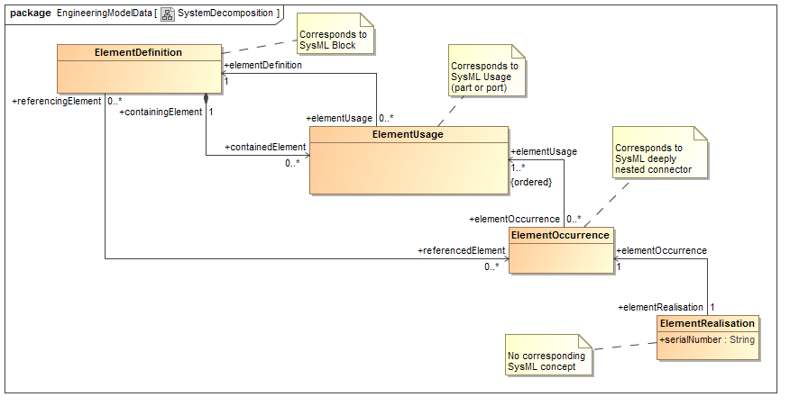
ECSS Improvement w.r.t. SysML: Explicit Occurrence and Realisation in system decomposition

Slide 24
ECSS Improvements w.r.t. SysML: “Category” concept
Category is added as explicit concept in model
Category is a runtime, user-defined classification feature
User-defined validation rules / constraints on basis of Category
Adds flexibility to extend models with functionality that was unforeseen at design time without need for update of software implementations
Similar to on-the-fly extensibility of RDF/OWL based ontologies

Slide 25
ECSS Improvements w.r.t. SysML: Evolution of “QUDV”
ParameterType (SysML ValueProperty type) is extended with CompositeParameterType that allows for non-scalar multi-value parameter / properties (including mathematical n^{th} order tensors )
MeasurementScale is added as concept, with precise subclasses
OrdinalScale
IntervalScale
RatioScale
CyclicRatioScale
Base10LogarithmicScale
NaturalLogarithmicScale
Mathematical NumberSet is added in definition of QuantityKind
Full ISO/IEC 80000 (14 parts) is captured as Reference Data Library

Slide 26
Possible Extension of “QUDV”: “PropertyValueCube” for Analysis/Test Results
properties
Derived from “STEP-NRF datacube”
Hypercube for efficient representation of large amounts of results data
Re-uses SysML / ECSS ValueProperty, Block/Element, state ValueProperty
Each cell of the hypercube is a property value (can be non-scalar, any datatype)
Store slices of data for given time, frequency or other state variable
Has been implemented, tested and used with high-speed, low-memory footprint open source HDF5 library
observable items: blocks, elements
states
typically: sampled time or frequency

Slide 27
ECSS-E-TM-10-25 improvements for interactive multi-domain concurrent engineering (1/2)
DomainOfExpertise is explicit concept in model
Participant in an engineering activity is a Person with a Role and represents a single DomainOfExpertise at a time
Any Requirement, Element, Parameter (i.e. ValueProperty) is “owned” by a DomainOfExpertise, who is responsible for its existence and value
DomainOfExpertise (other than owner) can take subscription on a Parameter, in order to use it as an input in his/her analysis
Value updates of Parameters happen for non-owners only after explicit “publication” in order to prevent disruptions caused by continuous value changes
Value of a Parameter (i.e. ValueProperty) can be overridden at Usage, Occurrence or Realisation level
Provides “value inheritance” in addition to “type inheritance”

Slide 28
ECSS-E-TM-10-25 improvements for interactive multi-domain concurrent engineering (2/2)
Built-in version control at object level with subversion-like revisions
(Design) Option is explicit concept in model
Architecture can be configured for different Options
For each Option the ElementOccurrence tree (explicit full system structure) is generated on the fly from the implicit ElementDefinition and ElementUsage composite structure
Net difference between Options can be used in system trades
Requirements can be expressed as machine readable boolean expressions

Slide 29
Limitations of UML2/OCL based data models
UML2 is not sufficiently precise to define rock solid semantic data models
Can fix a lot with UML profiles, but not ideal
UML2 meta-model (in MOF) is overly complicated, and as a consequence XMI or tool APIs are hard to use and lack interoperability
OCL helps, but OCL tooling is only reasonably mature for Java, not for other programming languages
Better “real” semantic modeling language and tooling is needed
Most likely candidates: RDF/OWL and FBM (Fact Based Modeling)
For intermediate period EMF Ecore seems solid, practical industrial solution

Slide 30
Learn from non-SE domains (1/2)
M-CAx / E-CAx - design, analysis, simulation, V&V
Geometry and topology – 2D, 3D, CSG, parametric design
Structured modular approach (separate part and assembly definition)
Electronic catalogues / libraries of reusable items / materials
Integrated configuration / variant / revision management (PLM)
Integrated digital approval / sign-off (PLM)
Scaleability to big models, including analysis/simulation results
Control engineering and system simulation
Executable block diagrams
Modeling languages:
MATLAB/Simulink and derivatives
Modelica and similar object-oriented non-causal simulation languages

Slide 31
Learn from non-SE domains (2/2)
Software engineering (and IT)
Object-oriented models – separation of concerns, inheritance, encapsulation, polymorfism, … BUT: Software OO models are not the same as System OO models
Configuration / version control – "trunk", branching, merging – “light PLM”
Time-boxed, incremental, iterative "agile" development approach as opposed to traditional waterfall → has consequences for procurement / contractual approach
Test-driven SW development → V&V-driven system engineering?
Wikis / multi-authoring → useful to bridge documents / models

Slide 32
New collaboration initiative: INCOSE and NAFEMS Working Group
NAFEMS is a world-wide professional society, like INCOSE and IEEE
NAFEMS is an “independent not-for-profit body with the sole aim of promoting the effective use of engineering simulation methods such as finite element analysis, multibody system dynamics and computational fluid dynamics”, see http://www.nafems.org
Extensive knowledge on mechanical engineering analysis and simulation: CAD, FEM, CFD, Thermal, Kinematics, Multi-Physics, …
Announcement on https://www.incose.org/newsevents/news/details.aspx?id=266 Joint cross organizational working group on Systems Modeling & Simulation, including MBE
Tomorrow first open WG meeting 1-5 PM in Tallahassee Boardroom

Slide 33
References
ECSS: http://www.ecss.nl
Eclipse: http://www.eclipse.org in particular http://www.eclipse.org/modeling/
ESA CDF: http://www.esa.int/SPECIALS/CDF/
Fact Based Modelling (FBM): http://www.factbasedmodelling.org
RDF/OWL: http://www.w3.org/standards/semanticweb/
SysML: http://www.omgsysml.org/
UML: http://www.omg.org/uml/

