Slide 1
Model Management Concept
May 17, 2013
Rev b-Updated August 14, 2015
S. Friedenthal

Slide 2
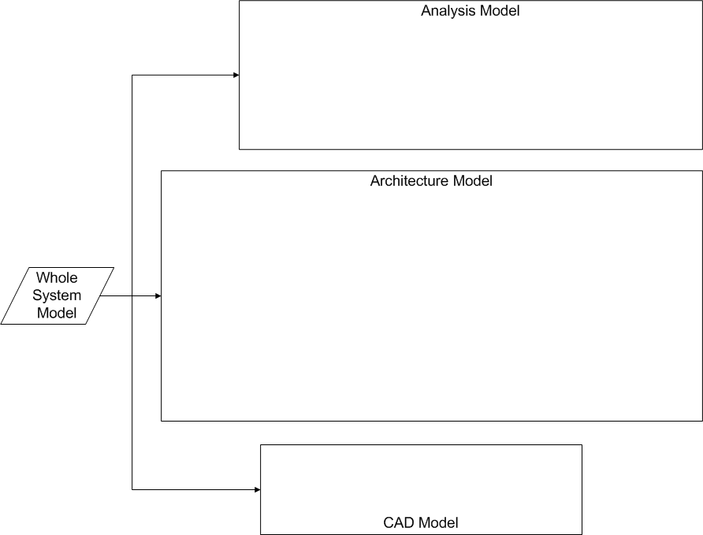
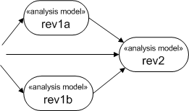
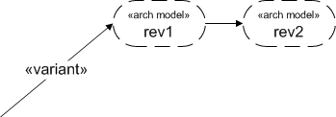
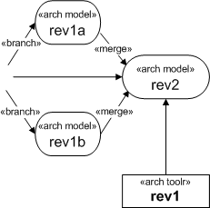
- Change notification relates to work flow mgmt
Metadata (related work flow)
Work package
Role/person

