Slide 1
DOD Digital Engineering / Digital System Model Workshop
Mrs. Philomena “Phil” Zimmerman
Deputy Director, Engineering Tools & Environments Office of the Deputy Assistant Secretary of Defense for Systems Engineering (ODASD(SE))

Slide 2
Agenda
Workshop Overview
DASD(SE) Organization
DSM Overview
Proposed DSM Taxonomy
DSM Taxonomy Tool
Breakout Sessions – DASD(SE) Team
Outbriefs – Workshop Participants

Slide 3
DASD(SE) Organization
Acting Deputy Assistant Secretary of Defense and Principal Deputy, Systems Engineering Kristen Baldwin
Homeland Defense Capability Development
Robin Hicks
Major Program Support James Thompson
Engineering Enterprise Robert Gold
Supporting USD(AT&L) Decisions with Independent Engineering Expertise
Engineering Assessment / Mentoring of Major Defense Programs
Program Support Assessments
Overarching Integrated Product Team and Defense Acquisition Board Support
Systems Engineering Plans
Systemic Root Cause Analysis
Development Planning/Early SE
Program Protection
Leading Systems Engineering Practice in DoD and Industry
Systems Engineering Policy and Guidance
Technical Workforce Development
Specialty Engineering (System Safety, Reliability and Maintainability, Quality, Manufacturing, Producibility, Human Systems Integration)
Security, Anti-Tamper, Counterfeit Prevention
Standardization
Engineering Tools and Environments
Providing technical support and systems engineering leadership and oversight to USD(AT&L) in support of planned and ongoing acquisition programs

Slide 4
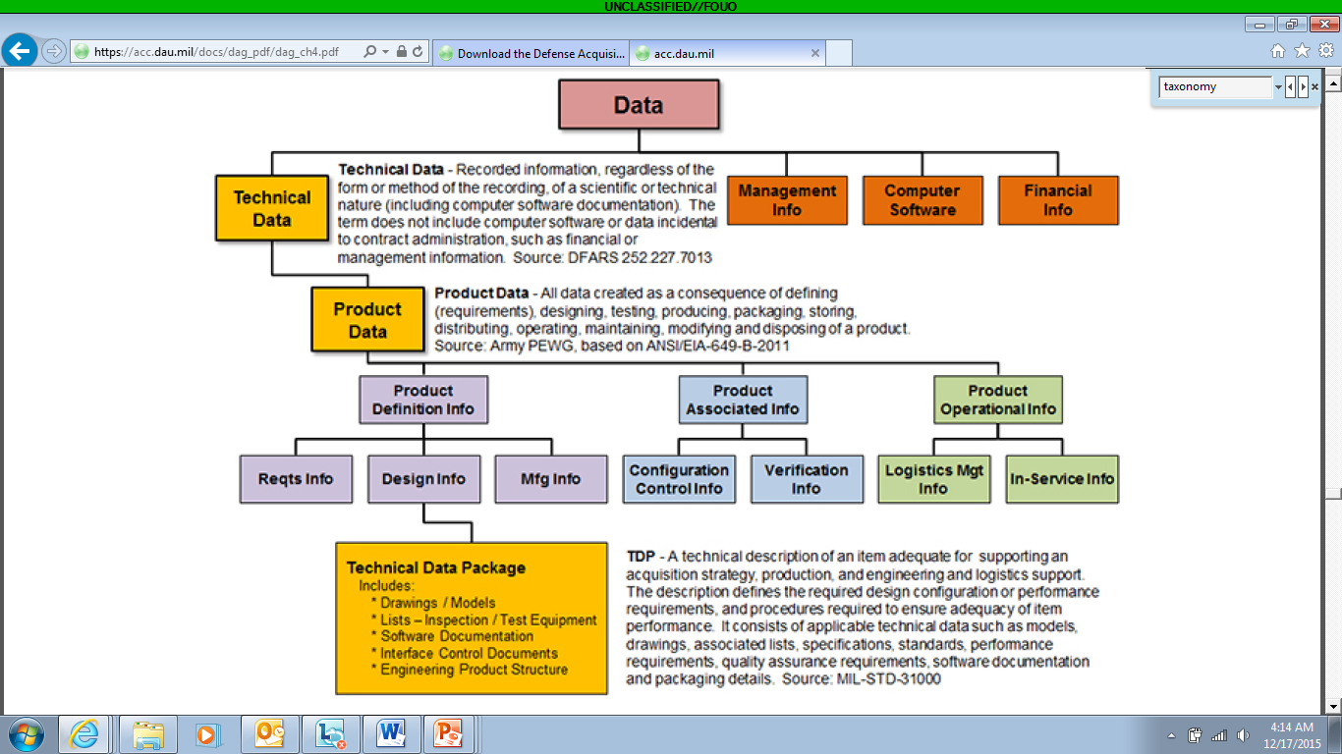
DSM Overview
DSM Definition
DSM Objectives
Update existing DAG Chapter 3 taxonomy
Provide stakeholders a structure for the types of data that should be considered across the life cycle.
Used as a basis to drive the community towards Digital Engineering
Key Changes
Expands document perspective to incorporate data and models
Incorporates the Integrated Product Support Elements to align with L&MR efforts
Includes hardware, software, management, cost and schedule information as part of system information
Includes Technical, Program, Financial, Schedule, and WBS as part of Management Info
Includes Validation/Verification as part of Definition Info
Incorporates the WBS to align with CAPE efforts
Defines the next (4th) level of the taxonomy
“Digital representation of a defense system, generated by all stakeholders that integrates the authoritative technical data and associated artifacts which define all aspects of the system for the specific activities throughout the system lifecycle.” (DAU Glossary)

Slide 5
Proposed DSM Taxonomy
Red Boxes: Changes to existing taxonomy
System Info
Definition Info
Management Info
Product Support Info
Schedule
WBS
Financial
Technical
…
…
…
…
Requirements
Design
Mfg
Verification & Validation
Lifecycle Sustainment Management
Technical
Management
Infrastructure Management
…
…
…
…
…
…
…
The Digital System Model Taxonomy expands on level 4 of the data taxonomy in Chapter 3 of the Defense Acquisition Guidebook

Slide 6
DSM Taxonomy Tool

Slide 7
Workshop Format
WORKSHOP GOALS
Review and provide feedback on the DSM taxonomy.
Brainstorm the resulting digital artifacts
Define how to migrate into digital acquisition/engineering practice.
Groups
Breakout groups will be formed based on subject matter expertise
Requirements Info
Design Info
Manufacturing Info
Verif/Validation Info
Definition Info
Management Info
Product Support Info
Breakout groups will have an electronic copy of the taxonomy to make redlines
Break-out Sessions
Review assigned portion of the taxonomy and suggest edits and rationale for the document, model, and data taxonomy
Based on the DSM taxonomy, brainstorm and identify digital artifacts for acquisition
Brainstorm and identify insertion points for use of digital artifacts in acquisition
Outbriefs
Each group provide an outbrief to the workshop participants

Slide 8
For Additional Information
Philomena Zimmerman Deputy Director, Engineering Tools & Environments Office of the Deputy Assistant Secretary of Defense for Systems Engineering 571-372-6695 philomena.m.zimmerman.civ@mail.mil
Additional Contributors:
Tracee Walker Gilbert, Ph.D. Frank Salvatore
Tyesia Pompey Alexander, Ph.D.
Darryl Howell
Geethesh Kukkala Allen Wong

Slide 9
INCOSE International Workshop (IW) Torrance, CA Jan 28-31, 2017
I. DASD(SE) @ INCOSE IW
IAWG Presentation (Zimmerman) 01/28/2017
Digital System Model (DSM) Workshop (DASD-SE Team) 01/28 - 29/2017
MBSE Pathfinder: NASA/OSD (Weiland & Holiday) 01/29/2017
Digital Thread (DT) Decision Analysis Workshop (AF, DASD-SE Team) 01/30/2017
II. DSM/DT Workshop Goals
DSM Workshop Goals:
1. Review and provide feedback on the DSM taxonomy.
2. Brainstorm the resulting digital artifacts
DT (Decision Analysis) Workshop Goals:
1. Classify the variety of analyses, and characterize the nature of the DT.
2. Define the corresponding digital artifacts for the decision analyses.
3. Define how to migrate into digital acquisition/engineering practice.
III. Workshops’ Format
Introduction Briefing – provides overview of taxonomy
Break-out Sessions – groups formed (e.g., Reqs, Des, Mfg, V&V) to review the document/data/model taxonomy
Out-briefs
IV. Meeting Logistics
Pre-Planning
Meeting Facilitation
Outbriefs
Roles and Responsibiliteis
Notes:
III. Workshops’ Format
A. Introduction - Short briefing providing an overview of the taxonomy.
B. Break-out sessions - To achieve the goals of the workshop by eliciting SME input on the DSM/DT
C. Session Out-Briefs - Each group will provide PPT summary of results of break-out session
IV. Meeting Logistics
A. Pre-Planning – Provide print-outs to participants and provide real-time access to the DSM tool.. Market the session to Ontology, Model-based and Tools/Interoperability Working Groups to send representatives and potentially include a block across working groups to attend..
B. Meeting Facilitation – Break out sessions will be grouped by SME domain, and led by DASD(SE) team members. Groups are formed based on Level 2 of the DSM taxonomy (e.g., Reqs, Design, Mfg, V&V)
C. Outbriefs
i. Session out-briefs will present results to the DSM/DT workshop
Ii. IW out-brief will provide results at the close of the workshop to IW particiatnts.
D. Roles and Responsibilities
Introduction Briefing
Break-out Session Facilitator
Capturing SME Input
Synthesizing Meeting Outcomes
Updating the Taxonomy
Workshop Outbrief
Defining Next Steps

