Slide 1
Financial Industry Business Ontology (FIBO)
Monthly Status/review call
Wednesday July 11th 2012

Slide 2
These slides
Headline Points
FIBO Moving Parts
Summary
Activities
Status
Plan the work going forward

Slide 3
Headline Points
FIBO is a thing of many moving parts
FIBO for Business Entities OMG submission is in a good place
Needs coordination with the other moving parts
Demonstrate how this is operationalized
Deliver at least one FIBO Operational Ontology as an OMG Specification
Communication is Key
To potential users (data modelers and Semantic Web)
To business stakeholders

Slide 4
Headline Points
FIBO for Business Entities is substantively complete
We have OWL
Convenience Document (June 2012) available
We are taking this off the table for the September OMG Meetings
Convenience Document only
Focus from here on is operationalizing these ontologies
As a conceptual model for development
As RDF/OWL Operational Ontology
FIBO is intended to be used; we want to release something only when we can show usage

Slide 5
Headline Points
Big release in November
Business Entities
Securities
Derivatives (part)
Operational Ontology
Over the coming months the EDM Council and OMG FDTF will work towards aligning all the moving parts of the FIBO universe
Will hold off release until we have something of demonstrable value
Use Case: LEI information requirements
Determine the sub-set of FIBO-BE required for these

Slide 6
FIBO has many moving parts…
FIBO Business conceptual ontology
FIBO in OWL
Operational Ontology
Operational Ontology

Slide 7
Moving Parts
FIBO Business Conceptual Ontology
Business Presentation of FIBO Concepts
FIBO OMG Specifications
FIBO Foundations
FIBO for Business Entities
Etc.
Operational Ontologies
(per business use case)
Operational Ontology
Operational Ontology

Slide 8
Moving Parts
There follows:
Explanation of each of these parts
Description of the activities
Current status and work

Slide 9
Explanation: Business Conceptual Ontology
FIBO Business Conceptual Ontology
Full, legally grounded, nuanced description of the business facts
Common “Lattice” enables alignment of standards-based ontologies
Strong use of “Philosophical” constructs to pin down real meaning
Includes many terms which will never be of relevance to a financial services ontology
Aligns across multiple standards semantics

Slide 10
Explanation: Business Presentation
An integral part of FIBO as a business conceptual model specification is that it may be presented to and validated by business subject matter experts
Business Presentation of FIBO Concepts
Minimum requirements for business view
Spreadsheet representation of terms, definitions, synonym, relations
Boxes and Lines (Visio /whiteboard style)
Explicable to business with minimal (1 hour) introduction
Currently: in EA Tooling (not suitable for a global standard)
Coming: Adaptive representation of the content per the above requirements

Slide 11
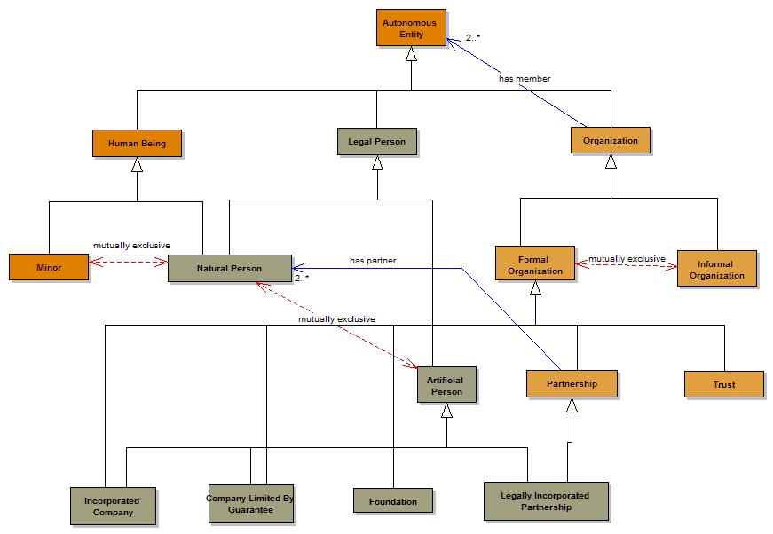
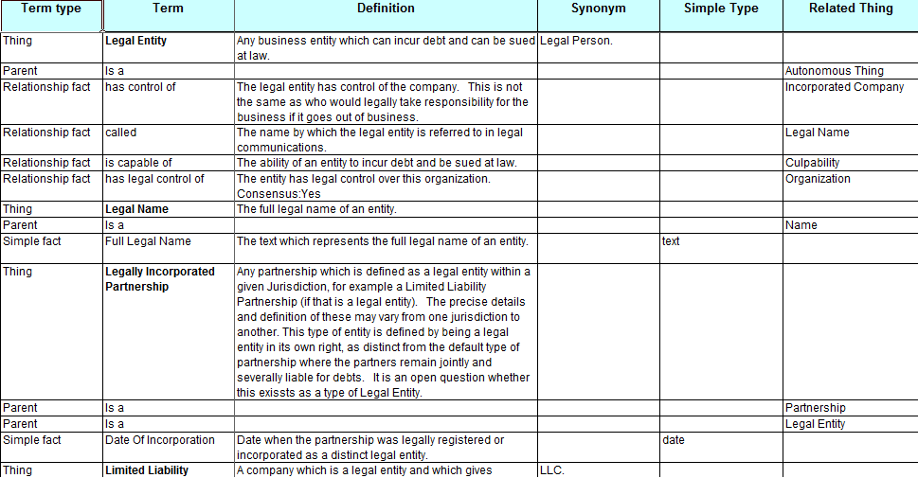
Explanation: Business Presentation
Business Presentation of FIBO Concepts

Slide 12
Explanation: FIBO OMG Specifications
OMG Formal Specifications (RFC)
Pragmatic expression of the concepts in FIBO Business Conceptual Ontology
Limited to those terms which have business value as conceptual model
FIBO OMG Specifications
FIBO Foundations
FIBO for Business Entities
Etc.
Available in RDF/OWL and ODM XMI
Formal, written standards for each subject area, plus Foundations:
Business Entities, Securities, Loans, Market Data etc.

Slide 13
Explanation: Operational Ontologies
RDF/OWL Extraction of FIBO Content
Focused on specific use case
Will use only a fraction of the terms in FIBO-BE etc.
Delivers the benefits of OWL based reasoning, classification etc.
Remains an accurate (conformant) representation of the business subject matter in RDF/OWL notation.
Operational Ontologies
(per business use case)
Operational Ontology
Operational Ontology

Slide 14
Activities and Status
FIBO Business Conceptual Ontology
Business Presentation of FIBO Concepts
FIBO OMG Specifications
FIBO Foundations
FIBO for Business Entities
Etc.
Operational Ontologies
(per business use case)
Operational Ontology
Operational Ontology

Slide 15
Activities: Business Conceptual Ontology
FIBO Business Conceptual Ontology
Business Subject Matter Expert Reviews
Modeling rework required for some sections
Shared Semantics / Namespace Alignment

Slide 16
Status: Business Conceptual Ontology
Subject Matter Expert Reviews substantively complete for:
Business Entities
Tradable Securities
Derivatives
Pricing / Market Data
Corporate Events and Actions
Modeling rework required for Derivatives, Market Data
Shared Semantics / Namespace Alignment
Transactions (REA/XBRL): results imminent
Needed for securities, derivatives transactions
Transaction Heat Map
Date / Time: working with OMG DTV
Phase 1 needed for Securities, Derivatives (schedules etc.)
Phase 2 Needed for Price/Yield /analytics (market data)
Other concepts in real estate, construction, portfolio modeling
Needed for MISMO (loan semantics)

Slide 17
Status: Business Conceptual Ontology
Transactions
Alignment of REA, XBRL terms completion end August
To be used in rework of OTC Derivatives semantics
Raw material for Securities Transactions, Payments
Payments
Session at Cambridge OMG FDTF Meeting
Good tie-in to Transactions
ISO TC68/WG5 looking for Fx-based payments example as validation of the value of semantic layer in ISO 20022
Shared Semantics: common payments concepts
Risk
High level model of risk concepts exists

Slide 18
Activities: Business Presentation
Current EA Presentation is not ideal
More understandable than most OWL tools
Diagrams get very cluttered very quickly
Simple diagrams can be extracted as needed but this takes time
Tool-dependent so not suitable for FIBO standard
Adaptive
Considerable improvement in readability, navigability
Requires extensive UI design
This work is under way
Business Presentation of FIBO Concepts

Slide 19
Status: Business Presentation
Adaptive Migration
Complete for FIBO-BE
Foundational elements used in FIBO-BE covered
Migration process to be documented, repeatable
Visuals
Icon design
New navigation diagrams
Splash screen / orientation
Descriptive
Whatever format FIBO content is presented in, needs detailed explanation for those less familiar with the legal aspects of things

Slide 20
Activities: OMG Specifications
Create Formal, written specification for each part of FIBO
Follows ISO Template (per OMG)
Formal requirements, OMG review, vote etc.
Content, Architecture, Conformance requirements
FIBO OMG Specifications
FIBO Foundations
FIBO for Business Entities
Etc.
FIBO Foundations
FIBO Business Entities
FIBO Reference Data (Securities)_
FIBO Derivatives
FIBO Loans
Etc.

Slide 21
Status: OMG Specifications
FIBO Foundations and FIBO-BE
Significant comments at June AB reviews focused on two areas:
Model content representation in the standard
Conformance section
These have been addressed
June 2012 convenience document has the new content material from Adaptive
Decisions at June quarterly meeting will radically simplify conformance points without losing the range of possible conformant applications which may exist
Proposed reduction in scope of FIBO-BE to be reflected in next formal specification

Slide 22
Status: OMG Specifications
FIBO Reference data (securities)
The content needs very little work
Metamodel update to conform with FIBO
FIBO Derivatives
Some rework of content required to adequately reflect transactional semantics
Metamodel updates as above
FIBO Loans
MISMO (Loans XML standard) alignment in progress
Substantial content, business reviewed
FIBO Market Data (price / yield / analytics)
Substantial content
To be aligned with OMG Date / Time Vocab (ongoing)
Others:
CAE ontology (static terms) done; process to follow
propose to segregate Indices and Indicators; Funds/CIV

Slide 23
Activities: Operational Ontologies
Demonstrate potential of Semantic Technology (RDF/OWL) to deliver real business results in applications
Demonstrates:
Reasoning capabilities
Automatic classification – derivatives etc.
Semantic Querying
Identify formal methods for extracting use-case specific ontology content from the FIBO OMG Release (conceptual ontologies)
May add metadata to the overall FIBO to enable this (e.g. for classification facets based on use case, business context)
Operational Ontologies
(per business use case)
Operational Ontology
Operational Ontology

Slide 24
Status: Operational Ontologies
Done
IR Swaps POC completed, well received
To do:
Extend to Credit Default Swaps
Extend to Loans / MBS
Deliver as formal FIBO Specification(s)
Other Semantic Technology applications
Querying over conventional data stores
Enable business participants to frame queries semantically
Need to identify a repeatable method for deriving operational ontologies for FIBO content
Scale up to deliverable products

Slide 25
Making FIBO Operational
There are two kinds of operational environment:
Semantic Technology (RDF/OWL)
Conventional (logical data models)
Conventional
Extract a sub-set of FIBO for a given use case
Map this to existing data models, message models
About to do this for counterparty credit risk reporting
Mapping
Not as simple as it seems
Many to many relationships
Term to graph relationships
Exploring tools to do this (e.g. Adaptive)
Let us help you with this!

Slide 26
What’s Next?
Communication
Making FIBO Operational
Completion of RFC specifications

Slide 27
Communication
There is no “easy way in” to understanding what is in FIBO or how to use it
We have focused on the development at the expense of communicating about it
Website, introductory slides to do
There are three distinct skill/knowledge sets involved:
Date modeling: database theory, modeling languages
Semantics: linguistic and philosophical
Semantic Technology: math and computer science
We need to reach all these constituencies

Slide 28
Making FIBO Operational
Semantic Technology
Define a useful sub-set of FIBO for the industry
For example, limited to the requirements of LEI in the first instance
Release this as FIBO for Business Entities etc.
Identify how to extract useful sub-sets of this for operational ontologies (per use case)
Deliver FIBO Operational Ontology RFC(s)
Conventional Technology
Create extracts and views of FIBO for specific use cases
LEI information requirements
Counterparty Exposures Reporting (FSB)
Map these to logical models, messages etc.
Bottom Line: Demonstrate how FIBO can deliver real business value in well defined business requirements

Slide 29
Completion
FIBO for Business Entities
Identify required sub-set of FIBO-BE terms for LEI use case
Requires business domain experts participation
Not expecting to have these completed by mid-August
FIBO Foundations
Incremental releases with only the terms needed for a given FIBO OMG specification
Complete the Specification (conformance; other comments)
FIBO for Securities
Prepare RFC Specification document
Beta material from 2010 almost ready to deploy
Implement outstanding Change Requests
FIBO for Derivatives
Prepare an RFC Specification covering IR Swaps, CDS
Use case driven: terms needed for counterparty credit?

Slide 30
FIBO Roadmap (as at July 2012)
June
Sept
Dec
Mar
June
Q3, 2012
Q4, 2012
Q1, 2013
Q2, 2013
Q3, 2013
Vote
FIBO-Foundations
Global Terms and modeling framework
Industry feedback
Finalization TF
FIBO-Foundations
Updates
Vote
FIBO-BE
Business Entity
Industry feedback
Finalization TF
FIBO-BE
Updates
Vote
DTV Alignment I
FIBO Reference Data
Securities
Industry feedback
Finalization TF
FIBO Reference Data
Updates
Vote
Operational Ontology
Task Force
Operational Ontology
Industry feedback
Finalization TF
Operational Ontology
Vote
FIBO Reference Data
Derivatives Part 1
Industry feedback
Finalization TF
FIBO Reference Data
Derivatives Part 2
Vote
MISMO Alignment
FIBO LOANS
Industry feedback
Finalization TF
Vote
Funds BE Terms
FIBO Reference Data
CIV/Funds
Finalization TF
Industry feedback
Vote
OMG DTV Alignment II
FIBO Date Dependent
Market Data Ontology
Industry feedback
Finalization TF
Vote
Process notation
FIBO Process
Corporate Actions
Industry feedback
Finalization TF
Vote
Txn SME reviews
FIBO Process
Transactions
Industry feedback
Finalization TF

Slide 31
Participate!
Decide on the workload for the regular working calls
Thursdays 2 – 3: FIBO OMG specification documents
Thursdays 3 – 4: Technical / OMG metamodel focus
Wednesday 10 – 11: SME Reviews
Monday / Tuesday alternating: POC / Operational
Shared Semantics ad hoc calls
Subject Areas
Completion of FIBO-BE and Foundations
Initiation and completion of FIBO-RefData and Derivatives
Payments / transactions (per Cambridge)
Operational Ontology Task Force
Counterparty Credit Reporting
LEI Information Requirements
Please sign up for the work you are interested in

Slide 32
Decisions Today
Thursday OMG-FDTF calls
Document / content focus Call 1
Continue with scheduled work
Technical / meta focus Call 2
Continue with scheduled work
Wednesday SME Review calls
Business Experts for LEI / FIBO-BE scope
Shared Semantics calls
Operational Ontology Task Force

Slide 33
Wrap-up (Mike Atkin)
Scope: Everything required for LEI, FSB etc.
Identification
Ownership
Relationship hierarchies
Links to obligations
Issuance, guaranty, obligor
Be usable in the IR operational ontology
When we have achieved this, we can release the standard
Prioritization to be decided
Tomorrow call as scheduled

