Slide 1
FIBO Crosses the Chasm (Extension of Competency)
March 25, 2014
Reston, VA
Dennis E. Wisnosky
Founder, Wizdom Systems, Inc.
Senior Advisor EDM - Council

Slide 2
FIBO Q1 2014 Development Process
Review Readiness with SME Team
Happy
Syntactic Transformation
Industry Requirements
FIBO BCO/UML
Model in
EA
FIBO BCO/UML
Model in Cameo VOM
EDM Council Determines Next FIBO SubDomain Release
Not Happy
One time conversion of EA to Cameo/VOM
FIBO Use and Maintenance in Cameo VOM
Perform Externality Review
Semantic Enhancement
Validation with Instance Data
No
Consistency Testing/Repairs
Change or add
Enhance?
yes
Yes
Semantic Issues Correction
Spiral implementation of enhancements
Refactoring
Pass?
No
No
Yes
Change FIBO BCO
Yes
Final SME Review
Submission to OMG Architecture Board
No
Build/Test OMG Submission
No
Yes
OMG Public comments
Changes
No

Slide 3
Q1 2014 Process Notes
One time conversion of EA OWL/Syntactic Transformation
Cycle the whole FIBO EA through Adaptive as a one-off, so that the annotations are added automatically as before (minus Archetype). Adaptive automatically adds meta data that was added by MB. Render the Archetypes as OWL annotation properties. Do the migration from OWL into Cameo, implement the ODM 1.1 profile in Cameo VOM and then add anything else required in Cameo VOM.
Semantic Issues Correction
Identify issues in the business meaning and address these within VOM
Prepare and Submit OMG Material
• produce clean UML XMI from Cameo
• clean up the UML XMI to make UML-compliant and fix cross-references as a OMG deliverable
• generate OWL as a OMG deliverable from VOM
Elisa to write the rules so that Pete could automate the rules
• import OWL into Adaptive
• generate ODM XMI as a OMG deliverable from Adaptive
• write specification-specific material (Scope, examples etc) as basis for specification document
• use the Lonnie VOM/Cameo plug-in(s) to generate necessary reports
MB will write a spec for Lonnie to write code to automate this physical procedure
• Diagrams
• Classes and Properties
• Meta Data
• Restrictions – New by Lonnie
• Logical Unions – New by Lonnie
• Assemble reports into specification document as a OMG deliverable
• write the Letter of Intent as a OMG deliverable
• write the inventory file as a OMG deliverable
Pete will automate inventory file creation through XSLT from Meta Data in the OWL
Semantic Enhancement
Replacement of direct properties between some elements with reusable properties and restrictions on their usage in the context of
various classes to simplify the ontologies, facilitate reuse, leverage classification-based reasoning
Design patterns e.g. cascading restrictions to make semantic assertions which were not possible in EA model.
FIBO Use and Maintenance in Cameo VOM
Use Cameo VOM to import the OWL ontology file into Cameo
Create the appropriate low-level VOM/ODM diagrams to visualize the ontology
Create new elements and place those on diagrams as needed for presentation purposes
Export any modifications to the ontology back to OWL
If necessary, serialize the model to XMI using Cameo VOM. If that isn't available, give the definitive OWL file to any other OWL tool that can serialize to XMI.
Validation with Instance Data
Starting with a sample of the proposed semantic enhancement(s):
Stand up a copy of the ontology in RDF/OWL
Create or reuse “Individuals” ontology with example data for the proposed elements
Run reasoner(s), validate results
Rinse and repeat: once these tests pass on an example of the proposed pattern, roll it out to other applicable concepts / sets of concepts
Refactoring
Incorporating metadata about the ontologies themselves based on the OMG AB specification metadata standard
Naming conventions, for namespaces, modules, elements
Increased use of metadata, standardized on OMG specification metadata plus additional FIBO-specific annotations to highlight provenance details
Additional modularity, application of an information architecture to facilitate downstream parallel development
Segregation of commonly used properties to facilitate reuse (e.g., Relations ontology in Foundations)
Consistency Testing / Repairs
Use of multiple reasoners and validation tools to uncover logical consistency and deductive closure issues
run QC (OOPS, OQUARE, etc.)
Regression tests (sample individuals ontology)

Slide 4
FIBO Q1 2014 Development Process
Industry Requirements
Syntactic Transformation
FIBO BCO/UML
Model in Cameo VOM
FIBO Use and Maintenance in Cameo VOM, Adaptive and other tools obeying W3C and OMG standards
FIBO BCO/UML
Model in
EA
One-time conversion of EA to Cameo VOM
This is an excerpt from slide 2. Look at where it says “One time conversion of EA to Cameo VOM”. Pete Rivett of Adaptive is converting the original EA model to OWL, with Mike Bennett correcting issues as they are uncovered in the original model, and Elisa Kendall revising the OWL as needed so that it can be loaded in Cameo VOM. When this is done, all of FIBO BCO/UML will be converted to Cameo VOM, in UML with the ODM stereotypes applied, and RDF/OWL. It will not be perfect, because there are some vestiges of decisions that MB made years ago reflected in the FIBO-BCO UML that do not convert well. The diagrams will also necessarily need to be recreated, but the model will be available in Cameo VOM as a starting point.
Having made the decision to have the entire working model in both UML and RDF/OWL through Cameo VOM we will have an architecture that exposes and links the approved FIBO models to the work in process FIBO models. Thus, all of FIBO will be available to those who chose to engage, not only the FIBO’s that have completed the standards process.

Slide 5
FIBO Q2 2014 Development Process
Review Readiness with SME Team
Happy
Industry Requirements
FIBO BCO/UML
Model in Cameo VOM
EDM Council Determines Next FIBO SubDomain Release from the UML Model
Not Happy
FIBO Use and Maintenance
Perform Architecture and Externality Review
Semantic Enhancement
Validation with Instance Data
No
Consistency Testing/Repairs
Change or add
Enhance?
yes
Yes
Semantic Issues Correction
Spiral implementation of enhancements
Refactoring
Pass?
No
No
Yes
Change FIBO BCO
Yes
Final SME Review
Submission to OMG Architecture Board
No
Build/Test OMG Submission
No
Yes
OMG Public comments
Changes
No

Slide 6
There are Four FIBO Types
Slides 4 and 5 show the evolution of the FIBO development and use process. The “One time conversion of EA to Cameo VOM,” activity enables every FIBO to be available in and RDF/OWL representation. Promotion of FIBO-FND as an adopted standard to the FIBO Repository - the solid green line, enables replacement of the Beta BCO UML model with the actual standard UML model.
On the way to accomplish this first FIBO standard, expectations have been greatly raised to begin using FIBO. The stage has been set. Now the script is being written as to how both business people and technical people can have an assured on-ramp into building and using FIBO in its four forms:
Slide 7 graphically depicts these four use cases.
FIBO’s in waiting
FIBO’s entering the Standards Process
FIBO’s in the Standards Process
Ratified FIBO Standards

Slide 7
Four FIBO Types Exist at the Same Time
FIBO BCO/UML
Model in
Cameo/VOM
FIBO-FND
FIBO-n….n-1
FIBO’s in waiting
FIBO’s entering the Standards Process
FIBO-BE
FIBO-IND
FIBO’s in the Standards Process
Ratified FIBO Standards
There is a constellation of FIBO’s in various states of maturation. A Mature FIBO has exited the standards process and been reinserted, published in the FIBO Repository as being in the family of
There are are . They would have exited the “Change FIBO BCO” decision diamond. These FIBO’s have both Compliant UML and RDF models, but not the required OMG decorations.
There are These FIBO’s have exited the box labeled “EDM Council Determines Next FIBO SubDomain Release from the UML Model. “ They will be subjected to the rigors of testing in industry standard inference engines against instance data. There are fffffffffffdddddd These FIBO’ have been developed by the Council and the SME’s, but have not yet entered the formal standards process. Each of these FIBO’s
FIBO Standards
FIBO’s in the standards process.
FIBO’s entering the Standards Process
FIBO’s in waiting.

Slide 8
Overlay of FIBO Types in the Development Process
Review Readiness with SME Team
Happy
Industry Requirements
FIBO BCO/UML
Model in Cameo VOM
EDM Council Determines Next FIBO SubDomain Release from the UML Model
Not Happy
FIBO-n….n-1
FIBO Use and Maintenance
How to Manage?
Perform Architecture and Externality Review
Semantic Enhancement
Validation with Instance Data
No
Consistency Testing/Repairs
Change or add
Enhance?
yes
Yes
Semantic Issues Correction
Spiral implementation of enhancements
Refactoring
Pass?
No
No
FIBO-IND
Yes
Change FIBO BCO
Yes
Final SME Review
Submission to OMG Architecture Board
No
Build/Test OMG Submission
No
Yes
OMG Public comments
Changes
FIBO-FND
No
FIBO-BE

Slide 9
FIBO Development Scenario - 1
Reference Data (product) Semantics
 | Domain | Sub-Domain | Class | Dependency | OMG | Substantive | Model | Initial
 | Foundations |  |  |  | X
 | Business Entities |  |  |  | X
 | Indices and Indicators |  |  |  |  | X
 | Common Concepts | (all Instruments) |  |  |  | X
 | Common Debt Terms |  |  |  |  | X
 | Listed Instruments | Bonds |  |  |  | X
 |  | Equities |  |  |  | X
 | Common Concepts | Loans
 | Common Concepts | Derivatives
 | Derivatives | OTC | Rate Based | Dependent on Indices |  |  | X
 |  |  | Credit Default | Dependent on Common Concepts for Loans, Common Debt Terms and Indices/Indicators |  |  | X
 |  |  | FX |  |  |  | X
(FIBO 1.0) Major Milestones
Phase 1
Phase 2
Phase 3
Phase 4
OMG = in RDF/OWL; Beta = Model Reviewed by SMEs; Model = Modeled in Enterprise Architect; Initial = Not Yet Modeled

Slide 10
FIBO Development Scenario - 2
Reference Data (product) Semantics
 | Domain | Sub-Domain | Class | Dependency | OMG | Substantive | Model | Initial
 | Mortgage |  |  |  |  |  | X
 | Listed Instruments | Debt | Structured Finance | Dependent on Bonds and Mortgage |  |  | X
 |  |  | Money Markets | Includes Repo, Treasury, Government, Agency, Tax-Free, etc. |  |  | X
 | Derivatives | OTC | Asset | Dependent on Equities, Bonds and Common Debt Terms |  |  | X
 |  |  | Commodity |  |  |  | X
 |  |  | Contracts for Difference |  |  |  | X
 | Collective Investment Vehicles |  |  | Dependent on Listed Instruments, Derivatives and Indices |  |  | X
 | Derivatives | Exchange Traded |  |  |  |  | X
 | Loans | Other | General Purpose, Construction, Student, Miscellaneous |  |  |  | X
 | Rights and Warrants |  |  | Dependent on Common Concepts for all Instruments |  |  | X
Phase 5
Phase 6
Phase 7
OMG = in RDF/OWL; Beta = Model Reviewed by SMEs; Model = Modeled in Enterprise Architect; Initial = Not Yet Modeled

Slide 11
FIBO Development Scenario - 3
Market Data (time and date) Semantics
 | Domain | Sub-Domain | Class | Dependency | OMG | Substantive | Model | Initial
 | Common Terms | Temporal Component |  |  |  |  | X
 | Equity Pricing |  |  |  |  |  | X
 | Debt Temporal Terms | Debt Pricing and Yields |  |  |  |  | X
 |  | Debt Analytics |  |  |  |  | X
 |  | Debt Pool Analytics |  |  |  |  | X
 | CIV Temporal Terms |  |  |  |  |  | X
 | Loan Temporal Terms |  |  |  |  |  | X
 | Trading Status |  |  |  |  |  | X
 | Credit Temporal Terms | Credit Rating |  |  |  |  | X
 |  | Credit Status |  |  |  |  | X
Future Phase
OMG = in RDF/OWL; Beta = Model Reviewed by SMEs; Model = Modeled in Enterprise Architect; Initial = Not Yet Modeled

Slide 12
FIBO Development Scenario - 4
Process Related Semantics
 | Domain | Sub-Domain | Class | Dependency | OMG | Substantive | Model | Initial
 | Corporate Actions and Events |  |  |  |  |  | X
 | Securities Issuance | Common Issuance Process Terms |  |  |  |  | X
 |  | Equity Issuance |  | IPO, Other Equity Issue Processes, Primary Market |  |  | X
 |  | Debt/Bonds Issuance |  | Auction, Syndication, Other Issuance Processes |  |  | X
 |  | Asset-Backed / Mortgage-Backed Issuance | Agency |  |  |  | X
 |  |  | Non-Agency |  |  |  | X
 | Securities Transactions |  |  | Trade, Post-Trade, Clearing, Settlement |  |  |  | X
 | OTC Derivatives Transactions |  |  | See OTC Derivatives Terms |  |  | X
 | Payments Processing |  |  |  |  |  |  | X
 | Portfolio and Holdings |  |  | Positions and Holding Terms |  |  |  | X
Future Phase
OMG = in RDF/OWL; Beta = Model Reviewed by SMEs; Model = Modeled in Enterprise Architect; Initial = Not Yet Modeled

Slide 13
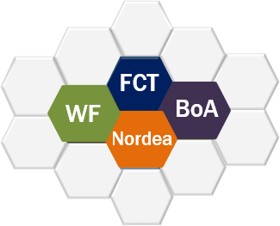
Extending the Competency
Build
Apply
Amplify
1
2
3
Implementations
Enterprise Data Management Council
Standards and Frameworks
Research
and
Innovation
EDMC FIBO Strategic Framework
Monitor
FIBO Communities
Current & Emerging Technology
Agile Change Strategy
Transition via
Enterprise Partnerships
Feasibility
Planning
Development
Team/Organization
Adaptation
FIBO Externality Review

Slide 14
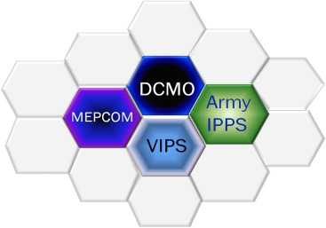
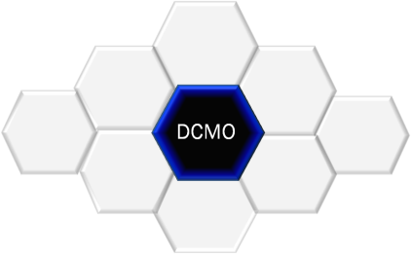
Extending the Competency
Build the FIBOs and the Process
Build
Apply
Amplify
1
2
3
Enterprise Data Management Council
Adopt & Adapt Current Research and Innovation
Office of the
Deputy Chief Management Officer
Develop New and Utilize Existing Standards, Frameworks & Guidance
Build and Maintain FIBO BCO
Build and Test OMG Submissions
Semantic Technology and Business Process Modeling – OMG/W3C
Standards and Frameworks
Research
and
Innovation
DoD DCMO
Strategic Framework
Monitor
DoD Communities
Establish and Mentor a FIBO Content Team (FCT)
Strong FIBO Roadmap and Strategic Framework
FCT
Current & Emerging Technology
Equip the FCT to support targeted industry partnerships in implementing FIBO
Public FIBO Methodology Document
Agile Change Strategy
Transition
via
Enterprise Partnerships
Accessible Repository (RDF/OWL) for all stages of FIBO Release Packages
Perform FIBO Change Final SME Review
Feasibility
Planning
Development
Team/Organization
Adaptation
Object Management Group
Governance and Configuration Management through OMG Architecture Board
OMG Public Comments and FIBO Changes

Slide 15
Extending the Competency
Deploy FIBO Change Teams (FCT)
Build
Apply
Amplify
1
2
3
Support the application of FIBO to Pilot Projects through the deployment of the FCT(s)
Office of the
Deputy Chief Management Officer
Required Activities
FIBO Strategic Framework
Standards and Frameworks
Research
and
Innovation
DoD DCMO
Strategic Framework
Develop an Agile Change Process that involves the parallel building and maintenance of FIBOs
Maintain the Roadmap and Repository
Define FIBO Competency and Conformance
Develop and Support a self and independent assessment capability of conformance to FIBO
Monitor
DoD Communities
Immediate Impacts
Industry acceptance of FIBO
Reduced time to deployment
Accelerated FIBO development
Improved Financial Data Management due to FIBO Network effect
Current & Emerging Technology
Agile Change Strategy
Transition
via
Enterprise Partnerships
EDMC Involvement
Develop FCT’s that support the roadmap and industry priorities, i.e. Financial Instruments Common Concepts FCT
Feasibility
Planning
Development
Team/Organization
Adaptation
Ensure the FIBO BCO Repository and Process supports FCT
Mentor the FCT to ensure success and utilize feedback to improve the Agile Change Process

Slide 16
Extending the Competency
Institute parallel FIBO Content Teams (FCT), to roll out multiple FIBO’s in parallel.
Implement a Pilot at the beginning of the FIBO Q2 process.
In addition to completing FIBO-IND, The FIBO Core Team (PEM) will work as mentors to this FCT and advance the FIBO Build/Maintenance process in parallel.
Because the FIBO Architecture will be constantly changing, as FIBO’s are built in parallel, it must be reviewed and modified within the Externality Review process.
Write A FIBO methodology document that will be used by every FCT.

Slide 17
FIBO Change Team (FCT)
3-5 People mentored by a PEM
Team leader from within the Finance Domain
An SME who understands the idea of Ontology
An Ontologist who understands a Finance Subdomain
SME’s from within the Subdomain

Slide 18
Extending the Competency
Interact with FIBO Use and Extension
Build
Apply
Amplify
1
2
3
Amplify Change Introduction, monitor and adjust change transfer
Amplification Plan
Office of the
Deputy Chief Management Officer
Encourage graduation of an FCT into a Pilot Project
Support the self and independent assessment process and consolidate results
Implementations
Proactively monitor industries that are implementing FIBO
Standards and Frameworks
Research
and
Innovation
Monitor
DoD Communities
Partner with internal and external OMG and Financial Education Services
Measure and record industry ROI after FIBO transition
Current & Emerging Technology
DoD DCMO
Strategic Framework
EDMC Efforts
Employ Proven Research and Development Implementation
Provide information and messaging that supports cultural adaptation
Agile Change Strategy
Transition
via
Enterprise Partnerships
Industry Proof of Concepts
OMG Technical sessions
Bootstrap application of FCT Services
Continue to refine an implementation methodology both for the advancement of the FIBO Standard and the change to industry Financial Data Management and Reporting
Feasibility
Planning
Development
Team/Organization
Adaptation
Develop strategy for FIBO data technologies and methodologies to transform interoperable business services industry wide

Slide 19
Extending the Competency
Build – Apply Amplify
Build
Apply
Amplify
Standards and Frameworks
Research
and
Innovation
FIBO Externality Review
FIBO Changes Based on Implementation Experience
FIBO Strategic Framework
Monitor FIBO Communities
FIBO Changes Based on FCT Experience
FIBO’s
FIBO’s
Implementations
Enterprise Data Management Council (EDMC) working with the Object Management Group (OMG)
Agile Change Strategy
Transition via Enterprise Partnerships
Current and Emerging Technologies
Change Data Management Methodologies and Policies
Growth through industry relationships
FCT
FIBO Content Team – Supported by a Methodology Document and the EDMC/PEM

Slide 20
The Ask!
Help improve the Process
Work on the tooling
Form your own FIBO Content Team along the lines of slide 17.

Slide 21
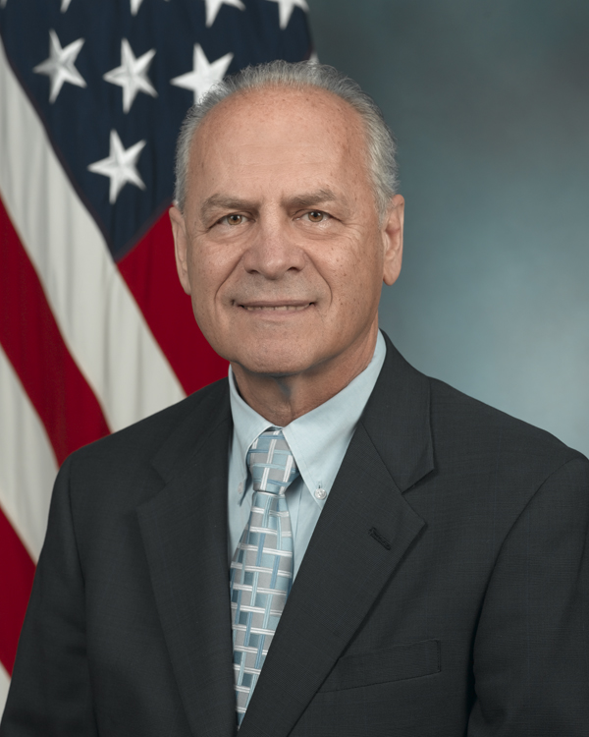
Thank you!
Questions?
Dennis@wisnosky.net

Slide 22
FIBO TO-BE Development Process
1) FIBO Team - Pick or extract subdomain from BCO by looking at the UML visualization in the tool of choice
To get this we need:
Business facing rendering of restrictions
Describable as refinements and/or reuse of properties
Rendering of existing classes and properties and disjoints and inverses
Ability to update the model in real time
Ability to view and edit definitions
Ability to generate additional synonyms
Ability to review and edit provenance metadata
Creating spreadsheets of terms, definitions and synonyms and metadata, etc. reports for off line review
Create clean diagram by drag and drop classes from old diagram to new diagram while maintaining relationships for PPT presentations
2) Business SME’s are now happy by an official sign off process
Convert to RDF/OWL and run QC (OOPS, OQUARE, etc.)
Consistency checks
Reasoners
Regression tests

Slide 23
FIBO TO-BE Development Process
3) Loop back to 1 to verify that BCO remains valid
4) Publish required OMG documents in the tool of choice
Write the Inventory File
Request document numbers for, and formally submit, each of the following:
Written specification
Inventory file
OWL files
ODM XMI
UML XMI
Model File (convenience document; has a number but is not part of formal specification)
Signed submission Letter (with IP rights declaration)
5) Repeat

