Slide 1
OMG Finance Domain Task Force (FDTF)
Monthly Status/review call
Wednesday September 7th 2016

Slide 2
Agenda
News
FIBO Vocabulary update
OMG FDTF Quarterly Meeting Planning (Chicago)
Other FDTF Activities
Blockchain
New co-chair
Roadmap and co-ordination
FIBO Process Update
FIBO Status
Status of Current Specifications
Status of upcoming FIBO specifications and FCT activities
Other FIBO Activities
Schema.org

Slide 3
News
FIBO Vocabulary
Launch in NYC (20 July) went well
Initial Early Adopter trial 02 Aug
Today’s meeting 7 Sept (FIBO-DEBT)
Tooling and socialization of this. Biweekly meetings under way
Work under way on specification alignment
Submissions planned for Sept OMG (Aug 15):
IND
FBC
BE
FND RTF is now deferred to November
Blockchain for FDTF
Regular calls ongoing
Focus on Smart Contracts

Slide 4
FIBO Vocabulary
Expression of FIBO business content via SKOS
Derived from underlying OWL models
These reflect the “simplistic” use of OWL in Red FIBO
Will include minimal formal restrictions (not in Red FIBO today)
Other OWL “Anti-patterns” addressed
SKOS tools to enable business SME review and completion of the legacy business ontology content
CCM derived diagrams an HTML Report

Slide 5
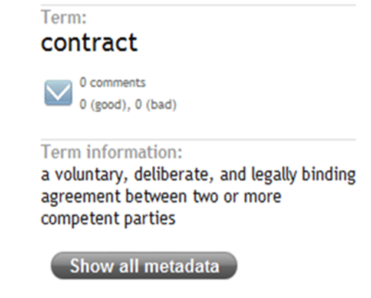
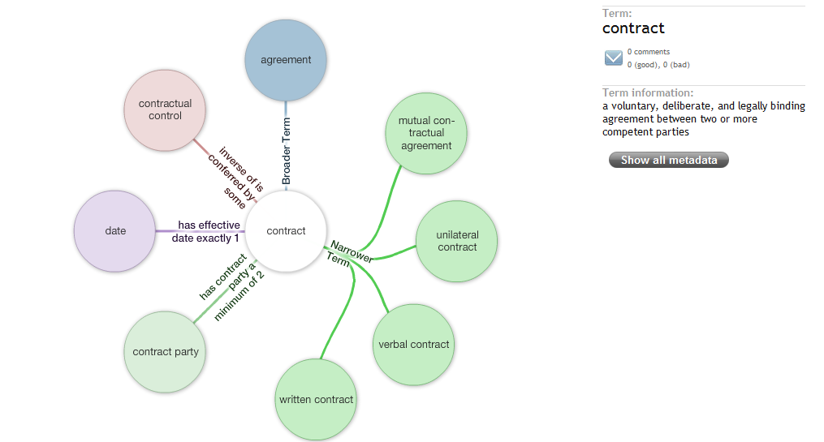
FIBO Vocabulary
FIBO Vocabulary: Glossary for BCBS 239
BCBS 239: align financial terms to the “concepts they represent”
G-SIB request: FIBO business conceptual ontology but the standards process is taking too long
Vocabulary: extract the legal concepts from the BCO and express as SKOS for industry validation
FIBO work stream is now underway
* Screen shot SmartLogic Semaphore Ontology review tool

Slide 6
FIBO-V Rationale
How to get minimum viable deliverables for Derivatives, Bonds etc. to the industry in a timely manner…
Exploring bringing forward the terminological ontologies (informally described as “FIBO Vocabulary” in EDM Council briefings)
Focus on established business meaning;
Includes basic restrictions
Bring the reasoning enhancements into play later on

Slide 7
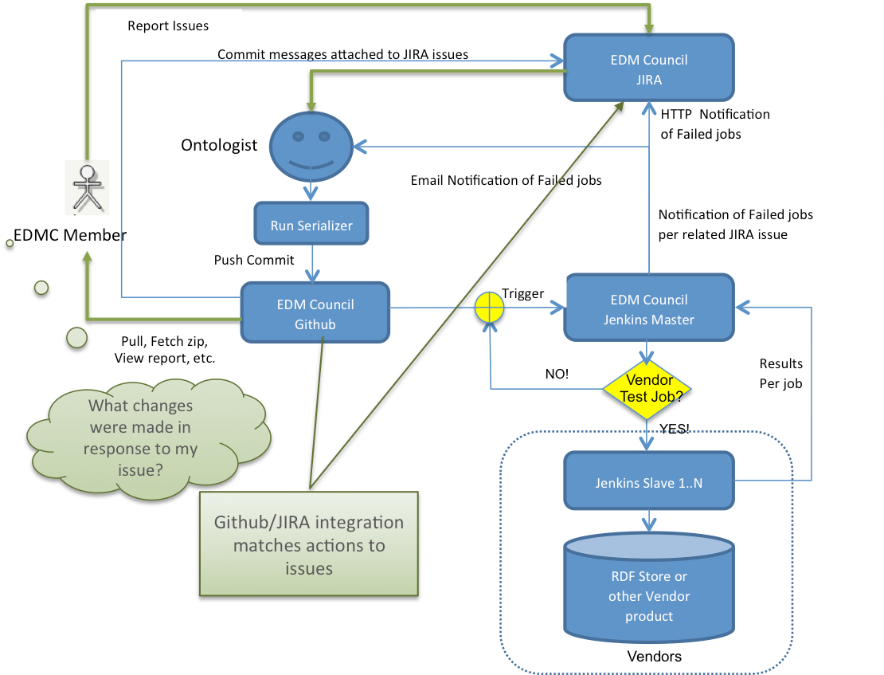
FIBO VOCABULARY DEVELOPMENT PROCESS (for early adopters)
FIBO Repository Alignment -FEBRUARY 2016
Structural resolution – i.e. properties with more than one sub-property, name union/anonymous union, enumerated number ranges, object and data types properties replaced with restrictions, missing definitions, restrictive explanations, classification approach
Status | Domain | 2016 Plan
Comprehensive | Foundations | Green (✓)
Comprehensive | Business Entities | Green (+)
Substantive | Indices / Indicators | Green (+)
Substantive | Securities / Equities | Yellow (↑)
Substantive | OTC Derivatives | Yellow (↑)
Substantive | Loans (common) | Yellow (↑)
Complete | Debt / Bonds | Pink (FCT)
Majority | Collective Investment Vehicles | Pink (FCT)
Complete | Equity & Debt Pricing | Pink (FCT)
Majority | Structured Finance | Pink
Majority | Rights & Warrants | Pink
Good | Money Markets | Pink
Good | Exchange Traded Derivatives | Pink
Good | Mortgage Loans | Pink
Good | Corporate Actions | Pink
Initial | Transactions, trading status, credit rating & status, payments, issuance, portfolios & holdings
❶
❸
Member Verification Process
Enhancement & finalization
Prioritized for BCBS 239
Managed by dedicated resource
Align with FIBO, validate and generate OWL expressed as a single repository
❷
Address gaps and align with FIBO design principles
Unified OWL Repository
APRIL 2016
❹
Integrate into FIBO engineering process for inference processing
generate
align
Legend
Comprehensive: modeled, EDMC tested, OMG process
Substantive: modeled with SME review, to OMG
Complete: needs alignment with FIBO structure, FCT
Majority: modeled but not verified
Good: modeled but not complete
Initial: early stage
SEPTEMBER 2016
build UML/
submit to
❺
VOCABULARY V1.1

Slide 8
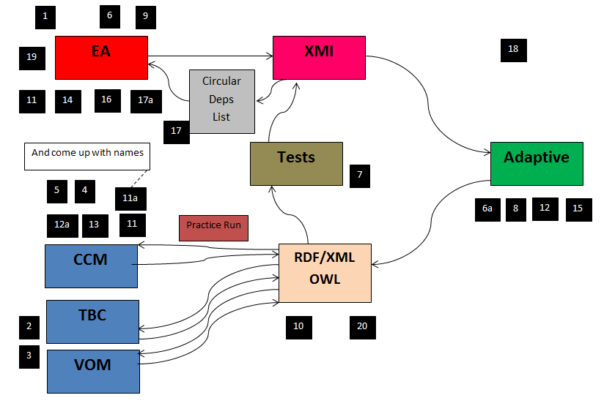
Anti-patterns Plan
Numbers refer to numbered anti-patterns in spreadsheet
See https://wiki.edmcouncil.org/display/FND/Anti-Patterns+for+FIBO-V

Slide 9
Alignment: Red v Pink/Yellow/Green
FIBO-KE (FKA “Red” FIBO)
EDMC-FIBO
Upper Ontology
ext/snap
etc.
etc
etc
Social Constructs
SysML (QUDT)
DEBT
REA
Transactions
LOAN
Commitments
Information
Quantities
SEC
UnitsAndMeasures
FBC
MeasurementTypes
BE
MonetaryMeasures
FND

Slide 10
Anti-patterns Status
Generated initial OWL from CCM
Expected reasoning errors identified ☺
Now passes a “Classifier” test in Pellet
CCM output was still not OWL API friendly but this has now been addressed (not not tested)
Addressed misplaced and misused properties and restrictions
For Debt initially
Ongoing elsewhere
Dean generates “Merged” vocabulary from this
SKOS generated from that
CCM HTML report generated from Merged files
NEXT:
One reasoning error caused by Placeholder
Start alignment with Pink content
Pink now in th CCM model
Validate as we go

Slide 11
Anti-Patterns Ongoing Work
Alignment
Align with Green FIBO
Walk this forward to current Pink
Test with Pellet each time
Alignment Rationale
Have the elements in CCM “Red” FIBO refer to canonical OWL where this exists
Many terms retained in Pink but in different URIs so these will be moved
Challenges
Differences in conceptual grounding (Time, Quantities, Occurrents)

Slide 12
FIBO Flavors Relationships
Feedback
FIBO Vocabulary (SKOS/RDF-S)
Feedback
Detailed FIBO Documents
generated
FIBO Core UML-SIMF / ODM Diagrams)
FIBO Core
OWL Ontologies
generated
aligned
FIBO.Schema.org
generated
Feedback
Natural Language Glossaries
Feedback

Slide 13
OMG Quarterly Meeting Sept 2016 (Chicago IL)
FIBO- total 45 min + questions for all 3 = TUE AM
IND
FBC
BE
2 RFPs to socialize: (2 hours)
Inputs to cashflow generator
Inputs to risk management calculations
Blockchain
Update on FIRO (Financial Industry Regulatory Ontology)
Update on FIBO-V (tentative)
Might or might not be a whole session
Workshop
Testing the spec and our understanding
Generating material that can be added as documentation
Need to capture the outcome of the March one
Use IND next time
New co chair
Other Presentations:
ACTUS Cashflows?
Ontology and Accounting concepts – how to bring together accounting concepts at different levels of ontologies
Messaging interest group (standard coordination) UPDATE

Slide 14
Tuesday
Morning
FIBO – one session for all 3 – 1 hour
BE
FCT
IND
Where to go next – second session half hour
FBC additional content
Securities next steps
Add more IND material e.g. GDP, stock / bond indices
Hear from LOANS FCT
Mike Uschold – half hour
FIBO-V
General concept (DW on the bigger picture)
FIBO-DEBT
Afternoon
FIRO (late morning or early afternoon) – Elie and tom Butler 45 min
New RFPs – 2 hours for the 2 proposals
Alignment with ACTUS debt cashflow terms
Workshop set-up

Slide 15
Wednesday
Morning
Accounting semantics
Standards coordination update and exploration
(coffee)
Blockchain
Updates from the group
Ongoing discussion / Proof Concept work
Afternoon
Workshop
In 2 parts:
Blockchain process notation
FIBO exercises

Slide 16
FTF and RTF Charters (Friday Plenary)
Foundations
1.2 RTF chartered March, due to report in Sept
Motion to defer to Dec
Business Entities
1.1 RTF chartered March, report Sept
Indices and Indicators
FTF2 moved across to FTF3
FTF3 chartered to September
Financial Business and Commerce
New FTF chartered December
Extended to September

Slide 17
FIGI Status
Nothing new

Slide 18
Roadmap
Non OMG
FIBO
PoC
Refactoring/
testing
Public review
OMG finalization
OMG
Spec
Key
Legacy
2013
2014
2015
2016
Q4
Q1
Q2
Q3
Q4
Q1
Q2
Q3
Q4
Q1
Q2
Q3
Q4
OMG Revision TF
(RTF) also for FBC
RTF2 For Loans, Sec, Der ???
Foundations
FIBO-FND
FIBO-FND v^{n}
Public review
FIBO-FND OMG finalization TF
(FTF)
FTF2
Final
1,1
Beta1
Beta2
FTF2
Legal Persons, LEI Entities;
Ownership and Control
RTF
FIBO-BE
Public review
FIBO-BE OMG finalization TF
(FTF)
FIBO-BE
RFC
Beta2
Final
1,1
FIBO-BE v2: Government, Jurisdiction
RFC
FIBO-BE2 FTF
Final
Indices & Indicators
Public review
Indices &
Indicators
IND FTF2
OMG FTF
FTF2 Incorporate
concepts in FBC
RFC
{
Beta1
Beta2
Final
Financial Business and Commerce
Final
FIBO Content Teams
RFC
Securities and Equities
RFC
Final
Loans Common
Dry Run
RFC
Final
Derivatives PoC
IR Swaps
Derivatives
By Contract type; by underlying asset type
RFC
SKOS
Other FIBO Components
FIBO Market Data, CAE, Risk/Reporting
FIBO Market Data, CAE, Risk/Reporting
FIBO schema.org
18
FIBO Market Data, CAE, Risk/Reporting

Slide 19
Current Activities
Co-ordination between specs
Timings / Roadmaps between specs
FIBO-V
Pocess under way, uner Wes Moore and Elie Abi-Lahoud
Now under way with Debt under Marc Alvarez

Slide 20
OMG Spec Co-ordination and Timings
Per process, there is a focus now on co-ordination of requirements and dependencies across FIBO specifications
https://wiki.edmcouncil.org/display/FND/FIBO+Content+Team+Requirements+for+Foundations
BE, FBC, government entities and anti-corruption
Real-world circularities e.g. shares v limited companies
Timings between FBC, LCC, FIBO-Foundations
Sept2016
FBC FTF
BE RTF
Dec 2016
FND RTF

Slide 21
Co-ordination
FCTs working on detailed “Roadmaps”
Align with the overall roadmap
Identify cross dependencies
Requirements for FND, FBC, BE extensions

Slide 22
FIBO Current Specifications Status Overview
FIBO Foundations
Final version approved by OMG March 2015
Revised 1.1, approved March 2016 (now Board-approved)
FIBO Business Entities
Final 1.0 approved March 2016 (Board-approved)
RTF chartered March
FCT under David Newman (Wells Fargo) meets Tuesdays
FIBO Indices and Indicators
Approved September 2014
FTF2 chartered Dec 2015
Completion Sept 2016
FCT under Elisa Kendall (Thematix)

Slide 23
FIBO Indices and Indicators Status Detail
FTF made its Formal submission May 18
AB formal approval at June 2015 meeting in Berlin
IND FTF2 chartered in Dec 2015
FTF2 closed out in June 2016
FTF3 to Sept (last call)
FCT meets Fridays (Elisa Kendall)

Slide 24
FIBO-BE Status Detail
FIBO-BE Beta 2 submitted and approved at Reston
FTF2 chartered in Reston, with Beta2 as baseline
FIBO-BE Final approved March 2016
Now working on RTF for 1.1
Government related entities
Liability structures
Jurisdiction specific concepts
Ownership and Control?

Slide 25
FIBO FBC Status Detail
Second reading passed at December OMG Meeting
Now in FTF
Urgent issue via IND
Possibly an FTF activity
Dependencies
Pre-requisite for Securities and Equities
Pre-requisite for Debt Common / Bonds
Depends on FIBO-BE
Depends on LCC
Sept 2016

Slide 26
Languages, Countries and Codes (LCC)
Not an FDTF spec, this is owned by ADTF
Was issued for comments in December 2015
Approved March 2016

Slide 27
FIBO Upcoming Specifications Status Overview
FIBO Securities Common and Equities
FIBO Content Team under Richard Beatch (Bloomberg)
Meets Mondays alternating with FBC
Plan to charter an RTF in June 2016
FIBO Loans
FIBO Content Team meets Thursdays
Submission date – TBC
FIBO Bonds / Debt Common
FCT Lead in place (Mark Alvarez)
Uses FIBO-V material (legacy content)
Will need to cover debt common terms before bond specifics
Dependencies: FBC, BE, FND

Slide 28
FIBO: Scope and Content
Upper Ontology
FIBO Foundations: High level abstractions
FIBO Business Entities
FIBO Financial Business and Commerce
FIBO Indices and Indicators
FIBO Contract Ontologies
Securities (Common, Equities)
Securities (Debt)
Derivatives
Loans, Mortgage Loans
Funds
Rights and Warrants
FIBO Pricing and Analytics (time-sensitive concepts)
Pricing, Yields, Analytics per instrument class
FIBO Process
Corporate Actions, Securities Issuance and Securitization
Future FIBO: Portfolios, Positions etc.
Concepts relating to individual institutions, reporting requirements etc.

Slide 29
FIBO: Status
Key
Draft in Semantics Rep
OMG in process
OMG in preparation
OMG Complete
Upper Ontology
FIBO Foundations: High level abstractions
FIBO Business Entities
FIBO Financial Business and Commerce
FIBO Indices and Indicators
FIBO Contract Ontologies
Securities (Common, Equities)
Securities (Debt)
Derivatives
Loans, Mortgage Loans
Funds
Rights and Warrants
FIBO Pricing and Analytics (time-sensitive concepts)
Pricing, Yields, Analytics per instrument class
FIBO Process
Corporate Actions, Securities Issuance and Securitization
Future FIBO: Portfolios, Positions etc.
Concepts relating to individual institutions, reporting requirements etc.
Notes:
Also viewable in Adaptive – see link on next slide

Slide 30
FIBO Where is What!
General Information - http://www.edmcouncil.org/financialbusiness
Historical perspective and status
29 FIBO Business Conceptual Ontologies have been built since 2008
http://www.edmcouncil.org/semanticsrepository/index.html
Contains much detailed downloadable information including models, spreadsheets and XLS files for 29 FIBOs
Github Working Wiki page”
https://github.com/edmcouncil/fibo/wiki
For those who want to get serious soon – Links to UML and RDF/OWL downloadable files for all 29 FIBOs and much much more of Pink and Yellow and Green FIBOs
Browseable and searchable repository with workspaces for all ontologies
http://us.adaptive.com/FIBO/a3/
http://www.omg.org/spec/EDMC-FIBO/FND/Current
Contains FIBO-FND in final OMG documentation form including UML and RDF/OWL models for FIBO Foundations
Github wiki is at:
https://github.com/edmcouncil/fibo/wiki/FIBO-Foundations
http://www.omg.org/spec/EDMC-FIBO/BE/Current
Contains FIBO-BE (Business Entities) In OMG documentation form.
Github wiki is at
https://github.com/edmcouncil/fibo/wiki/FIBO-Business-Entities
A working version in testing (“David’s Branch”) is at
https://github.com/dsnewman/fibo/tree/pink/be
http://www.omg.org/spec/EDMC-FIBO/IND/Current
Contains FIBO-IND (Indices and Indicators) In OMG documentation form
Github wiki is at
https://github.com/edmcouncil/fibo/wiki/FIBO-Indices-and-Indicators .
Pointer to Loans FIBO Github Wiki page
https://github.com/edmcouncil/fibo/wiki/FIBO-Loans
Pointer to Securities and Equities FIBO Github wiki page
https://github.com/edmcouncil/fibo/wiki/FIBO-Securities-and-Equities

Slide 31
FIBO Atlassian Wiki Spaces
FIBO Overall
https://wiki.edmcouncil.org/display/FIBO/FIBO
FIBO Content Teams
Foundations
https://wiki.edmcouncil.org/display/FND/FCT-FND
Business Entities
https://wiki.edmcouncil.org/display/BE/FIBO+-+FCT+-+Business+Entities
Indices and Indicators
https://wiki.edmcouncil.org/display/IND/FCT-IND
Financial Business and Commerce
https://wiki.edmcouncil.org/pages/viewpage.action?pageId=786677
Loans
https://wiki.edmcouncil.org/display/LOAN/FCT-LOAN
Securities and Equities
https://wiki.edmcouncil.org/pages/viewpage.action?pageId=786661
Derivatives
https://wiki.edmcouncil.org/display/DER/FCT-DER
Vendor Team
https://wiki.edmcouncil.org/display/FVT/FIBO+-+Vendor+Team

Slide 32
schema.org Status
Core Extensions submitted
Approved
FIBO Specific parts under way
See FIBO Wiki structure
Wiki group management as per FCTs (see other notes)

Slide 33
Appendices: Background Slides
I Jargon Blaster
II FIBO Infrastructure
III Red FIBO
IV FIBO Content and Status (“scenario” slides)

Slide 34
Appendix I: Jargon Blaster
ISO 10962
Classification of Financial Instruments (CFI)
New version released in Jan 2015
ISO 20022
Messaging standard, UML to XML transformation
incorporated the draft ISO 19312 (WG11)
WG11 model was starting point for most FIBO
ISO 11179 = Metadata Repositories
XBRL = eXtensible Business Reposrting Language
Concepts are in individual “Taxonomies” (model schemas) only (IASB, IFRS, US-GAAP, etc.)
MDDL – Market Data Definition Language

Slide 35
Appendix II: FIBO Infrastructure
The “Holy Trinity”
GitHub
JIRA
Jenkins
Wiki
Each FCT and other teams have Wiki area (“Space”)
Minutes, actions etc. posted there
How-to Guide will be posted to Wiki also
Wiki to JIRA Bridge: meeting actions identified in Wikis are also now reflected as JIRA issues
Need for some instruction in this for FCT Leads

Slide 36
How-To Guide
Shows overall process to follow in using GitHub and Atlassian Sourcetree, for FCT Leads
Detailed screenshots for each part of the process
New section on definitions added
Additional definitions added
This is the version that is posted on the Wiki
New section on aligning local and remote branches with EDM Council Master

Slide 37
Engagement Model
Groups
Each Team is configured as a “Group” in JIRA
This group is then also used for participation in Wiki “spaces”
If you registered for GitHub access, you GitHub ID also becomes your JIRA ID
Group leads will then add you to their team group
Otherwise, you will have received an invitation from JIRA directly
You may want to retrospectively ask to be added to GitHub
Some people are having difficulty accessing the Wiki – there is a synch to be run periodically

Slide 38
Process Progress
FCT Process (to be followed by FCT Leads)
Standard template / slides used by all FCT leads
Minutes posted to Wiki
Dennis is doing this fro MB notes;
FCT leads should take on responsibility for note-taking and publishing
FIBO Proof of Concept Teams
May use any FIBO color as appropriate
Run on same process as FCTs (wiki etc.).
FIBO Vendor Team
Initially focused on tool support for specification activities
Will also extend to potential test assistance, PoCs etc.
Build / Test / Deploy / Maintain document
This is the definitive reference for all process (see Fig 4 of that)
GitHub / Process User Guide updated
Will extend to overall process over time

Slide 39
FIBO Content Teams
Each FIBO Content Team has
A GitHub fork on the FCT Leader GitHub account
A working wiki on the main (EDM Council) GitHub account
Regular meetings

Slide 40
Appendix III: Red FIBO
This is one Foundations Content Team Activity
Application of the “FIBO Principles” across the FIBO Family
Starting to firm up how these are applied
Units of Measure was initial example
Now working on Continuant v Occurrent as a pre-requisite to REA Transactions workflow
Deliver abstractions to FCTs so that formal OMG submission models are in line with philosophy, abstractions and common mid level ontology concepts

Slide 41
Red v Pink working – Example
Lattice
ext/snap etc.
QUDV
Platonic
Relatives
Quantities
REA
UnitsAndMeasures
MeaurementTypes
MonetaryMeasures
QuantitiesAndUnits
CurrencyAmount

Slide 42
Red FIBO Foundations Topics
Many recent topics of interest are in Red FIBO somewhere
Products and Services
Regulations, Regulatory restrictions
Codes, Schemes, Identifiers
FCT Leads liaise with Foundations FCT for abstractions of all model content (nothing is defined in isolation)
Foundations provides a more complete model so you can use the pieces you need right away
Use case for this is non destructive changes when additional abstractions are needed by a future FCT

Slide 43
Appendix IV: FIBO Content and Status

Slide 44
Key to Colors
 | Planned Phase Colors |  | Status Colors | OMG | EA Subst | EA Draft | Initial
 | Foundations and Business Entities, Indices |  | Red = EDM Council legacy
 | Common Concepts all Instruments; Equity; Debt |  | Pink = Initial Refactoring
 | Derivatives Common; Loans Common |  | Yellow = OMG Submission
 | Derivatives: Rate, Credit, Fx |  | Green = OMG Final
 | Loans: Mortgage
 | Debt: Structured Finance, Money Markets
 | Derivatives: Asset, Commodity, CFD
 | Derivatives: Exchange Traded
 | Collective Investment Vehicles
 | Rights and Warrants
1
2
3
4
5
6
7
8
9
10
Future
OMG = in RDF/OWL; EA Subst = Model Reviewed by SMEs; EA Draft = Modeled in Enterprise Architect; Initial = Not Yet Modeled

Slide 45
FIBO Development Scenario (August 2015)
Reference Data (product) Semantics
Phase | Domain | Sub-Domain | Dependency | OMG | RDF/OWL | EA Subst | EA Draft
1 | Foundations |  |  | X
1 | Business Entities |  |  | X
1 | Indices and Indicators |  |  | X
2 | Common Concepts (all instruments) |  |  |  | X
2 | Equity Instruments | Equities |  |  | X
2 | Debt Instruments | Debt Terms (including bonds) |  |  |  | X
5 |  | Structured Finance | Dependent on bonds and mortgage |  |  |  | X
5 |  | Money Markets (includes Repo, Treasury, Government, Tax Free) |  |  |  |  | X
3 | Loans | Common Loan Terms |  |  | X |  | X
5 |  | Mortgage Loan Terms |  |  |  |  | X
7 |  | Other (i.e. general purpose, construction, student, miscellaneous) |  |  |  |  | X
OMG = in standards process; RDF/OWL = in Web Ontology Language; Beta = Model Reviewed by SMEs;
Model = Modeled in Enterprise Architect;

Slide 46
FIBO Development Scenario (August 2015)
Reference Data (product) Semantics
Phase | Domain | Sub-Domain | Class | Dependency | OMG | RDF/OWL | EA Subst | EA Draft
3 | Derivatives | Common Concepts |  |  |  |  |  | X
4 |  | OTC Derivatives | Rate Based | Dependent on indices |  |  |  | X
4 |  |  | Credit Default | Dependent on common concepts for loans, common debt terms, indices |  |  |  | X
4 |  |  | Foreign Exchange |  |  |  |  | X
7 |  |  | Asset | Dependent on equities, bonds, common debt terms |  |  |  | X
7 |  |  | Commodity |  |  |  |  | X
7 |  |  | Contracts for Difference |  |  |  |  | X
8 |  | Exchange Traded |  |  |  |  |  | x
9 | Collective Investment Vehicles |  |  | Dependent on listed instruments, derivatives, indices |  |  |  | X
10 | Rights & Warrants |  |  | Dependent on common concepts for all instruments |  |  |  | x
OMG = in standards process; RDF/OWL = in Web Ontology Language; Beta = Model Reviewed by SMEs;
Model = Modeled in Enterprise Architect;

Slide 47
FIBO Development Scenario (August 2015)
Market Data (time and date) Semantics
 | Domain | Sub-Domain | Dependency | OMG | RDF/OWL | EA Subst | EA Draft
 | Common Terms |  |  |  |  |  | X
 | Equity Pricing |  |  |  |  |  | X
 | Debt Temporal Terms | Debt Pricing and Yields |  |  |  |  | X
 |  | Debt Analytics |  |  |  |  | X
 |  | Debt Pool Analytics |  |  |  |  | X
 | CIV Temporal Terms |  |  |  |  |  | X
 | Loan Temporal Terms |  |  |  |  |  | X
 | Trading Status |  |  |  |  |  | X
 | Credit Temporal Terms | Credit Rating |  |  |  |  | X
 |  | Credit Status |  |  |  |  | X
Future Phase
OMG = in standards process; RDF/OWL = in Web Ontology Language; Beta = Model Reviewed by SMEs;
Model = Modeled in Enterprise Architect;

Slide 48
FIBO Development Scenario (August 2015)
Process Related Semantics
 | Domain | Sub-Domain | Dependency | OMG | RDF/OWL | EA Subst | EA Draft
 | Corporate Actions and Events |  |  |  |  |  | X
 | Securities Issuance | Common Issuance Process Terms |  |  |  |  | X
 |  | Equity Issuance (includes IPO, primary market) |  |  |  |  | X
 |  | Debt/Bonds Issuance (includes auction, syndication and other issuance processes |  |  |  |  | X
 |  | Asset-Backed / Mortgage-Backed Issuance (includes agency and non-agency) |  |  |  |  | X
 | Securities Transactions (includes trade, post trade, clearing, settlement)
 | OTC Derivatives Transactions |  |  |  |  |  | X
 | Payments Processing
 | Portfolio and Holdings |  | s
Future Phase

