Slide 1
Simplified Vehicle Requirement Example
Bjorn Cole

Slide 2
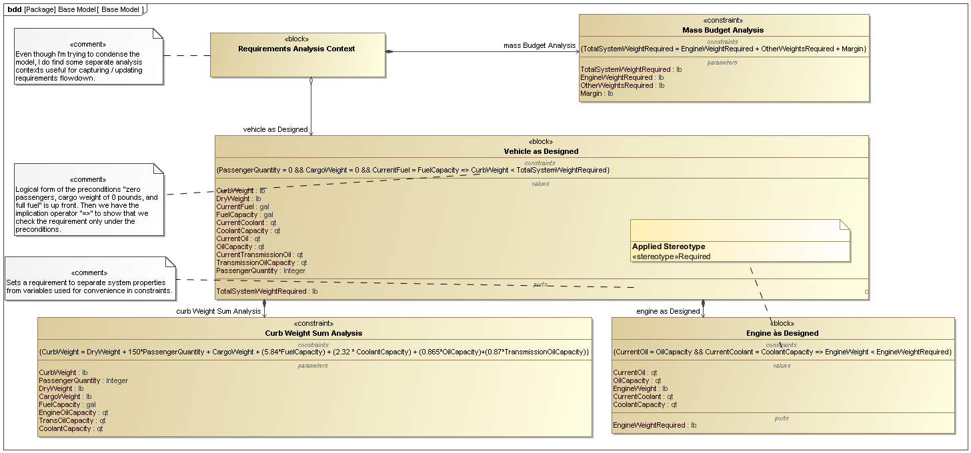

Slide 3
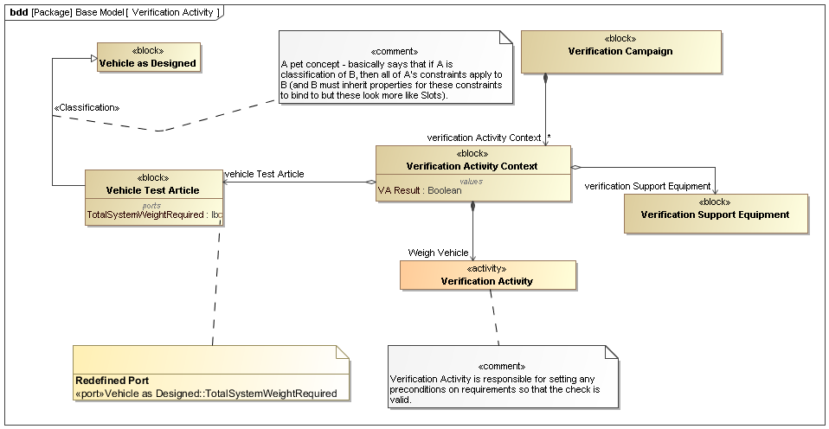

Slide 4
