Slide 1
SysML v2 Model Interoperability & Standard API Requirements
Axel Reichwein
Consultant, Koneksys
December 10, 2015
Notes:
OSLC stands for Open Services for Lifecycle Collaboration. OSLC is a very promising integration approach which is increasingly used for Product Lifecycle Management (PLM) and Application Lifecycle Management (ALM) solutions

Slide 2
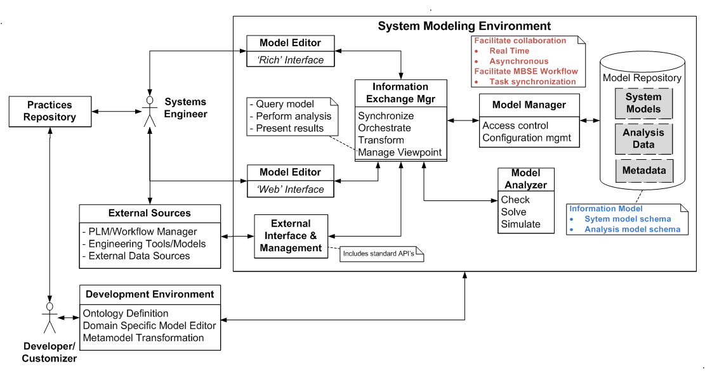
Systems Modeling Environment Conceptual Architecture
Image from “Status of SysML v2, Planning & Requirements, Berlin, Germany June 16, 2015, Sandy Friedenthal & Eldad Palachi, http://www.omgwiki.org/OMGSysML/doku.php?id=sysml-roadmap:sysml_assessment_and_roadmap_working_group”

Slide 3
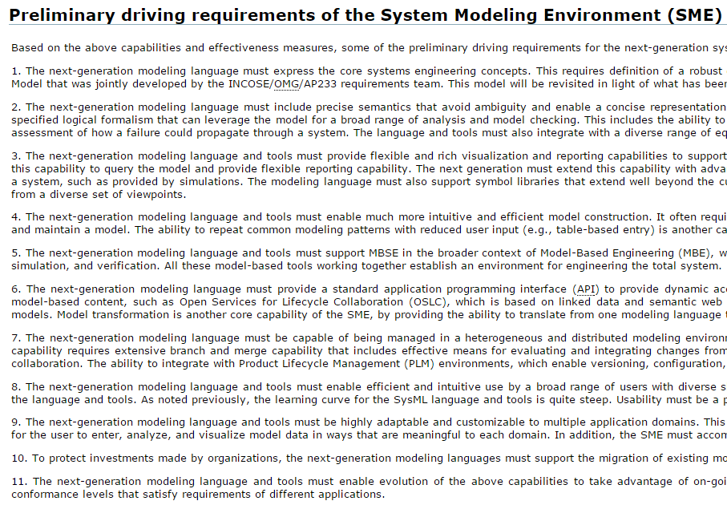
http://www.omgwiki.org/OMGSysML/doku.php?id=sysml-roadmap:sysml_assessment_and_roadmap_working_group

Slide 4
Preliminary Driving Requirement #5
The next-generation modeling language and tools must support MBSE in the broader context of Model-Based Engineering (MBE), where the models and tools are fully integrated across discipline-specific engineering tools, including hardware and software design, analysis and simulation, and verification. All these model-based tools working together establish an environment for engineering the total system.

Slide 5
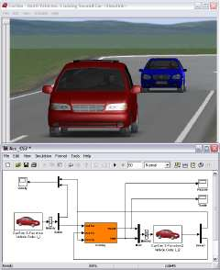
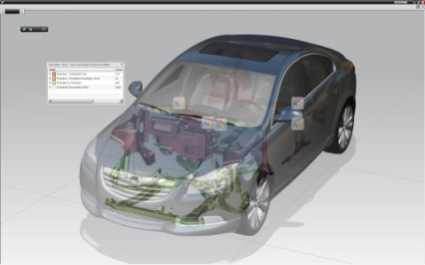
Example
Requirements
Software
Simulation Model
Test Cases
Geometric Model
v
"NX7-HD3D-car-300dpi" by Jsarfati - Own work. Licensed under Creative Commons Attribution 3.0 via Wikimedia Commons - http://commons.wikimedia.org/wiki/File:NX7-HD3D-car-300dpi.jpg#mediaviewer/File:NX7-HD3D-car-300dpi.jpg
System Architecture
Notes:
A certain requirement can for example be satisfied by a specific system architecture component, for which there is a more detailed geometric model, whose parameters such as the center of gravity need to be forwarded to a simulation tool, whose simulation results will ultimately be used to test and validate the original system requirement. This is just one example of a chain of relationships which exists between engineering data. There are many more and it is impossible for engineers to memorize them all. However, it is crucial to keep track of these relationships because this is the basis for enabling data traceability and integration. Changes always happen in engineering.
This is challenging because the data is created with different tools, thus the data is available in different formats and is accessible through different protocols. Existing solutions are mostly based on proprietary sets of integrated tools, which are limited in their capability to capture all the possible relationships. This is why we still speak of PLM and of ALM solutions as separate solutions. Eventually, we need a common solution which can be applied across all engineering disciplines.

Slide 6
Why do we need Traceability Links?
Queries
Impact Analysis
Analytics
Better Overview => Better Decisions

Slide 7
Change Management Scenario
Change Request needs to refer to affected design documents/models
Change Request
Requirements
Software
Simulation Model
Test Cases
Geometry Model
v
"NX7-HD3D-car-300dpi" by Jsarfati - Own work. Licensed under Creative Commons Attribution 3.0 via Wikimedia Commons - http://commons.wikimedia.org/wiki/File:NX7-HD3D-car-300dpi.jpg#mediaviewer/File:NX7-HD3D-car-300dpi.jpg
System Architecture

Slide 8
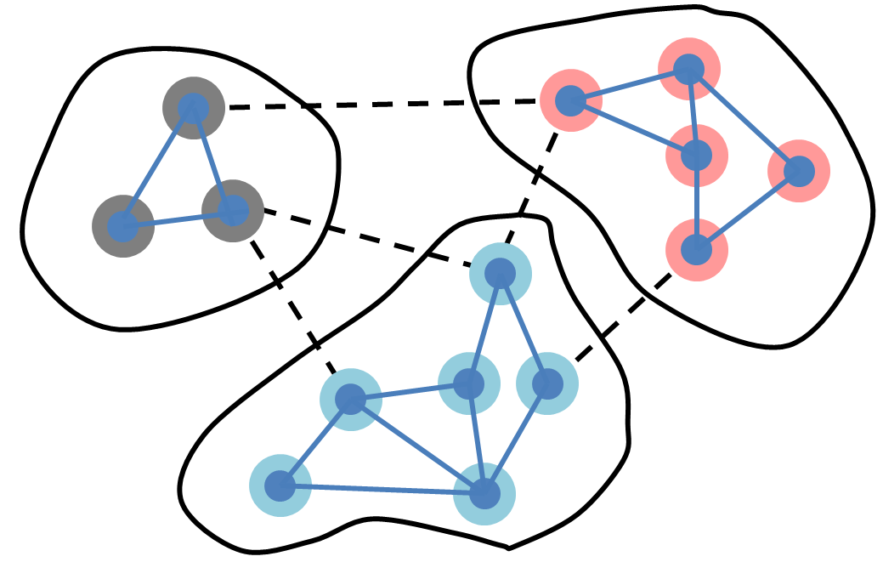
Status Quo concerning Traceability Links
Systems
Engineering
Embedded
systems
Mechanical
Engineering
No cross-disciplinary traceability
Different (proprietary data formats)
Need to capture the graph in a common data format

Slide 9
Derived Requirements supporting Req #5
System Modeling Environment (SME) should use:
a data format suitable for describing graphs
a non-proprietary data format
a widely adopted data format
Choice of data format critical
Choice of data format will influence the choice of related standards such as for metamodeling and querying

Slide 10
Specific Requirement supporting Req #5
Data of the System Modeling Environment (SME) should be available in the W3C standard Resource Description Framework (RDF)
RDF
Open W3C standard
Format designed to describe graphs
RDF can be serialized in XML, JSON, and other formats
Supported by open source libraries such as Apache Jena
Supported by open-source and commercial graph databases
Already widely used by the semantic web community
Discipline-neutral

Slide 11
Discipline-specific standards for RDF data
Systems
Engineering
Embedded
systems
Mechanical
Engineering
Standards to describe discipline-specific data in RDF

Slide 12
Specific Requirement supporting Req #5
Metadata (semantics) in the System Modeling Environment (SME) should be defined in an RDF vocabulary (W3C RDFS) and shape constraints (Resource shapes, W3C SHACL)
W3C RDFS and W3C SHACL
Open W3C standards
Adopted by the semantic web community
Used to define metadata related to various domains
Possibility to reuse existing RDF vocabularies
RDF vocabularies can be minimalistic

Slide 13
Example
RDF Vocabulary
Resource Type URIs
Predicate (Property) URIs
RDF Shape Constraints
Example:
http://omg.org/sysml#Requirement
Example:
http://omg.org/sysml#satisfiedBy
Example:

Slide 14
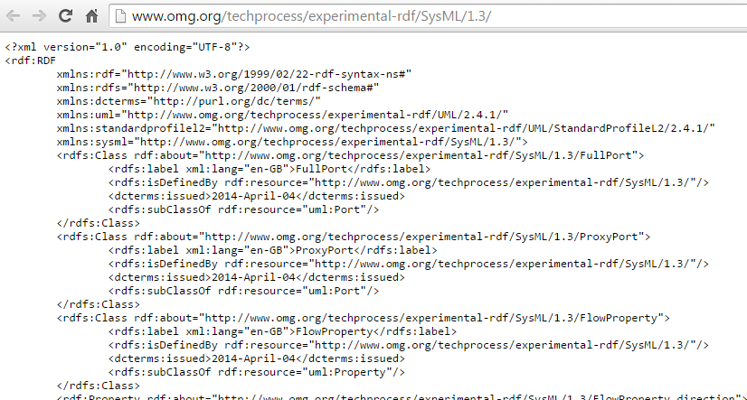
Converting SysML into OSLC Standard
SysML 1.3 RDF vocabulary online at http://www.omg.org/techprocess/experimental-rdf/SysML/1.3/
Check out new revised submission MOF2RDF http://www.omg.org/techprocess/meetings/schedule/MOF_to_RDF_Structural_Mapping_in_Support_of_Linked_Open_Data_RFP.html

Slide 15
Standards for cross-disciplinary links
Systems
Engineering
Embedded
systems
Mechanical
Engineering
Cross-disciplinary links need to be standardized (http://www.omg.org/SysML/1.3/Requirement_satisfiedBy) . Otherwise traceability links will not be queriable, and value of traceability links will largely be diminished

Slide 16
Short/middle/long term plans for supporting Req #5
Step 1: SysML tool exposes SysML data as RDF
Step 2: SysML tool exposes SysML data as RDF conforming to SysML RDF vocabulary and shape constraints
Step 3: SysML tool captures cross-disciplinary relationships in RDF
Step 4: SysML tool captures standardized cross-disciplinary relationships in RDF

Slide 17
Preliminary Driving Requirement #6
The next-generation modeling language must provide a standard application programming interface (API) to provide dynamic access to the model, while providing appropriate access controls.
It should also integrate with emerging platforms for managing and integrating model-based content, such as Open Services for Lifecycle Collaboration (OSLC), which is based on linked data and semantic web technology, and the Functional Mockup Interface (FMI), which provides model exchange and co-simulation capability for executable behavior models.
Model transformation is another core capability of the SME, by providing the ability to translate from one modeling language to another.

Slide 18
SysML Tool APIs Status Quo
No standard API to access SysML data
No standard Web API to access SysML data
No API supports complex queries

Slide 19
Derived Requirements supporting Req #6a
Standard Web API to access SysML data
API supporting complex queries

Slide 20
Specific Requirements supporting Web API
Web API should
be RESTful
conform to W3C Linked Data Platform
RESTful Web APIs
Easy to implement (only HTTP)
Supported by the web infrastructure (caching, etc…)
W3C Linked Data Platform
defines a set of rules for HTTP operations on web resources
Similar to OSLC Core v2

Slide 21
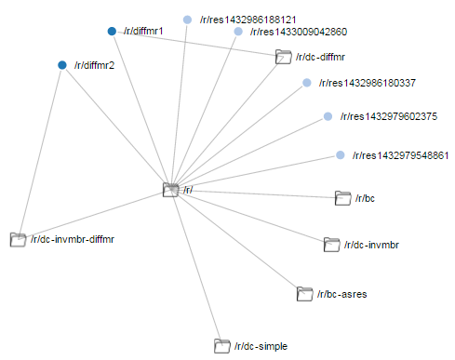
LDP Example
http://ldp-speicher.rhcloud.com/

Slide 22
Specific Requirements supporting API for complex queries
API for complex queries
Query language: W3C SPARQL
Communication protocol: W3C SPARQL Protocol (HTTP)
W3C SPARQL
Open W3C standard
Similar to SQL for relational databases
Supported by many graph databases
Supported by open-source and commercial graph databases
W3C Linked Data Platform
defines a set of rules for HTTP operations on web resources
Similar to OSLC Core v2

Slide 23
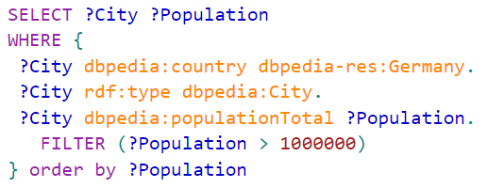
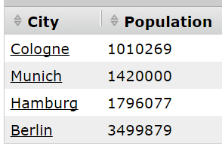
SPARQL Example
Example DBPedia Query: Cities in Germany with population larger than 1Mio?
Notes:
Using DBPedia, you can for example perform a query to know the capitals in Europe. Instead of receiving a bunch of web pages as a result of your query, the user receives the query results in a machine-readable format, which contain links to related data, such as the geographical location of the capitals. The query results can then be easily pushed to Google Maps for visualization. Linked Data is an important new way to use the Web. Linked Data allows the Web to capture relationships between data in general, including links between engineering data!
understood by machines. A famous example of Linked data is DBPedia, the equivalent of Wikipedia in structured data format.

Slide 24
Short/middle/long term plans
Step 1: SysML tools expose SysML data through RESTful API
Step 2: SysML tools expose SysML data through RESTful API conforming to W3C LDP
Step 3: SysML tools offer a RESTful API supporting SPARQL Protocol

Slide 25
TODO
Update spreadsheet to possibly add additonal services required for traceability/interoperability
Indicate services used to support traceability/interoperability
Address requirements related to FMI and model transformation
Present traceability/interoperability requirements in the context of change management scenarios
Create Wiki page

