Slide 1
Systems Engineering Concept Model (SECM) Status Update
20 March 2017
John Watson
jcwatson@ieee.org

Slide 2
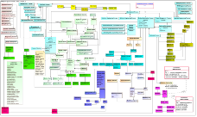
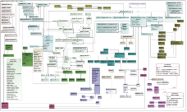
Systems Engineering Concept Model (SECM) Approach
INCOSE Systems Engineering Handbook V4
ISO/
IEC/IEEE 15288:
2015
V 1.5
SECM – 2015 Industry Reference
SysML V2 Service Requirements
Other
OMG
Specs
Other Industry Ontologies
SECM - SysML V2 RFP
SysML V2 Spec
Meta-model
Profile
Libraries
Concrete Syntax
SysML V2 RFP
SECM – 2003 Industry
Reference
*
Standardized API
Reference Model
UML 4SE RFP
SysML V1.X Spec
User Interface
Guidelines
* Joint INCOSE/AP233/OMG, Led by Dave Oliver

Slide 3
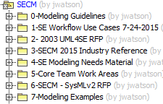
SECM Model High Level Content
Notes:
Uses Magic Draw using a Teamwork Server provided my No Magic

Slide 4
SECM Content
0-Modeling Guidelines
Contains guidelines across the full SECM
1-SE Workflow Use Cases 7-24-2015
A snapshot of the available use cases in the related SysML v2 project
2- 2003 UML4SE RFP
Captures the concepts and definitions used in the original SysML RFP in 2003
3-SECM 2015 Industry Reference
High Level SE Concepts as reflected in the SEBoK, 15288 and INCOSE Handbook

Slide 5
SECM Content (Continued)
4-SE Modeling Needs Material
Preliminary work done by Sandy and John to prepare the more focused work groups
5-Core Team Work Areas
Provides a work area for each of the focus teams to create their contribution of requirements, glossary term definitions, concept models and examples
6-SECM - SysMLv2 RFP
This section of the model will contain the glossary term definitions, and requirements used in the SysML V2 RFP
7-Modeling Examples
The examples in this section provide examples across multiple focus areas.

Slide 6
SECM Focus Since December OMG Meeting

Slide 7
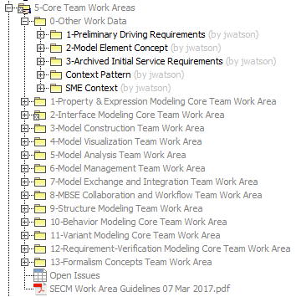
Core Team Work Areas
Staging area for developing:
RFP content information:
Requirements
Glossary Terms
Other informative Information:
SE Concept Development
Examples
Traceability to Concepts and Driving Requirements
Manage Follow-up Issues
SECM Work Area Guidelines
Notes:
Once the Requirements and Glossary terms are stable, they are moved to the SysML v2 RFP area
Each of the work areas have a hyperlink to their Wiki

Slide 8
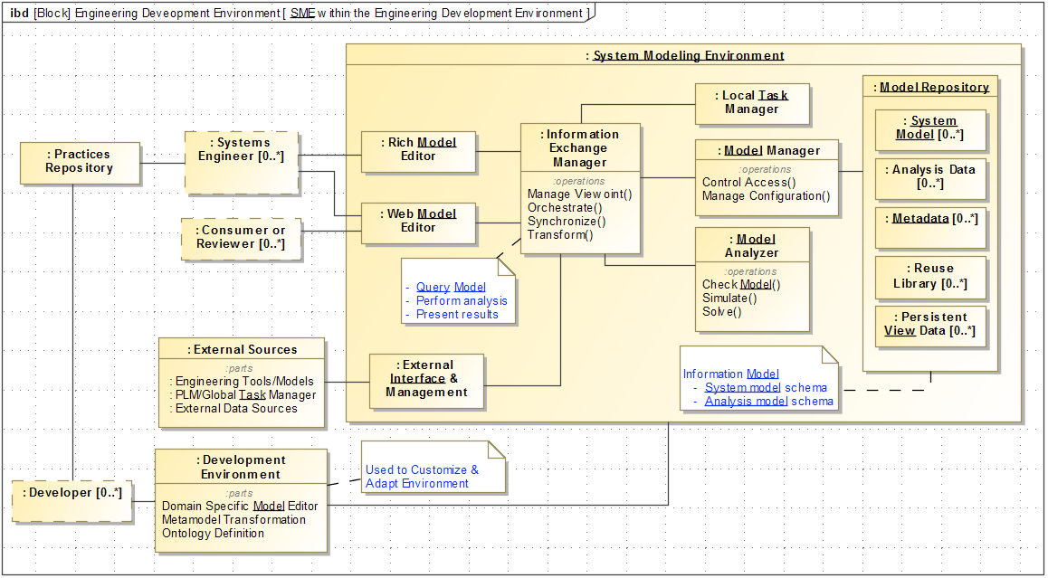
Logical Context Diagram of the System Modeling Environment (SME)

Slide 9
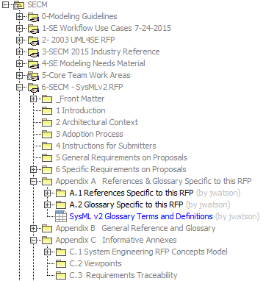
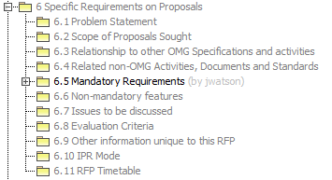
SECM – SysML v2 RFP Model Organization
Notes:
1. Reference list and glossary

Slide 10
The Four Pillars of SysML
6.5.2 Data Model Requirements
6.5.2.1
Common Core
6.5.2.6 & 7 Requirements & Verification
6.5.2.5
Behavior
6.5.2.3
Structure
6.5.2.8
Analysis
6.5.2.4
Interface
6.5.2.2
Properties and Expressions

Slide 11
Core Team Workgroups Status
Core Workgroup Team | Requirements and Reqt. Groups | Glossary Terms | SE Concept Diagrams | Examples
Analysis | 16/4 | 17 | Yes | -
API (Model Exchange & Integration) | 9 | - | No | -
Behavior | 0 | 0 | Not Started | -
Common Core Concepts | 0 | 32 | Yes | Yes
Formalism | 7 | 10 | No | -
Structure/Interfaces | 14 | 27 (in work area) | Yes | Yes
Services | 64 (owned by others | Provided by others | - | -

Slide 12
Core Team Workgroups Status
Core Team Workgroup | Requirements and Reqt. Groups | Glossary Terms | SE Concept Diagrams | Examples
Model Construction | 16/7 | 5 | In Progress | -
Model Management | 21/3 | 9 | In Progress | -
Requirements & Verification | 25/6 10/2 | 62 | Yes | Yes
Variants | 2 | 6 | Yes | Yes
Visualization | 13 | 3 | Yes | -
Workflow and Collaboration | 7/1 | 6 | - | -

Slide 13
Summary
Accomplishments Since December Meeting
Contributions from 12 Core Work Groups
RFP Content Information
140 Requirements Available
149 Glossary Terms
Informative Information
Multiple Examples and Concept Diagrams
Captured Driving Requirements in SECM
Captured the SME in SECM
What’s next?
Behavior Concepts
Identify the tools and process for conducting reviews
Refine RFP Content
Conduct Reviews for RFP Content
Normalize terms and requirements across all work areas
Add content for other RFP sections
Update tools to 18.5 in late March

Slide 14
Questions?

Slide 15
Backup

