Slide 1
Initial Draft Requirements Concepts
SysML V2 RFP WG Meeting
12/08/2016
John Watson

Slide 2
Requirement Concepts Modeling Focus Team Overview
Requirements/Verification Concepts Team Wiki
Notes:
Open the wiki page and review
the folks that are contributing;
the starting and updated needs artifacts
the list of 8 questions that are being worked, their status and who’s doing the work

Slide 3
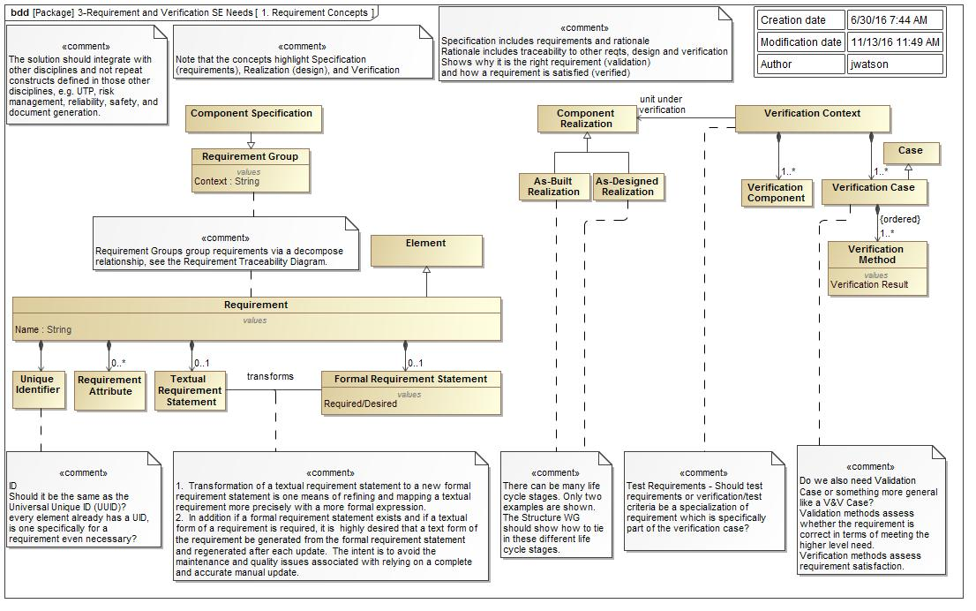
Requirement Concepts
Specification
Realization
Verification
Notes:
Concepts of Specification, Realization and Verification
Brian will say a few words about verification concepts in the upper right, and say the direction you are headed
Requirement composition
Concept of Formal Requirement is new

Slide 4
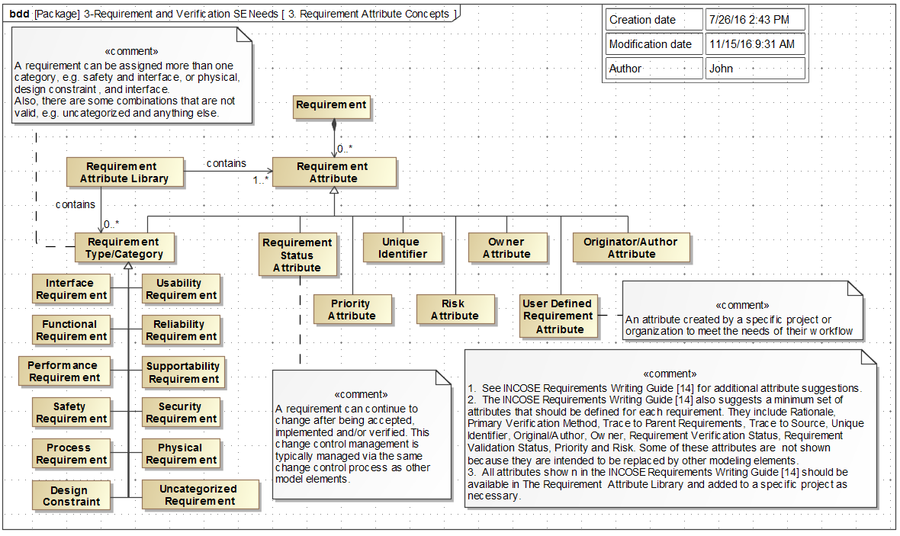
Requirements Attribute Concepts
Notes:
Item 2, Bertil Muth proposed changes, they were reviewed by the group and implemented in the model.

Slide 5
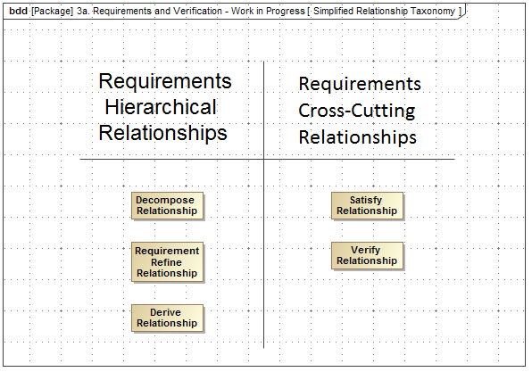
Simplified Relationship Taxonomy
Notes:
Item 3 - Rick Steiner and Brian Selvy
Rick will augment the discussion when slide is shown, and note that we will be addressing other relationships as well.

Slide 6
Requirements Form a Constraint Boundary Adding Constraints to a Reqt. Group
Acceptable Design
< Constraint 1
< Constraint 2
> Constraint 3
Constraints can span
N dimensional space
Notes:
Sandy will explain

Slide 7
Questions

Slide 8
Systems Engineering Concept Model (SECM) API Requirements Capture
John Watson
6 Dec 2016

Slide 9
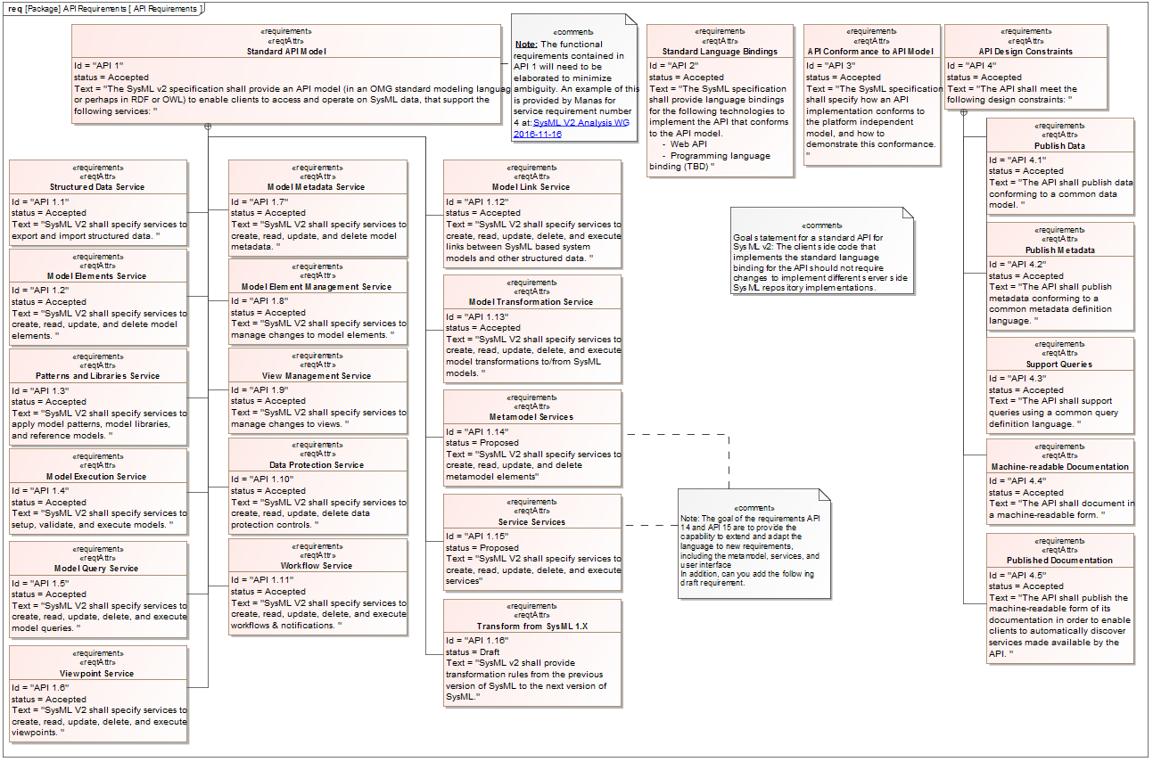
API Requirements - Diagram View

Slide 10
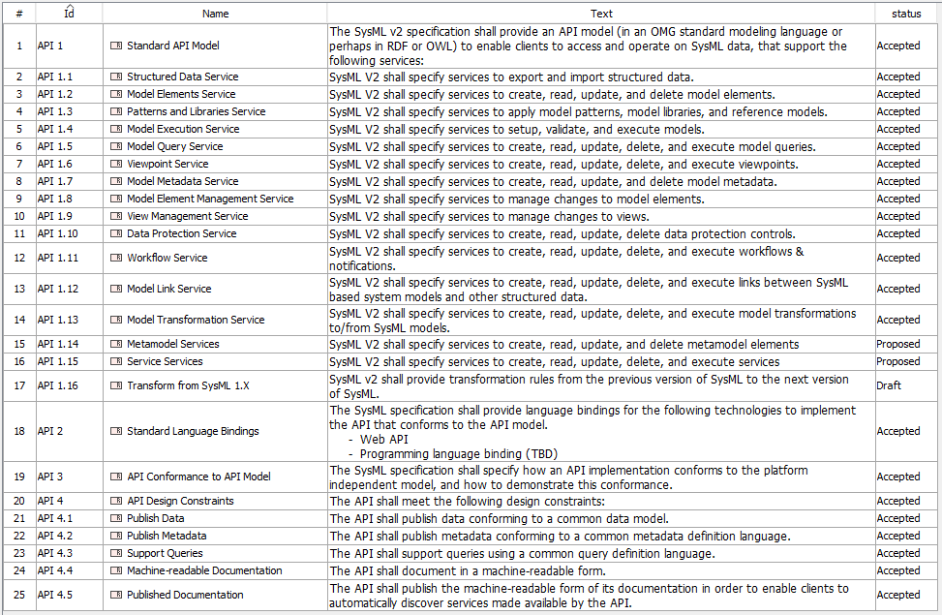
API Requirements - Table View

Slide 11
Backup

