Slide 1
SysML v2 Mapping Service Requirements to “Process Change Request” Use Case Task Result Summary
08/30/2017
Laura Hart, Christian Muggeo, John Watson

Slide 2
Approach
Utilized existing SE Workflow Use Case Model
Use Case - “Process Change Request”
Includes 8 Activity Diagrams
For each Activity
Context is “Systems Engineering”
Includes all SE roles and tools (some roles and tools may need more / less requirements)
Use only Actions in the Systems Engineering swimlane
Call Behaviors, Call Operations, decisions, etc. are not used
Interactions with external entities identified by flows that cross the Systems Engineering context
Exported to a spreadsheet
Actions within the Systems Engineering swimlane
76 Total Actions across 8 Activities
Services requirements
70 Requirements and 18 Requirement Groups
In spreadsheet, map the appropriate Services Requirements to each action
In SE Workflow Use Case model - Allocate Service Requirements to actions
Assumptions
Large complex model, geographically dispersed
Modeler experience level - Novice to Expert
Notes:
“Process Change Request” Use Case – Nov 2015, developed with Hybrid SUV Change Scenarios

Slide 3
Process Change Request Information Flow
Implementation Phase
Estimation Phase
Architectural Design Phase
Change Request Branch
Reject
Reject
Baseline
Baseline
Archive and Close Branch
Approved
Archive and Close Branch
Branch
Merge
Active Release CM Branch

Slide 4
Observations
Patterns of “Multiple Services per Action”
Starting a task
Update Model
Update Branch
Create a baseline
Some actions were user cognitive actions, e.g.
Activity “Add Requirement”
Action “Determine if requirement is a good Requirement”
Most Visualization Services were used for most actions
Unused Services
SVC 1.5.1 – Create Pattern
SVC 1.5.3 – Delete Pattern
SVC 4.1.03 - Define MCI Definition Default Rules
SVC 4.1.15 - Delete Model Control

Slide 5
Observations
Suggested Requirements Changes
Identified requirements that could be modified to help clarify need, e.g.
4.1.11 – Merge Branch to Trunk
More generalized store requirement
SVC 3.3 - Store Analysis
Include storing other types of artifacts
More generalized query requirement
SVC 3.4 - Query Analysis and Results
SVC 2.4.1 – Viewpoint Method
Include other types of artifacts, not just model elements and analysis artifacts
Create a service to execute a model validation
See spreadsheet activity “Add Requirement” and action “Determine if requirement is a good Requirement”. This requirement was added.
Create a service to create a model validation

Slide 6
Future Work
Validate the need for unused services
Identify one or more use cases that would validate the need for the four services not used in the “Process Change Request“ use case.
The Services include:
SVC 1.5.1 – Create Pattern
SVC 1.5.3 – Delete Pattern
SVC 4.1.03 - Define MCI Definition Default Rules
SVC 4.1.15 - Delete Model Control
Covert the Excel sheet to Cameo:
Aurelius (NoMagic) offered his help to convert the Rhapsody model of the Use Case - “Process Change Request” into a Cameo Model
Transfer the allocation of Service Requirements and actions in the Process Change Request from the Excel sheets into Cameo.

Slide 7
Questions?

Slide 8
Backup Slides

Slide 9
Graphical interpretation of MLM functionalities
Christian Muggeo & MLM Working Group

Slide 10
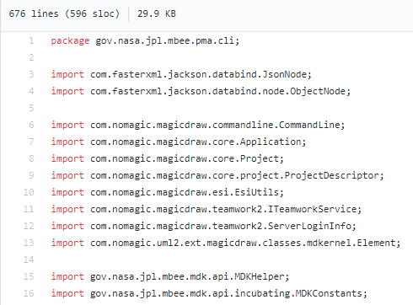
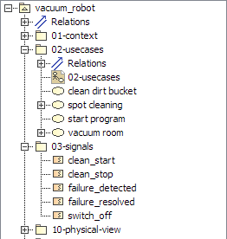
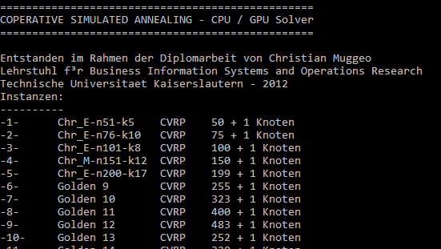
Possible content inside a baseline
Code
(SysML) Model
Simulation Model / Executable

Slide 11
Label
Comment: Christian´s test branch because of John´s reported defect
Owner: Christian
Status: In Work
Creation Date: 2017-08-30-13-03-34-CET
…
L
L
L
L
L
L
L
L
L
L
L
L
L
L
L
L
branch
merge
branch
rebase
branch
Update
branch
close
branch
basline
label

Slide 12
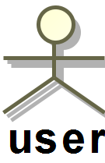
Client side
Alter elements
Access and load elements
L
Update branch / write action
Server side
L
L
L
L
L
L
L
L
L
L
L
L
L
branch
merge
branch
rebase
branch
Update
branch
close
branch
basline
label

