Slide 1
Systems Engineering Workflow Use Cases Process Change Request
John Watson
12/08/2015

Slide 2
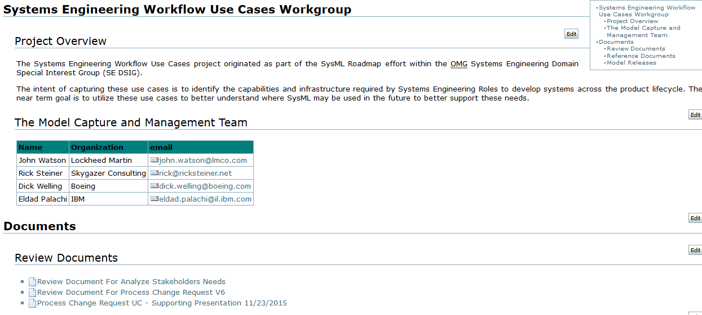
SE Workflow Use Cases
Use Case – “Process Change Request”
Used as a reference for the support of the “Hybrid SUV Change Scenario”
Review document available at the wiki:

Slide 3
Process Change Request Preconditions
A baseline exists for a release of the system
Systems are operating in the field and more are being manufactured
The next release of the system has been planned, implementation has started and has finished a detailed design review
A Change Requested is then initiated

Slide 4
Process Change Request Information Flow
Implementation Phase
Estimation Phase
Architectural Design Phase
Change Request Branch
Reject
Reject
Baseline
Baseline
Archive and Close Branch
Approved
Archive and Close Branch
Branch
Merge
Active Release CM Branch

Slide 5
Process Change Request Activities
Go to Version 7 review document

