Slide 1
Status of the Systems Engineering Concept Model (SECM)
Boston Technical Meeting
Presenter: Charles Galey

Slide 2
Summary
Domain Model
captures the core set of domain specific concepts that the language should be able to express.
Kernel Model
derives from the Domain Model the key language concepts used to describe the domain concepts.
provides a vehicle to address aspects of the existing SysML language that we want to address/keep/modify in SysML 2.0

Slide 3
Requirements of the Kernel
The Kernel will be used to define requirements on the SysML2 Language to ensure Domain concepts can be described
The Kernel must (at minimum) define the sub-set of UML used to describe the Domain concepts
As work on the Kernel matures more concepts from it may need to be added to describe the Domain

Slide 4
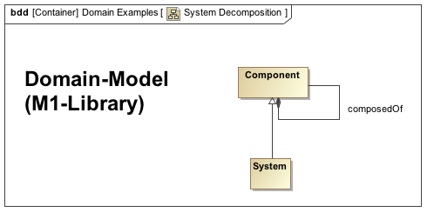
Example: System Decomposition

Slide 5
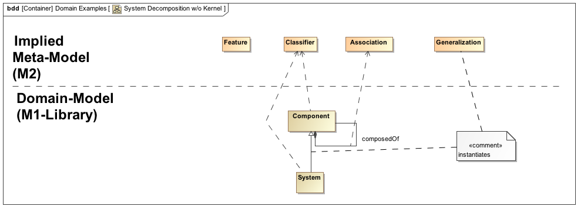
System Decomposition: Implied Meta-Concepts

Slide 6
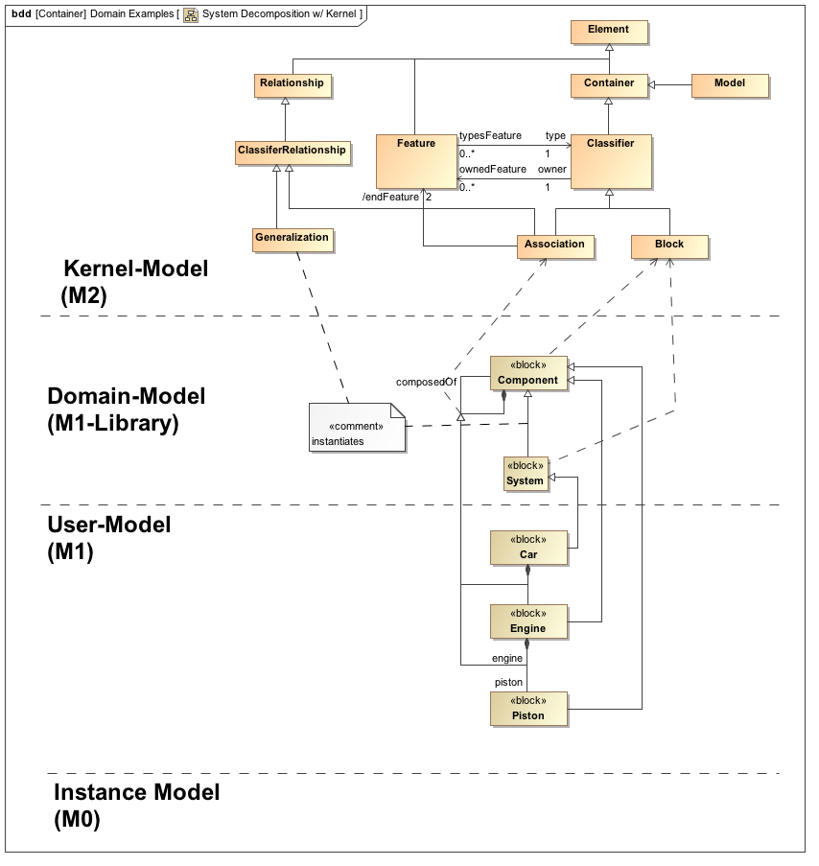
System Decomposition: Kernel Example

Slide 7
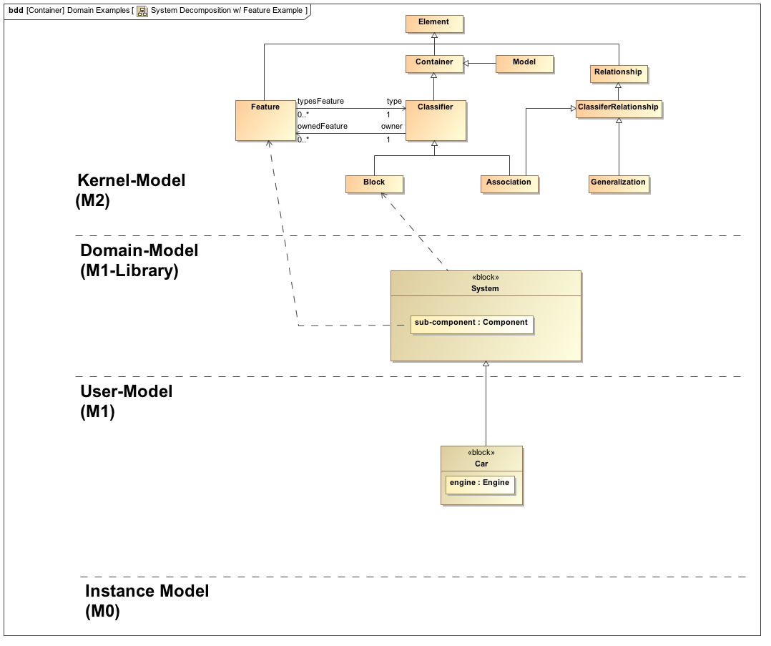
System Decomposition: Feature

