Slide 1
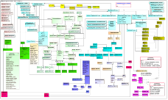
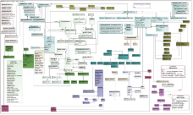
Systems Engineering Concept Model (SECM) Approach
INCOSE Systems Engineering Handbook V4
SEBoK
V 0.5 Model
ISO/
IEC/IEEE 15288:
2015
V 1.4
SECM Domain Model
SysML V1.X Spec
Joint
INCOSE/
AP233/
OMG
Data
Model *
SysML V2 RFP Model
SysML V2 Spec
UML 4SE RFP
SysML V2 Meta-model
SysML V2 RFP
Other Industry Ontologies
Service Spec
SysML V2 Services Requirements
Other OMG specs
* Also known as the Oliver Model

Slide 2
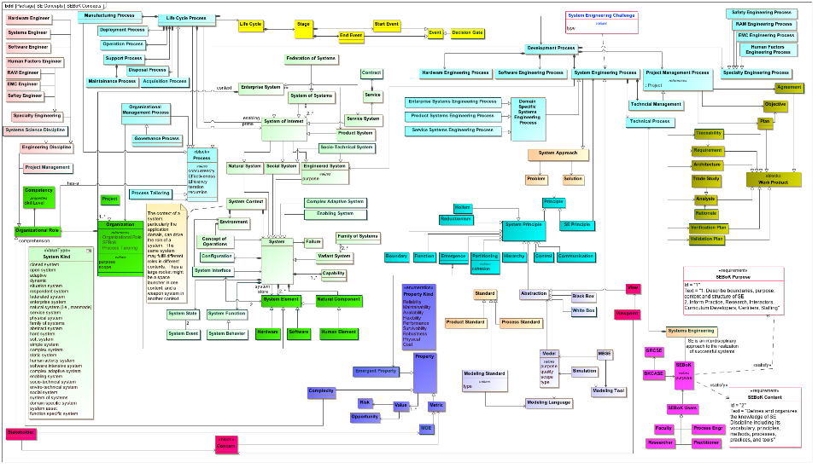
Systems Engineering Concepts (v0.5)

Slide 3
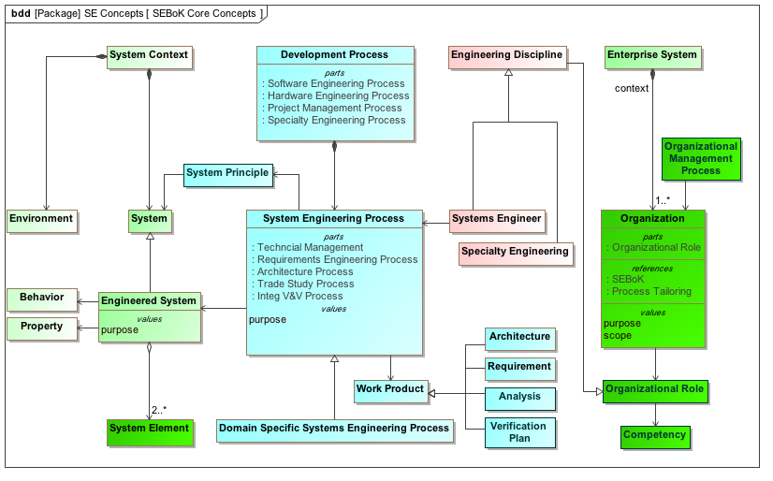
SE Core Concepts (v0.5)

