Slide 1
PLM4MBSE working group update
OMG TC Meeting – SE-DSIG / SME roadmap WG
Cambridge, MA, 24 September 2015

Slide 2
INCOSE/GfSE PLM4MBSE working group
PLM4MBSE WG
initiated Feb. 2014, chartered Aug. 2014 by GfSE (German INCOSE)
28 members and growing
Regular conference calls
3 F2F meetings so far
Charter:
Elaboration of requirements on MBSE authoring and PLM systems in support of an improved virtual interdisciplinary product development process
Identification of the current state of technology and deficiencies in the subject areas
Identification of potential demand for standardization work with respect to modeling languages, development methodologies, and interface specifications for the affected IT-Systems
Elaboration of a positions paper in collaboration with stakeholders in the subject area (OMG SE-DSIG & ManTIS, ProSTEP iViP, INCOSE MBSE WG, OSLC, …)
Achievements:
June 2015: GfSE position paper on PLM and MBSE integration issued
http://www.gfse.de/Dokumente_Mitglieder/ag_ergebnisse/PLM4MBSE/PLM4MBSE_Position_paper_V_1_0.pdf
Also available from: http://www.omgwiki.org/MBSE/doku.php?id=mbse:modelmgt
Comments & contributions to: plm4mbse@gfse.de

Slide 3
10 Theses about PLM and MBSE
MBE is the enabler for the “Internet of Things” and “Industrie 4.0”.
Future PLM systems need a holistic view on a product as a multidisciplinary system.
Early design decisions must be logically and functionally validated using system models (front-loading).
Results from MBSE must be made available over the whole product lifecycle.
MBE requires models with meaning.
The MBE tool chain must rely on technology independent standards.
Increasing complexity of products and production systems asks for new development processes, methods, and tools.
Product liability and functional safety regulations are a driving factor for MBE.
MBE requires changes in organization, methodology, technology and education
Investments in MBE can deliver a ROI of 3:1.

Slide 4
Roadmap
technical paper to discuss the MBE challenges and value propositions
Initiate project on PLM MBSE integration (SEISMIC / SEISMIK – “Systems Engineering Integration Solution using Model Integration Concepts”)

Slide 5
Role of System Model through Product Lifecycle
Increasing
PLM support
Req.
„SysML“
PLM System Model
Top-Down
Model Creation
„configure“
reference
System Development
System Integration
Bottom-Up
Systems
"Re-Engineering
MCAD
Final Spec
ECAD
Software
etc.

Slide 6
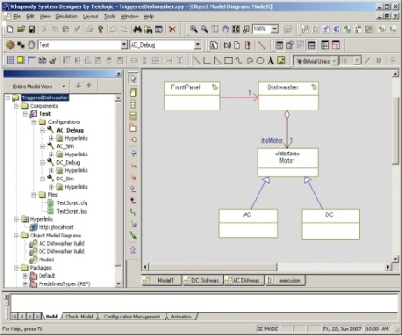
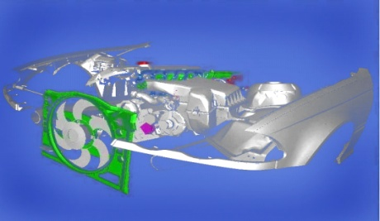
SEISMIK MBSE framework V2.0
AUTHORING
INTEGRATION,
VERIFICATION
EVALUATION,
VALIDATION
Systems Modeling
Composition
Behavior
Requirements,
Constraints, …
Functional / System Mock-Up
DMU
Contextual, semantic
mapping
Simulation
…
Systems Modeling derived PLM structure
Model Elements (Requirements, Parts, SW-modules, Functions, …)
Trace-Links between model elements
Model Checking
Search, Navigation, …
Cost estim.
Functional models
CAD
E/E Models
Embedded Software
…
contextual, semantic
mapping
Standardized PLM System Model (SpecIF)
Model
Repository
/ Library
Traditional PDM
Traditional SDM
PLM-X
Source: ModelAlchemy,
ISYPROM project
Notes:
Authoring tools retain their native format
Derived, standards-based formats for Mock-Ups
Common metamodel for the derived data

Slide 7
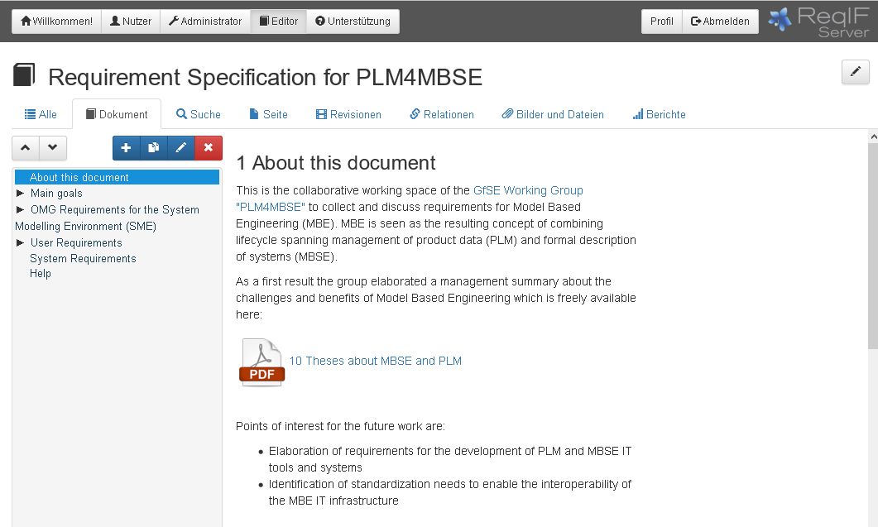
PLM4MBSE Requirements capturing using ReqIF
Public access:
https://se.reqif.net/apps/reader.html

Slide 8
ManTIS Cambridge meeting outcome
4 PLM, 1 SysML tool vendor attended to show their concepts to support interated systems modeling:
Dassault, PTC, Siemens PLM, ARAS PLM
NoMagic
Agreed to not agree
Need for further discussion in preparation of an RFI / RFP on the PLM-MBSE integration subject
Schedule conference call end October
Continue in La Jolla/San Diego Dec. 15

Slide 9
Thank you!
Questions?

