Slide 2
MBSE and the Business of Engineering
Pawel Chadzynski Sr. Director, Product Management, Aras
Michael Pfenning PLM Consultant, XPLM
No Magic World Symposium, Allen, May 2016

Slide 3
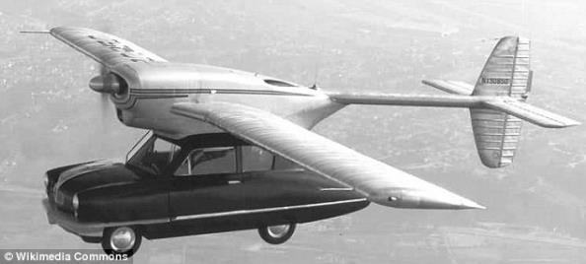
Product complexity is increasing And creating system design challenges
Product
Complexity
Connected
Systems of Systems
Software
Product as
a System
Electronic
3D Mechanical
Product as a Service
Electrical
2D Mechanical
Smart Connected Products
Smart Products
Early Products
Time

Slide 4
Product vs. Behavior
Are these cars products with lots of parts?
Or is it a system with behavior working with lots of other systems with behaviors?
Is plane a product with lots of parts?
Or is it a system with behavior working with lots of other systems with behavior?

Slide 5
Product vs. Behavior
Are these cars products with lots of parts?
Or is it a system with behavior working with lots of other systems with behaviors?
Is plane a product with lots of parts?
Or is it a system with behavior working with lots of other systems with behavior?
Forces new organizational thinking

Slide 6
V-Process supports Systems Engineering
Behavior appears after integration!!!
Needs
System
Needs
System
System validation
System validation
Requirements
Requirements
System
architecting
System
integration
System
architecting
System
integration
Sub-system
design
Sub-system
integration
Sub-system
design
Sub-system
integration
Component
design
Component
test
Component
design
Component
test
M
E
S
S
E
M
Process, manufacture, assembly
Process, manufacture, assembly
In theory
In reality

Slide 7
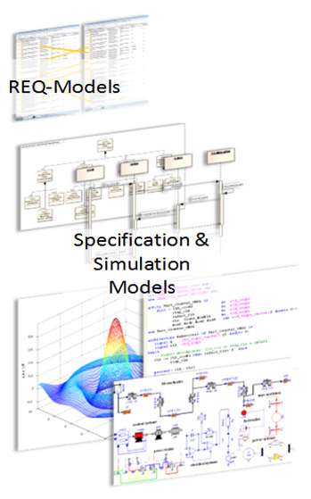
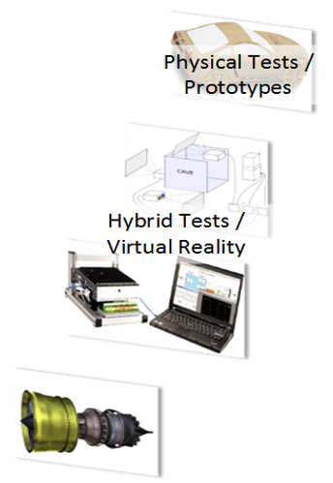
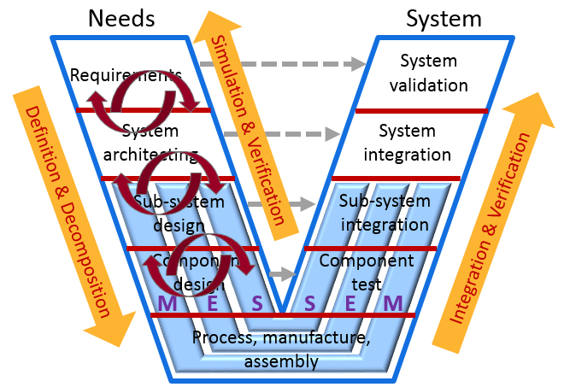
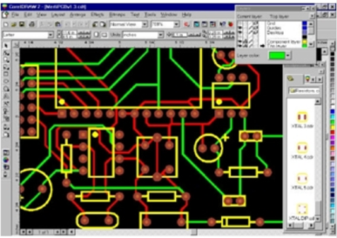
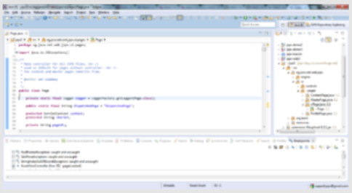
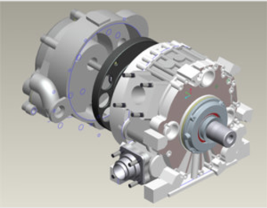
MBSE spans many tools & data models
Behavior part of every design step
Domain specific designs

Slide 8
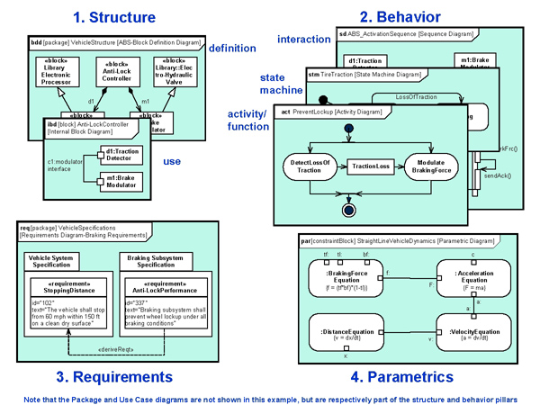
MBSE is not MBD or 3D Mockup
MBSE – Model-Based Systems Engineering
MBD – Model Based Drawing/Design
1. Structure
2. Behavior
3. Requirements
4. Parametrics
All eliminate paper documents/drawings but only MBSE captures system behavior

Slide 9
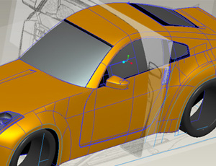
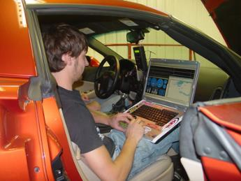
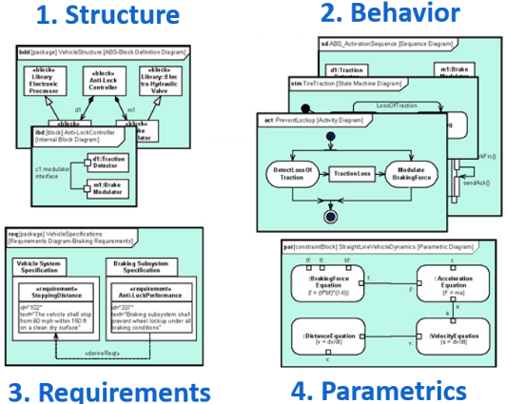
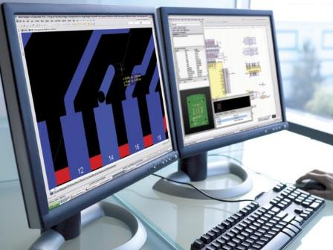
Connecting System models to Design domains in PLM
Testing
OK, but how
MCAD
?
ALM
Manufacture
ECAD

Slide 10
Cross-domain link challenge
MCAD – deep IP in PLM
MCAD file = PLM Part/Assembly (BOM)
MCAD files mapped to PLM Parts
Electronic/Electrical – no IP in PLM
Schematic block?
Interconnect/layout blocks?
Software – no IP in PLM
IDE files ≠ PLM Part/Assembly (BOM)
Build process? Released binary?
System model – TBD in PLM
Requirements?
Block diagrams (functional & logical)?
Models as input, Reports as outputs?
Behavioral complexity is here
Parts and part structures are already live in PLM
It will take more finesse than this!
PLM does not understand ECAD structures (manufacturing files and off-shelf BOM is not a structure)
PLM does not understand software structures (binary file is not a structure)
PLM does not understand or manage RFL at all

Slide 11
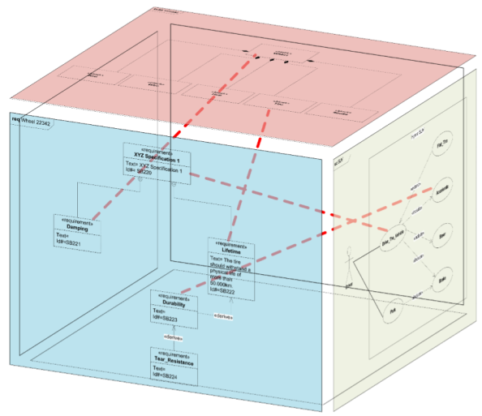
MBSE and PDM
Model Rev 1
Model Rev 2
Model Rev 3

Slide 12
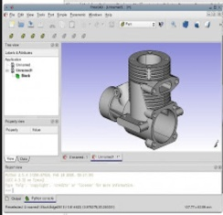
MBSE and PLM – today’s target
Mechanical
System Rev 1
System Rev 2
System Rev 3

Slide 13
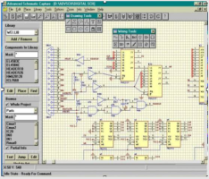
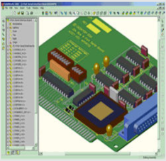
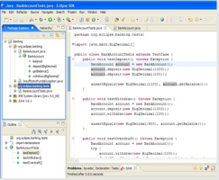
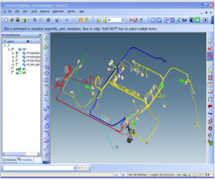
MBSE and PLM – real target
Electronic
Software
Mechanical
Harness
System Rev 1
System Rev 2
System Rev 3

Slide 14
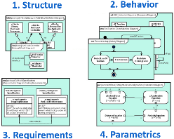
MBSE-PLM use cases
The goal is a full traceability between requirements, models, and product details
Top/Down – System model first, then detailed Product design
Design everywhere at once – System model is collaborated with on-the-fly
Redesign – Field driven requirements changed
1
1
2
2
3
3

Slide 15
PLM Connectors today
As Designed
A
B
C
Software ALM
D
E
F
No system context, only domain specific BOM structures
G
H
I
Connectors
J
Mechanical CAD
K
L
M
O
Q
R
Electronic CAD
S

Slide 16
That’s why MBSE needs PLM
PLM manages post design evolution of physical structures - with strong configuration and change management control across life stages
As Designed
As Ordered
As Planned
As Built
As Delivered
As Serviced
A
A
A
A
SN #6
A
SN #6
A
SN #6
B
B
P1
C
C
C
C
C
C
D
D
D
D
D
D
F
SN #89
F
SN #89
F
SN #97
E
F
F
P2
G
G
G
G
G
F
T
T
T
H
I
H
I
G
J
J
J
J
J
T
K
K
K
K
K
J
L
L
L
L
M
L
K
O
SN #44
O
SN #44
O
SN #44
O
O
L
I
H
H
Q
Q
O
Q
SN #53
Q
SN #71
Q
SN #71
“As Designed” is not a true Digital Twin of the “thing” in the field
R
R
H
I
R
R
R
S
S
Q
S
S
S
R
S

Slide 17
Add System Model structures in PLM
Required
Functional
Logical
As Designed
As Ordered
As Planned
As Built
As Delivered
As Serviced
R1
L1
A
A
A
A
A
SN #6
A
SN #6
A
F1
SN #6
R2
F2
L2
B
B
P1
C
C
C
R3
F3
L3
C
C
C
D
D
D
R4
L4
D
D
D
F
SN #89
F
SN #89
F
F4
SN #97
R5
F5
L5
E
F
F
P2
G
G
G
R6
F6
L6
G
G
F
T
T
T
SysML tool connector
R7
F7
L7
H
I
H
I
G
J
J
J
R8
F8
L8
J
J
T
K
K
K
R9
F9
L9
K
K
J
L
L
L
R10
F10
L10
L
M
L
K
O
SN #44
O
SN #44
O
SN #44
R11
F11
L11
O
O
L
I
H
H
R12
F12
Q
Q
O
Q
SN #53
Q
SN #71
Q
SN #71
R13
F13
R
R
H
I
R
R
R
R14
F14
S
S
Q
S
S
S
F15
R
F16
S
Required Functional Logical

Slide 18
Traceability gap
Required
Functional
Logical
As Designed
As Ordered
As Planned
As Built
As Delivered
As Serviced
R1
L1
A
A
A
A
A
SN #6
A
SN #6
A
F1
SN #6
R2
F2
L2
B
B
P1
C
C
C
R3
F3
L3
C
C
C
D
D
D
R4
L4
D
D
D
F
SN #89
F
SN #89
F
F4
SN #97
R5
F5
L5
E
F
F
P2
G
G
G
R6
F6
L6
G
G
F
T
T
T
R7
F7
L7
H
I
H
I
G
J
J
J
Concept/Link Barrier
R8
F8
L8
J
J
T
K
K
K
R9
F9
L9
K
K
J
L
L
L
R10
F10
L10
L
M
L
K
O
SN #44
O
SN #44
O
SN #44
R11
F11
L11
O
O
L
I
H
H
R12
F12
Q
Q
O
Q
SN #53
Q
SN #71
Q
SN #71
R13
F13
R
R
H
I
R
R
R
R14
F14
S
S
Q
S
S
S
F15
R
F16
Logical <> As Designed
S

Slide 19
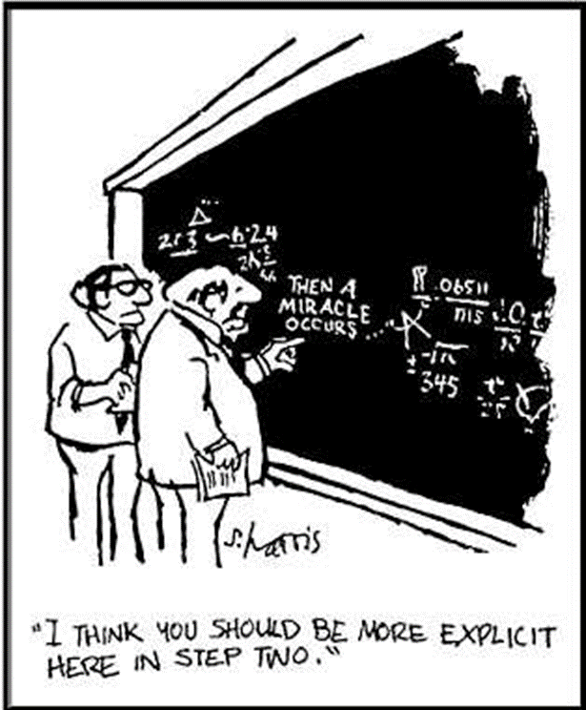
Traceability gap
Required
Functional
Logical
As Designed
As Ordered
As Planned
As Built
As Delivered
As Serviced
R1
L1
A
A
A
A
A
SN #6
A
SN #6
A
F1
SN #6
R2
F2
L2
B
B
P1
C
C
C
R3
F3
L3
C
C
C
D
D
D
R4
L4
D
D
D
F
SN #89
F
SN #89
F
F4
SN #97
R5
F5
L5
E
F
F
P2
G
G
G
R6
F6
L6
G
G
F
T
T
T
R7
F7
L7
H
I
H
I
G
J
J
J
Concept/Link Barrier
R8
F8
L8
J
J
T
K
K
K
R9
F9
L9
K
K
J
L
L
L
R10
F10
L10
L
M
L
K
O
SN #44
O
SN #44
O
SN #44
R11
F11
L11
O
O
L
I
H
H
R12
F12
Q
Q
O
Q
SN #53
Q
SN #71
Q
SN #71
R13
F13
R
R
H
I
R
R
R
R14
F14
S
S
Q
S
S
S
F15
R
F16
Logical <> As Designed
S

Slide 20
Add SysML Requirement & Logical structures
Software ALM
SE Requirements
SE
Logical
System Model
Mechanical CAD
Created by connector
Electronic CAD

Slide 21
Add Requirements decomposition
ALM Requirements
Software ALM
MCAD Requirements
SE Requirements
SE
Logical
Referenced automatically
or manually via connectors
System Model
Mechanical CAD
ECAD Requirements
Each domain has its own requirements breakdown
Electronic CAD

Slide 22
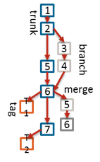
Add Logical to Physical
ALM Requirements
ALM
Structure
Not really “physical”
Software ALM
MCAD Requirements
MCAD
Structure
SE Requirements
SE
Logical
System Model
Mechanical CAD
ECAD Requirements
ECAD
Structure
Linked by connectors or manually within PLM
(a diagram-like visual drag/drop process?)
Electronic CAD

Slide 23
Add multiple models
ALM Requirements
ALM
Structure
SE Requirements
SE
Logical
Software ALM
System Model_1
MCAD Requirements
MCAD
Structure
Multiplicity of SE models as part of the same PLM structure
Mechanical CAD
SE Requirements
SE
Logical
ECAD Requirements
ECAD
Structure
System Model_n
Electronic CAD

Slide 24
Add “System” properties (data/control flow)
ALM Requirements
ALM
Structure
SE Requirements
SE
Logical
Software ALM
System Model_1
MCAD Requirements
MCAD
Structure
Mechanical CAD
Created/linked by connectors or manually within PLM (a diagram-like visual drag/drop process?)
SE Requirements
SE
Logical
ECAD Requirements
ECAD
Structure
System Model_n
Electronic CAD

Slide 25
Properties are cross-domain negotiable “Contracts”
Linked between any two structural items
Value, range, enumerated list
Units
Fixed or a target (a budget)
A domain owner
On a structural item or accumulative for an assembly
Transformation function on a property link
Created/linked by connectors or manually (a diagram-like visual drag/drop process within PLM?)
Makes Requirements quantifiable and PLM SE structures behavioral
Item A
Item B
f(x) = y
Property x
Property y
f(y) = x

Slide 26
Add simulation data
ALM Requirements
ALM
Structure
Simulation data
SE Requirements
SE
Logical
Software ALM
System Model_1
Simulation data
MCAD Requirements
MCAD
Structure
Simulation data
Mechanical CAD
SE Requirements
SE
Logical
ECAD Requirements
ECAD
Structure
System Model_n
Simulation data
Electronic CAD
Simulation data

Slide 27
Add Logical to Logical
ALM
Logical
ALM
Structure
SE Requirements
SE
Logical
Software ALM
System Model_1
MCAD
Logical
Connectors extract Logical block abstractions per domain
MCAD
Structure
Mechanical CAD
SE Requirements
SE
Logical
ECAD
Logical
ECAD
Structure
System Model_n
Electronic CAD

Slide 28
Enable Negotiations
ALM
Logical
ALM
Structure
SE Requirements
SE
Logical
Software ALM
System Model_1
MCAD
Logical
MCAD
Structure
Space to negotiate “Contracts” on a Logical block level
Mechanical CAD
SE Requirements
SE
Logical
ECAD
Logical
ECAD
Structure
System Model_n
Electronic CAD

Slide 29
Result: Complex & Overwhelming
ALM
Logical
ALM
Structure
SE Requirements
SE
Logical
Software ALM
MCAD/ECAD Physical structures
… linked with …
Logical structures
Requirement decomposition
ALM/Software structures
Multiple SysML models
Simulation data
Control/Data Flows
… plus …
MPP, QP, V&V, Docs, etc.
System Model_1
MCAD
Logical
MCAD
Structure
Mechanical CAD
SE Requirements
SE
Logical
ECAD
Logical
ECAD
Structure
System Model_n
Electronic CAD

Slide 30
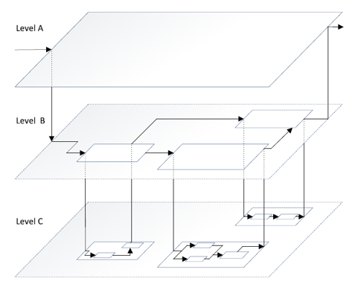
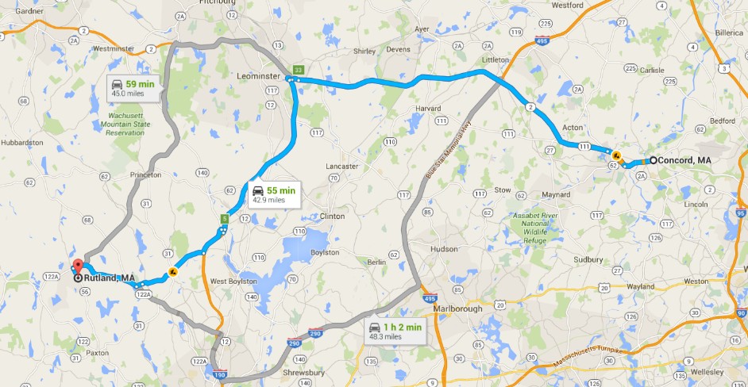
Make PLM “invisible”
ALM
Logical
ALM
Structure
SYS
SE Requirements
SE
Logical
Software ALM
System Model_1
MCAD
Logical
MCAD
Structure
Mechanical CAD
Connectors
Connectors
SE Requirements
SE
Logical
Reinvent PLM driven Traceability & Navigation
ECAD
Logical
ECAD
Structure
System Model_n
SYSmap
Electronic CAD

Slide 31
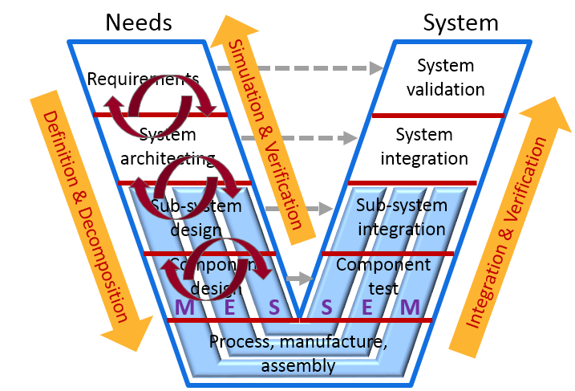
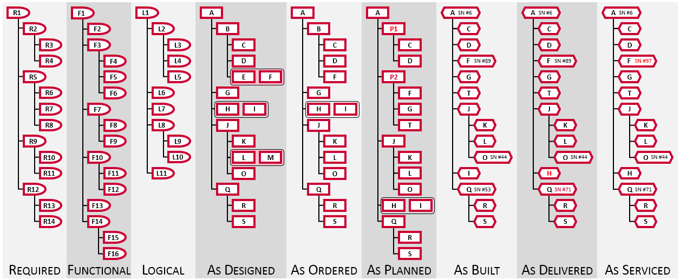
Business of Engineering
Continuous System & Product design process
PLM
Digital Twin & Digital Thread configuration management

Slide 32
Partnering with
TU Kaiserslautern: Proof of Concept (MagicDraw)
Airbus/IBM/Aras: OSLC-based ALM/PLM integration
XPLM/No Magic: MagicDraw integration
Aras/Altium: Bringing ECAD into MBSE

Slide 33
Acknowledgements
Airbus
IBM
Dr. Eigner, TU Kaiserslautern
Dr. Zhang, AVIC
Altium
No Magic
ProSTEP
INCOSE
OMG
OASIS
XPLM

