Slide 1
Systems Engineering Concept Model (SECM) Update
Status 08 Dec 2016
John Watson

Slide 2
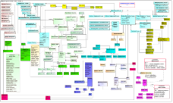
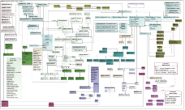
Systems Engineering Concept Model (SECM) Approach
INCOSE Systems Engineering Handbook V4
ISO/
IEC/IEEE 15288:
2015
V 1.5
SECM – 2015 Industry Reference
SysML V2 Service Requirements
Other
OMG
Specs
Other Industry Ontologies
SECM - SysML V2 RFP
SysML V2 Spec
Meta-model
Profile
Libraries
Concrete Syntax
SysML V2 RFP
SECM – 2003 Industry
Reference
*
Standardized API
Reference Model
UML 4SE RFP
SysML V1.X Spec
User Interface
Guidelines
* Joint INCOSE/AP233/OMG, Led by Dave Oliver

Slide 3
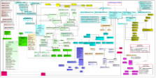
“SECM – SysML V2 RFP” Approach
SECM – 2015 Industry Reference
Topic Expert Core
Team
SE Needs Concept Model
Related Papers
Produce “SE Needs”
Refine with Industry Experts
Requirements & Concepts
Example Models
Other Industry Ontologies
SE Needs Document
SECM - SysML V2 RFP
UML 4SE RFP
Notes:
Same as a typical SE Process, Needs analysis followed by requirements to drive the solution

Slide 4
Topic Core Teams
Properties and Expression Concepts Modeling Core Team
SE Needs Artifacts Available on Wiki
Core Team Launched January 2016
Their status will be provided today by Hans Peter de Koning
Interface Concepts Modeling Core Team
SE Needs Artifacts Available on Wiki
Core Team Launched May 2016
Their status will be provided today by Marc Sarrel
Requirements and Verification Concepts Modeling Core Team
SE Needs Artifacts Available on Wiki
Core Team Launched September 2016
Their status will be provided today by John Watson
Structure/Behavior Concepts Modeling Core Team
Core Team Launched October 2016
The Structure status will be provided today by Hans Peter de Koning
Variant Concept Modeling Core Team
Core Team Launched November 2016

Slide 5
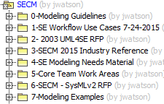
SECM Model High Level Content
Notes:
Uses Magic Draw using a Teamwork Server provided my No Magic

Slide 6
SysML v2 RFP Model Status
Just Getting Started
Published the Glossary
SysML v2 Glossary 07 Dec 2016
Captured First set of Requirements
API Requirements 07 Dec 2016
Focus Team’s Integration Guidance
Use SysML
Submit Concept Model with defined Concept Terms
Submit Requirements with attributes assigned
Define any other Requirements Terms
Use existing Glossary Terms

Slide 7
Questions?

Slide 8
Backup

Slide 9
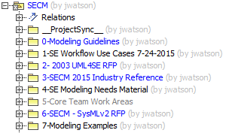
SECM Model High Level Content

