Slide 1
MBSE / SysML adoption issues
OMG TC Meeting – SysML Roadmap WG
2014-06-17, Boston, MA, USA

Slide 2
Outline
Assessment method
Summary of what was done
Conclusion and future assessment effort
Key Findings (list below is for every finding)
Area of improvement
What evaluation criteria are most impacted
What category of action would address this area of improvement (spec change, tool improvement, process change, other)
Priority (per discussion)

Slide 3
Assessment method
Review of existing sources
Determination of Categories of issues
Struggle between MBSE and SysML
Priorisation (future task)
SysML for
MBSE
MBSE
SysML
Notes:
MBSE does not necessarily imply SysML, but SysML is a good means.
OTOH, there is an impact on SysML doing MBSE – what makes SysML being the best choice for doing MBSE?

Slide 4
What has been done
Review of existing sources for SysML adoption issues

Slide 5
Review of existing sources
2009 SysML RFI
RFI Report
RFI Summary presentation
Original responses, as available
INCOSE MBSE Survey from 2012
SE DSIG discussions
Mostly 2013-2014
Other resources and publications:
GfSE (German chapter of INCOSE) Workshop on SE – PLM integration (Feb. 2014)
INCOSE MBSE Workshops 2013, 2014
Recent papers about SysML
Ferrari, Fantechi et al: Adoption of SysML by a Railway Signaling Manufacturer
Graves, Bijan: Using formal methods with SysML in aerospace design and engineering
Piques, Andrianarison: SysML for embedded automotive Systems: lessons learned
…

Slide 6
2009 RFI Report – most relevant questions
Question 4: Value of diagram types and associated modeling concepts
Question 5: Issues regarding diagram types and associated modeling concepts?
Question 6: What part(s) of SysML were hardest for your stakeholders to understand?
Question 8: SysML language effectiveness – open ended responses
Question 9: SysML - Precision
Question 10: SysML - Ease of use
Question 11: SysML - Integration
Question 12: SysML - Tool implementation complexity
Question 13: Other measures you would use to assess the effectiveness of SysML
Question 14: What additional capabilities or features are desired of the language?
Question 16: Identify SysML specification changes you recommend and why?
Question 18: Most critical changes to enhance adoption of SysML and MBSE?
Question 39: What were your primary tool issues, if any?
Question 54: What were the primary training issues?
Question 55: What level of benefit did MBSE bring to your project?
Question 56: How were modeling results perceived by the project stakeholders?

Slide 7
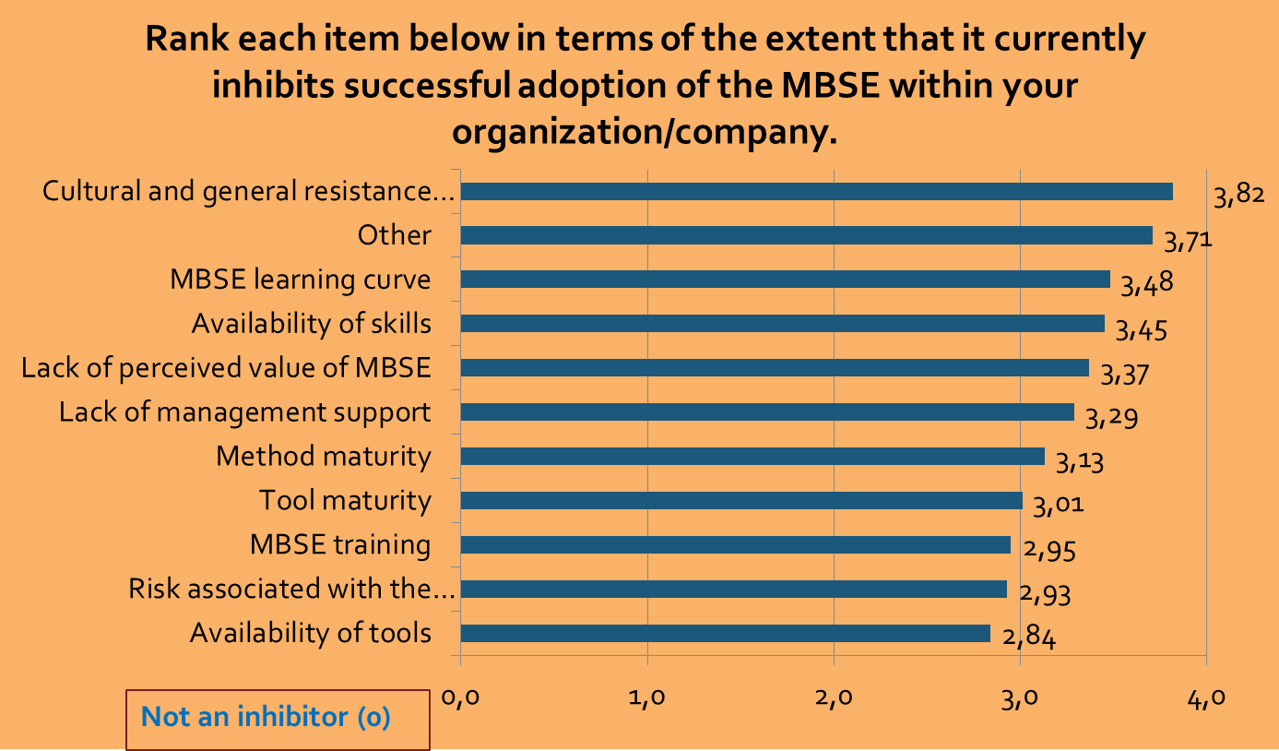
MBSE Survey 2012: Question 9
Source: http://www.omgwiki.org/MBSE/doku.php?id=mbse:incose_mbse_is_2012

Slide 8
SE-DSIG MBSE Adoptions issues
Source: SysML Assessment & Roadmap Approach / SE DSIG
More focus on mechanical engineering
Provide more examples/guidance
Availability of libraries of reusable models
Availability of patterns
Language stability
Increased analysis capabilities
A clear value assessment from using SysML
Model consistency
Domain specific icons
Support for continuum of models that support early concepts and more detailed formal models
Agility of modeling
Dynamic (i.e. simulation) and static analysis capabilities
Capture of trade studies
Reduce the number of ways things can be modeled. This is a source of confusion to modelers
Ability to represent model in textual form
Better handling of large number of requirements
FMEA capabilities
Consider industries which are not highly regulated
Consider how to model humans
Make the model invisible (transparent) to support other discipline engineers
MDA for SysML

Slide 9
Difficulties
Huge amount of resources
Undocumented redundancy of aggregated information
Lost context in RFI report and the SysML assessment summary
At least keep track from answers to originator
Finding a structure to present the adoption issues
Classification
Illustrate interrelations between issues
Are we talking about MBSE or SysML adoption issues?
Comprehension of some highly aggregated adoption issues (e.g. “MDA for SysML”)

Slide 10
Categorisation / Classification
Finding categories of adoption issues

Slide 11
Alternative ways of categorization
Issue may belong to different categories, so categorization may be more adequate than classification
RFP evaluation criteria
Distinguish between Language- and Implementation issues
MBSE - SysML
Fine granular categorization:
Language
Integration
Deployment / Implementation
Methodology, Process, Organization related issues

Slide 12
Adoption issues categorization
Two major directions:
Impacts on language spec
Impacts on implementation
Categorization necessary at all?
Language issues
Constructs (e.g. mech. eng.)
Extensibility
Domain adaptability
…
Integration issues
Integration with other modeling languages
Model exchange, model management, PLM
Integration with „solvers“
…
Deployment / Implementation issues
Tool issues
Model libraries, standard parts
Reusability of models
…
Methodology, Process, Organization related issues
Modeling guidelines, procedural models (e.g. OOSEM, SYSMOD)
How MBSE changes the enterprise product development processes
Transition process from „traditional“ SE to MBSE
Stakeholder issues (e.g. management support)
…

Slide 13
Action categories
SysMLx – any upcoming version of SysML
MBSE – any general requirement for an MBSE environment, not necessarily connected to SysML
Tool - implementation of SysML and/or MBSE, including tool integration, development process definition, adaptation of organizational structures
Other – everything else
SysML1.y – anything the RTF can resolve???

Slide 14
Evaluation Criteria
Ease of Use
Unambiguity
Preciseness
Completeness
Scalability
Adaptability to Domains
Evolvability
Model Interchange
Diagram Interchange
Independency from Methodology, Process
Compliance with UML metamodel
Verifyability

Slide 15
Conclusion
Conclusion and future assessment effort

Slide 16
Conclusion and future assessment effort
Need significant more time
More input awaited from end-users
Not completed the review of the following resources:
RFI report regarding language constructs (Q5-Q12)
RFI report open ended responses
Very few or no information about the following (potential) adoption issues:
Availability of a MBSE development methodology (OOSEM, SYSMOD, etc.)
Diagram interchange (2 occurrences in the RFI report)
Future:
Solicit contributors
Create more detailed action items to feed the roadmap

Slide 17
Key Findings part 1
Language specific issues

Slide 18
Key Finding – time models
Area of improvement | Evaluation criteria impacted | Category of action | Priority
Representation of continuous time models (dynamic) and concurrency | Completeness | SysMLx

Slide 19
Key Finding – learning curve
Area of improvement | Evaluation criteria impacted | Category of action | Priority
SysML needs steep learning curve Difficult to learn for non-software engineers | Ease of Use, Adaptability | SysMLx

Slide 20
Key Finding – support for domain modeling
Area of improvement | Evaluation criteria impacted | Category of action | Priority
More focus on mechanical engineering Domain specific icons Consider industries which are not highly regulated ?? FMEA capabilities | Ease of Use, Adaptability | SysMLx

Slide 21
Key Finding – diagram and constructs issues
Area of improvement | Evaluation criteria impacted | Category of action | Priority
Any issues related to SysML diagrams, modeling constructs as queried in RFI Q5 |  | SysMLx
NOT YET COMPLETED

Slide 22
Key Findings part 2
Integration specific issues

Slide 23
Key Finding – model integration
Area of improvement | Evaluation criteria impacted | Category of action | Priority
Integration of SysML models with other models (RFI report conclusion was: need further research to understand the issue) | Integration | SysMLx

Slide 24
Key Finding – requirement mgmt. interface
Area of improvement | Evaluation criteria impacted | Category of action | Priority
Lack of formal coupling to requirements related tools Better handling of large number of requirements | Integration | SysMLx, MBSE, Tool

Slide 25
Key Finding – modeling collaboration
Area of improvement | Evaluation criteria impacted | Category of action | Priority
Encapsulation of SysML models to be reused as templates Availability of patterns and libraries of reusable models (also relates to model exchange, model libraries etc.) | Integration, Ease of Use | SysMLx, MBSE, Tool

Slide 26
Key Finding – concept for model assemblies
Area of improvement | Evaluation criteria impacted | Category of action | Priority
Elaboration of a concept for model assemblies and reusability of models (cf e.g. 3D CAD models) (also relates to modeling collaboration) | Integration | SysMLx, MBSE, Tool

Slide 27
Key Finding – relation persistency
Area of improvement | Evaluation criteria impacted | Category of action | Priority
Persistency of relations and associations between models and components over system borders | Integration | SysMLx, MBSE, Tool

Slide 28
Key Findings part 3
Implementation and deployment specific issues

Slide 29
Key Finding – model consistency, language stability
Area of improvement | Evaluation criteria impacted | Category of action | Priority
Model consistency, language stability (from: MBSE assessment) | Unambiguity, Preciseness, Completeness, Compliance with UML metamodel | SysMLx

Slide 30
Key Finding – provision of examples, patterns
Area of improvement | Evaluation criteria impacted | Category of action | Priority
Provide more examples/guidance | Ease of Use, Adaptability to domains | SysML1.y, SysMLx, MBSE, Tool

Slide 31
Key Finding – analysis and simulation capabilities
Area of improvement | Evaluation criteria impacted | Category of action | Priority
Increased analysis capabilities Dynamic (i.e. simulation) and static analysis capabilities | Integration, Completeness | SysMLx, MBSE, Tool

Slide 32
Key Findings part 4
Methodology, Process, Organization specific issues

Slide 33
Key Finding - culture
Area of improvement | Evaluation criteria impacted | Category of action | Priority
Culture and general resistance to change Lack of management support Lack of perceived value of MBSE … see: MBSE 2012 survey, Q9 | Adaptability to Domains, Ease of Use? | MBSE, Tool

Slide 34
Key Finding – integration into product development
Area of improvement | Evaluation criteria impacted | Category of action | Priority
Lack of integration of MBSE in the overall enterprise product development process (PDM/PLM) | Adaptability to Domains, Ease of Use? | MBSE, Tool

Slide 35
Key Finding – MBSE value assessment
Area of improvement | Evaluation criteria impacted | Category of action | Priority
A clear value assessment from using SysML | ? | SysMLx, MBSE, Tool

Slide 36
Key Finding – Certification in an MBSE environment
Area of improvement | Evaluation criteria impacted | Category of action | Priority
MBSE only useful if the full chain including certification of a product is model-based | ? | MBSE, Tool

Slide 37
Questions?

