Slide 1
Systems Engineering Workflow Use Cases Activity SysML Roadmap Activity
John Watson
5/5/2015 Status

Slide 2
Contents
Overview of the Project and Status
Quick Look Through Model
Example Review Document View

Slide 3
Foundational Material
INCOSE‐TP‐2003‐002‐03.2.2, INCOSE Systems Engineering Handbook v. 3.2.2, October 2011
Pyster, A. and D.H. Olwell (eds). 2013. The Guide to the Systems Engineering Body of Knowledge (SEBoK), v. 1.2. Hoboken, NJ: The Trustees of the Stevens Institute of Technology. Accessed DATE. www.sebokwiki.org/
International Standard – ISO/IEC 15288 and IEEE 15288 – 2008, Second Edition 2008-02-01, Systems and software engineering - System life cycle processes

Slide 4
Basic Approach for SysML Roadmap
In a SysML model
Define the System Context
Identify the set of Workflow Use Cases
Capture what System Engineers Do
Initial pass based on Foundational Material
Produce a Review Document for each Use Case
Solicit Experts to refine and improve
Iterate as required
Derive SysML Needs Requirements from results
Under Construction

Slide 5
Team Members
Model Capture
John Watson (Lockheed Martin)
Rick Steiner (Skygazer Consulting)
Dick Welling (Boeing)
Eldad Palachi (IBM)

Slide 6
Workflow Use Cases organized by Life Cycle Phases
Total 31 Use Cases Identified
Organization by Lifecycle Stages (like references)
Exploratory/Concept Stage
System Development Stage
Management Use Cases
SE Domain Use Cases
Validation and Verification Use Cases
Production Stage
Product and Service Life Management
Utilization Stage
Support Stage
Retirement Stage

Slide 7
Higher Priority Use Cases
Analyze Stakeholders Needs
Derive System Requirements
Derive Product Architecture
Evaluate System Safety
Collaborate with Implementation Domain Team

Slide 8
Integration with other Roadmap Efforts
Key Capabilities (Sandy’s & Roger’s INCOSE Paper)
Model Construction
Model Visualization
Model Analysis
Model Management
Model Exchange and Integration
Support for MBSE Collaboration and Workflow
SE Concept Model - Domain

Slide 9
Quick Look through model

Slide 10
Model Content
Model Walkthrough Section
Model Walkthrough Jump Diagram
Note and Issues Table
Model Views Table
SysML IOI Table
Modeling Practices and Guidelines
Systems Engineering Operations Section
Structure – SE Development System
Behavior – SE Use Cases
Generated Review Documents
Information Model Section

Slide 11
Example review document

Slide 12
Backup Slides

Slide 13
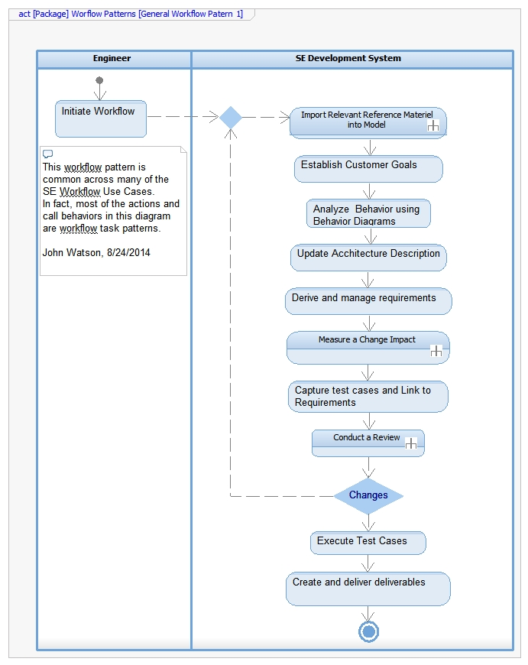
Workflow and Task Patterns
Workflow Pattern 1
Significance of Patterns
They become a reference for creating other workflows
They help identify repeatable, common steps
They becomes a focus for language and tool development
Workflow Pattern 1
This pattern is common across many SE Workflow Use cases
Most actions are Workflow Task Patterns
Task Patterns →
*
*
*
*

Slide 14
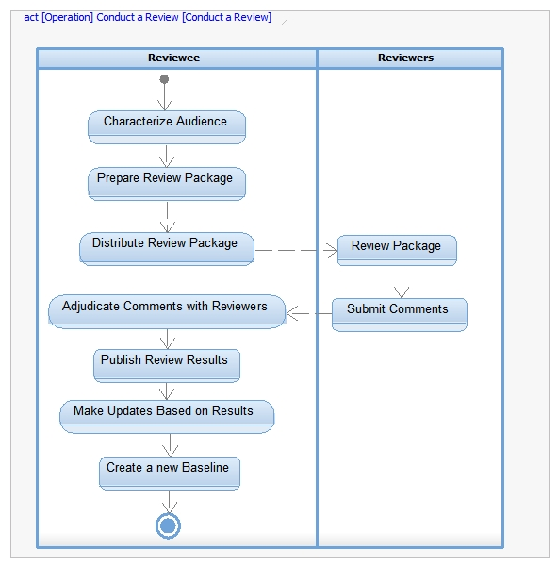
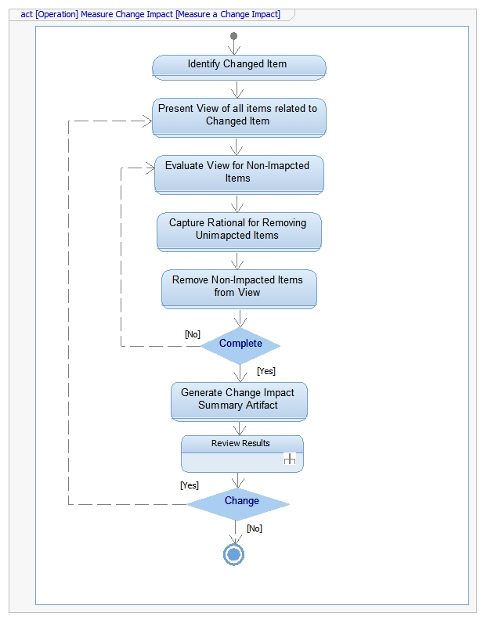
Example Task Patterns
Review Pattern
Change Impact Pattern

Slide 15
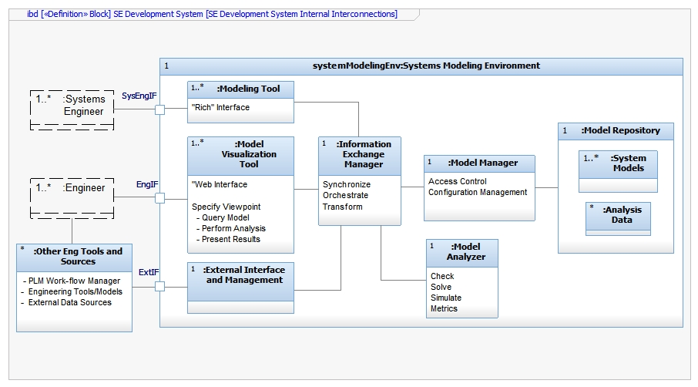
Ibd[Block]SE Development System[SEDS Internal Connections]

