Slide 1
SysML 2.0 Interface Concepts Modeling Core Team Status Update
Marc Sarrel, Jet Propulsion Laboratory, California Institute of Technology
Steve Hetfield, BAE Systems, Inc.
Chas Galey, No Magic, Inc.
2016-09-15
© 2016 California Institute of Technology. Government sponsorship acknowledged.

Slide 2
Introduction

Slide 3
Objectives
Improve Interface Modeling efficiency with more mature constructs and automation
Improve Interface Modeling consistency across domains with standard based rules
Clarify, define tool implementation concepts for modeling Interfaces

Slide 4
Approach
Review Interface Needs Document
Demonstrate current limitations with notes and issues
Add Interface concepts to SECM concept model
Derive requirements to address notes and issues
Leverage other services where possible to meet requirements
Define user-level languages to accomplish goals (transformation, simplification, query)
Illustrate concepts with example from HSUV Change Scenario
Ensure all kinds of interfaces are addressed: Electrical, Hydraulic, Pneumatic, Mechanical, Software, Human, etc.

Slide 5
Interface Concept Model

Slide 6
Needs Document Quick Review
Did presentation on Interface Needs document at Orlando meeting in June
Interface Concept Model
Interface Specification vs. Realization
Item Flows
Transfer Agreements
Interface Abstraction Levels
Interface Layers
Physical geometry
Interface Tables
Libraries

Slide 7
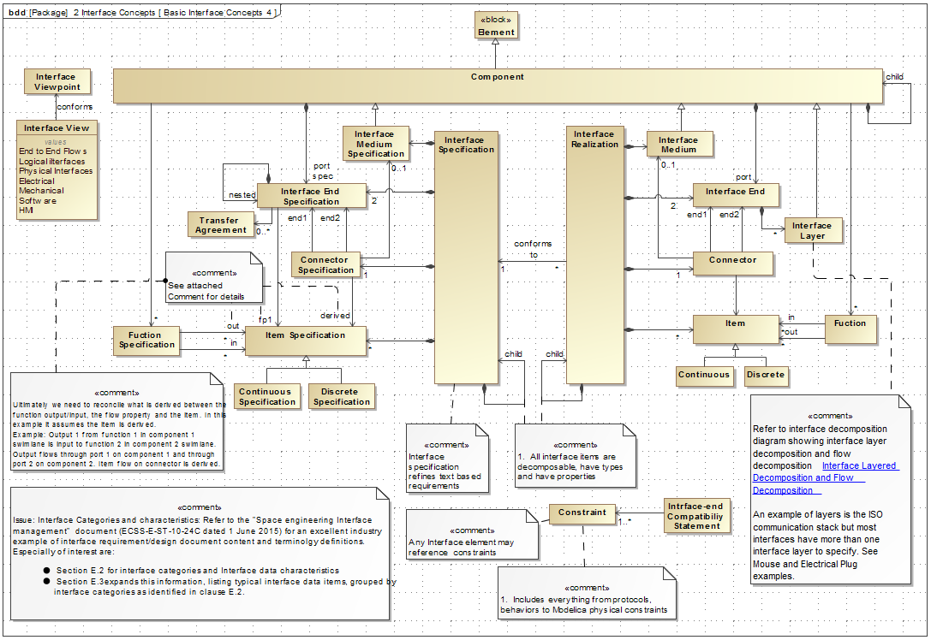
Interface Concept Model
From John Watson’s Interface Needs Presentation

Slide 8
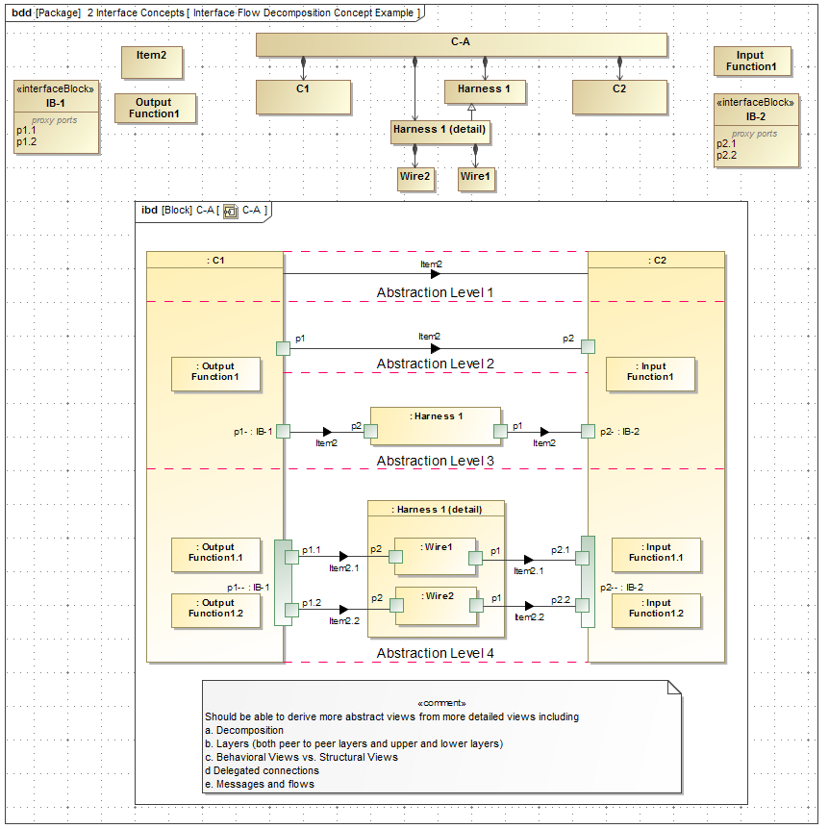
Levels of Abstraction
From John Watson’s Interface Needs Presentation

Slide 9
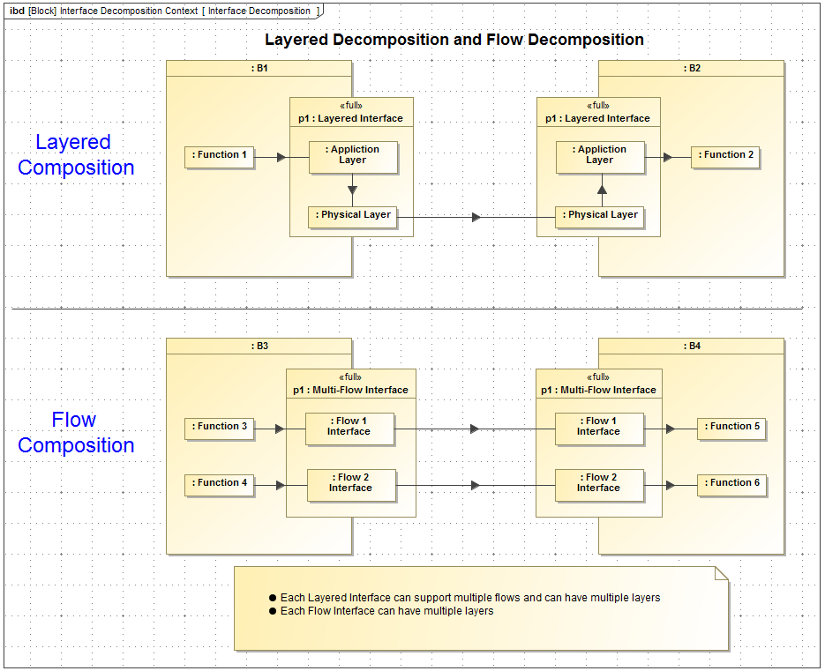
Interface Composition
From John Watson’s Interface Needs Presentation

Slide 10
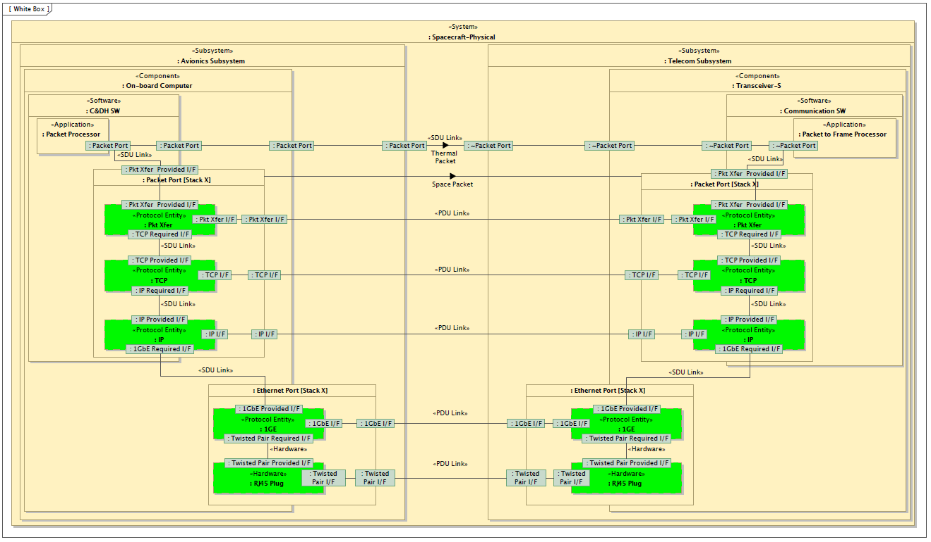
Layered Interface
From John Watson’s Interface Needs Presentation

Slide 11
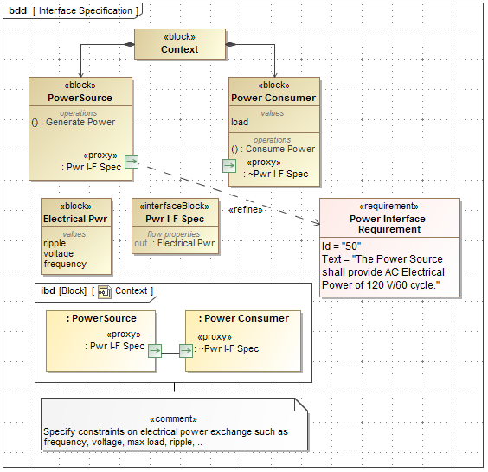
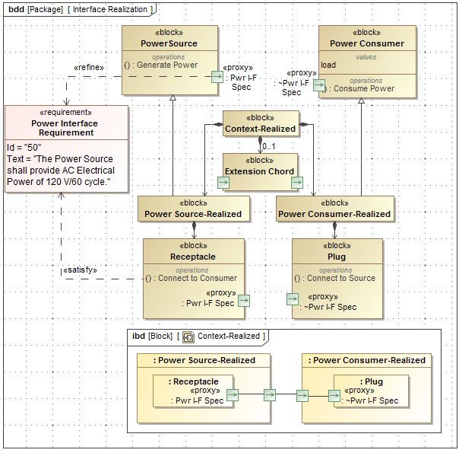
Specification and Realization
From John Watson’s Interface Needs Presentation

Slide 12
HSUV Use Case
Tire Pressure Control System

Slide 13
HSUV Change Proposal Scenario A Example
Trade Study for Tire Pressure Control System
Interface Concepts - Requirements for Interface concepts in the concept model
Model Elaboration - Model elaboration and inference via transformation language, user extensible
Visual Simplification - for SysML working diagrams
Visualization Sharing - to incorporate visualizations from other tools, and provide to other tools (e.g. 3D CAD)
Cross-Model Navigation - from model elements in SysML to model elements in other tools via persistent cross-linking
Properties - to describe interfaces
Library - re-usable elements for interfaces

Slide 14
Interface Concepts
Provides ability to define the specification (the “What”) of a Tire Pressure Control System without over constraining the design alternatives (the “How”) for the trade study
Add air compressor to the car and identify high level interfaces
Mechanical interface to existing component X (frame)
Electrical interface to existing component Y (power subsystem)
Data interface to existing component Z (car’s computer)
Thermal interface to existing components (nearby components with which it exchanges heat)
etc.

Slide 15
Model Elaboration
Helps ensure that the Tire Pressure Control System interfaces specification leverages existing standards currently utilized within the HSUV, or alternatively, industry standards
Mechanical Interface is specified as 4 bolt pattern, shock mounted attenuation
Electrical Interface is elaborated to specify a 12V DC Power and Return
Data Interface is specified as Controller Area Network (CAN) subscribing to messages for Vehicle Speed, Transfer Case Mode (2x4/ 4x4), Terrain Selector (Optional)

Slide 16
Visual Simplification
Allows the Tire Pressure Control System to be assessed during the trade study at the right level of detail/ abstraction for evaluation and scoring
Mechanical Interface may be simplified to a single connector with only the shock mount thickness presented for each alternative
Electrical Interface may be simplified to show a single connector with Power (Watts) presented for each alternative
Data Interface may be simplified to show a single connector with only optional Messages supported for each alternative presented

Slide 17
Visualization Sharing
Allows the components of the Tire Pressure Control System to be visualized within the 3D solid modeling environment for packaging, assembly instructions assessment of trade study
Compressor space claim alternatives
Under hood
Under 2nd Row Seats
Behind Rear Wheel Well
Each mounting location impacts
Assembly plant installation
Cabling length, Pneumatic Hosing Lengths, etc.

Slide 18
Cross-Model Navigation
Allows Tire Pressure Control System interface properties (Bolt sizes, torque, etc.) to be integrated with other analyses (e.g. Human Factors, assembly operations/ instructions, etc.)
Mounting Bolt sizes and torque must be evaluated against current assembly plant tooling and Human Factors analyses
Electrical, Data, Pneumatic connection locations on compressors are also evaluated for sequencing within assembly line

Slide 19
Properties
Allows design constraints to be defined for the Tire Pressure Control System interfaces (e.g. Vehicle Speed data refresh rate, Mounting bolt torque, etc.)
Makes for a more comprehensive trade study assessment of alternatives
Electrical Power for each alternative that utilizes existing spare Fuse Box slots are less risky
Data refresh rates for each alternative that are already supported by the vehicle network are less risk
Mounting Bolt Torque values that are same as current assembly plant tooling are less risky

Slide 20
Library
Provides library of interface standards (e.g. signal and pneumatic interfaces) that can be leveraged for Tire Pressure Control System.
Use of existing standards would minimize the risk of an alternative in trade study
Use of open standards reduces the risk to integrate future upgrades

Slide 21
Requirements

Slide 22
Requirements
Start with requirements for new interface concepts from the concept model
Rely heavily on other services of SysML 2.0
Minimize redundancy stored in model through use of rule-based techniques
Many of the limitations of SysML identified in the Interface Needs document are broadly applicable beyond Interfaces
Categorized requirements based on which service we might rely on
Need to work these with leads of other SysML 2.0 WGs
Extensible library of re-usable components
Working Groups identified to date
Model Construction, Visualization, Model Management, Properties

Slide 23
Categories of Requirement
Interface Concepts - Requirements for Interface concepts in the concept model
Model Elaboration - Model elaboration and inference via transformation language, user extensible
Visual Simplification - for SysML working diagrams
Visualization Sharing - to incorporate visualizations from other tools, and provide to other tools (e.g. 3D CAD)
Cross-Model Navigation - from model elements in SysML to model elements in other tools via persistent cross-linking
Properties - to describe interfaces
Library - re-usable elements for interfaces

Slide 24
Interface Concepts
This class of requirement defines the concepts specific to interfaces
These three specify the relationship between Interface Specifications, Interface Realizations and textual Requirements
Requirement | Needs Document
The Interface Specification elements shall refine textual requirements. | 5.1.1
The Interface Realization elements shall satisfy textual requirements. | 5.1.1
The Interface Realization elements shall conform to Interface Specification elements. | 5.1.1

Slide 25
Model Elaboration
Model elaboration is meant to remove the tedium of constructing models with many detailed elements – automation
Start with a simple model and then selectively elaborate it
Each elaboration can replace or modify the previous elements
Reduces redundancy
Requirement | Needs Document
SysML shall specify a language to describe model transformations. | 5.5.x
SysML shall allow the user to extend existing transformations, and create new ones, using the transformation language. | 5.5.x

Slide 26
Visual Simplification
Visually simplify working SysML diagrams, as distinct from viewpoints and views
Takes a complex, elaborated model and makes it diagrammatically simple
Requirement | Needs Document
The Interface Specification Element shall be shown in views at different levels of selectable decomposition. | 5.8.1 5.8.5
The Inferface Realization Element shall be shown in views at different levels of selectable decomposition. | 5.8.1
The interface elements shall be shown with a selectable less or more detail of abstraction.

Slide 27
Elaboration and Simplification, Two Sides of the Same Coin
User driven elaboration from less detail to more
Automated visual simplification from more detail to less
Eliminates redundancy of storing all for versions in the model simultaneously.

Slide 28
Visualization Sharing
Allow SEs to reveal physical views of a system as they do SysML views
We did not want to make SysML tools into 3D CAD tools
So, we rely on an interface to existing external 3D CAD tools
Requirement | Needs Document
SysML shall provide a local display capability in which to show visualizations and views of data from external tools and resources. | 5.6.1
SysML shall provide visualizations and views for display in other external tools and resources. | 5.6.1

Slide 29
Cross-Model Navigation
Enables simultaneous use of multiple tools in a diverse environment
User navigates to external tool and to corresponding element
Pairs with requirement for SysML query language
User pulls up 3D CAD visualization of corresponding element
Requirement | Needs Document
SysML shall link SysML model elements to model elements of external tools and resources using a persistent, unique and navigable external identifier. | 5.6.1
SysML shall navigate to model element in external tools and resources using the external identifier. | 5.6.1

Slide 30
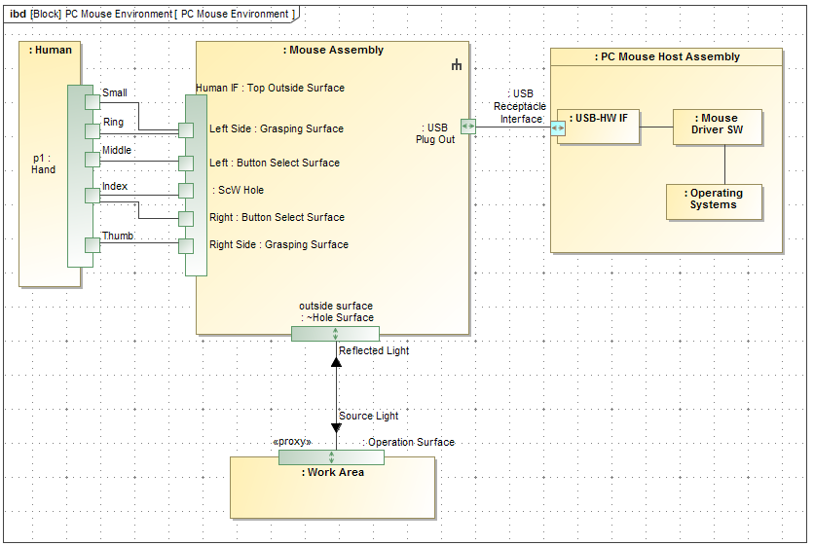
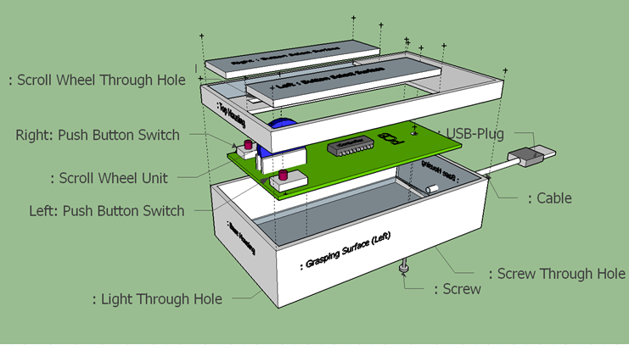
Cross Model Navigation and Visualization Sharing in Action Together
SysML Tool
3D CAD Tool
Navigate to External Tool
Mouse Assembly System model lives in SysML tool
Show Shared Visualization in SysML Tool
Local GUI Interface
Mouse Assembly 3D model lives in this tool
Shared Visualization

Slide 31
Properties
Interface concepts are characterizable like any other SysML element
The characterizations need to follow the rules of inheritance and structural composition
Requirement | Needs Document
The Connector Specification element shall allow constraints that characterize the element to be added. | 5.2.4a
The Connector Realization element shall allow constraints that characterize the element to be added. | 5.2.4a
Interface concept elements shall be characterizable by properties separately for different uses in the same context. | 5.2.4a

Slide 32
Library
We’re proposing that SysML define re-usable libraries
Interface concept elements for common kinds of interfaces (standards)
Model elaboration rules
Visual simplification rules
Languages for rule specification shall be defined as part of SysML
Libraries are extendable by end users
Requirement | Needs Document
SysML shall provide a library of model elements for commonly used interfaces. | 5.7.1
SysML shall provide a library of model transformations, specified in its model transformation language, to assist the user to elaborate parts of an interface. | 5.5.x
SysML shall provide a library of visual simplifications, specified in its model transformation language, to assist the user to simplify SysML diagrams. | 5.8.1

Slide 33
Demo

