Slide 1
System Engineering Concept Model – Domain 9/24/2015 Status
John Watson
Notes:
There are two separate efforts, the Kernel Model and the Domain Model

Slide 2
Contents
Team Resources
Goals and Overview
Approach and SECM-Domain Model Walk-thru

Slide 3
Resources - SECM-Domain Team
Contributors
Yves Bernard
Sandy Friedenthal
Chas Galey
Rick Steiner
John Watson
Systems Engineering Concept Model Wiki
HTML model snapshot periodically posted at
http://blog.ricksteiner.net/sysmlweb/SECM-Domain_WP2.0/
Tools
MagicDraw Modeling Tool
Teamwork Server
Team collaboration tool
Server and licenses provided by No Magic

Slide 4
SECM-Domain Goals and Overview
Task objective
Derive a data model that expresses the core Systems Engineering concepts to support the requirements for the next generation system modeling language (SysML v2)
Capture the system modeling language requirements that will be used in the SysML V2 RFP
Use Cases
Systems engineers and other discipline engineers contribute to the development and maintenance of the system model throughout the lifecycle to support system specification, design, analysis, and verification activities
MoE
The concepts used within the SysML V2 requirements are clear and concise
Target First Baseline – 1st Quarter 2016
High Level Intent/Driving Requirement:
(R1) The next-generation modeling language must express the core systems engineering concepts. This requires definition of a robust data model that reflects these concepts. The requirements that drove SysML derive from the original Systems Engineering Conceptual Model, jointly developed by the INCOSE/OMG/AP233 WG requirements team. Modifications and refinements to this model will occur in light of lessons learned over the last several years, and as necessary to express the core systems engineering concepts.
Notes:
There are two separate efforts, the Kernel Model and the Domain Model

Slide 5
SECM-Domain Model Contents
UML for SE RFP Baseline Model (As-Is Model) includes:
Imported requirements from the UML 4SE RFP
Imported Systems Engineering Concept Terms that supported the UML 4SE RFP
UML for SE Definitions (April 1, 2003)
UML 4SE RFP Requirements Model
Reflects the requirement text in SysML diagrams
The diagrams depict:
The concept terms found in the requirement text
The relationships between the terms, requirements, and SE Workflow Use Cases
Create new terms for terms not defined in RFP definitions
Collect SysML Issues
SysMLv2 RFP Model (To-Be Model)
Derives a set of Requirements and Concept Terms for SysML 2.0
Information in this model will be used to generate parts of the SysML 2.0 RFP
Will leverage other SE Concept and Ontology Modeling work, such as:
UML 4SE RFP Model
INCOSE Systems Science Working Group
JPL – SE Ontologies and Modeling Patterns
And others
SE Workflow Use Cases Model Connection
Imported Use Cases and their definitions
Will be used to show what use cases “refine” what requirements
Synchronize Concept Terms
Notes:
Original Requirements and definitions will be archived as a UML 4SE RFP baseline model
These definitions and requirements will not be changed

Slide 6
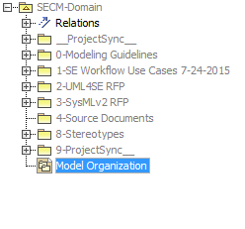
SECM-Domain Model organization

Slide 7
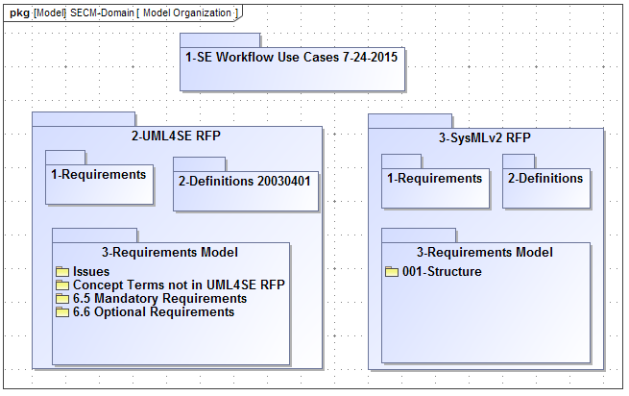
Concept Model Organization

Slide 8
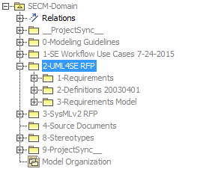
UML 4SE RFP Baseline Model

Slide 9
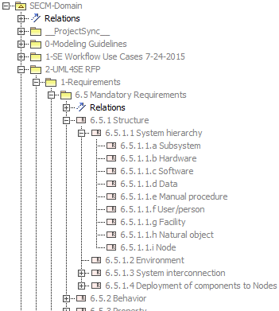
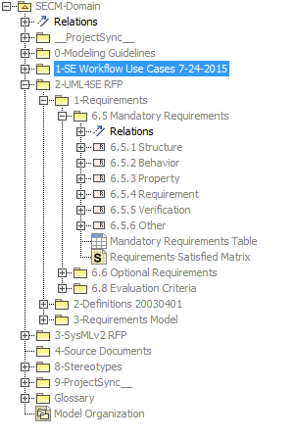
Requirements from UML 4SE RFP

Slide 10
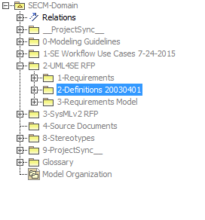
UML 4SE RFP Definitions

Slide 11
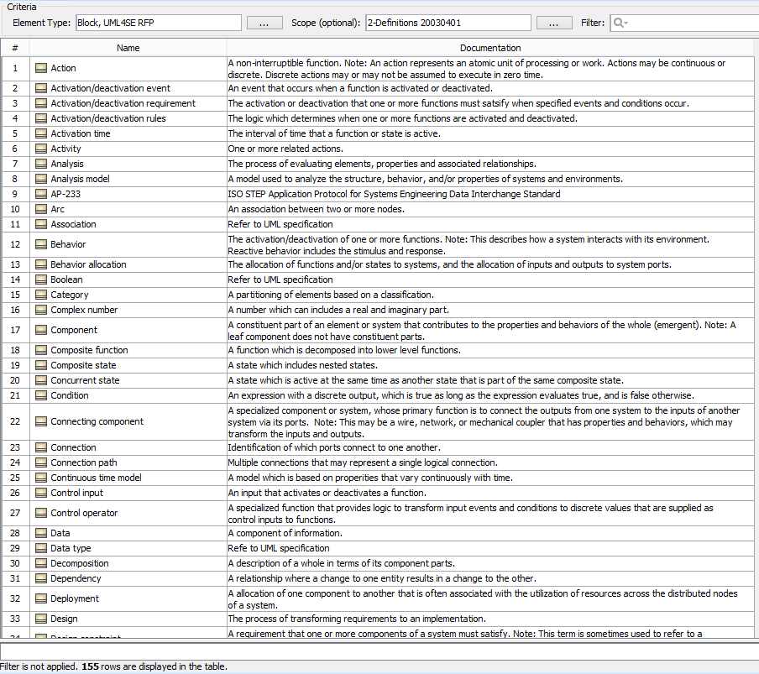

Slide 12
UML 4SE RFP Definitions

Slide 13
UML 4SE RFP Requirement (as-is) Model
Intent of this modeling exercise is to:
Provide a “stake in the ground” model to measure against for SysML 2.0
Establish a baseline model for UML 4SE RFP
Capture the requirements, concept terms and their relationships as they existed for SysML1.0
Capture a set of requirement issues observed during this exercise
How do we measure “Done”?
Does the model capture the requirement’s text sufficiently to help us:
Establish a common interpretation of the text requirements?
Identify relevance of requirements/concepts for SysML v2?
Identify issues with the as-is requirements?
As each diagram is reviewed work will begin on the To-Be model for that topical area

Slide 14
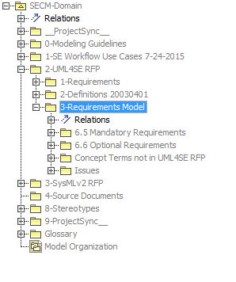
UML 4SE RFP Requirement Modeling

Slide 15
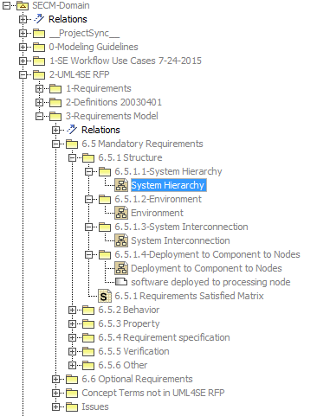
UML 4SE RFP Requirement Modeling - Structure

Slide 16
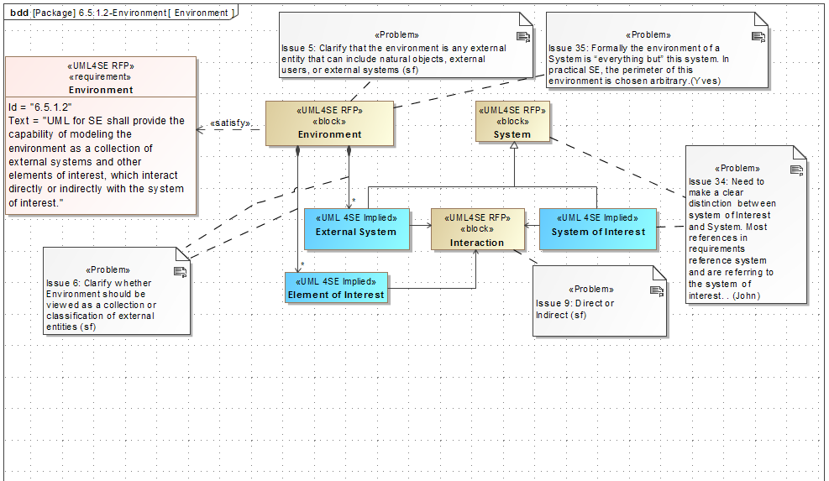
UML 4SE RFP – Environment Requirement Modeling

Slide 17
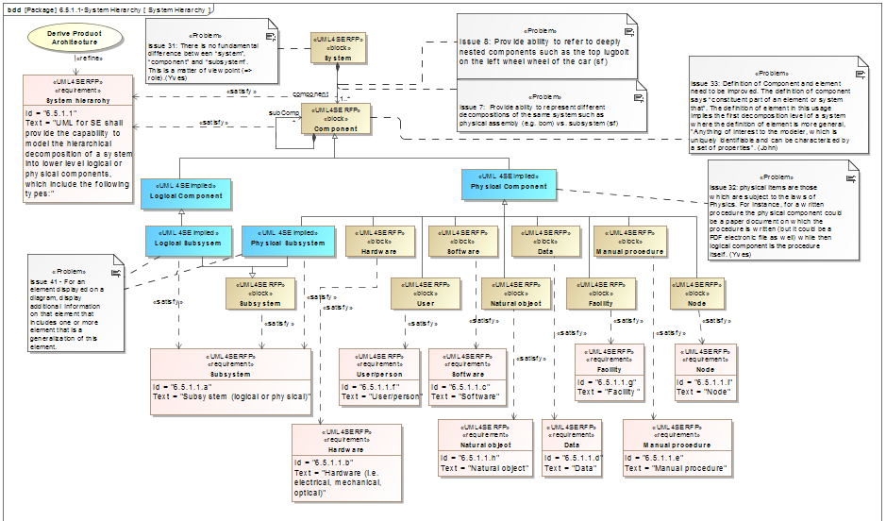
UML 4SE RFP – System Hierarchy Requirement Modeling

Slide 18
Concept Terms not defined in UML 4SE RFP

Slide 19
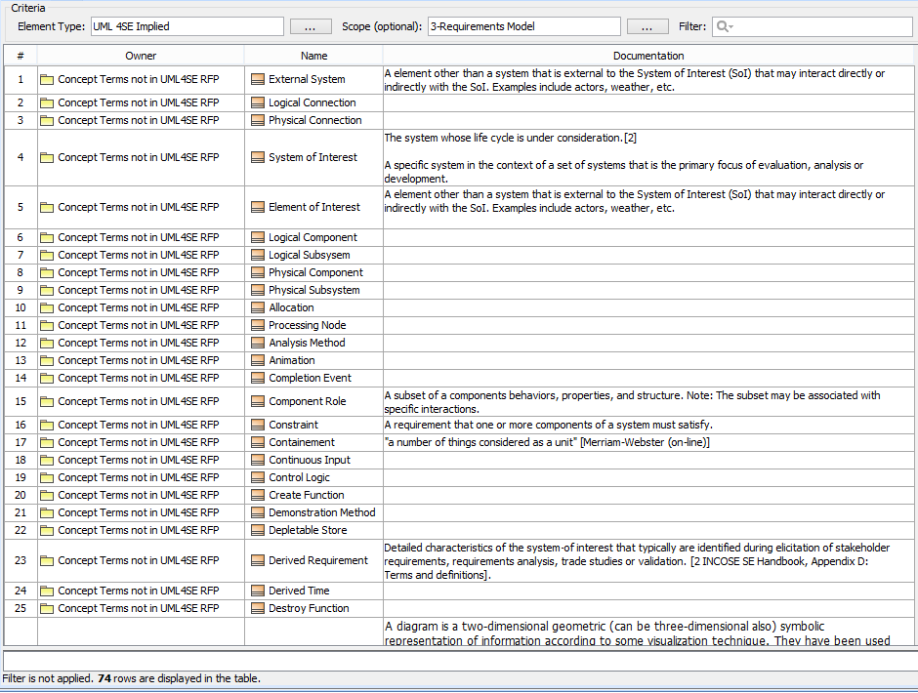

Slide 20
Capturing SysML Issues

Slide 21
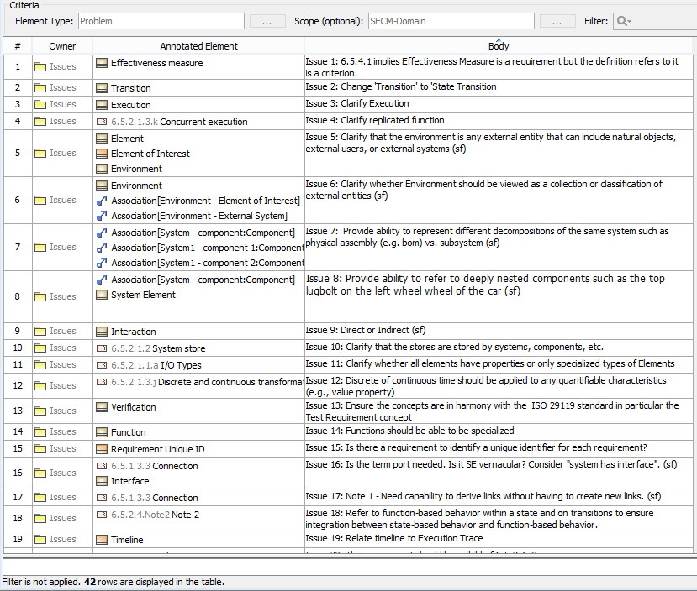

Slide 22
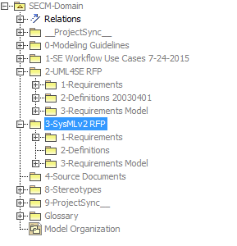
SysMLv2 RFP Model

Slide 23
SysMLv2 RFP (to-be) Model
Purpose
To model the System Engineering Concepts (the SE vernacular)
Including their definition and the relationships between them
Concept Terms will be sourced and measured against multiple resources, including;
SEBoK, INCOSE Handbook, 15288, SE Workflow Use Cases, etc.
Use a limited set of UML constructs, such as;
Class, Association and Generalization
To close/resolve Issues from the UML 4SE RFP Model
To Derive SysML 2.0 requirements
Will leverage other SE Concept and Ontology Modeling work, including:
UML 4SE RFP Model
Dave Oliver SE Conceptual model reproduced by Rick (a reflection of 2003 RFP)
INCOSE Systems Science Working Group
JPL –Ontologies and Modeling Patterns
And others

Slide 24
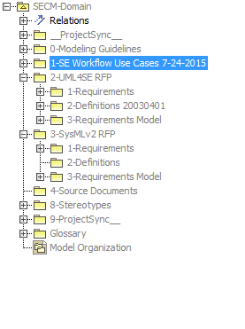
SE Workflow Use Cases Connection

Slide 25
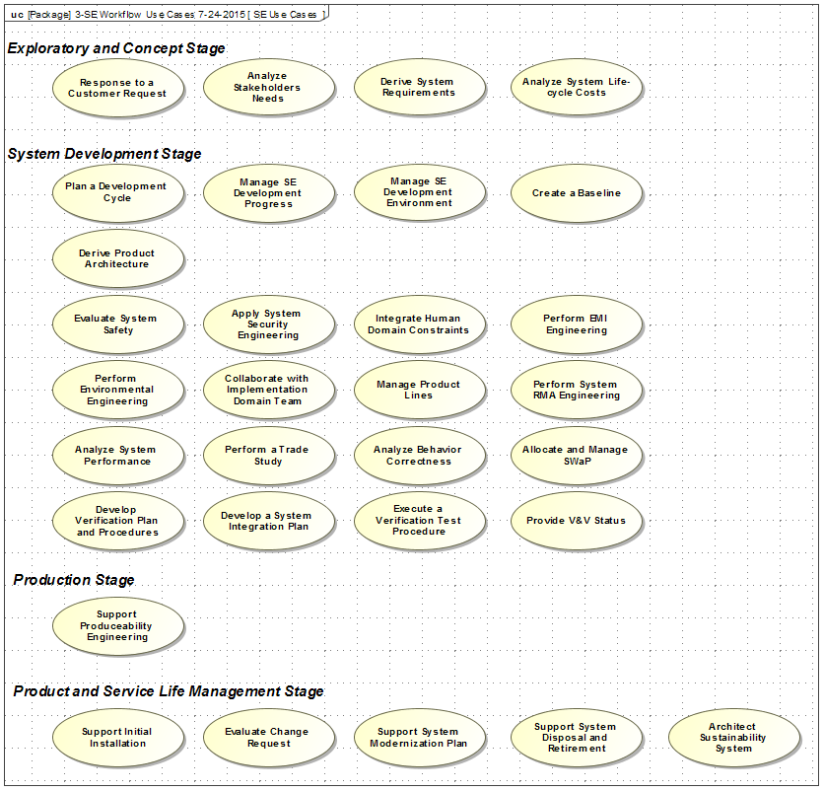

Slide 26
Summary – Systems Engineering Concept Model - Domain
UML 4SE (as-is) Model
Imported Requirements and Concept Terms from UML 4SE RFP
Mandatory Requirements (167) - All have been modeled
Optional Requirements (27) – Still in-progress
Identified 74 undefined Concept Terms
Identified 42 Issues to be addressed in to-be model
SysMLv2 RFP (to-be) Model
Work just beginning
Adjusted approach to model in parallel with as-is model development
Will leverage other SE Concept and Ontology Efforts

Slide 27
Questions

Slide 28
Backup slides

Slide 29
