Slide 1
PLM-MBSE integration discussion
SysML 2 roadmap WG
OMG TC Meeting, Reston, 15 March 2016

Slide 2
Outline
Status of the effort (including Wiki)
Effectiveness measures and driving requirements
Limitations of current SysML
Key features of PLM-MBSE concept
Service requirements (e.g. functions)
Illustration of how the concepts supports the Hybrid SUV scenario
Plans for prototypes to demonstrate feasibility
RFI concrete questions

Slide 3
Status of the effort (including Wiki)
Status:
Work on PLM-MBSE integration RFI in progress
Main work is going in GfSE/INCOSE WG PLM4MBSE
Outcome: Position paper „10 theses about MBSE and PLM“ (see: model management wiki)
Current work: started discussion about model configuration items at GfSE workshop in Hannover (Feb. 2016)
Wiki:
Not yet established own wiki
Need to coordinate between SE interoperability and MLM WG
Meanwhile check ManTIS‘ website and wiki

Slide 4
Effectiveness measures and driving requirements
Addressed requirements:
5. The next-generation modeling language and tools must support MBSE in the broader context of Model-Based Engineering (MBE), where the models and tools are fully integrated across discipline-specific engineering tools…
6. The next-generation modeling language must provide a standard application programming interface (API) to provide dynamic access to the model, while providing appropriate access controls…
7. The next-generation modeling language must be capable of being managed in a heterogeneous and distributed modeling environment.

Slide 5
Current SysML / MBSE limitations
See also: PLM-MBSE interop RFI
SysML tools lack integration with other engineering tools and requirements management systems
Lack of standardized interfaces
Immaturity of model exchange
Problems handling large sets of structured requirement
Lack of representation of artefacts from important disciplines:
Mechanical CAD, Geometry
Electrics, Electronics (ECAD)
Insufficient support for the re-use for system models
No encapsulation of SysML models
To support model assemblies like in 3D CAD
To build model libraries
To exchange model patterns
Lack of variant-, configuration, and change management
Lack of information traceability throughout the whole lifecycle, including maintenance, disposal

Slide 6
Current PLM / PDM limitations
See also: PLM-MBSE interop RFI
Lack of system-level representation of products, rather supports only document-centric representations
No support for rich semantic modeling of interdisciplinary information
Lack of representation of behavioral system information
Lack of modeling for requirements engineering
Lack of highly granular traceability information

Slide 7
Key features of PLM-MBSE integration concept
Establish the concept of a System Model to become „central (single) source of truth“
Extend usefulness of System Models throughout a products lifecycle
Enable MBSE to become an integral part of “traditional” product development process
Systems Modeling targeting product architecture
Capture stakeholder requirements
Discipline independent abstraction
E.g. FAS method
Systems modeling to integrate discipline specific modeling
Capture system level requirements
Discipline specific abstraction
E.g. SysML extension for simulation

Slide 8
Service requirements (e.g. functions)
This is part of the RFI discussion
Interchangeable model libraries
Model versioning, config mgmt., etc. → MLM
…

Slide 9
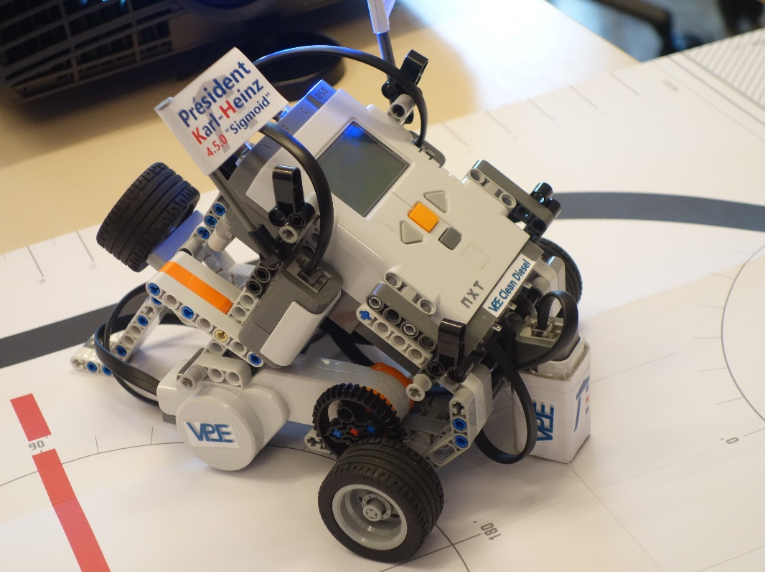
Illustration of how the concepts supports the Hybrid SUV scenario
Not yet under consideration
PLM4MBSE WG choose LEGO Mindstorm Robot
Existing CAD data
SysML model developed Univ. Kaiserslautern

Slide 10
Plans for prototypes to demonstrate feasibility
Partly: SEISMIK research project proposal
Aims at building MBSE ecosystem through establishment of services in support of (SysML) systems modeling
Development of SE libraries and standard parts
Systems “Re-Engineering” to easily populate system models with existing product data (BOM, MCAD, ECAD, …)
Transform textual requirements to “models”
…
Derive requirements for SysML 2.0 RFP

Slide 11
Plm-mbse interoperability RFI - PMII

Slide 12
Concrete questions to answered 1/3
What is/should be the role of MBSE within your product development process?
What are the key issues setting up multidisciplinary engineering processes?
What artefacts in SysML and PLM share corresponding semantics?
Which information in the system model can be (re-)used in other models (MCAD, ECAD, Analysis…) in order to reduce manual efforts?
What information from discipline-specific models (MCAD, ECAD, Analysis…) needs to be represented in a system model?
How should a MBSE change process look like?
Does a MBSE change process have to support branching and merging?

Slide 13
Concrete questions to answered 2/3
What is needed to better support reuse of (partial) system models?
What is needed to better support collaboration between SysML-Modelers?
What is needed to better support collaboration between SysML-Modelers and engineers creating discipline-specific models (such as MCAD, ECAD, Analysis)?
What benefit is provided when using the system model over the whole lifecycle / in later lifecycle stages?
Which components and artefacts of a system model need to be put under configuration control?
Which constructs of the system model need versioning?

Slide 14
Concrete questions to answered 3/3
How much granularity for versioning is needed? Should versioning be supported on the object, package, diagram or model level?
How important is a system model as a single point of reference over the whole lifecycle of a product?
Is there a need to freeze certain baselines of the system model at certain stages of the engineering process? If yes, which concepts need baselining?
What is the benefit of managing models as objects instead of managing the system models textual representation (XML snippets)?
Who besides the systems engineers need information captured inside the system model? How can this information be displayed and made available to that users?

Slide 15
Questions?

Slide 16
Facettes of PLM-MBSE integration
Or: fundamental issues in product development that need to be solved
Need for a holistic integrated system model
Multidisciplinary development needs common language
Traceability
Complexity management
Large sets of requirements
Many dependencies between system components
Collaboration between many development teams
Co-Simulation
Increase comprehensibilty of a product/system
Integration of enterprise and business aspects
Enterprise architecture
Business objectives
Support for collaboration in MBSE
Support management of MBSE artefacts
? Product line engineering = ALM

Slide 17
PLM/PDM – where we are

Slide 18
PLM Defintion
EN
PLM according to Wikipedia
product lifecycle management (PLM) is the process of managing the entire lifecycle of a product from its conception, through design and manufacture, to service and disposal
PLM integrates people, data, processes and business systems and provides a product information backbone for companies and their extended enterprise
Product-Lifecycle-Management (PLM) is a concept for the seamless integration of information concerning the whole lifecycle of a product
The concept is based on coordinated methods, processes and organisational structures and is implemented usind IT systems for authoring and maintenance of the data
The term PLM originates from Product Data Management (PDM) and EDM
GER

Slide 19
PDM Basic functionality
PDM - Product Data Management:
Historically: 2D/3D CAD Drawing Database
Main application area: Mechanical CAD
Todays extensions: ECAD, Requirements, Simulation Data, etc.
Typical data managed by PDM:
CAD models
Specifications (as documents)
Bill of Material (BOM)
Product structure (Assembly)
Digital Mock-Up (DMU)
…
Typical PDM Functionality:
Versioning, Variant Management
Configuration Management, Baselining
Classification (abstract product structure)
Change control, Engineering Change Management
Visualization (Reporting, Structure browsing, DMU)
Query, Search, Data Exchange

Slide 20
MBSE – where we are

Slide 21
MBSE – where we are
INCOSE MBSE Definition
“Model-based systems engineering (MBSE) is the formalized application of modeling to support system requirements, design, analysis, verification and validation activities beginning in the conceptual design phase and continuing throughout development and later life cycle phases.” INCOSE SE Vision 2020 (INCOSE-TP-2004-004-02), Sept 2007
Systems modeling evolved:
SysML
Modelica
…
SE Vision 2020 (excerpt):
Extensive reuse of model libraries, taxonomies and design patterns
Standards that support integration and management across a distributed model repository
Highly reliable and secure data exchange via published interfaces

Slide 22
MBSE – PLM integration, further aspects
Thoughts about MBSE-PLM integration
Handle large sets of structured requirements
Support for Functional Mock-Ups
Use cases for MBSE-PLM integration
Role of ALM (Application Lifecycle Managament)
Role of OSLC
Model Management working group
SE-Authoring tools (e.g. SysML) be used as PLM configurator?

