Slide 1
Ideas on “useability layering“ the System Modeling Environment OMG LaJolla Meeting, December 2015
Bertil Muth, ProSTEP iViP association

Slide 2
The general idea of “useability layering”
People don’t want to use software
They want to achieve desired outcomes
Example:
Desired Outcome: “Read book”
Possible solutions:
Non software solution: go to public library
Software solutions: buy book on website, use e-reader
Different users have different desired outcomes, and the software should make it easy to achieve these by “layering” the functionality based on user groups

Slide 3
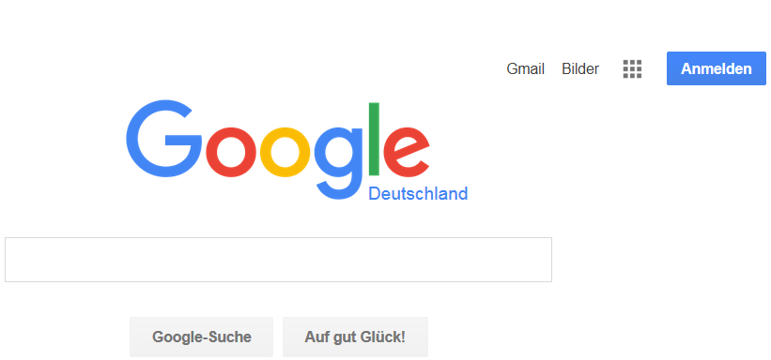
Example: how Google “layers” their user interface
Layer 2 - n:
Other users
Layer 1:
Everyday search engine user
Source: www.google.de

Slide 4
What that means for a System Modeling Environment
Different groups of users use models in a different way
Example for user roles (just to explain, not to suggest):
Model Reader, Beginning Model Builder, Advanced Model Builder, Model Analyst …
The idea: respect the different ways to use models when creating the System Modeling Environment and thus, also in the standard
If that idea is accepted, decisions need to be made:
Having one user interface for all roles vs. several UIs (or even editions?)
One standard for all user roles vs. several standards
Having the same modeling concepts for all roles vs. splitting them
Explicitly explaining concepts for user roles, or not
…

