Slide 1
SECM - Variant Modeling Concepts
John Watson
30 Dec 2016 Rev A

Slide 2
Changes to Review
Slide 5 – Added 2 new Requirements
Slide 6 and 7 - New

Slide 3
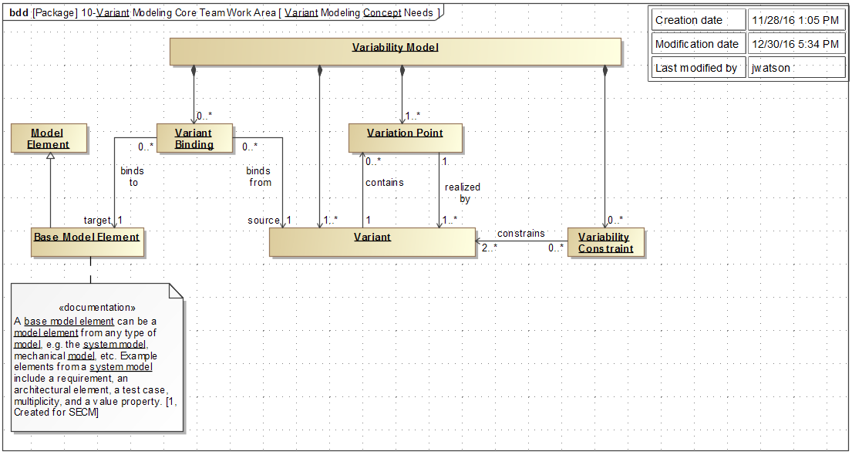
Variant Concepts

Slide 4
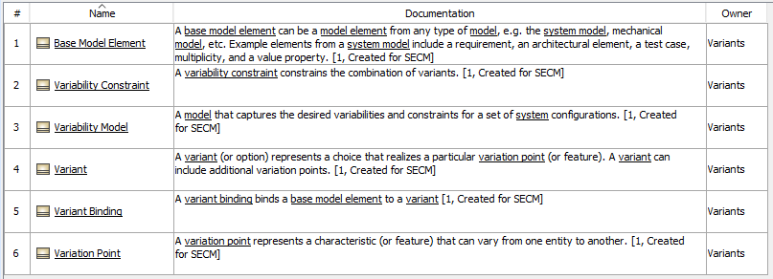
Variant Concept Terms

Slide 5
Variant Concept Requirements

Slide 6
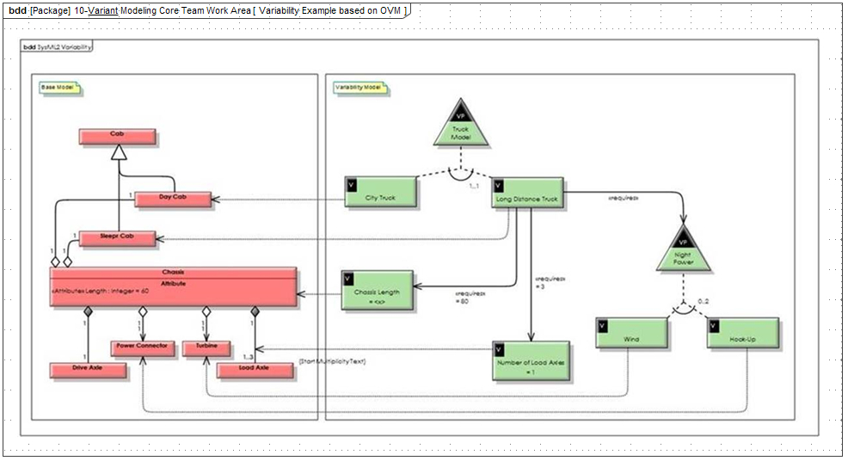
Variability Example based on OVM

Slide 7
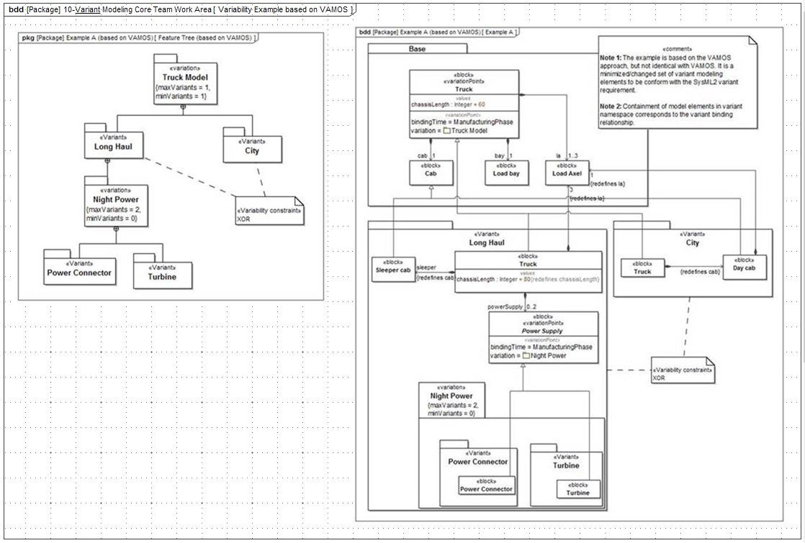
Variability Example based on VAMOS

