Slide 1
Precise Semantics of UML Composite Structures
Initial submitters meeting (telco), September 25, 2012

Slide 2
Agenda
Preparation of the test suite
Execution of fUML test suite
Review of the example model discussed in Jacksonville
Preliminary execution results
Work in progress
Improvement of Document Generation Template
Discussion / update of the front matter
Connector redefinitions
What’s the conclusion of the discussion on the mailing list?
=> Impact on model transformations
=> Out of scope at this time
Actions for the next telco

Slide 3
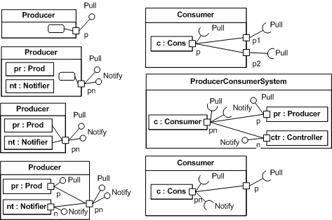
Preparation of the test suite
Objectives:
Being able to execute the existing fUML test suite from reference implementation
+ tests written in Alf (cf. ed)
Define a first model example (as simple as possible) involving composite structures
Refine / define variants of this simple model, to show relevant aspects of composite structures semantics, e.g:
Note: => Writing examples in Alf was much more efficient for fUML
=> We should consider optional requirements (n° …) related to Alf extension for composite structures
Deal with ports / parts => Already a non-normative annex in Alf, but we need an extension of alf which provides a surface syntax which make more convenient to notate composite structures, and a better semantic integration
+ Test coverage metrics for the test suite,
define some kind of test coverage criteria
Define an ideal test suite that would meet all these criteria

Slide 4
Execution of fUML test suite
Seems to be OK:
Cf. Live demo.

Slide 5
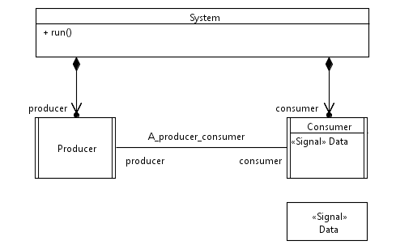
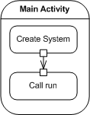
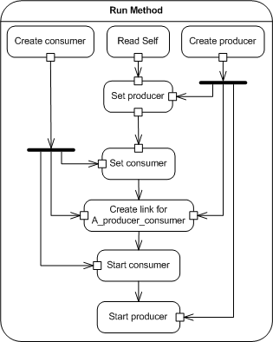
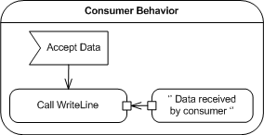
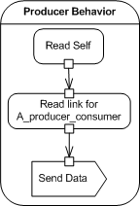
Review of the example model discussed in Jacksonville
Refactor System:
Have 2 operations
One for constructing
One for running
2
This ‘’initialization’’ part should be addressed by Composite Structures Semantics:
e.g. Constructor + Instance specification describing the configuration
Initial values for properties of composites
Overload CreateObjectActionActivation?
Pb: modifies semantics of CreateObjectActions
=> Not supposed to initialize anything
Define constructors in libraries?
Pb: invoking a constructor is not automatic (?)
Whatever the way we do it, we want to have something that produces a configuration of instances equivalent to the result of calling System’s constructor
1
3
Refactor Main:
Call the constructor
Then call run
+ Constructor on Consumer and Producer
=> To be continued…
5
6
Issue of Connector and/or properties (referenced by ConnectorEnd)
redefinition in this case?
4

Slide 6
Preliminary Execution Results
Seems to be OK:
Cf. Live demo.

Slide 7
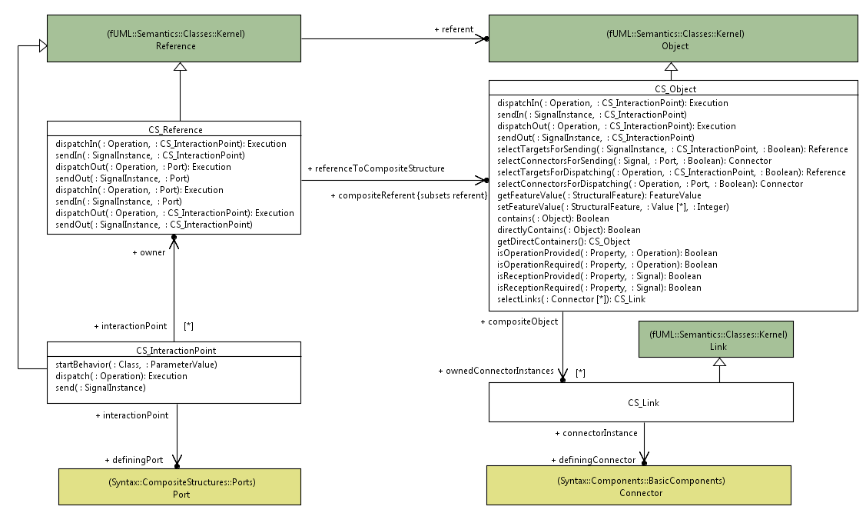
Work in progress
Test propagation through port / connector instances
This information needs to be computed when a CreateLinkAction is executed
Does not seem to be always trivial
To be confirmed (Work in progress related to overloading of CreateLinkActionActivation)
Is it actually possible to determine the defining connector?
fUML constraint on association ends may help
+ additional constraints about context (to infer the actual connector)?
definingConnector and ownedConnector Instances could be derived properties. In this case, no need to extend CreateLinkActionActivation
PB:
No way in UML action semantics to create an untyped link.
How to connect things?
Add specific opaque behaviors in libraries for that?
[0..1]

Slide 8
Agenda
Preparation of the test suite
Execution of fUML test suite
Review of the example model discussed in Jacksonville
Preliminary execution results
Work in progress
Improvement of Document Generation Template
Discussion / update of the front matter
Actions for the next telco

Slide 9
Improvement of document generation template
From matter:
Cf. example: IFML initial submission

Slide 10
Agenda
Preparation of the test suite
Execution of fUML test suite
Review of the example model discussed in Jacksonville
Preliminary execution results
Work in progress
Improvement of Document Generation Template
Discussion / update of the front matter
Actions for the next telco

Slide 11
Actions for the next Telco
Initial submission deadline: November 12
Go on with the TODO list:
Document, Model, Transformations, Test suite, SysML / MARTE impact analysis
Specific actions:
??

