Slide 1
Precise Semantics of UML Composite Structures
Initial submitters meeting (telco), October 03, 2012

Slide 2
Agenda
Test suite
Basic example (refactored)
Basic example: Refinement V1
Basic example: Refinement V2
Issue of « determining the defining connector for a CS_Link »
Ongoing solution => Get rid of connectors in the propagation process
Actions for the next telco

Slide 3
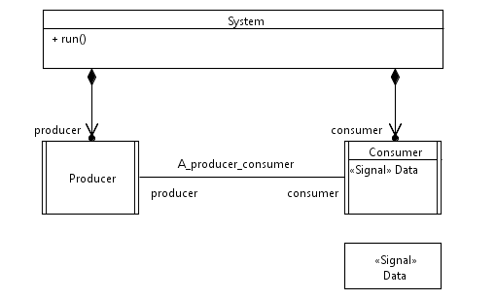
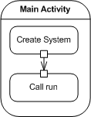
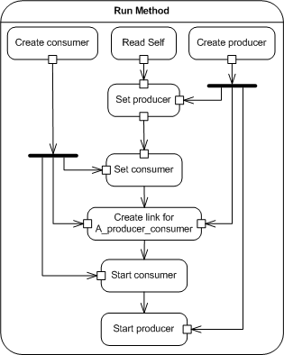
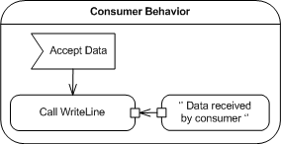
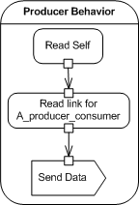
Review of the example model discussed in Jacksonville
Refactor System:
Have 2 operations
One for constructing
One for running
(Slide from Telco of September 25)
2
This ‘’initialization’’ part should be addressed by Composite Structures Semantics:
e.g. Constructor + Instance specification describing the configuration
Initial values for properties of composites
Overload CreateObjectActionActivation?
Pb: modifies semantics of CreateObjectActions
=> Not supposed to initialize anything
Define constructors in libraries?
Pb: invoking a constructor is not automatic (?)
Whatever the way we do it, we want to have something that produces a configuration of instances equivalent to the result of calling System’s constructor
1
3
Refactor Main:
Call the constructor
Then call run
+ Constructor on Consumer and Producer
=> To be continued…
5
6
Issue of Connector and/or properties (referenced by ConnectorEnd)
redefinition in this case?
4

Slide 4
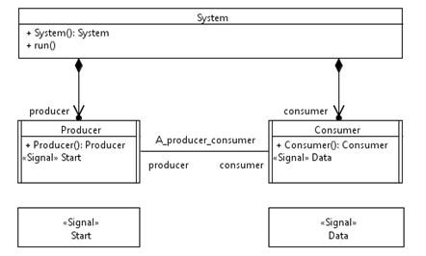
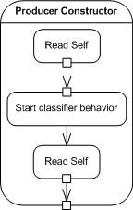
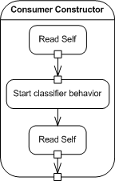
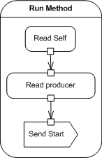
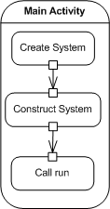
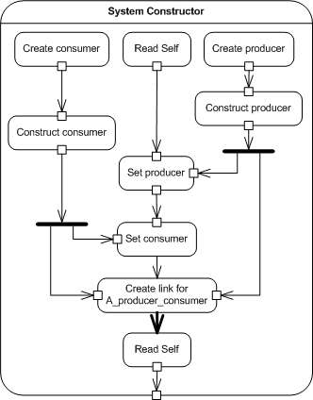
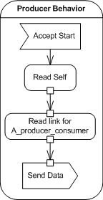
Basic example model discussed in Jacksonville
(refactored according to telco of September 25)
2
1
5
7
9
In the examples, Constructor methods are modeled following « Alf semantics » (at least, that was the intent) => Classifier behavior is started at the end of the constructor (in the case of a constructor for an active class).
Option:
Not mandate start classifier behavior to be started when the constructor is called (e.g., this is what is done in code generation strategies of IBM)
=> TODO: Write the corresponding Activities (Eldad)
=> Question: can the two versions be written in Alf?
3
8
4
6

Slide 5
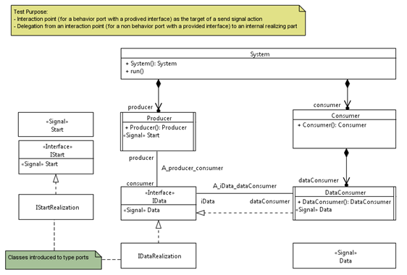
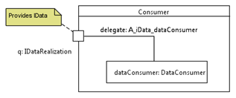
Basic example model: Refinement V1
Test purpose:
Interaction point (for a behavior port with a provided interface) as the target of a send signal action
Cf, UML 2.5 « It is also possible to use an “interaction point” object (that is, an object instantiated in a Port) as the target
object for a CallOperationAction, SendSignalAction, or SendObjectAction without specifying onPort.
In this case, the request is sent directly to the interaction point and is then routed internally within the owner of the Port
(as also described in Subclause 11.3.3). The request goes into the owner of the interaction point through one of the provided
Interfaces of the Port.
Delegation from an interaction (for a non behavior port with a provided interface) to an internal realizing part
Structure
2
1
2
Issue => Nicolas: Suppose
Producer:p : IStart
IStartRealization1 realizes IStart
IStartRealization2 realizes IStart
which of the 2 realizations do we use to bind the value of System.producer.p ?
suggest making explicit in (3) the fact that the system needs 2 additional parts:
pValue : IStart = IStartRealization1
qValue : IData = ....
Proposal : Then we can say in (3) that:
System.producer.p is bound to System.pValue
=> Can it be expressed in UML (e.g.default values)? To be checked (Nicolas)
=> TODO: Share example models (Arnaud)
What is the activity diagram corresponding to the quote from UML 2.5:
« It is also possible to use an “interaction point” object (that is, an object instantiated in a Port) as the target object for a CallOperationAction, SendSignalAction, or SendObjectAction without specifying onPort. In this case, the request is sent directly to the interaction point and is then routed internally within the owner of the Port (as also described in Subclause 11.3.3). The request goes into the owner of the interaction point through one of the provided Interfaces of the Port.
=> Arnaud Comment: Next slides show my understanding of this quote.
Question: Is this interpretation correct?
3

Slide 6
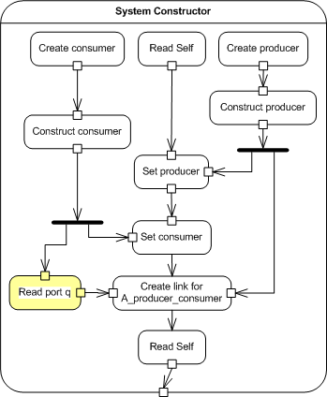
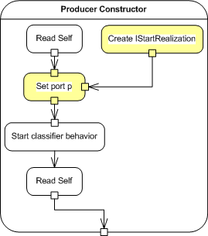
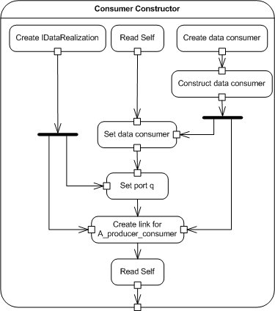
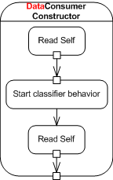
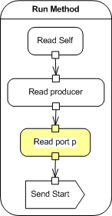
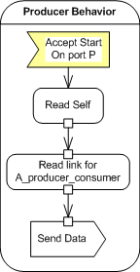
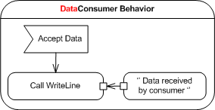
Basic example model: Refinement V1
Behavior
5
2
1
4
3
6
7

Slide 7
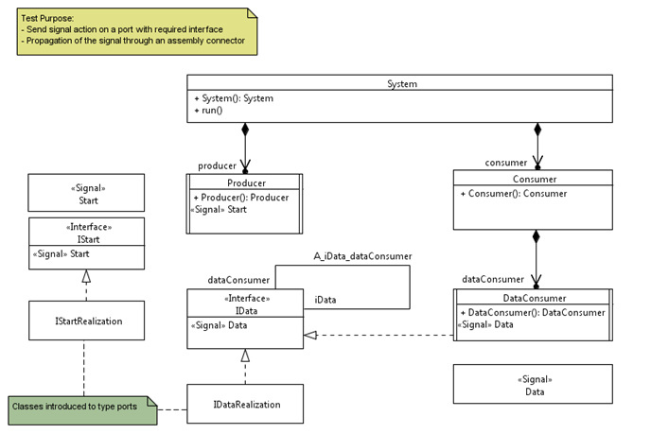
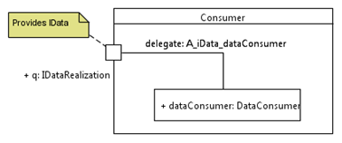
Basic example model: Refinement V2
Structure
Test purpose:
Send signal action on a port with a required interface
Propagation of the signal through an assembly connector
2
1
3

Slide 8
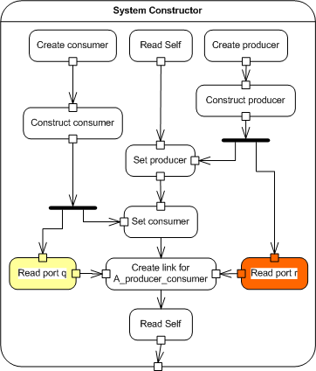
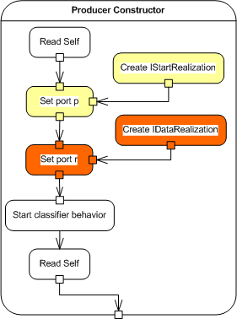
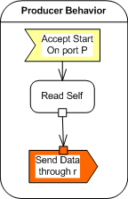
Basic example model: Refinement V2
Behavior
2
1
3

Slide 9
Preparation of the test suite
Objectives:
Being able to execute the existing fUML test suite from reference implementation
+ tests written in Alf (cf. ed)
Define a first model example (as simple as possible) involving composite structures
TBC - Refine / define variants of this simple model, to show relevant aspects of composite structures semantics, e.g:
Note: => Writing examples in Alf was much more efficient for fUML
=> We should consider optional requirements (n° …) related to Alf extension for composite structures
Deal with ports / parts => Already a non-normative annex in Alf, but we need an extension of alf which provides a surface syntax which make more convenient to notate composite structures, and a better semantic integration
TBD - Test coverage metrics for the test suite,
define some kind of test coverage criteria
Define an ideal test suite that would meet all these criteria

Slide 10
Agenda
Test suite
Basic example (refactored)
Basic example: Refinement V1
Basic example: Refinement V2
Issue of « determining the defining connector for a CS_Link »
Ongoing solution => Get rid of connectors in the propagation process
Actions for the next telco

Slide 11
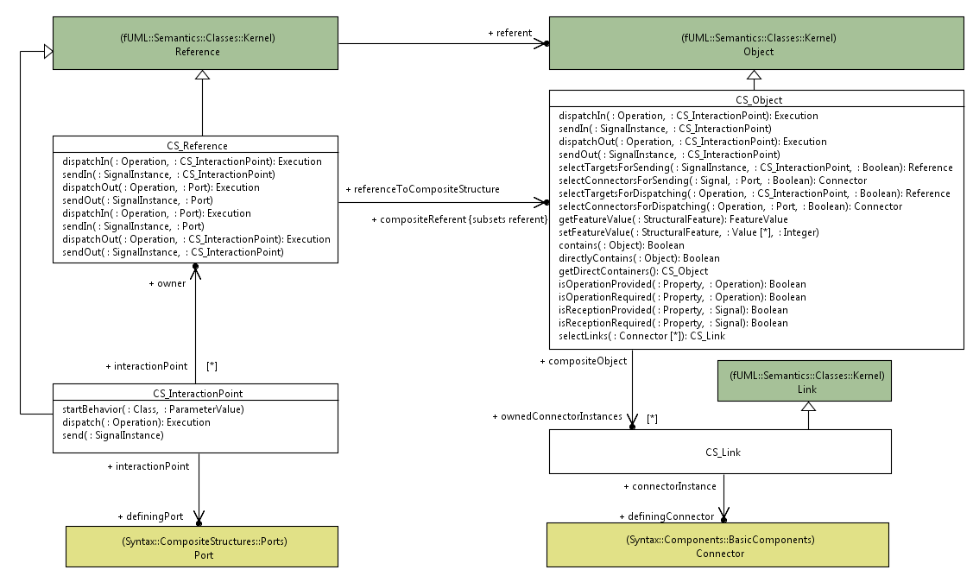
Issue : « determining the defining connector of a CS_Link »
(Slide from telco of September 25)
This information needs to be computed when a CreateLinkAction is executed
Does not seem to be always trivial
To be confirmed (Work in progress related to overloading of CreateLinkActionActivation)
Is it actually possible to determine the defining connector?
fUML constraint on association ends may help
+ additional constraints about context (to infer the actual connector)?
definingConnector and ownedConnector Instances could be derived properties. In this case, no need to extend CreateLinkActionActivation
PB:
No way in UML action semantics to create an untyped link.
How to connect things?
Add specific opaque behaviors in libraries for that?
[0..1]

Slide 12
On going solution
=> Get rid of Connector! (strongly inspired by discussion on the list)
Principles behind these changes:
Does not rely on Connector anymore!
Use the fact that, for given CS_Object, CS_Link and CS_InteractionPoint (where this interaction point is a value for a FeatureValue of CS_Link), this link can target:
The Internals of CS_Object (i.e. all other feature values of the link are values for feature values of the CS_Object, or interaction points on values for feature values of this CS_Object)
The environment of CS_Object (i.e. all other feature values of the link are NOT values for feature values of the CS_Object, or interaction points on values which are NOT values for feature values of this CS_Object)
From selected links, propagate requests according to Operation/Reception provided/required by selected target objects.
=> Seems to work: Cf. demo
+ Additional operations
[0..1]

Slide 13
Agenda
Test suite
Basic example (refactored)
Basic example: Refinement V1
Basic example: Refinement V2
Issue of « determining the defining connector for a CS_Link »
Ongoing solution => Get rid of connectors in the propagation process
Actions for the next telco

Slide 14
Actions for the next Telco
Initial submission deadline: November 12
Go on with the TODO list:
Document, Model, Transformations, Test suite, SysML / MARTE impact analysis
Specific actions:
Test suite:
Variants on the Basic example => Introduce operation calls
Semantics:
Report changes (tested in the implementation) in the model
Align with 2.5
Move semantics from CS_Reference to CS_Object
Documentation generation template:
Update front matter (cf. IFML example)

