Slide 1
Transition to Model Based Embedded System Development
Jim Ross – John Deere
January 2012

Slide 2
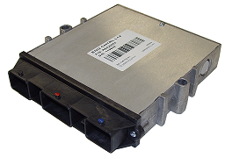
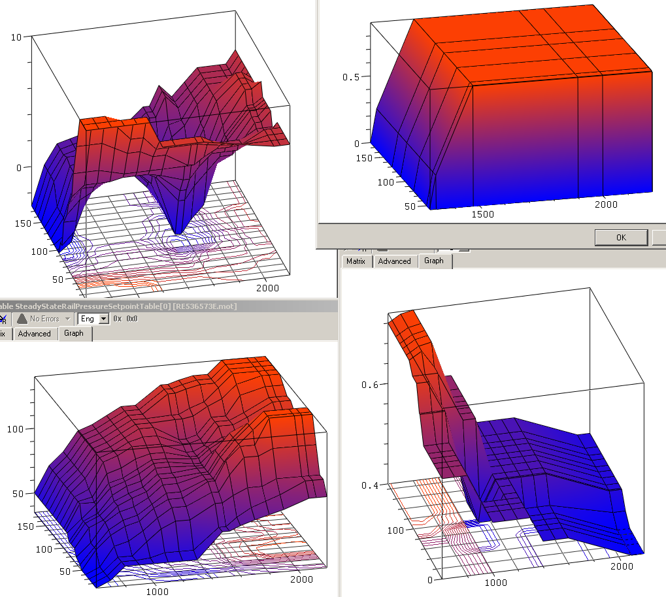
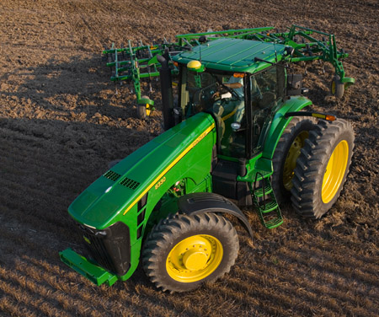
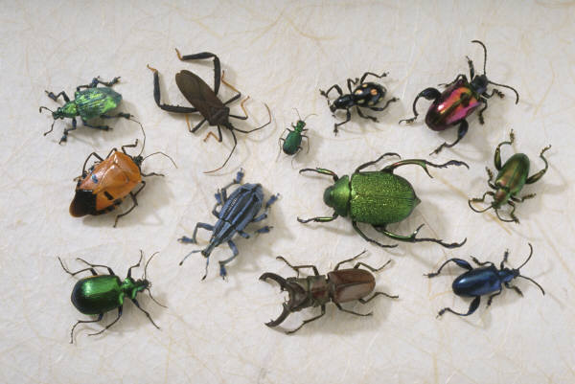
A Look Inside an ECU
System
Engineer
Hardware
Engineer
Software
Engineer
PV&V
Engineer
Calibration
Engineer

Slide 3
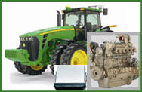
Model-Based System Development
Final Product
Model Based Software Development
Product Maturity
Performance
Verification
Physical System
Development & Testing
Controller Cal
and Gain Tuning
Physical
Virtual system model
also used for
First Line Support
after production launch
More Model Cal
Algorithm
Updates
Initial Model Cal
Design Updates
Model Validation
Virtual
Systems &
Interface Specs
Virtual System
Modeling & Simulation
System Architecture & Requirements
Rough Product
Concurrent & Iterative System Engineering
Develop physical system from virtual system model
Validate and refine virtual system model from physical system testing
Time
Notes:
System vs. Software
MBSD – both System and Software
This slide paints a picture of System View
Identifies Software within it
MB Software Development
- Certainly value here
- Also significant effort invested in models
- Use for only SW leaves value “on the table”
- Extension of MathWorks’ “Rule of Twos”
The key is that the whole is greater than the sum of the parts. - Optimizing the parts is good – there is value there.
- Optimizing the whole is much, much better.
This is true when designing a product
- a vehicle or a building or a spacecraft.
- It is also true when designing a development process.
It all comes down to taking your blinders off and realizing there is more out there.

Slide 4
Model-Based Systems Development (MBSD)
Simple Definition
Design process using mathematical models that describe the logical and physical behavior of a system
In Practice
Graphical model of embedded software algorithm
Plant models capturing physical behavior
Simulate and analyze system behavior and interactions
Code generation from software algorithm model
Controller Model
Plant Model
Controller
(Software Algorithms)
Actuator
(Driver/Physical)
Plant
(Physical)
Sensor
(Driver/Physical)
Notes:
Graphical = Block Diagram, State Diagram
Application Appropriate Plant Models – Right model for the task
Virtual design cycle through simulation/analysis

Slide 5
Architecture, Design, Implementation
Architecture
Functionality split into components reused throughout the process and/or for multiple projects.
Component A Model
Component B Model
Component C Model
Design
Application model reused throughout the development process.
Implementation
Target variations are handled via the Data Dictionary and Code Generation.
Application Model
Doubles
Fixed-Point
Singles
Doubles
Fixed-Point
Singles
Simulation
Rapid Control
Prototyping
Production Code
Generation Platform 1
Production Code
Generation Platform 2
Björn C. Becker
Notes:
Architecture – Reuse - Separate Design from Implementation
Interfaces are key here
Doubles Singles Fixed Point
Simulation x x x
RPC x
PCG 1 x
PCG 2 x
Idealized Process
Design vs. Implementation
Neutral Model – new application/algorithm logic in model form only
Data Dictionary with Implementation Details (Elaboration = Refinement)
Model can be used at any stage with any elaboration needed
Reality
Often stay with elaborated model
Struggle with “partially” elaborated models
Often capture some elaboration in model itself
Hard to go back to a neutral model for future design revisions
Overall, this is a success but there are some difficulties.

Slide 6
Data Dictionary
Value Layer
Values – Simulation, Code Generation, & Production
Implementation Layer
Data Type – Simulation (optional) & Code Generation
Variable Name, Filenames, Storage Class – Code Generation
Range, Units – Documentation
Notes:
Values
Physical Components – Nominal values come from the design
Software Components – Nominal values are part of the software calibration

Slide 7
Plant Model Classifications
 | Simple | Controls | Analysis
Typical Tools | Simulink & Stateflow | Simulink & Stateflow Transfer Function | AMESim EASY5 Dymola GT-Suite Kuli
Basis | Logic | Dynamics | Physics
Nature | Reactive | Reactive | Predictive
Fidelity | Low | Medium | High
Execution Time | Low | Low | High
Key Business Driver | SIL Testing | MBSD | HW Design
Domain Knowledge | Low | Medium to High | High to Very High
Notes:
Nature
Reactive means model is valid under conditions it was created -> Reacts to known conditions
Predictive means model is valid under all conditions -> Predicts response to unknown conditions
Domain Knowledge
Need for specialized domain knowledge

Slide 8
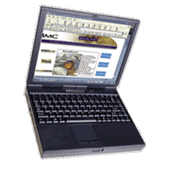
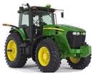
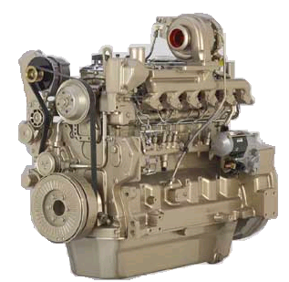
In The Loop
Software In the Loop (SIL) System
Processor
Virtual I / O
ECU Code DLL
Host PC
Plant Model
I/O Signals
Processor
I / O
Host PC
Electronic Control Unit
Hardware In the Loop (HIL) System

Slide 9
Plant Model Usage
MIL
System
SW Model
ECU Model
SW
ECU
Sensor Models
Plant
Model
Sensors
Plant
SIL
HIL
SW
ECU Model
SW
ECU
Sensor Models
Plant Model
Sensor Models
Plant
Model
Windows
RealTime
Notes:
MIL Use Cases
Simple – Initial Development
Controls – Final Development, Final Validation, Optimization
Analysis – Virtual Calibration
SIL Use Cases
Simple – Software Test, Integration Test
Controls – Integration Test, Performance Test
HIL Use Cases
Simple – Final Validation
Controls – Regression Test, Performance Test, Fault Behavior Test, Tolerance/Sensitivity Test

Slide 10
Model in the Loop Usage
MIL
Initial Algorithm Development
Simple Software Model
Final Algorithm Development
Controls Model
Final Validation
Additional Interface Models
Controls Model
Virtual Calibration
Analysis Model
Optimization
Controls Model
SW Model
ECU Model
Sensor Models
Plant
Model
Notes:
Note that the appropriate data dictionary can be used for each model based on the current activity
Right fidelity for the task at hand
- Traditional Model Fidelity
- Data Dictionary Implementation Layer

Slide 11
Software in the Loop Usage
Software Test
Simple Software Model
Software Integration Test
Simple Software Model
Controls Model
Performance Testing
Controls Model
SIL
SW
ECU Model
Sensor Models
Plant
Model
Notes:
Performance Testing is a variation of Virtual Calibration/Optimization performed in MIL

Slide 12
Hardware in the Loop Usage
Final Validation
Simple Software Model
Regression Testing
Controls Model
Performance Testing
Controls Model
Fault Behavior Testing
Controls Model
Fault Insertion Unit
Tolerance/Sensitivity Testing
Controls Model
HIL
SW
ECU
Sensor Models
Plant
Model
Notes:
Tolerance/Sensitivity Testing can be performed in MIL or SIL as well.
- In MIL, an Analysis model can be used for limited iterations.
- Controls model would be used for screening first, then an Analysis model used to look more closely where needed

Slide 13
Conclusion
Opportunities
Confidence in models BEFORE hardware availability
Model Integration
Requirement Traceability
User Interface Modeling
Co-simulation
Reality vs. Vision
Model Management
Separation of Design and Implementation
Notes:
Model Integration
- Combine component models into system level models
Requirement Traceability
- Very difficult, need automation
Co-Simulation
- Can be very difficult, needs to be easier
Reality vs. Vision
- Vision is solid, reality falls short

