Slide 1
What Questions Would a Systems Engineer Ask to Assess MBSE Models as Credible?
Edward R. Carroll
Robert J. Malins
Sandia National Laboratories

Slide 2
Introduction
CONTEXT:
Increasing system complexity + digital engineering = steadily increasing complexity of system models (to include MBSE models)
THE PROBLEM:
Define practical, objective, and affordable methods for evaluating the credibility of MBSE models
THE APPROACH:
Tailor the evaluation methods from the VVUQ body of knowledge by applying the experience of a broad range of MBSE SMEs
OUTCOME:
Defined six overarching criteria for MBSE model credibility and expanded each criterion into a series of measures that can be objectively evaluated
TODAY’S GOAL:
Make contact with practitioners who are interested in reviewing the details, providing feedback, and collaborating on the path forward

Slide 3
Please Take One of the Handouts
Our team would greatly value your review and feedback
Are these questions useful?
Are there additional questions?
Do you think you could score a model using these?
Are there questions you think could be automated?
Please take one of the handouts and provide us with your contact information
We will contact you to set up a time to talk
POC: Ed Carroll
Sandia National Laboratories
ercarro@sandia.gov

Slide 4
Overview: MBSE Model Credibility Criteria
Credibility Criteria | Description
Compliance (with MBSE good practices and domain standard ontology) | The model properly and fully conforms to MBSE good practices and established guidelines; there are no errors and/or omissions relative to MBSE guidelines; the model properly employs the standard ontology for the domain of interest.
Accuracy (ability to accurately and effectively fulfill the intended use of the model) | The model can answer the questions that are put to it, given that these questions were defined up front; the model is structured to answer the questions and contains sufficient information to produce the answers.
Correctness (how well the model describes the real-world system) | The model properly and fully represents the real-world system of interest, including system composition, system behaviors, and system employment characteristics; the model can be used in lieu of the real system to answer questions of interest.
Completeness (maturity of the model in the context of the program developing the model) | The model's maturity is appropriate for the current system lifecycle stage; the model’s contents will accomplish the intended use of the model and the intended use of the system being modeled.
Testability (ability of the model to participate in testing the design) | The model can serve as a key element of design for testability and test first/test exploration; the model provides behavior representations that are executable and provides useful guidance to test first/test exploration of design options
Reusability (reuse of previous models in the current model + ability to reuse current model’s elements) | Model development employed model elements reused from previous models; the model provides elements to a library for reuse; the model displays the patterns appropriate to the domain of the system.
Notes:
This is what you have in the handout

Slide 5
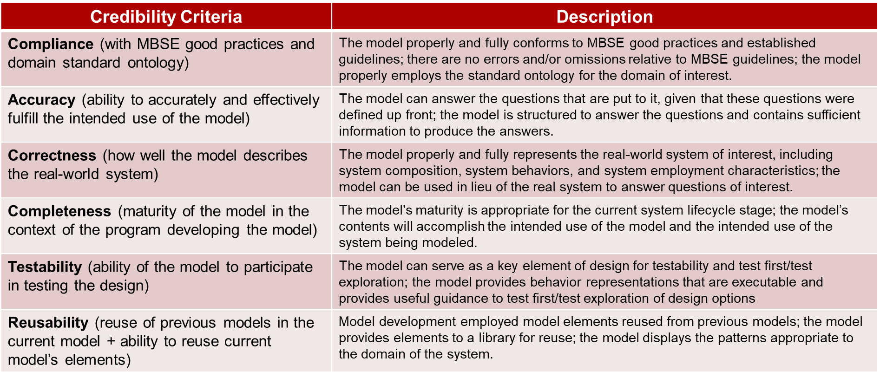
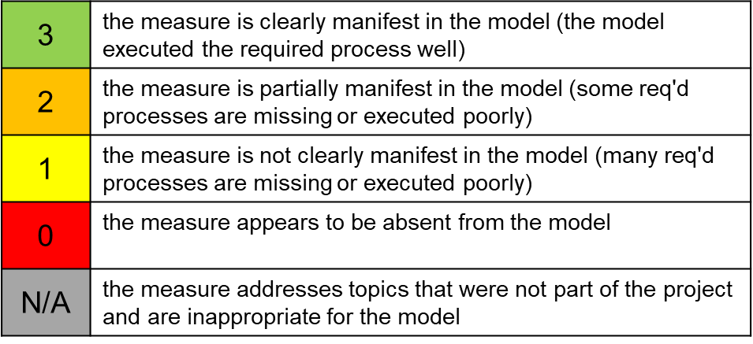
Evaluating MBSE Credibility Criteria
Each criterion has been decomposed into detailed measures related to objective characteristics of an MBSE model
While the measures require engineering judgement to evaluate, they should lead to more consistent and more reproducible evaluations.

Slide 6
Automating MBSE Model Evaluation
Some Criteria/Measures are readily automated
Compliance: Do the MBSE elements follow the program specified style guide (e.g., for naming)?
Compliance: Does the model provide traceability from architectural options to the requirements?
Correctness: Are all system functions traceable to a validated requirement?
Some Criteria/Measures could be automated for a specified MBSE ontology
Compliance: Are all triples/relationships in the model part of the domain ontology?
Completeness: Are there omitted objects? (requires domain specific MBSE guidelines)
Completeness: Are there omitted relationships? (requires domain specific MBSE guidelines)
Some Criteria/Measures could be tracked via attributes within the MBSE model
Accuracy: Are Key Performance Indicators included and mapped to relevant system elements?
Testability: Have all design experiment outcomes been used to evaluate the model's simulated behavior?
Many MBSE tools already have evaluations similar to these built into the tool; additional evaluations could be programmed via the tool’s API

Slide 7
Outcomes: MBSE Credibility Measures (1 of 12)
Criterion: Compliance (with MBSE good practices and domain standard ontology)
Measures (Part 1 of 2)
Is the model correctly based on the chosen domain standard ontology?
Are all elements of the model represented as entities that are part of the ontology?
Are the minimum number of ontology elements represented in the model?
Are all triples/relationships in the model part of the ontology?
Does the model contain specified requirement-function patterns?
Does the model structure follow a standard or MBSE guideline?
Is the model intelligible?
Can the model be navigated and understood without external help?
Does the model enable understanding of the overall design?
Does the model minimize its internal complexity?
Does the model set the stage to minimize design complexity?
Do the model artifacts follow MBSE good practice guidelines?
Do the MBSE elements follow the program specified style guide (e.g., for naming)?
Do the MBSE artifacts (e.g., diagrams, dependency matrices) follow the program specified style guide (e.g., for layout)?
Are the MBSE artifacts mapped to the proper program milestones?
Are all fit-for-purpose MBSE artifacts fully explained and mapped to the user decisions they support?
Notes:
DISCUSSION OF DEFINITION AND/OR EXAMPLES:
Incorrect object usage and incorrect relationships are errors and are addressed in this criterion.
A standard ontology for the appropriate domain should be implemented to specify the required objects and relationships within the model.
If good information is put into the wrong part of the model, then that is an error
This criterion is about following MBSE guidelines to form the model properly; following systems engineering or design standards (e.g., 15288) is addressed in correctness
MBSE guidelines are things like the DoDAF manual that define the artifacts to be creates and describe the characteristics of a high-quality artifact.

Slide 8
Outcomes: MBSE Credibility Measures (2 of 12)
Criterion: Compliance (with MBSE good practices and domain standard ontology)
Measures (Part 2 of 2)
Does the model comply with OWL 2.0 standards?
Does the model enable the full range of analyses for MBSE good practice guideline?
Does the model/model artifacts support identification of single point failures?
Does the model/model artifacts support the design analysis for surety strategy implementation?
Have elements that do not trace to a req’t been justified and accepted by the customer?
Does the model provide traceability from the architectural options to the requirements and can the model show that the options satisfy user needs?
Are there modeling tool error messages that have not yet been resolved?
Have appropriate levels of configuration management and access control been applied?
Does the model incorporate good design practices (e.g., include parameters addressing design for manufacturability)
Notes:
DISCUSSION OF DEFINITION AND/OR EXAMPLES:
Incorrect object usage and incorrect relationships are errors and are addressed in this criterion.
A standard ontology for the appropriate domain should be implemented to specify the required objects and relationships within the model.
If good information is put into the wrong part of the model, then that is an error
This criterion is about following MBSE guidelines to form the model properly; following systems engineering or design standards (e.g., 15288) is addressed in correctness
MBSE guidelines are things like the DoDAF manual that define the artifacts to be creates and describe the characteristics of a high-quality artifact.

Slide 9
Outcomes: MBSE Credibility Measures (3 of 12)
Criterion: Accuracy (ability to accurately & effectively fulfill the model’s intended use)
Measures (Part 1 of 2)
Is this model the right model for the intended use?
Have the model users been identified, and their needs incorporated into the model design?
Have the stakeholders in the model and the system been identified and their needs incorporated into appropriate model elements?
Has the scope of the architecture been determined to meet the needs of the stakeholders?
Can the model show that the scope satisfies stakeholder needs?
Does model meet the needs of the user of the model?
Does model meet the needs of the user of the system?
Have stakeholders signed off on how the MBSE model interprets their needs?
Have the critical data elements and metadata for this architecture been identified and incorporated into appropriate model elements?
Are the Key Performance Indicators included in the model and mapped to the relevant system elements
Are the Critical Success Factors for the system application included in the model and mapped to the relevant system elements?
Have the critical constraints on the system design space been incorporated into the model?
[NOTE: there may be other critical data elements and domain specific critical data elements]
Notes:
DISCUSSION OF DEFINITION AND/OR EXAMPLES:
In this context, the term "intended use" always refers to the intended use of the MBSE model.
In this context, "meeting the need of the user" refers to both the user of the system and the user of the model.
The accuracy of the model is dependent on compliance, correctness, and completeness of the model.

Slide 10
Outcomes: MBSE Credibility Measures (4 of 12)
Criterion: Accuracy (ability to accurately & effectively fulfill the model’s intended use)
Measures (Part 2 of 2)
Have the critical data elements for the model been collected through a verified and validated process?
Can the model / has the model answered the stakeholder questions? Have the stakeholders signed off on this?
Can the model distinguish between the current design and any past designs of the same system? (e.g., identify details that did not exist in previous designs)
Notes:
DISCUSSION OF DEFINITION AND/OR EXAMPLES:
In this context, the term "intended use" always refers to the intended use of the MBSE model.
In this context, "meeting the need of the user" refers to both the user of the system and the user of the model.
The accuracy of the model is dependent on compliance, correctness, and completeness of the model.

Slide 11
Outcomes: MBSE Credibility Measures (5 of 12)
Criterion: Correctness (how well the model describes the real world system)
Measures (Part 1 of 2)
Has the model development process correctly followed systems engineering standards (e.g., ISO 15288)?
Has the model been developed by staff with appropriate training in model development, systems engineering, and the real-world system?
Have the model elements been derived from valid sources using a validated process? (e.g., use cases from CONOPS, architecture from use cases, functions that are achievable)
Are all system functions traceable to a validated requirement or else properly justified and evaluated -- and disabled if needed -- for inclusion into the design?
Have functional simulations been executed and documented?
Have all errors during functional simulation been resolved?
Have procedures been employed to ensure all functional paths have been tested through simulation?
Notes:
DISCUSSION OF DEFINITION AND/OR EXAMPLES:
Correctness includes ensuring that all the information on which the model is based (e.g., requirements, CONOPS, use cases) has been validated.
The purpose of the model is to enable testing of the system before it is built; this can only be done with a correct model.
If the model correctly describes the design, but the design is flawed, then the model should enable detecting flaws that manifest themselves in the system description.
Issues arising from execution of SE standards (e.g., 15288) are addressed here as correctness issues.
Correctness is dependent on the model being properly formed (i.e., requires compliance; Correctness can only be evaluated on a Compliant model)
(the functional simulation includes sequence, state, timing and activities; OPINION: functional simulation becomes component simulation via allocation of functions.)

Slide 12
Outcomes: MBSE Credibility Measures (6 of 12)
Criterion: Correctness (how well the model describes the real-world system)
Measures (Part 2 of 2)
Do the functional simulations demonstrate the appropriate behavior for the model?
Have all behavior deficiencies been reviewed with SMEs and resolved?
Can the MBSE model be traced to detailed design models (e.g., CAD, ECAD)?
Can all elements of the detailed design model trace to the MBSE model?
Does the model provide evidence showing that the design employs good design practices (e.g., for manufacturability)
Notes:
DISCUSSION OF DEFINITION AND/OR EXAMPLES:
Correctness includes ensuring that all the information on which the model is based (e.g., requirements, CONOPS, use cases) has been validated.
The purpose of the model is to enable testing of the system before it is built; this can only be done with a correct model.
If the model correctly describes the design, but the design is flawed, then the model should enable detecting flaws that manifest themselves in the system description.
Issues arising from execution of SE standards (e.g., 15288) are addressed here as correctness issues.
Correctness is dependent on the model being properly formed (i.e., requires compliance; Correctness can only be evaluated on a Compliant model)
(the functional simulation includes sequence, state, timing and activities; OPINION: functional simulation becomes component simulation via allocation of functions.)

Slide 13
Outcomes: MBSE Credibility Measures (7 of 12)
Criterion: Completeness (maturity of the model relative to the context of the maturity of the program)
Measures (Part 1 of 2)
Are there omitted objects? (e.g., are there missing req'ts? are there missing use cases?)
Are there omitted relationships? (e.g., are there req'ts without functions? have all functions been allocated to components?)
Are there omitted system artifacts? (e.g., have all functions been addressed via behavior diagrams? have all states been included in state diagrams?)
Does the model include action plans to gather the information and build any omitted objects, relationships, or artifacts?
Have all the necessary attributes of objects and relationships been filled in?
[for early program stages] Does the model have the appropriate elements and maturity for the current point in the system lifecycle?
[for early program stages] Does the model include mitigation plans to address any missing or not yet validated requirements?
Notes:
DISCUSSION OF DEFINITION AND/OR EXAMPLES:
For a conventional systems engineering V program approach, MBSE model completeness is dependent on the program phase or milestone; completeness for conceptual design is less than completeness required for a final design.
However, the above reasoning does not apply for an agile systems development process; for agile systems development the MBSE model should represent everything that has been designed up to that point.
Overall, an MBSE model is not complete until the design is complete
Omitted data and associated relationships represent incompleteness. [Compliance addresses whether the data in the model is in the proper ontology elements; Correctness addresses whether the data in the model is correct and validated data; completeness addresses how much data have been put into the model]
The model must be properly formed in order to be complete; therefore, compliance with an MBSE guideline is a precursor to completeness.
The model must be able to display all real world system behaviors in order to be complete; therefore, correctness is a precursor to completeness.
For a specific class of systems (e.g., NW LEP) a reference architecture could be constructed and used to address completeness, compliance, correctness.

Slide 14
Outcomes: MBSE Credibility Measures (8 of 12)
Criterion: Completeness (maturity of the model relative to the context of the maturity of the program)
Measures (Part 2 of 2)
[for early program stages] Does the model include mitigation plans to address any missing specifications (TBDs or VOIDs)?
Have all the appropriate (for the current program stage) model elements been brought under configuration management, reviewed, and used to create a design baseline?
Do all system requirements have verification requirements included in the model? Are these validation requirements linked to test or other validation plans, events, and outcomes?
Have surety analyses been completed and mitigation strategies established for all surety faults? Have associated req'ts been incorporated into the model?
Does the model define HW & SW to sufficient detail to enable technical management of subcontractors providing the HW/SW?
Are any requirements partially satisfied or not satisfied by the design? Have all model details been reviewed for maturity/TRL?
Notes:
DISCUSSION OF DEFINITION AND/OR EXAMPLES:
For a conventional systems engineering V program approach, MBSE model completeness is dependent on the program phase or milestone; completeness for conceptual design is less than completeness required for a final design.
However, the above reasoning does not apply for an agile systems development process; for agile systems development the MBSE model should represent everything that has been designed up to that point.
Overall, an MBSE model is not complete until the design is complete
Omitted data and associated relationships represent incompleteness. [Compliance addresses whether the data in the model is in the proper ontology elements; Correctness addresses whether the data in the model is correct and validated data; completeness addresses how much data have been put into the model]
The model must be properly formed in order to be complete; therefore, compliance with an MBSE guideline is a precursor to completeness.
The model must be able to display all real world system behaviors in order to be complete; therefore, correctness is a precursor to completeness.
For a specific class of systems (e.g., NW LEP) a reference architecture could be constructed and used to address completeness, compliance, correctness.

Slide 15
Outcomes: MBSE Credibility Measures (9 of 12)
Criterion: Testability (ability of the model to participate in testing the design)
Measures (Part 1 of 2)
Are there sources of truth that can be used to evaluate the appropriateness of the behaviors displayed by the model?
Are the model simulation results reproducible? Do the simulation results display the system intent?
Has the model been part of experiments and reviews that have evaluated the TRL & MRL of components, assemblies, subsystems?
Has the model's behavior simulation been used as part of a design experiment?
Have all design experiment outcomes been used to evaluate the model's simulated behavior?
Have mitigation plans been developed for all test-behavior mismatches? Are these mitigation plans tracked within the model?
Have tests been identified to measure how well requirements and constraints are satisfied?
Have the model data elements been used to drive an external simulation of the system?
Notes:
DISCUSSION OF DEFINITION AND/OR EXAMPLES:
Testability includes using test and simulation to evaluate the model. (see also the reference to functional simulation under correctness)
The model must provide the "right data" for test first/test exploration; the "right data" includes constraints (e.g., power, mass, interfaces, form factor, messaging), behavior (e.g., timing, sequencing), and aspect (e.g., reusable parts, assemblies, subsystems)
Testability is not dependent on correctness, accuracy, or completeness – test exploration can be useful even if the model (design) is wrong [all models are wrong … some models are useful]

Slide 16
Outcomes: MBSE Credibility Measures (10 of 12)
Criterion: Testability (ability of the model to participate in testing the design)
Measures (Part 2 of 2)
Have all external simulation outcomes been used to evaluate the model's simulated behavior?
Have mitigation plans been developed for all simulation-behavior mismatches? Are these mitigation plans tracked within the model?
Do the model simulations clearly demonstrate the intended impact of the constraints defined in the model.
Notes:
DISCUSSION OF DEFINITION AND/OR EXAMPLES:
Testability includes using test and simulation to evaluate the model. (see also the reference to functional simulation under correctness)
The model must provide the "right data" for test first/test exploration; the "right data" includes constraints (e.g., power, mass, interfaces, form factor, messaging), behavior (e.g., timing, sequencing), and aspect (e.g., reusable parts, assemblies, subsystems)
Testability is not dependent on correctness, accuracy, or completeness – test exploration can be useful even if the model (design) is wrong [all models are wrong … some models are useful]

Slide 17
Outcomes: MBSE Credibility Measures (11 of 12)
Criterion: Model Reusability (ability of the model to reuse elements from a model library and to provide elements into such a library)
Measures (Part 1 of 2)
Has the domain of the system been clearly defined from the perspective of identifying existing models that represent the domain?
Have previous models representing this domain been identified and obtained for reuse?
Have design and/or model patterns been identified to characterize the models representing this domain?
Has a library or compendium of model (design) elements been established from which reusable model elements can be derived?
Does the model reuse elements from other models in the system's domain?
Does the model reproduce the patterns that are displayed by models in the system's domain?
Notes:
DISCUSSION OF DEFINITION AND/OR EXAMPLES:
A model that reuses many entities, relationships, model segments, etc. from other models is a good model.
A model that provides many entities, relationships, model segments, etc. to a library for reuse is a good model.
A system's domain includes an ontology that must be used correctly. And it also includes a design and modeling body of knowledge represented in a set of design/model patterns; the design patterns should be reused as new systems are developed.
A model must be compliant, accurate, and correct in order to be reused; however, a reusable model need not be complete and it may not meet all testability measures.

Slide 18
Outcomes: MBSE Credibility Measures (12 of 12)
Criterion: Model Reusability (ability of the model to reuse elements from a model library and to provide elements into such a library)
Measures (Part 2 of 2)
Does the model include elements that are not present in the domain compendium and that could be reused in future system developments in this domain?
Does the model manifest patterns that have not been observed in this domain and that could be the basis for future system developments in this domain
Notes:
DISCUSSION OF DEFINITION AND/OR EXAMPLES:
A model that reuses many entities, relationships, model segments, etc. from other models is a good model.
A model that provides many entities, relationships, model segments, etc. to a library for reuse is a good model.
A system's domain includes an ontology that must be used correctly. And it also includes a design and modeling body of knowledge represented in a set of design/model patterns; the design patterns should be reused as new systems are developed.
A model must be compliant, accurate, and correct in order to be reused; however, a reusable model need not be complete and it may not meet all testability measures.

Slide 19
Please Take One of the Handouts
Our team would greatly value your review and feedback
Are these questions useful?
Are there additional questions?
Do you think you could score a model using these?
Are there questions you think could be automated?
Please take one of the handouts and provide us with your contact information
We will contact you to set up a time to talk
Thank You!
POC: Ed Carroll
Sandia National Laboratories
ercarro@sandia.gov

