Slide 1
INCOSE International Symposium MBSE Track INCOSE MBSE Initiative System Modeling
John C. Watson
Principal Member of Engineering Staff
Lockheed Martin, MST Moorestown, NJ
john.watson@lmco.com

Slide 2
Agenda
Methodology and Metrics MBSE Activity
MBSE Workshop System Modeling Breakout Session Summary
2

Slide 3
Methodology and Metrics MBSE Activity
Supporting Wiki
http://www.omgwiki.org/MBSE/doku.php?id=mbse:methodology
Overview Info
Share Information
Links to topics of interest

Slide 4
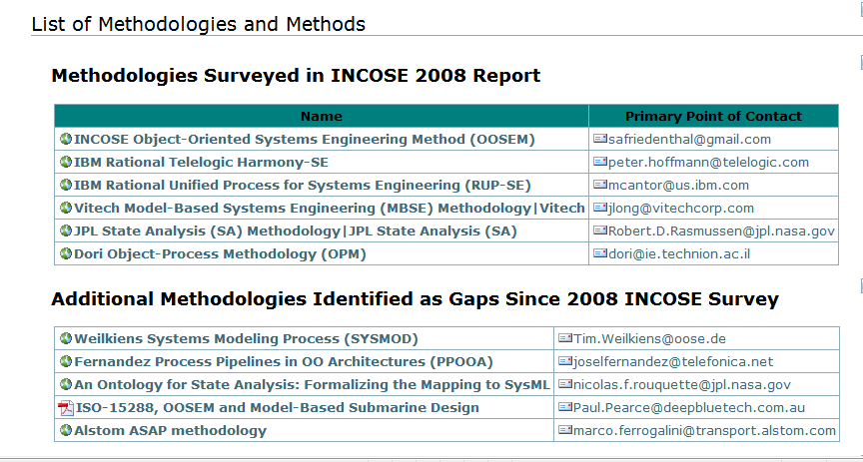
List of MBSE Methodologies/Methods
11 captured to date
Each Includes a Wiki page containing an abstract, reference material and POCs
4

Slide 6
Metrics - ROI
Lack of ROI Information
MBSE Barrier to Change
Understand Risk, Cost and Benefits of change
Catch-22!
Can’t measure it until we do it
Can’t do it until we measure it
Metrics Information few and far between
Sensitive or Proprietary
Simply not collected or published
“Apples to Apples” comparison difficult to find
6

Slide 7
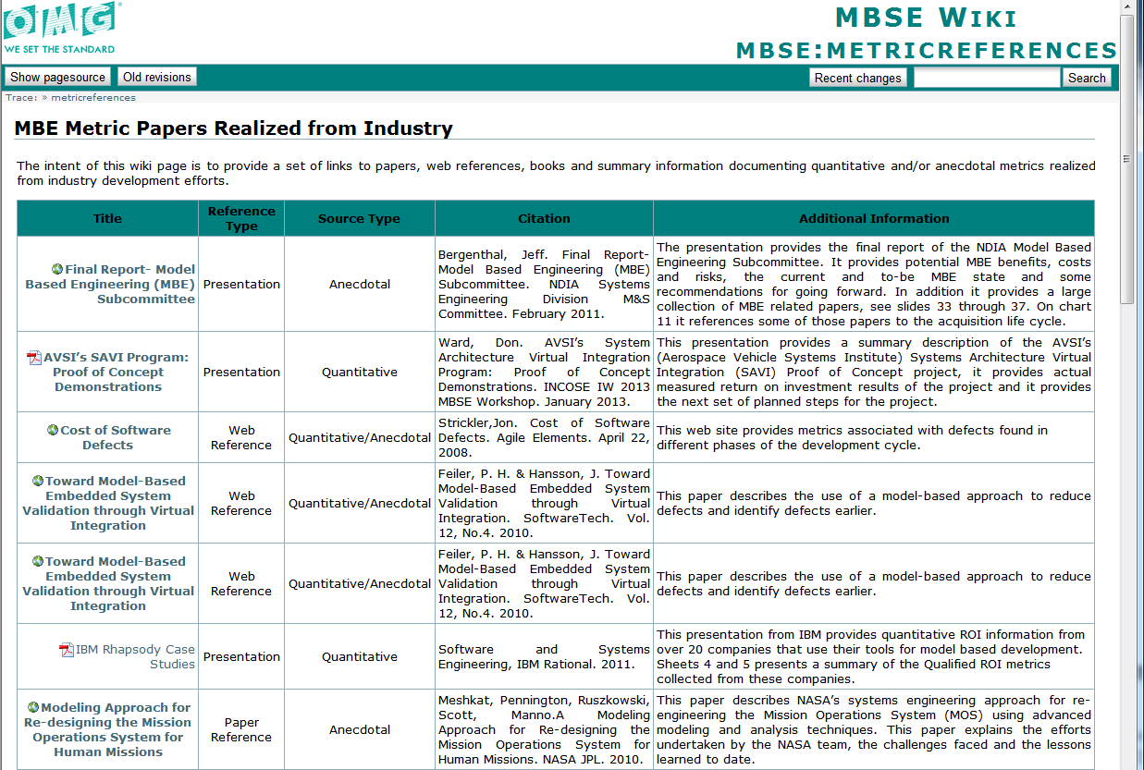
23 MBE Metric Papers Collected
7

Slide 8
Methods and Metrics
Need your help
Know of any Methodologies that should be posted?
Know of any metrics references/papers/links worth sharing?
If so, please contact john.watson@lmco.com
8

Slide 9
INCOSE IW 2013 MBSE Workshop System Modeling Breakout Session
Objectives
To focus on the topic of System Architecture and Requirements Flowdown
To be a forum for information exchange
To network with experienced model-based developers
Share, learn and ask questions
3 Presentations + Open Discussion
44 People attended
9
Notes:
About 40 People attended
Format – 3 Guest Speakers and an open panel discussion session, “Where we are vs. where we want to go”

Slide 10
Guest Speaker - Rick Steiner, Raytheon
Top Management sees value in Model Based approaches
“The model is the [System] design”
Brian Wells Video @ IBM Innovate 2012
Publicly Discussed Techniques and Methods
Software Innovation for Tomorrow (SWIFT)/Advanced Software Productivity Environments (ASPEN)
Virtual Solution Development (VSD™)
Rapid cross-domain collaboration toward a Point of Departure Design
Model Based Distributed Integration and Test
Concept Engineering/Mission Profiling
SE/SW Interface for Algorithm Development
Mechanical CAD Model Based Enterprise
Multi-Disciplinary Design Optimization
Physics Based Modeling for Embedded Systems
Raytheon is on the threshold of major MBE/MBSE deployment
10

Slide 11
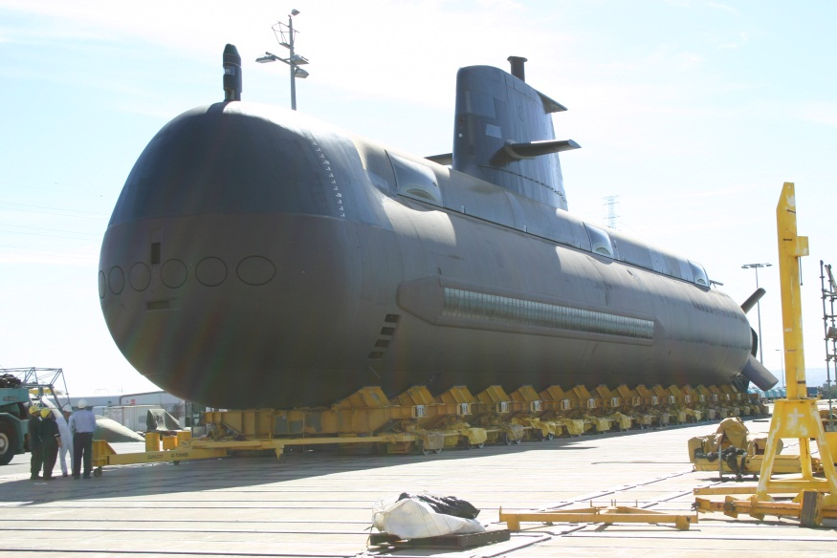
Guest Speaker - Paul Pearce, Deep Blue Tech
Introducing MBSE to a Submarine Concept Design Team
Successor to the existing Collins Class
Buy-in has been a challenge
Going Forward
Increasing perceived value to Naval Architects
Leveraging the design process
Promoting the System Model to help the team specify and develop submarine designs
11

Slide 12
Guest Speaker - Chris Delp, JPL
Views and Viewpoints
MBSE success has a strong dependence on the capability to communicate with stakeholders and system implementers
Purpose
Defines a Stakeholder perspective, the concern and a method
Method can include the query, presentation and analysis
Presentation provides a excellent overview with many examples
Continuing work at the SysML RTF

Slide 13
Open Discussion
Agile
Views & Viewpoints
Management Support
Validation Support
Technical Review support, PDR/CDR
Metrics
ROI
Continuous measurement
Do we measure?

Slide 14
Conclusion
MBSE – An environment for automation
Cheaper, Better, Faster
Managing Complex System development
Take away
Not so much - “how do we model”
More – “How do we integrate domains and share”

Slide 15
Thank You

