Slide 1
2018 Military Operations Research Society (MORS) Emerging Techniques Forum (ETF)
Exchanging Model-Centric Digital Artifacts for the System Life Cycle
Ms. Philomena Zimmerman
Deputy Director, Engineering Tools & Environments
Office of the Under Secretary of Defense for Research and Engineering
December 5, 2018

Slide 2
Abstract
Herbert F

Slide 3
The Challenge
Why is it so hard to exchange engineering artifacts in a digital era?
Notes:
Upcoming Charts:
1. The Digital Exchange Context Crossing the Buyer-Seller-User Boundaries
How do we exchange digital artifacts using historical contracting-language from a document-based tradition?
2. Problem Statement: Digital Artifact Conversion Occurs
The World of Data Item Descriptions (DID) & Contract Data Requirements List (CDRL)
“The Cycle of Create and Recreate”

Slide 4
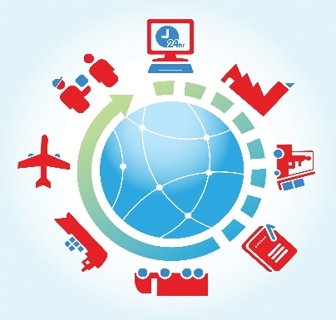
The Digital Exchange Context Crossing the Buyer-Seller-User Boundaries
Upstream DEIX Downstream DEIX
Service Providers
Manufacturers
Wholesalers
Resellers
Prime Contractors
System Integrators
Major Distributors
Organizations of Interest
Acquisitions Org.
Procurement Org.
Sponsor Org.
Operators
Logisticians
Maintainers
N-Tier Suppliers
1st Tier Suppliers
Users / Consumers
Digital Artifacts Conversion Occurs
Digital Artifacts Conversion Occurs
Digital Artifacts Conversion Occurs
How do we exchange digital artifacts using historical contracting-language from a document-based tradition?
Notes:
Message:
There is an unwanted Digital Artifact Conversions that repeatedly occurs in our current system
The redundancy and rework increases cost and time across the entire supply chain
When you multiply that by every conversion in a global supply chain and across each systems’ lifespan, then you have gross inefficacies

Slide 5
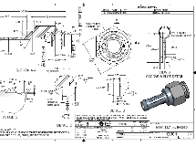
Problem Statement: Digital Artifact Conversion Occurs
The World of Data Item Descriptions (DID) & Contract Data Requirements List (CDRL)
“The Cycle of Create and Recreate”
ACQUIRER
Acquirers Create in Tools
Converts to e-Documents for dissemination
Suppliers Recreate in Tools
Suppliers Create in Tools
Converts to e-Documents per Acquirer’s Instructions
Acquirers Recreate in Tools
SUPPLIER
Notes:
Message:
Despite advances in the digital era, when we currently ask for digital artifacts senders convert them from the their digital environment to a transport format then we convert them back to the requesters’ digital environment
It occurs between Suppliers and Buys’ digital environments
It occurs between technical disciplines’ computer aided technologies (CAx)
It occurs between business functions’ specialized enterprise information systems
What if, we had a standard convention for requesting, offering, and exchanging digital artifacts in a seamless fashion

Slide 6
A Conceptual Approach
A New Way of Thinking about Exchanging Digital Engineering Information
Notes:
Upcoming Chart:
The Computer Aided Conversion: From Digital Artifact to Stakeholder Wisdom
Digital Artifact to Software Enabled Digital Viewpoint to Interactive Digital View

Slide 7
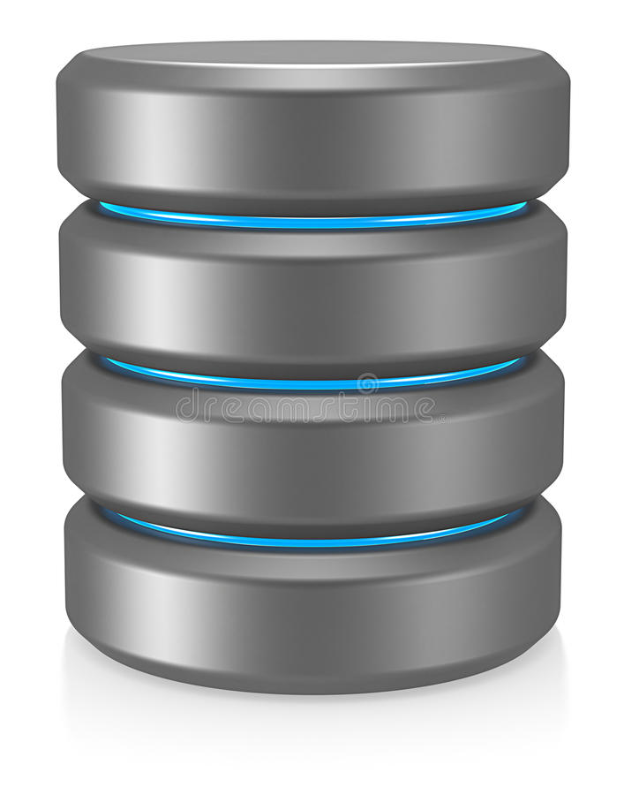
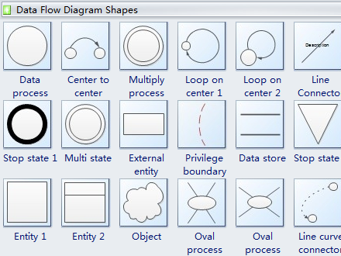
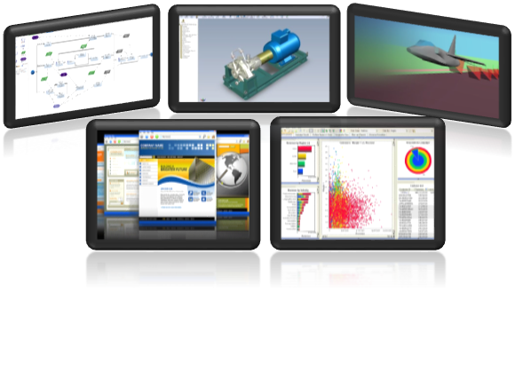
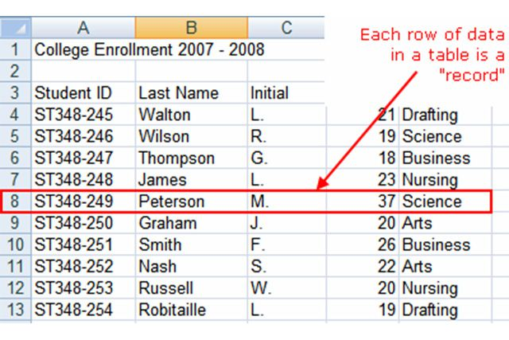
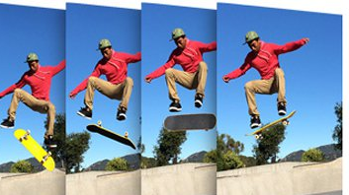
The Computer-Aided Conversion: From Digital Artifact to Stakeholder Wisdom
Digital Artifacts
Software Enabled Digital Viewpoint
Interactive Digital View
Model Elements
Assembling Digital Artifacts
Data Records
Access, Exchange, or Synchronize
Retrieve or Reference
Geometric Primitives
Digital Viewpoint as Digital Artifact
Video Frames
Digital View as Digital Artifact
Notes:
A Conceptual Model for Automated Digital Artifact Conversions
Digital Viewpoint
A user experience design that defines how digital technology can select, compile, and present digital artifacts to create digital views for stakeholders
Digital View
The user interfaces that allows stakeholders to interact with a variety of digital artifacts in ways that serve their unique needs

Slide 8
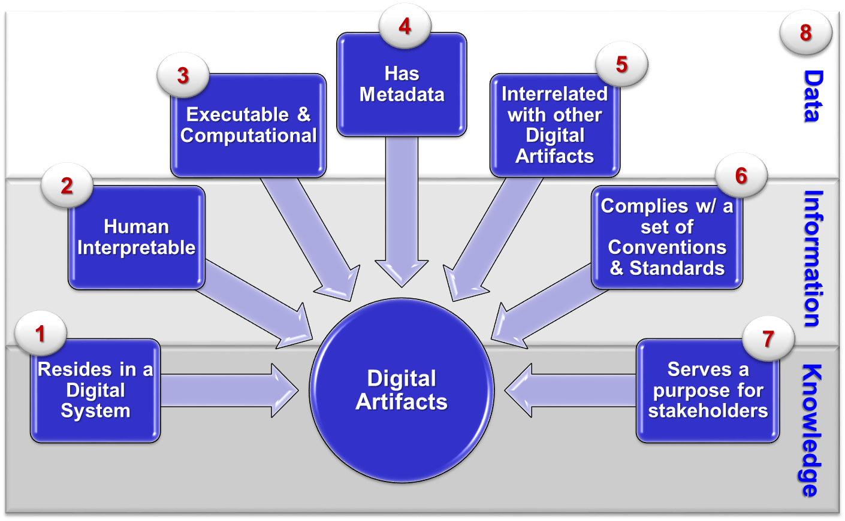
An Evolved Concept of Digital Artifact
Any digital object produced with digital technology
It represent concepts, items, or phenomena.
Contains following Characteristics:
_{Authoritative Sources of Truth}
Notes:
The Concept
A digital artifact is any combination of professional data, information, knowledge, and wisdom (DIKW) expressed in digital form
It is exchanged within a digital ecosystem.
During an exchange, the originator’s digital form of DIKW remains intact and is interpretable by the recipient.
Professionals create digital artifacts when they use digital technologies to produce or convert their DIKW into digital forms.
Digital artifacts encode data, behaviors, attributes, or properties that software uses to retrieve and display the professionals’ DIKW.
It possesses some of the following characteristics:
Resides in a digital device or system
Human interpretable
Executable and computational
Has metadata
Interrelated to other digital artifacts
Complies with a set of conventions & standards
Serves a purpose for stakeholders
Contains data, information, knowledge or wisdom (DIKW)

Slide 9
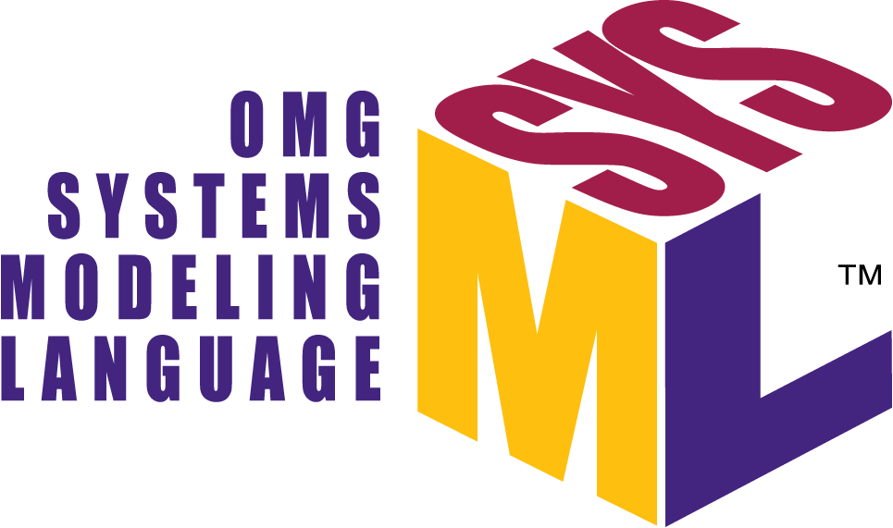
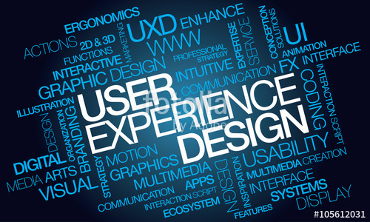
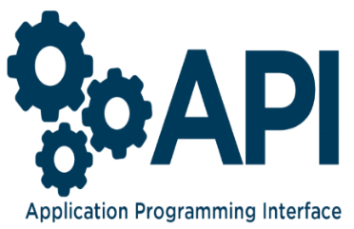
Converting Digital Artifacts to Digital Views Digital Viewpoint
Examples Digital Viewpoint Conventions
An information model or design
Selects, compiles, and displays digital artifacts
Software enabled conversions
Catalyst for digital artifact exchange
Query Languages
User Experience Design (UXD) / User Interface Design (UID)
Notes:
The Concept
The digital viewpoint defines the digital view.
It uses conventions, formalisms, and standards to define procedures to select, compile, and layout, digital artifacts
The viewpoint is digital because it is applied to a set of digital artifacts using software and digital technology to produce the digital view.
Experts would design digital viewpoints to fulfill the stakeholders’ need to make decisions, conduct responsibilities, or both.
The digital viewpoint defines…
One or more digital artifacts,
The standards and conventions to compile the digital artifacts,
The operations to present digital artifacts in any digital multimedia formats
The digital viewpoint may include constructs that specify the type, structure and organization of content; such as…
models
designs
computer algorithms
Thus, the digital viewpoint is a design for a digital, interactive, multimedia view of digital artifacts based on...
Stakeholder requirements
Sources of digital artifacts
Formalisms and standards

Slide 10
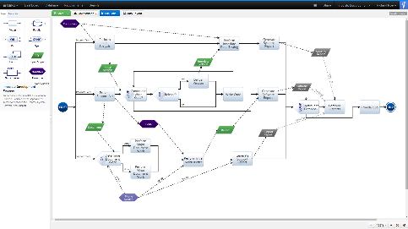
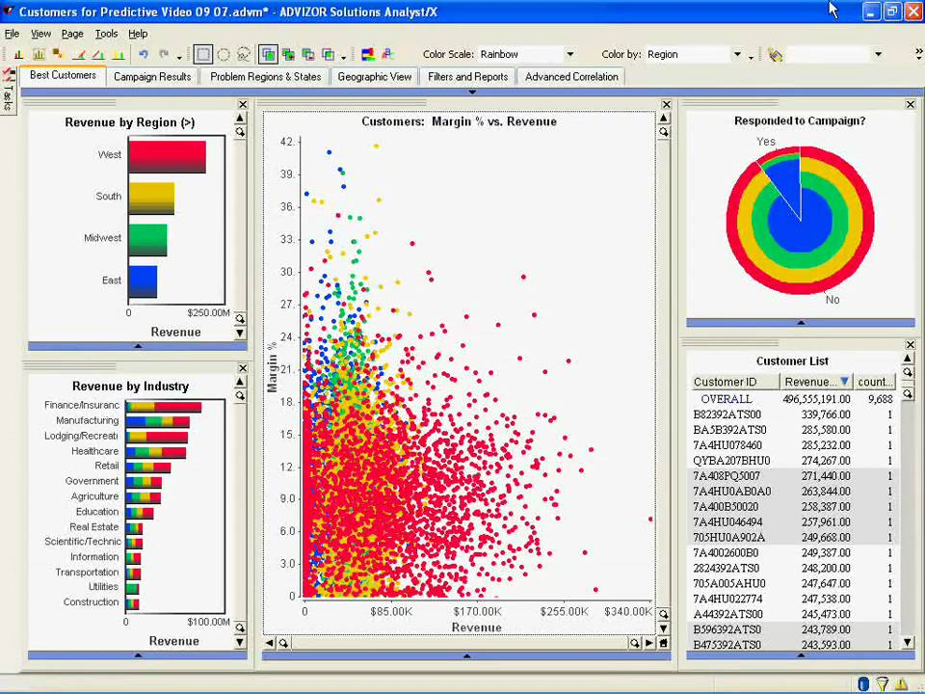
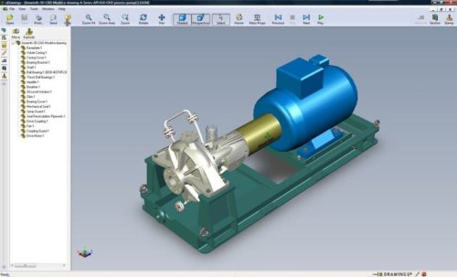
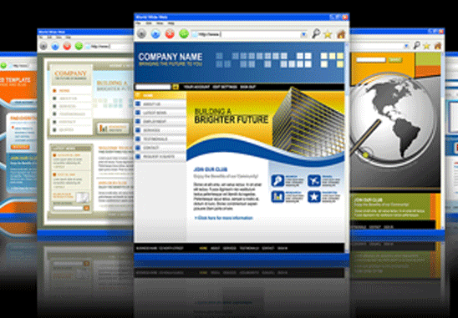
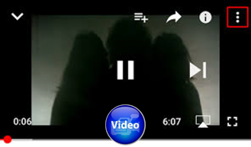
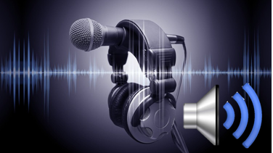
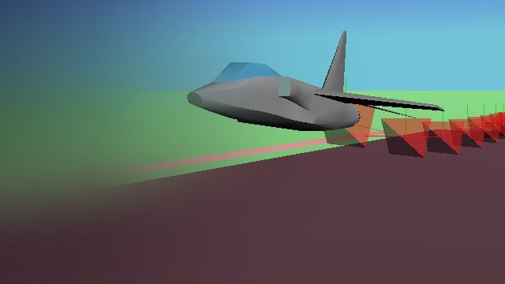
Converting Digital Views to Stakeholder Wisdom The Digital View
Examples of Digital Views
An interactive view on a digital display device
It includes one or more assembled digital artifacts
It enables stakeholders' unique activities
It conforms to its digital viewpoint
2-D SE Models & Diagrams
Dynamic Data Visualization
3-D PDF’s w/ 360º Perspectives
Videos of Tests
Dynamic Multimedia / Hypermedia Content
Decision Meeting Audio Recordings
Animations of Simulations
Notes:
The Concept
An interactive view on an electronic display of one or more digital artifacts
The digital artifact content enables stakeholders’ unique activities at any phase in the system lifecycle
It conforms to the conventions established by the digital viewpoint
The digital view relies on a wide variety of digital technologies and software applications for interactive viewing
Many digital artifacts are born digital and rely on graphical software linked to databases, computational software, and graphical software
With the advantages of digital technology, the stakeholder can specify the type of digital artifacts they view and how they interact with it
With the advances in multimedia and hypermedia, the stakeholder can take advantage of the digital technology capabilities to navigate complex information relationships and visualize the digital artifacts in new and intuitive ways.

Slide 11
The Payoff
Leverage the power of
digital automation and
multimedia displays
Notes:
Upcoming Chart:
The Computer Aided Conversion: From Digital Artifact to Stakeholder Wisdom
Digital Artifact to Software Enabled Digital Viewpoint to Interactive Digital View

Slide 12
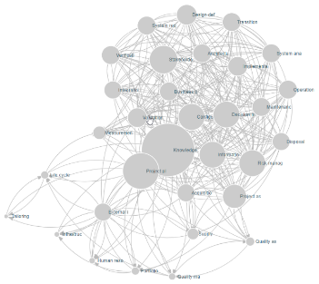
Opportunity Statement: Automated, Synchronized, & Interactive Digital Artifacts
The World of Digital Engineering Information Exchange
“Seamless Exchanges in a Digital Ecosystem”
Acquirer Creates Digital Artifacts
Software Enables Digital Viewpoints
Acquirer Grants Access to Digital Views
And / Or
Acquirer exchanges or synchronizes Digital Artifacts
ACQUIRER
Supplier Creates Digital Artifacts in tools
Software Enables Digital Viewpoints
Supplier Grants Acquirer Access to Digital Views
And / Or
Supplier exchanges or synchronizes Digital Artifacts
SUPPLIER
Notes:
Message:
We have an opportunity to automate, synchronize, & interactively access or exchange Digital Artifacts
We Need to…
Leverage the power of new digital technologies so digital viewpoints can convert and exchange digital artifacts
Enrich the access to models and data by using digital views and leveraging the capabilities of multimedia and interactive technologies
Define a conventional approach to encapsulate and share professionals’ DIKW in digital artifacts
Consider trade-offs for Accessing versus Exchanging digital artifacts
Take-away: Once we agree on conventional ways to share digital artifacts, we can avoid the create and recreate cycle

Slide 13
How You Can Help: Digital Engineering Information Exchange Working Group (DEIX WG)
Primary Goal of DEIX WG:
To identify conventional ways to define, request, offer, and exchange graphical and non-graphical digital artifacts between stakeholders across the systems life cycle.
Need Volunteers for Products:
Digital Artifacts List (DAL): Systems engineers to define digital artifacts required for ISO/IEEE/IEC 15288 audits & reviews
DEIX Model: Modelers to define & model aspects of the DE information exchange concepts
DEIX Encyclopedia/Wikipedia: Writers to write encyclopedia entries on relevant concepts
DEIX Framework of Standards: Researchers to research, catalog, and perform gap analysis of existing and emerging standards
For more Information go to OMG MBSE Wiki:
http://www.omgwiki.org/MBSE/doku.php
Notes:
Primary Goal of Digital Engineering Information Exchange Working Group:
To Identify conventional ways to define, request, offer and exchange graphical and non-graphical engineering information between buyers, suppliers, and disciplines across the systems life cycle.
Products:
Digital Artifacts List (DAL): A List of defined Digital Artifacts to acquire or procure
Need Volunteers: Systems engineers to define digital artifacts required for 15288 audits & reviews
DEIX Model: A set of models and descriptions of important concepts to exchange digital artifacts
Need Volunteers: Modelers to define & model aspects of the DE information exchange concepts
DEIX Encyclopedia/Wikipedia: Entries on core DEIX concepts
Need Volunteers: Writers to write encyclopedia entries on relevant concepts
DEIX Framework of Standards: Diagrams & descriptions of existing related standards
Need Volunteers: Researchers to research, catalog, and perform gap analysis of related standards

Slide 14
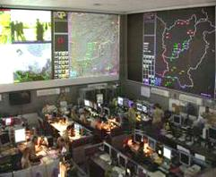
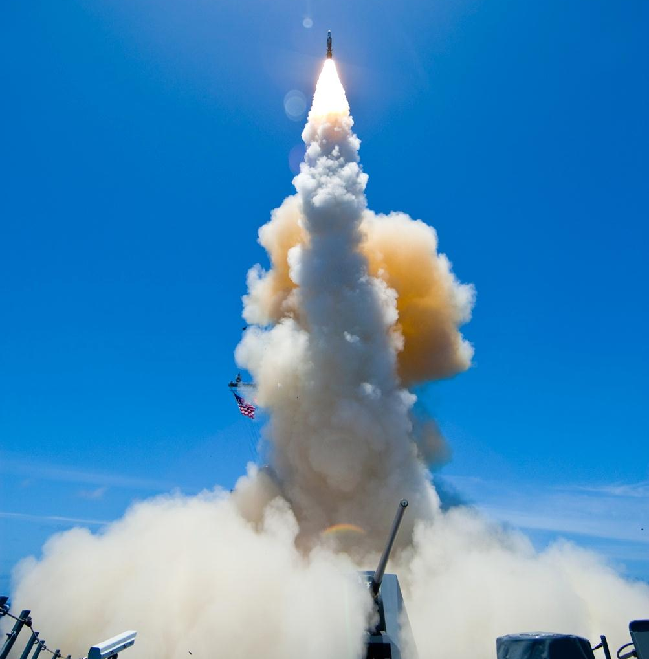
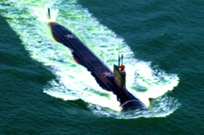
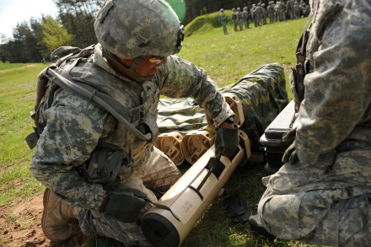
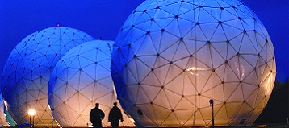
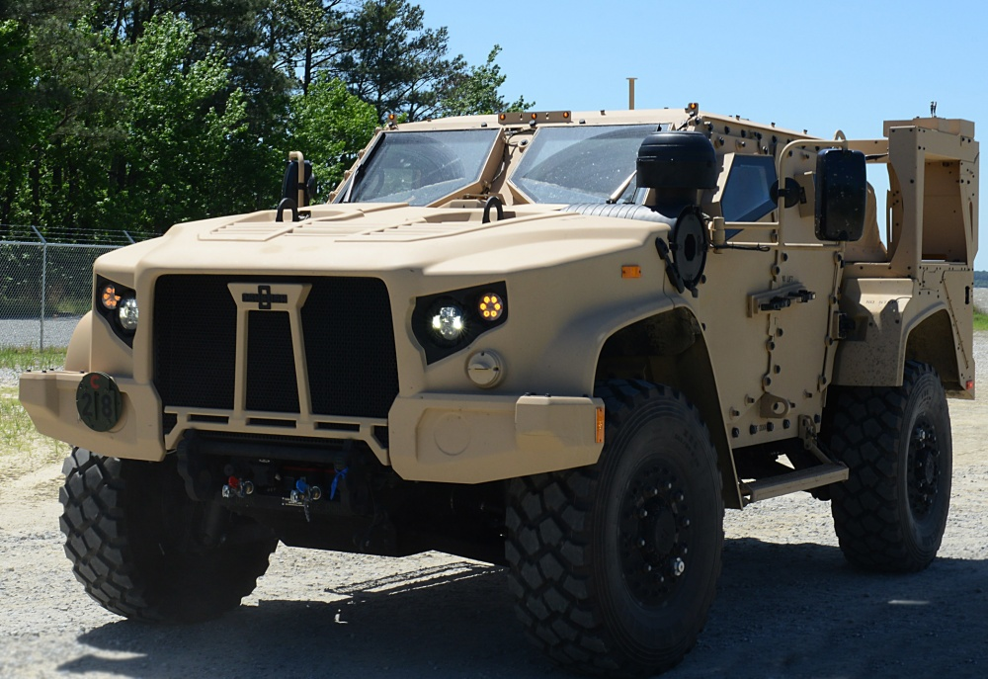
DoD Research and Engineering Enterprise Solving Problems Today – Designing Solutions for Tomorrow
DoD Research and Engineering Enterprise
https://www.acq.osd.mil/chieftechnologist/
Defense Innovation Marketplace
https://defenseinnovationmarketplace.dtic.mil
Twitter
@DoDInnovation

Slide 15
For Additional Information
Philomena Zimmerman
Office of the Under Secretary of Defense
Research and Engineering (571) 372-6695 Philomena.M.Zimmerman.civ@mail.mil
John H. Coleman III, Ph.D.
Engility Contractor Support (571) 371-6447 | John.H.Coleman10.ctr@mail.mil
Notes:
If you have follow up questions or concerns, our contact information is listed here.

