Slide 1
National Defense Industrial Association Systems Engineering Division Modeling and Simulation Committee
Group #1 – Artifact Concept Model
13-14 AUG 2018
Group Lead
Group Company

Slide 2
Approach
Review current concept
Definition of Artifact
Definition of Dataset
Stakeholder Relationships with other concepts
Work through Specification Example

Slide 3
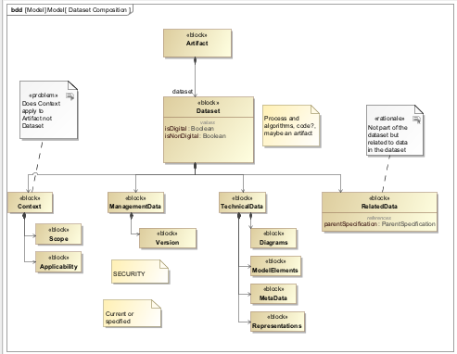
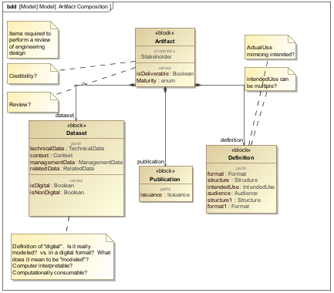
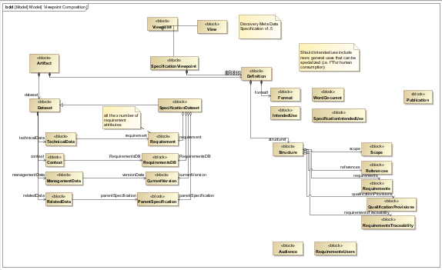
Examples
Dataset Definition
Artifact Definition
Specification Definition

