Slide 1
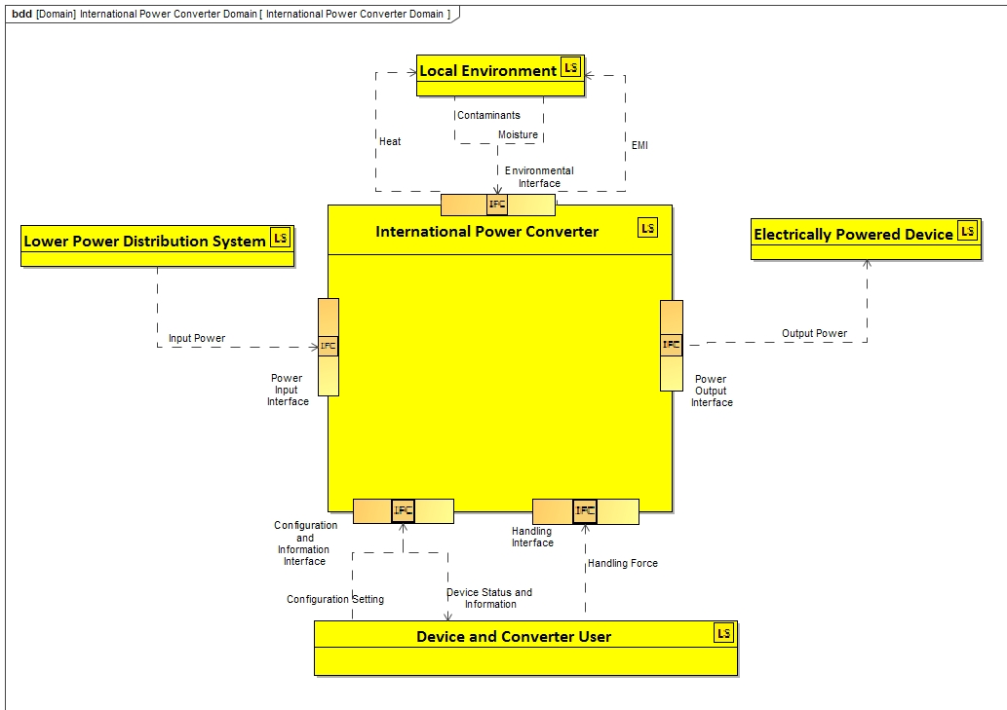
Ideas for Specific ST4SE Project Distributable (or Accessible) Demonstration Deliverable
Team meeting of Feb 9, 2021
B Schindel
schindel@ictt.com
V1.2.1

Slide 2
Demonstration / example deliverable
Demonstrate the “two way” use of pattern information promised by the original project charter (auto checking versus auto generating of models):
Configuring the International Power Converter Product Pattern to auto-generate two different configured SysML models:
DeLuxe Traveler Configuration (more countries and higher power capacity)
Economy Traveler (fewer countries and lower power capacity)
Given two manually-constructed SysML models, auto-check them for model errors:
Well-formedness against basic S*Metamodel pattern rules
Domain-specific against Power Converter Product pattern rules for power converters

Slide 3
Possible well-formedness rules, against basic S*Metamodel pattern
Need to convert these to more precise statements using the pattern’s ontological names (relationships and classes)
An S*Interface must have at least one associated S*System.
An S*Interface must have at least one associated S*Functional Interaction.
An S*Interface must have at least one associated S*Input/Output.
An S*Interface must have at least one associated S*System of Access.
Each S*Input/Output associated with an S*Interface must be associated with one S*Functional Interaction also associated with that S*Interface.
Each S*Input/Output associated with an S*Interface must be associated with one S*System of Access also associated with that S*Interface.
Each S*Architectural Relationship associated with an S*Interface must be associated with at least on S*Input/Output also associated with that S*Interface

Slide 4
Possible domain-specific rules, against Power Converter Product pattern for power converters
Configured Local Power Interface connector types should match configured Countries Supported list.
Configured Converter Capacity should match configured Power Level Option
Configured Circuit Breaker capacity should match configured Power Level option
All Input/Outputs associated with Electrical Power Interfaces should be types of Electrical Energy.
All Functional Interactions associated with Electrical Power Interfaces should be types of Transfer Electrical Energy Interaction.
All System of Access associated with Electrical Power Interfaces should be types of Power Distribution SOA.
Need to convert these to more precise statements using the pattern’s ontological names (relationships and classes)

Slide 5
Related questions
The above include the previous list of informally-stated rules, which need to be more precisely re-stated.
Can we come up with a “user friendly” view of results which is minimizes number of languages which need to be familiar?
Would an on-line (web based) version be easier for people who want to get their feet wet without setting up their own environment first?
Other questions . . .

