Slide 1
INCOSE Digital Artifacts Challenge Team
Team Lead: Ms. Philomena Zimmerman
Deputy Director, Engineering Tools and Environments
ODASD(SE) / Engineering Enterprise
Workshop Team:
Frank Salvatore, Dr. John Coleman, Dr. Tracee Gilbert,
Darryl Howell, Nathaniel Barley
January 21-22, 2018

Slide 2
Topics
Digital Artifacts Challenge Team
Workshop Activities

Slide 3
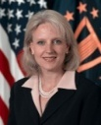
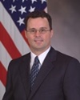
DASD, Systems Engineering
Acting Deputy Assistant Secretary of Defense and Principal Deputy, Systems Engineering Kristen Baldwin
Homeland Defense Capability Development
Robin Hicks
Major Program Support James Thompson
Engineering Enterprise Robert Gold
Supporting USD(AT&L) Decisions with Independent Engineering Expertise
Engineering Assessment / Mentoring of Major Defense Programs
Program Support Assessments
Overarching Integrated Product Team and Defense Acquisition Board Support
Systems Engineering Plans
Systemic Root Cause Analysis
Development Planning/Early Systems Engineering
Program Protection
Leading Systems Engineering Practice in DoD and Industry
Systems Engineering Policy and Guidance
Technical Workforce Development
Specialty Engineering (System Safety, Reliability and Maintainability, Quality, Manufacturing, Producibility, Human Systems Integration)
Security, Anti-Tamper, Counterfeit Prevention
Standardization
Engineering Tools and Environments
Providing technical support and systems engineering leadership and oversight to USD(AT&L) in support of planned and ongoing acquisition programs

Slide 4
Digital Artifacts Challenge Team History
The International Council on Systems Engineering’s (INCOSE) International Workshop (IW) 2017 highlighted the need to establish an accepted set of Digital Artifacts to help the Systems Engineering (SE) practice transform to a more model-based discipline
Participants made requests to the INCOSE SE Transformation Team and the Model-Based Systems Engineering (MBSE) Initiative to start a more enduring “Digital Artifacts” effort
INCOSE SE recommended standing up a Digital Artifacts Challenge Team
Digital Artifacts Challenge Team is a result of INCOSE IW 2017 activities

Slide 5
Digital Artifact Challenge Objectives
Advance understanding & acceptance of a finite set of Digital Artifacts that industry can institutionalize
Identify and describe Digital Artifacts required to support the entire life cycle of a system or product to include:
Engineering activities
Life cycle phase transition
Manufacturing process
Collaboration between domains
Business processes
Etc.

Slide 6
Digital Artifacts Concepts
Digital Artifacts (DAs) are produced within, or generated from, the activities with a digital engineering ecosystem.
These artifacts provide data, algorithms and/or processes used to visualize, communicate, deliver information and knowledge to stakeholders, and are used to aid in making decisions.
Digital artifacts can be thought of as those elements that describe any aspect of a system (physical, functional, analytical) and which can be executed in, or used in execution in a computing environment.
Shift the emphasis in Systems Engineering away from documents and towards digital artifacts.

Slide 7
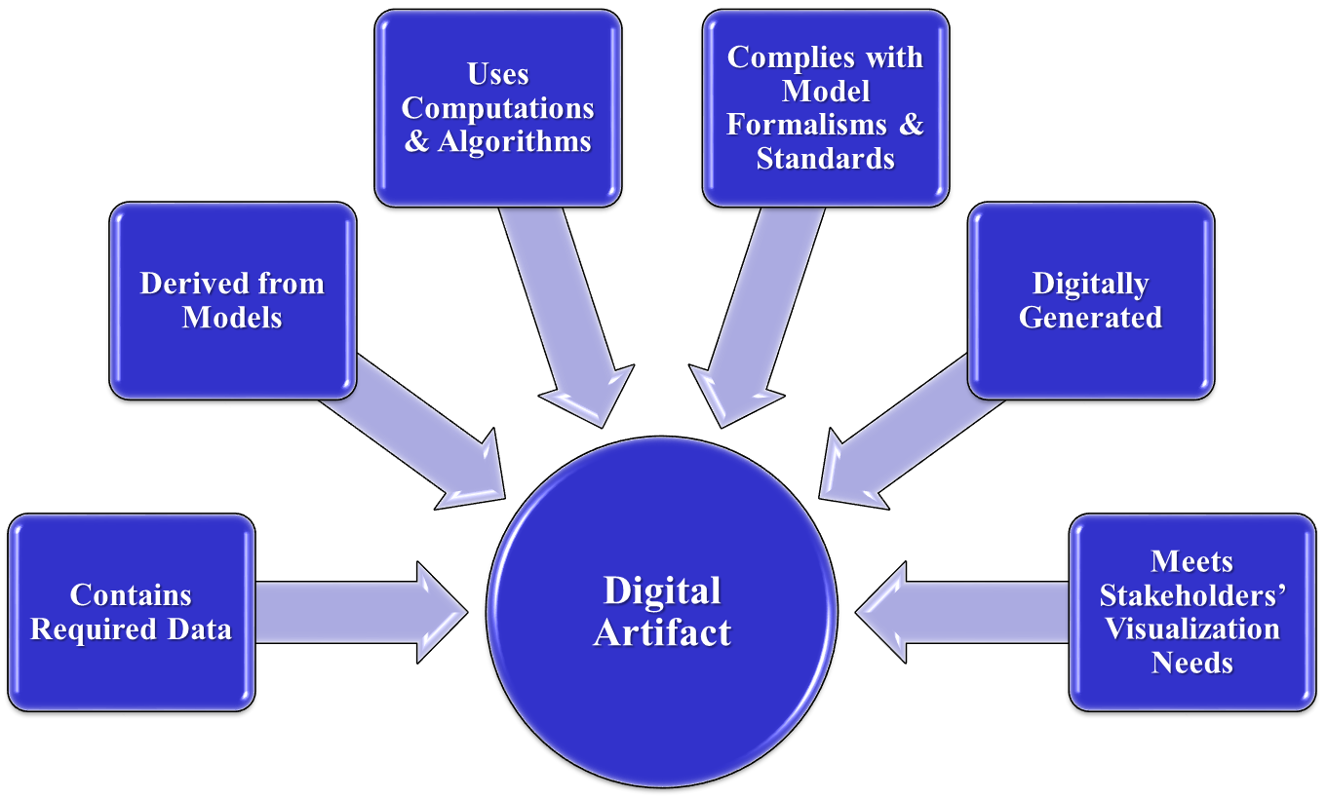
Generic Digital Artifact Concepts

Slide 8
Plan Overview / Description
Supplement start-up team membership with other interested team members, sharing and refining charter and gaining team buy-in to this plan
Bring team membership to a common level of Digital Artifacts understanding
Hold Digital Artifact working sessions and collaborate with other working groups to elicit Digital Artifacts
Create and validate targeted Challenge Team products, prioritized from above
Make Challenge Team products available to INCOSE membership, extending benefits
At the IW we will spend time to work on this. We need your help!

Slide 9
Digital Artifacts Workshop Agenda
Sunday 1/21/2018
1300 - 1315 Welcome & Introductions
1315 - 1330 Define Digital Artifacts Challenge Overview
1330 - 1500 Part-I Breakout: Architecture Decomposition & Definition
1500 - 1530 Break
1530 - 1600 Prepare for Brief-outs
1600 - 1700 Brief results for Architecture Decomposition & Definition
1700 - 1715 Wrap up
Monday 1/22/2018
1300 - 1315 Welcome & Introductions
1315 - 1330 Summary & Breakout Group Refresher
1330 - 1500 Part-II Breakout: Architecture Integration & Verification
1500 - 1530 Break
1530 - 1600 Prepare for Brief-outs
1600 - 1645 Brief results of Architecture Integration & Verification
1645 - 1700 Wrap up

Slide 10
For Additional Information
Name: Frank Salvatore
Phone:(973) 634-2957
email1: frank.salvatore@engility.com
email 2: frank.j.salvatore.ctr@mail.mil

