Slide 1
FIBO Proof of Concept for Blockchain Applications
WASN’T PRESENTED
OMG Finance Domain Task Force
Boston, MA
June 19 2018
Mike Bennett – Hypercube Ltd. – EDM Council Inc.

Slide 2
Overview
Exploration by Object Management Group Finance Domain Task Force
Premise: Use FIBO ontology as standard concept model for Smart Contracts in Blockchain
Exploration of concept model parameters
Chosen PoC; Interest Rate Swaps
FIBO exploration and extension

Slide 3
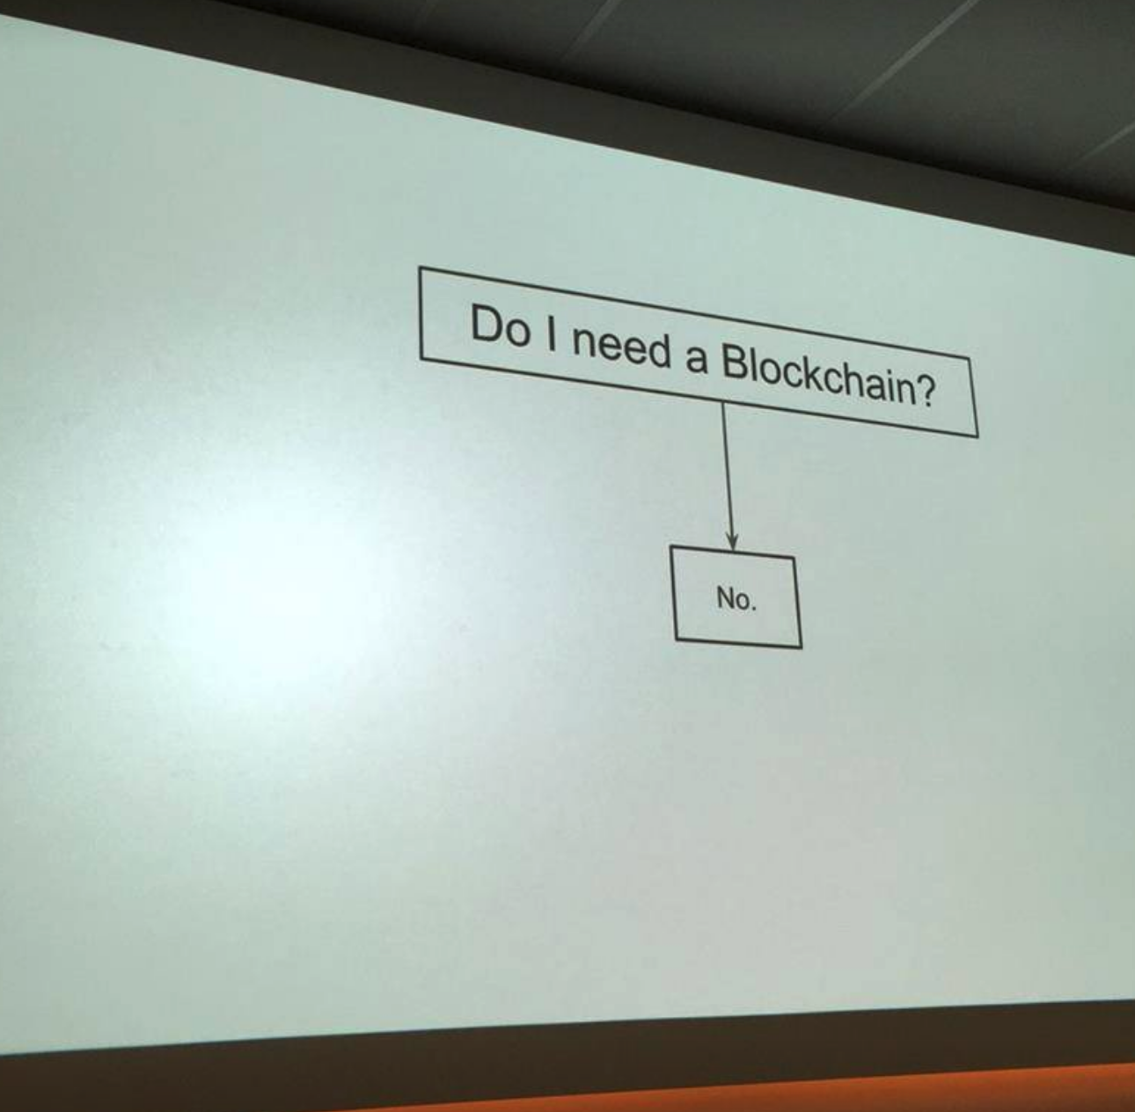
Blockchain…

Slide 4
Blockchain…

Slide 5
Actually
The value in Blockchain is in the architecture
Not only used for cryptocurrency
Anything that benefits from un-repudiatable data records
Anonymity versus performance
Not every application suddenly needs to be done on Distributed Ledgers
But there are many new opportunities that do
And many new architectures that open up the potential application space

Slide 6
Blockchain and Distributed Ledgers
Origin: BitCoin, paper Satoshi Nakamoto
Ability to post non repudiatable stuff on a distributed ledger
What stuff?
Balances
Hash code for any kind of file?
What is distributed?
Smart Contracts

Slide 7
Smart Contracts
What gets posted on the DL
Off-blockchain activities
Currently managed at the “code” level (physical)
Variations
Ethereum – VM where instructions are posted as pseudocode in the chain
As soon as logic is executed off chain or information accessed off chain it is not longer a DLT thing
Very limited opportunity for BC to be a closed system
So SC is a heavily hybridized concept. “Permission side chains”
R3: peer to peer copying of information with off-ledger services

Slide 8
Standards Exploration
Standards bodies (ISO, OMG etc.)
De facto standards (e.g. ERC-20 wallet standard)
CORDA: the “Blockchain Menu”
Selected features of Bitcoin Blockchain as needed
Not necessarily anonymous

Slide 9
Standards Activities and Liaisons
IOTA
DIDO
ISO TC307
BSI WG for ISO 307
Reported on in June

Slide 10
IOTA
New architecture in the Distributed Ledger space
“Tangle” not Block
What this is: Proofs of work done on two randomly chosen upstream items
Moves forward as a connected set (tangle) of records not a distributed set of identical records
Want to release open source software plus open standard
Liaise with OMG – ideally FDTF
Payments related applications hence FDTF

Slide 11
DIDO Reference Architecture
Reference architecture for distributed ledgers
Sets out many of the findings and issues we have identified, in much more detail
This is being presented this week at the MARS meetings on Thursday (10:15 – 10:55)
Seems to be convergence with what we have been trying to do
We have focused more on the conceptual modeling opportunities – these are not in DID but can be added?

Slide 12
ISO/TC 307
New ISO Technical Committee (from which projects will come)
Proposal from Australia: ISO/TS/P 258 April 2016
Standardisation of blockchains and distributed ledger technologies to support interoperability and data interchange among users, applications and systems.
Very broad in scope; maturity and readiness for standards questioned
ISO/TC 307 established September 2016
https://www.iso.org/committee/6266604.html
Mirror committees began to prepare
First meeting in Sydney, April 2017
Next plenary meeting in Chiyoda City (Tokyo), November 2017

Slide 13
What will it do?
Answer 1: TBD
Answer 2: Whatever the participants agree it should do, under the rules defined by ISO
Technical committees are established by the ISO/Technical Management Board (TMB) on a provisional basis. Within 18 months, provisionally established technical committees are required to prepare a strategic business plan for review by the ISO/TMB . The committees are formally established by the ISO/TMB at the time of acceptance of the business plan. This does not preclude the initiation of standardization projects during this 18 month period.

Slide 14
British Standards Institution (BSI)
June 2017 report-back, from Inessa Collier, Bloomberg
See Annex 3

Slide 15
British Standards Organization
There is a BSI WG on DLT.
This Feeds into ISO TC307, the ISO activity we heard about recently.
Outcomes of the BSI Work
BSI commissioned a report to identify areas related to DLT that would potentially require standardization based on stakeholder needs in the UK.

Slide 16
Need for standards:
Short-term:
terminology and vocabulary, taxonomy, ontology, identification – all things that establish what different terms actually mean, how they inter-relate, and how they are codified.
Medium term:
security and data governance to ensure safely and privacy
Long-term:
Tech - language or protocol (long term; it’s too early to think now, the industry has to work it out gradually)
Interoperability is deemed to be a priority for the financial industry. Specifically, reconciliation and asset safekeeping within the financial industry would be important.
Digital identity is one of the key application areas for DLT that can help with KYC/AML. However, there is a possible need for changes to existing standards to reflect evolving business practices. There are already such new identifier standards as OpenID (from CA Technologies) or 3SKey for banks (from SWIFT).

Slide 17
Discussion: Identifiers, Conceptual Ontology Application
Identifier Requirements
Entities
Financial Instruments
Ontology and Requirements Statements
Insight: ontology as point of reference for requirements

Slide 18
Vision of the uses of conceptual ontology and identifiers.
Smart contracts have a big potential and their adoption can lead to even smart auditing
automated auditing of services using computing methods.
One can argue that both smart contracts and especially smart auditing require full codification of all elements of the contract which in part relies on standard ontology (in the financial sector) and moving away from the hashes of pdf contracts.

Slide 19
Insight:
A formal ontology provides a good point of reference for other formalisms such as business rules
Where the rule can refer to the ontology elements as predicates for those rules, in preference to referring to data elements.
The same thinking can be carried over to formal requirements specifications, in Blockchain and anywhere else where formal requirements are needed.
That is, while an ontology won’t set out what the requirement for an identifier will be, the requirement can be framed formally and unambiguously by referring to elements that are defined in an ontology.
FIBO defines kinds of identifier and their corresponding identification schemes and so on
this would be a point of reference when setting out what the requirements for those identifiers is
for example, that they must be not changing during the life of the things being identified.
Ontology doesn’t set the rules but rules can refer to ontologies for precision.
This is true whether those rules are business rules, programmatic behavior, or formal requirements statements for something that is to be developed.

Slide 20
FDTF DLT Proof of Concept for FIBO

Slide 21
OMG Motivation
Are there aspects of Blockchain where some standardization would be of value?
If so, what to introduce as OMG standards v what to coordinate with other WGs
Potential value of FIBO for Blockchain / DLs

Slide 22
Discovery: Key Points
A distributed ledger is not a ledger
Though it can be
A Smart Contract is not a contract
BitCoin is not really money
It’s a commodity used as currency, like any mined commodity
It is not a fiat currency, as most modern money is.

Slide 23
A Model Driven Approach to Blockchain/DL
We see things happening at a physical or logical design level
Smart Contracts code in e.g. Python, defining required behaviors, conditions etc. when a thing is posted
Physical architecture of the different Blockchain and DLs
We see the need for and benefits of a common business view
Computational independent of “Conceptual”
Business semantics
Conceptual view for both structural and behavioral
FIBO as the conceptual model for contract terms

Slide 24
SMART CONTRACTS
Premise: Smart Contracts should standardize around ontological definitions of contracts (or commitments etc.) rather than whatever is the "Code" approach that others in Smart Contracts have been considering.
One opportunity is that whatever code is distributed, itself has a hash key, so if that has been vetted and accepted then the code is known that it can be trusted. We know we are executing the same code in the same VM
So consensus can be at the level of both the business content and the code that does the work (meta level)
Then execution is off chain but the DLT validates that you can trust the outcome

Slide 25
IR Swaps Proof of Concept
Based on a simple vanilla IR Swap example
Mapped out the process workflow
Use FIBO for representation of contractual terms
Extend for other conceptual matter (process and events)

Slide 26
What is an Interest Rate Swap?
Two loans
Interest: Fixed rate
Interest: Floating rate
Principal
Principal
Party A
Party B

Slide 27
What is an Interest Rate Swap?
Party A and Party B want to exchange interest cashflows
Interest: Fixed rate
Interest: Floating rate
Principal
Principal
Party A
Party B

Slide 28
What is an Interest Rate Swap?
IR Swap
Common Trade / Contract terms
Fixed Rate Leg
Floating Rate Leg
Principal
Principal
Party A
Party B

Slide 29
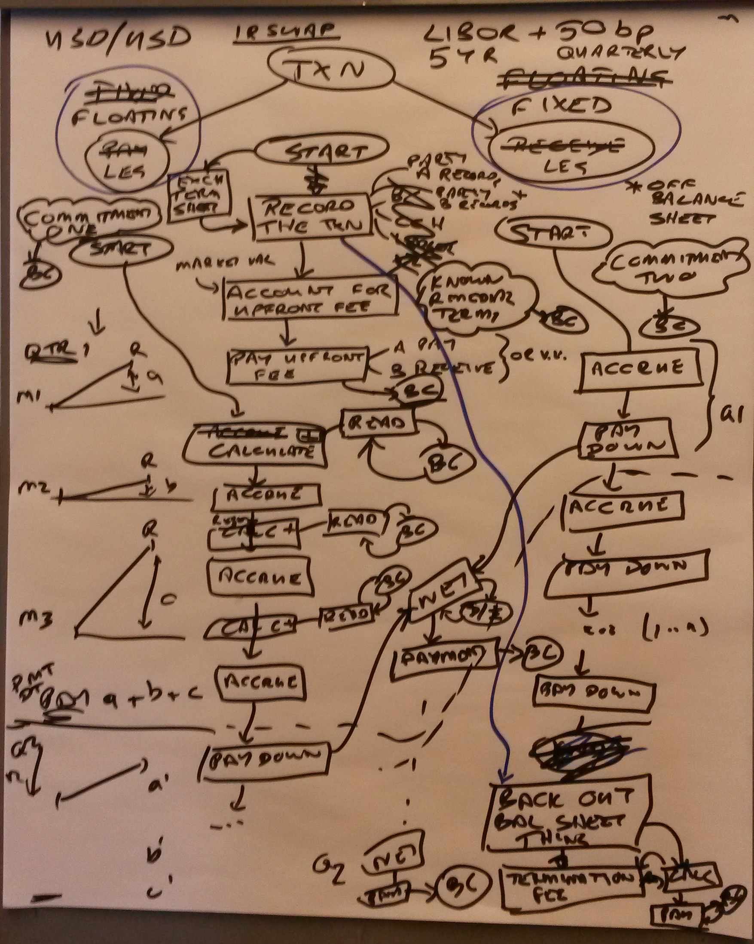
IR Swap Process Whiteboarding

Slide 30
Structural and Behavioral Business Content
Structural: terms of the contract
Mappable to or derived from FIBO
Behavioral
Payments process flow
off-Blockchain behaviors and activities
Events in the life of the swap and possible block postings for those events
Smart Contract program flow

Slide 31
Structural
If anything can be hashed and posted to the DL then:
Can be at the level of the whole contract (PDF)
OR
Can be at the level of the individual Commitment
FIBO describes commitments individually
Based on REA transaction semantics
Benefit in posting specific commitments to the DL for greater precision
These also map more directly to process activities

Slide 32
Behavioral
Business process or workflow
E.g. payments, settlement delivery workflows
Swap: two cashflow-based commitments
Can model these in
UML Activity Diagram format
BPMN (Business process modeling notation)
Process ontology
FIBO Conceptual Abstractions Model
Includes process and activity primitives

Slide 33
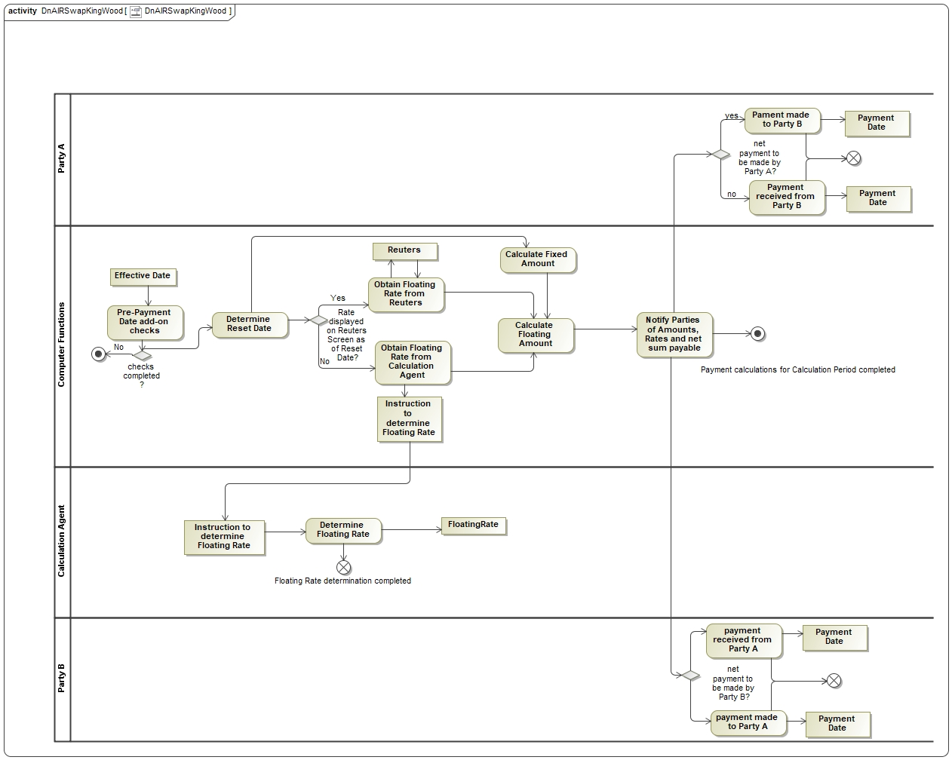
IR Swap Process

Slide 34
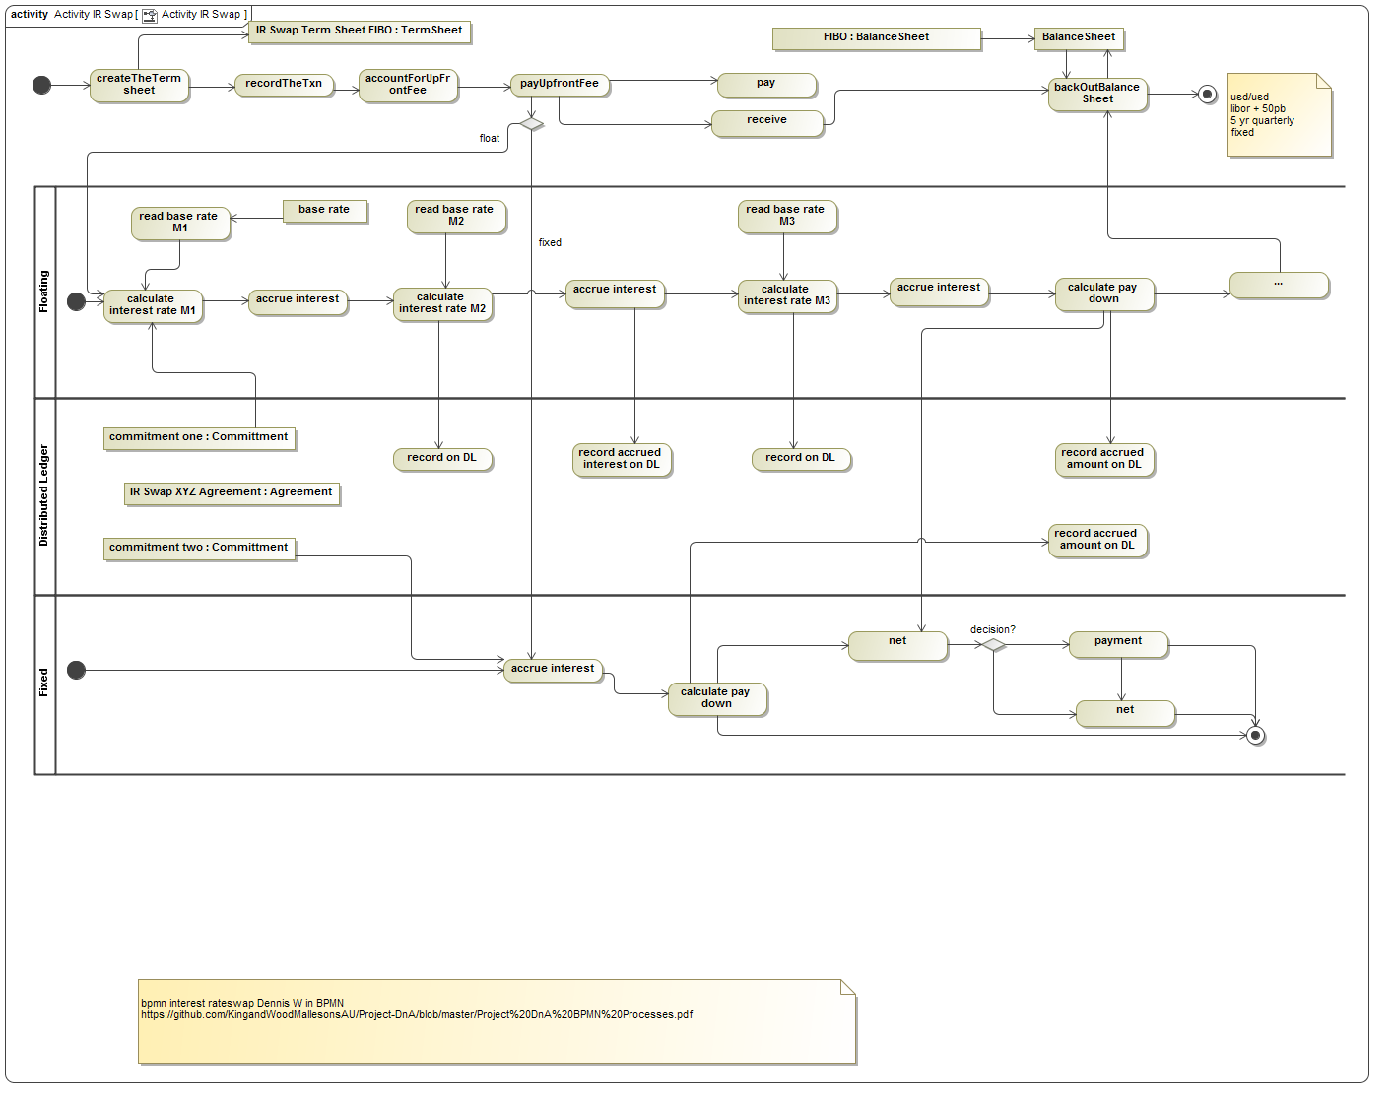
IR Swaps Process v1

Slide 35
Process Definition versus Events Occurrences
The proves activity is a prescriptive occurrent
It describes an event that is mandated and will happen many times
It has a ‘date’ but not a date
The instance is a descriptive occurrent
This happens (whether now or in the future, once or many times or never)
This has the percentages, dates, monetary amounts and so on

Slide 36
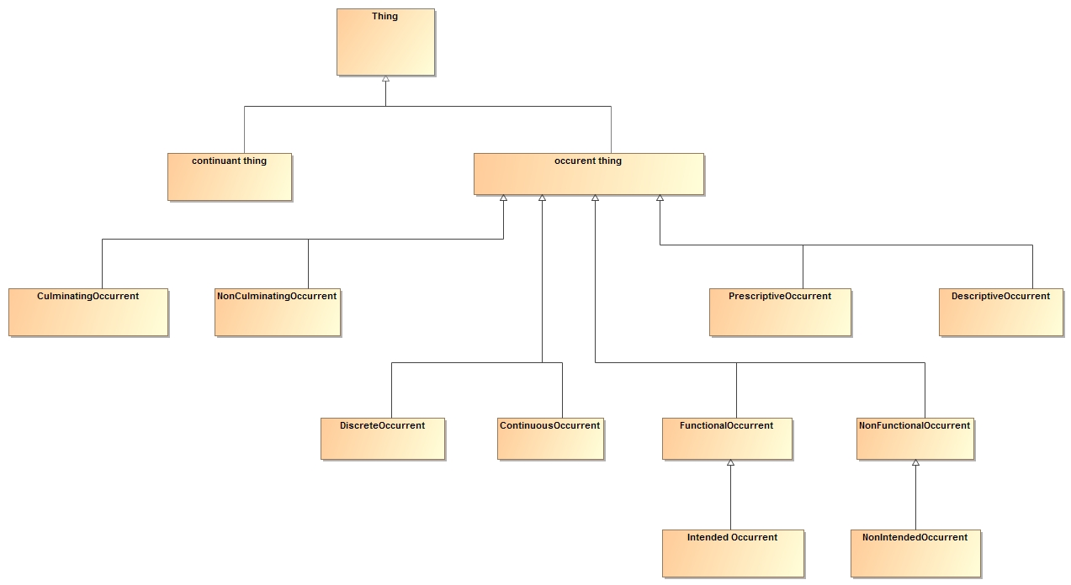
Occurrent Thing Ontology Facets

Slide 37
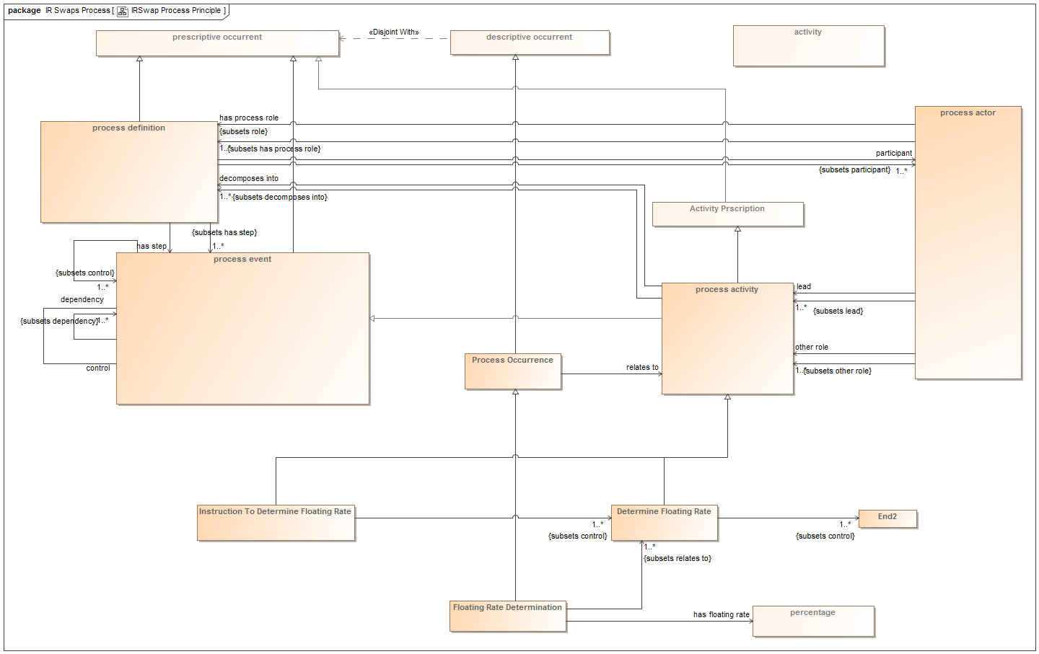
Prescriptive and Descriptive Occurrents
Control flow
Process occurrence is the ‘instance’ of the prescriptive occurrent being carried out

Slide 38
Next Step: Conceptual to Physical
Need indicative physical implementation(s)
Show how conceptual model specifies these
Need to get to know the languages used

Slide 39
Languages
Foundational languages to be familiar with
C++ | Main | https://www.gitbook.com/book/programmingblockchain/programmingblockchain/details
Node.JS | These are typically compatible, accepted, supported in active crypto environments
Python
Perl
DLT | Programming language | Link
The Blockchain (Bitcoin) | Script | http://davidederosa.com/basic-blockchain-programming/
Ethereum | Solidity | https://solidity.readthedocs.io/en/develop/
Hyperledger Fabric | Go | https://hyperledger-fabric.readthedocs.io/en/latest/prereqs.html#go-programming-language
Corda (R3) | Kotlin | https://www.corda.net/2017/01/kotlin/
Ripple | C++, Java, Node.JS, etc | https://github.com/ripple
Digital Asset Holdings | Digital Asset Modeling Language | https://digitalasset.com/press/introducing-daml.html
Stellar Networks | Horizon RESTful HTTP API | https://www.stellar.org/developers/guides/get-started/

Slide 40
Hunting the Elusive Code
Went looking at a range of sites for
Ethereum
Hyperledger
Found:
An IR Swaps hackathon and description
Lots of code for different financial actions
Specific to cryptocurrency
Ledger as ledger
We want ledger as record of anything

Slide 41
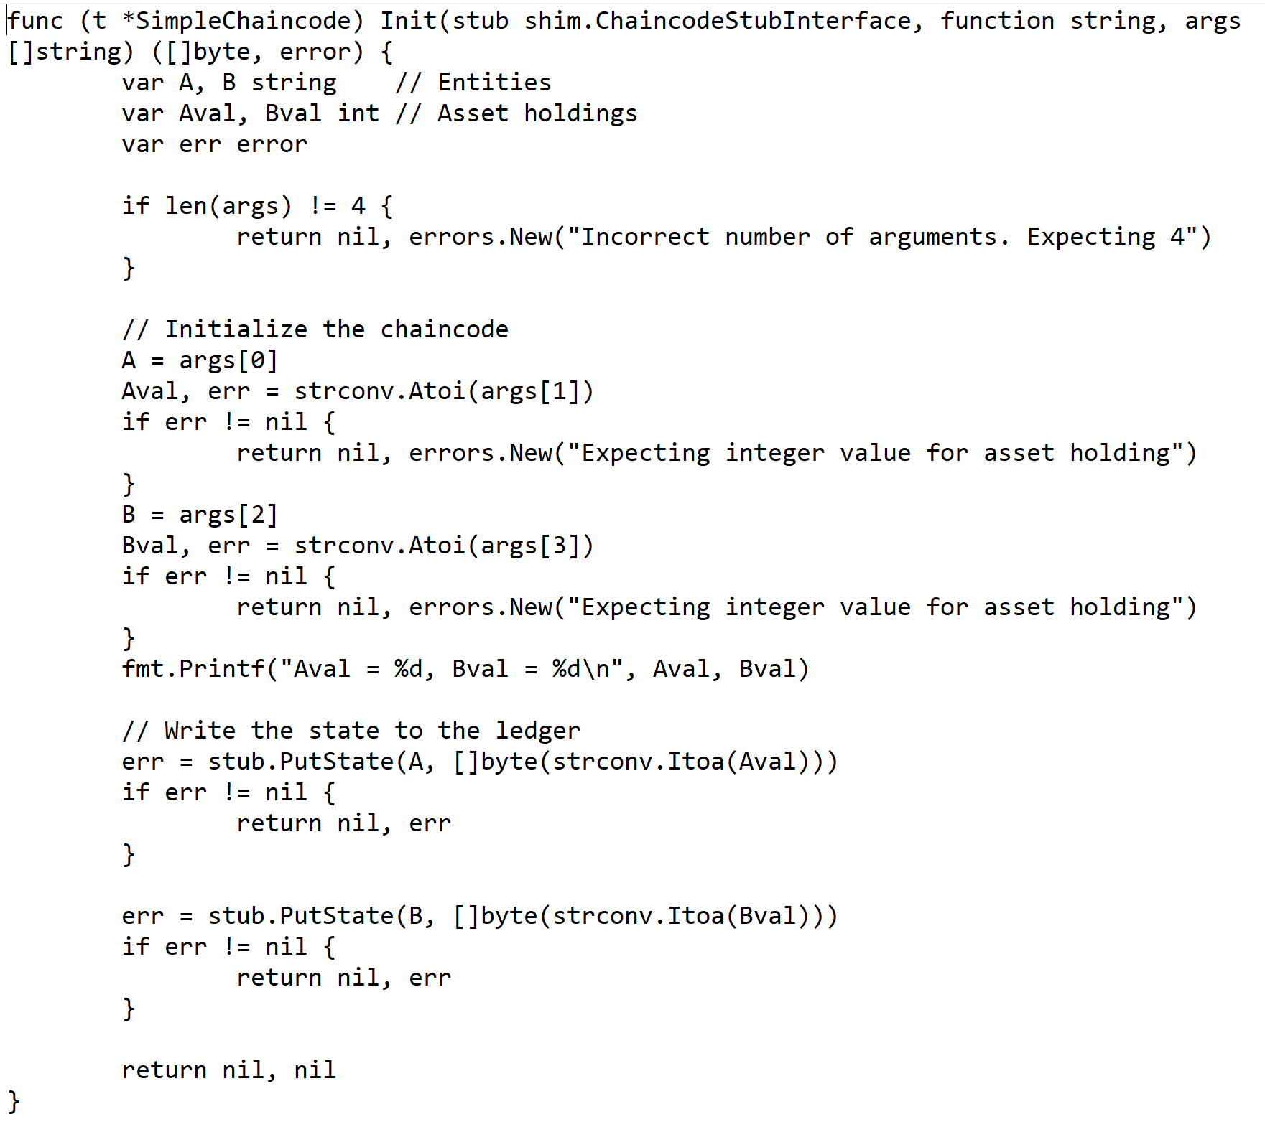
Chaincode

Slide 42
Code Fragments Needed
Post a percentage
Post a monetary amount
Not as a transaction but as a non repudiable record of that amount
Post a netting transaction

Slide 43
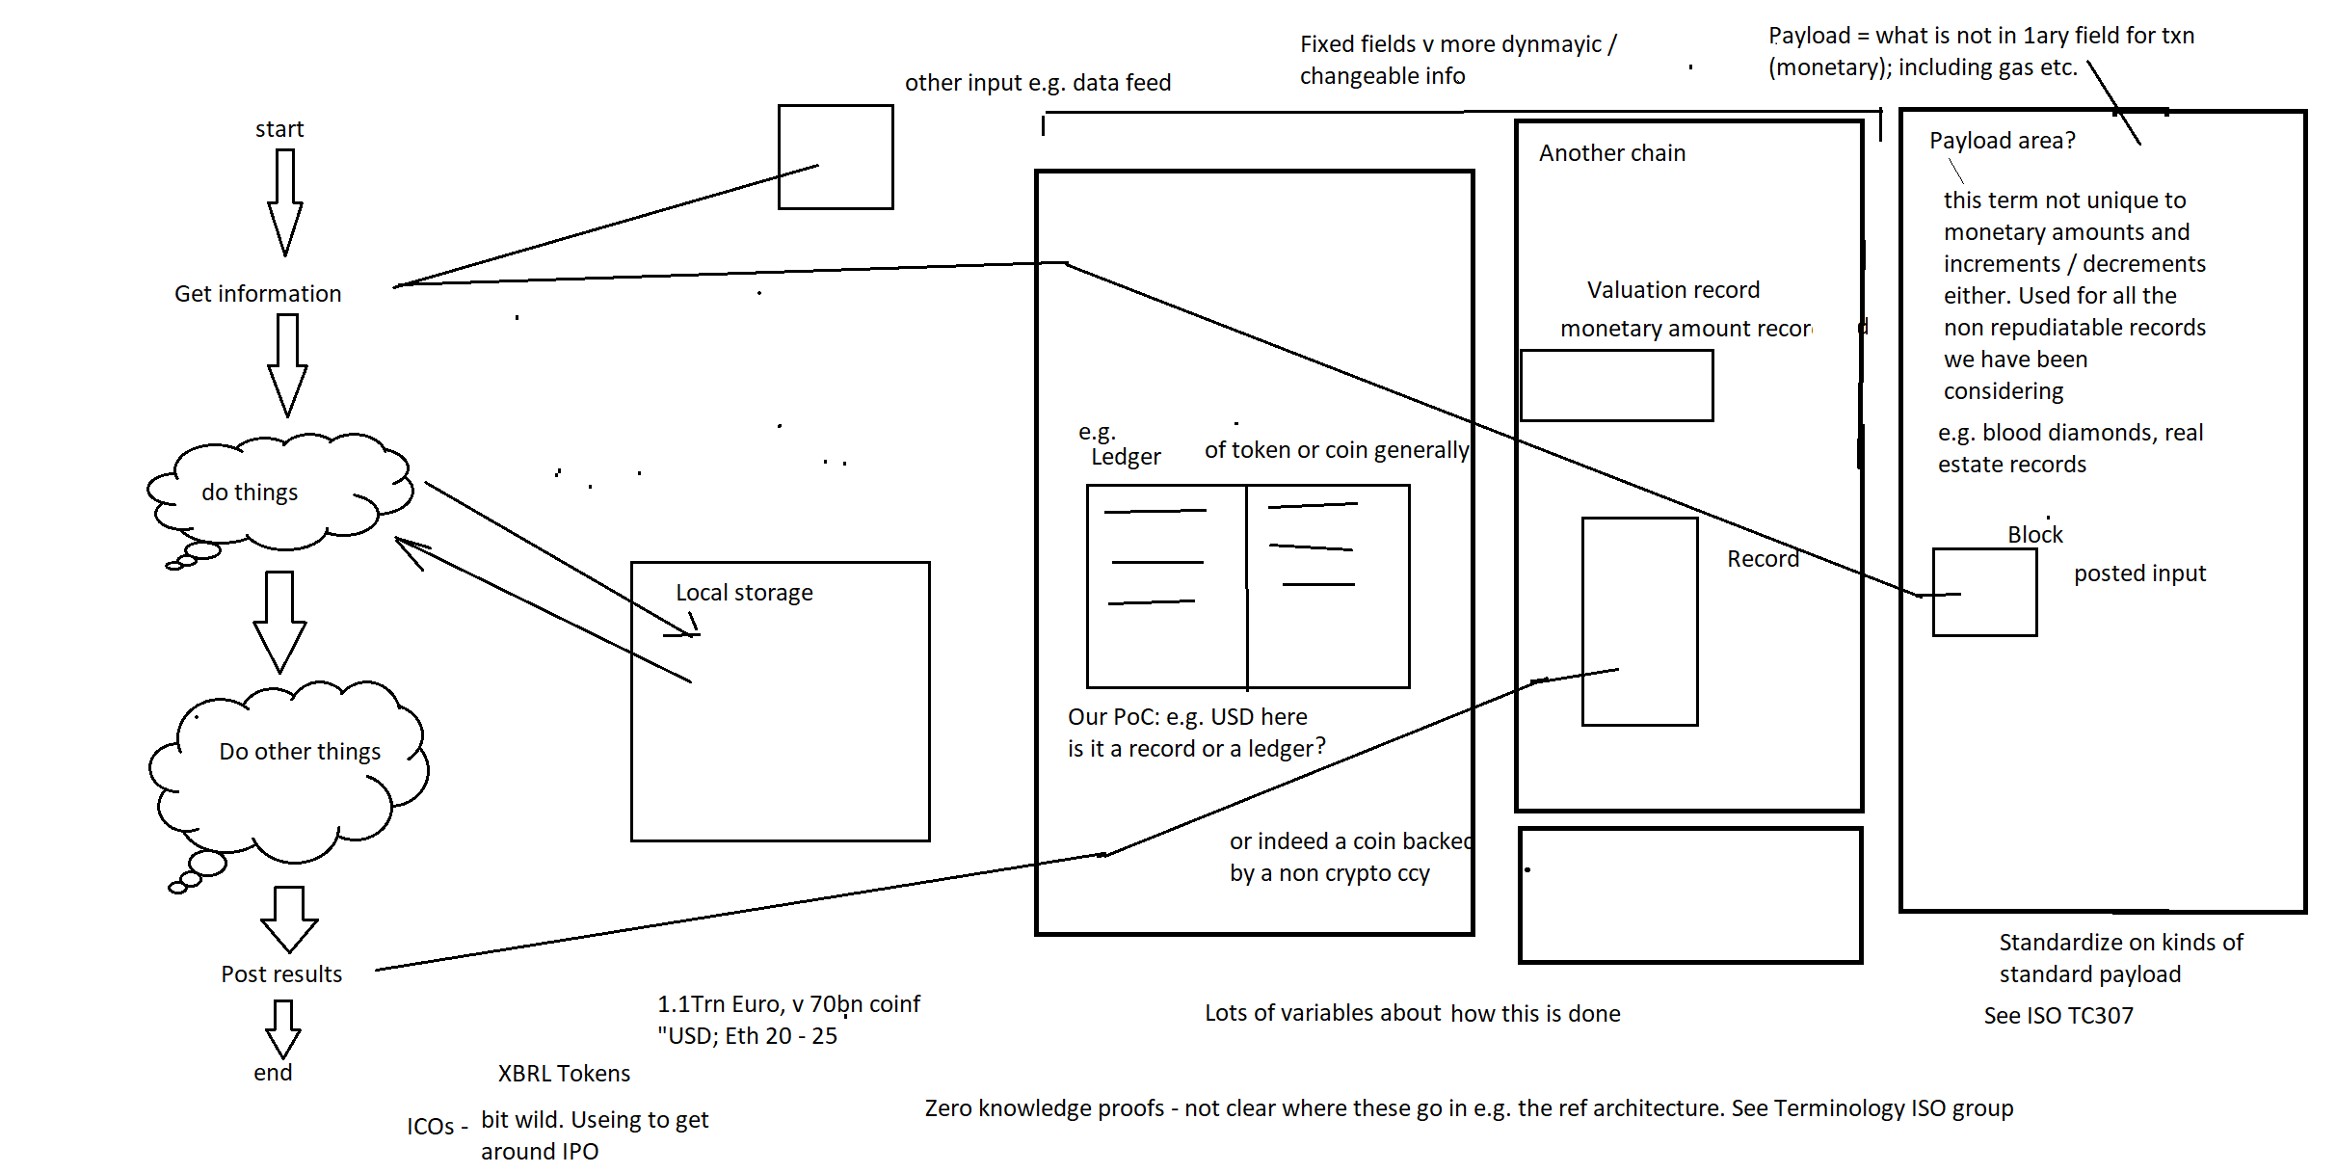
Some Very Untidy Whiteboarding…

Slide 44
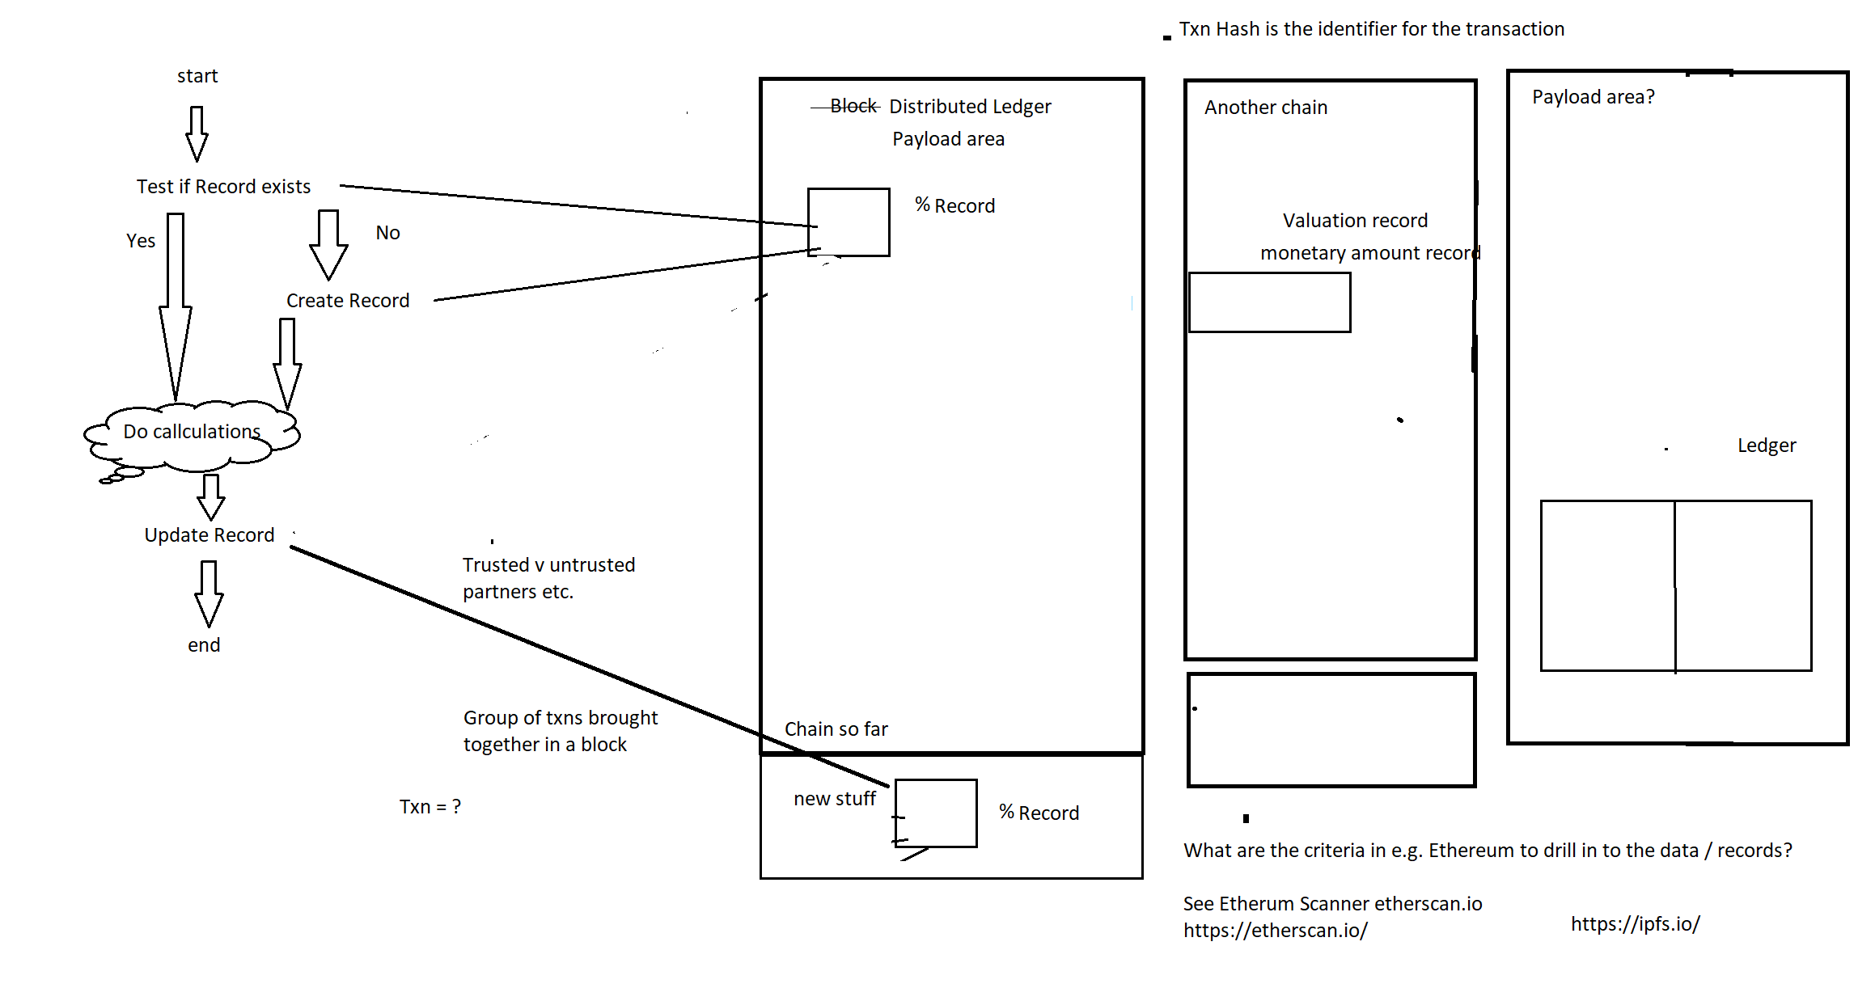
What gets Posted Where?

Slide 45
What gets Posted Where?
Oracles and other data stores
Posting to a Blockchain block incurs overheads
No one size fits all
If we did a model with ‘Posted to the Block this would represent one architecture not all
Logical (design) model not concept model

Slide 46
Different Block-thing Architectures
Blockchain
Bitcoin
Ethereum
Hyperledger
Block Graphs
IOTA – the Tangle
Hashgraph – gossip protocol
Blockchain Menu
CORDA / R3
Solutions to the bottleneck issues
Proof of Stake v Proof of Work
Use of cryptocurrency for mining reward etc. v Tangle Proof of Work

Slide 47
The “Blockchain Bundle” Menu
Ref
https://gendal.me/2016/04/05/introducing-r3-corda-a-distributed-ledger-designed-for-financial-services/
Consensus
Validity
Uniqueness
Immutability
Authentication

Slide 48
R3 Proposal for FiServ Bundle
Consensus
Between parties – not to all
Validity
Stakeholders
Validation logic
Uniqueness
Uniqueness service implementations
Trade-offs and prioritization
Immutability and Authentication
As per Blockchain

Slide 49
IOTA
New architecture in the Distributed Ledger space
“Tangle” not Block
What this is: Proofs of work done on two randomly chosen upstream items
Moves forward as a connected set (tangle) of records not a distributed set of identical records
Will release open source software plus open standards
Tangle Architecture – via OMG FDTF
Protocol – ESMA
Code – open source via eCore

Slide 50
Architecture Implications
Not only one ‘Blockchain’ approach
Some architectures you would want to post some material to other data stores
Called Oracles
Or you might retain some information only in dynamic memory
What you post to ‘The Block’ will vary by architecture
Derive a logical design from the concept model based on design decisions
Conclusion:
Back to the Concept Model principles: Identify variable data regardless of where posted

Slide 51
IR Swap Process Analysis
At first we defined a swimlane for ‘The Block’
What gets posted to ‘The Block’?
It turns out this depends very much on the block architecture and performance constraints
Come material might go on separate data stores sometimes called ‘oracles’
Latest: Swimlane defined by function not by form:
Time-variable information about the contract

Slide 52
Refining this
Final process model with variable data
Static contract terms (term sheets) in FIBO IR Swaps
Variable terms
Process activities that generate and use this data
Prescriptive: process definition
Descriptive: events that happen
These originate each piece of variable data

Slide 53
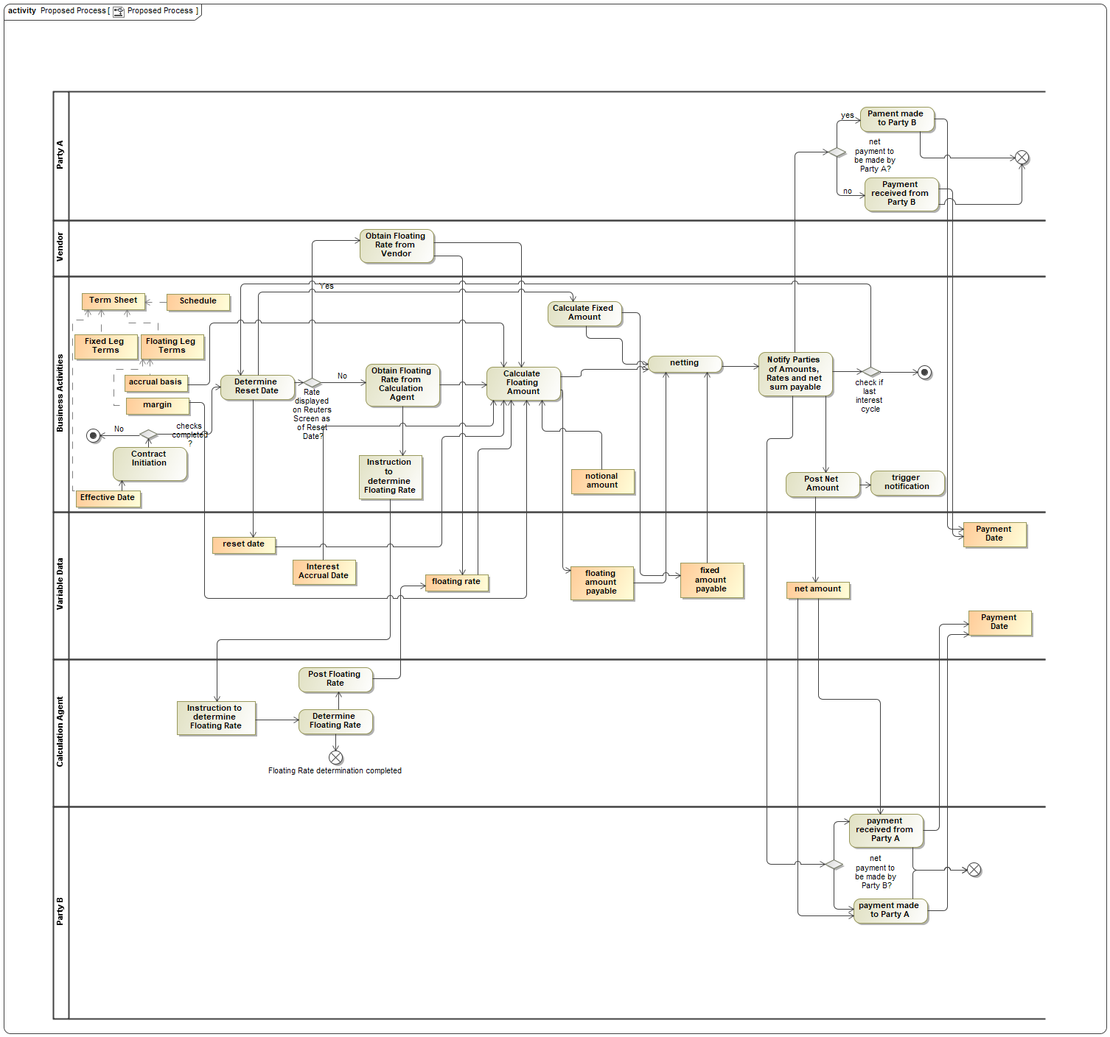
Updated Process

Slide 54
Data typing questions
Any kind of data ca be posted to the ‘Block’ or ledger
E.g. numbers, for money
Also text etc.
BUT how do we deal with posting of complex or qualified data
Monetary amounts (qualified by currency)
Interest amounts – (on what, for what period)
How to identify related contract etc. in a hige and growing block of stuff?
Also provenance and ther metadata

Slide 55
Breakthrough Moment
If any kind of datatype can be posted to the block, then
XML can be posted (as a complete XML Document)
E.g. ISO 20022
XML includes RDF/XML
So can post a semantic graph
e.g. instance data referenced to FIBO and others

Slide 56
Then
XML / ISO 20022 can be used directly were appropriate
Each ISO 20022 message type accompanies a process definition
If you are following that part of a process, this tells you all the data elements needed to accompany and qualify that element
Can also use the ISO 220022 content as analysis for an ontology representation of the same stuff

Slide 57
Then
Post RDF graphs with qualifying information for each data item
USE existing analysis where available
e.g. ISO 20022 or FpML
IR Swaps PoC: Analyze the qualifying terms needed
This will compete our PoC conceptual model exercise

Slide 58
PoC: What qualifies each Postable Term?
Specific trade (Unique Transaction Identifier)
Specific Quarterly cycle (Reset Date)
Monetary Amounts: Currency
These are the qualifying data elements for each posting of these records to a block or oracle or other record, depending on architecture
Posted graph = the core data (number etc.) plus these qualifiers

Slide 59
Term Sheet Semantics
This stuff: Contractual commitments
and agreed terms (triggers etc.)
= the semantics of the Contract
= FIBO IR Swaps

Slide 60
FIBO: Scope and Content
Upper Ontology
FIBO Foundations: High level abstractions
FIBO Business Entities
FIBO Financial Business and Commerce
FIBO Indices and Indicators
FIBO Contract Ontologies
Securities (Common, Equities)
Securities (Debt)
Derivatives
Loans, Mortgage Loans
Funds
Rights and Warrants
FIBO Pricing and Analytics (time-sensitive concepts)
Pricing, Yields, Analytics per instrument class
FIBO Process
Corporate Actions, Securities Issuance and Securitization
Future FIBO: Portfolios, Positions etc.
Concepts relating to individual institutions, reporting requirements etc.

Slide 61
FIBO PoC Extension
FIBO
Conceptual Ontology
Foundations
Upper Ontology
Derivatives
Occurrent Concepts
Swaps
Rate Derivatives
Process
Occurrences
IR Swaps
Swap Events

Slide 62
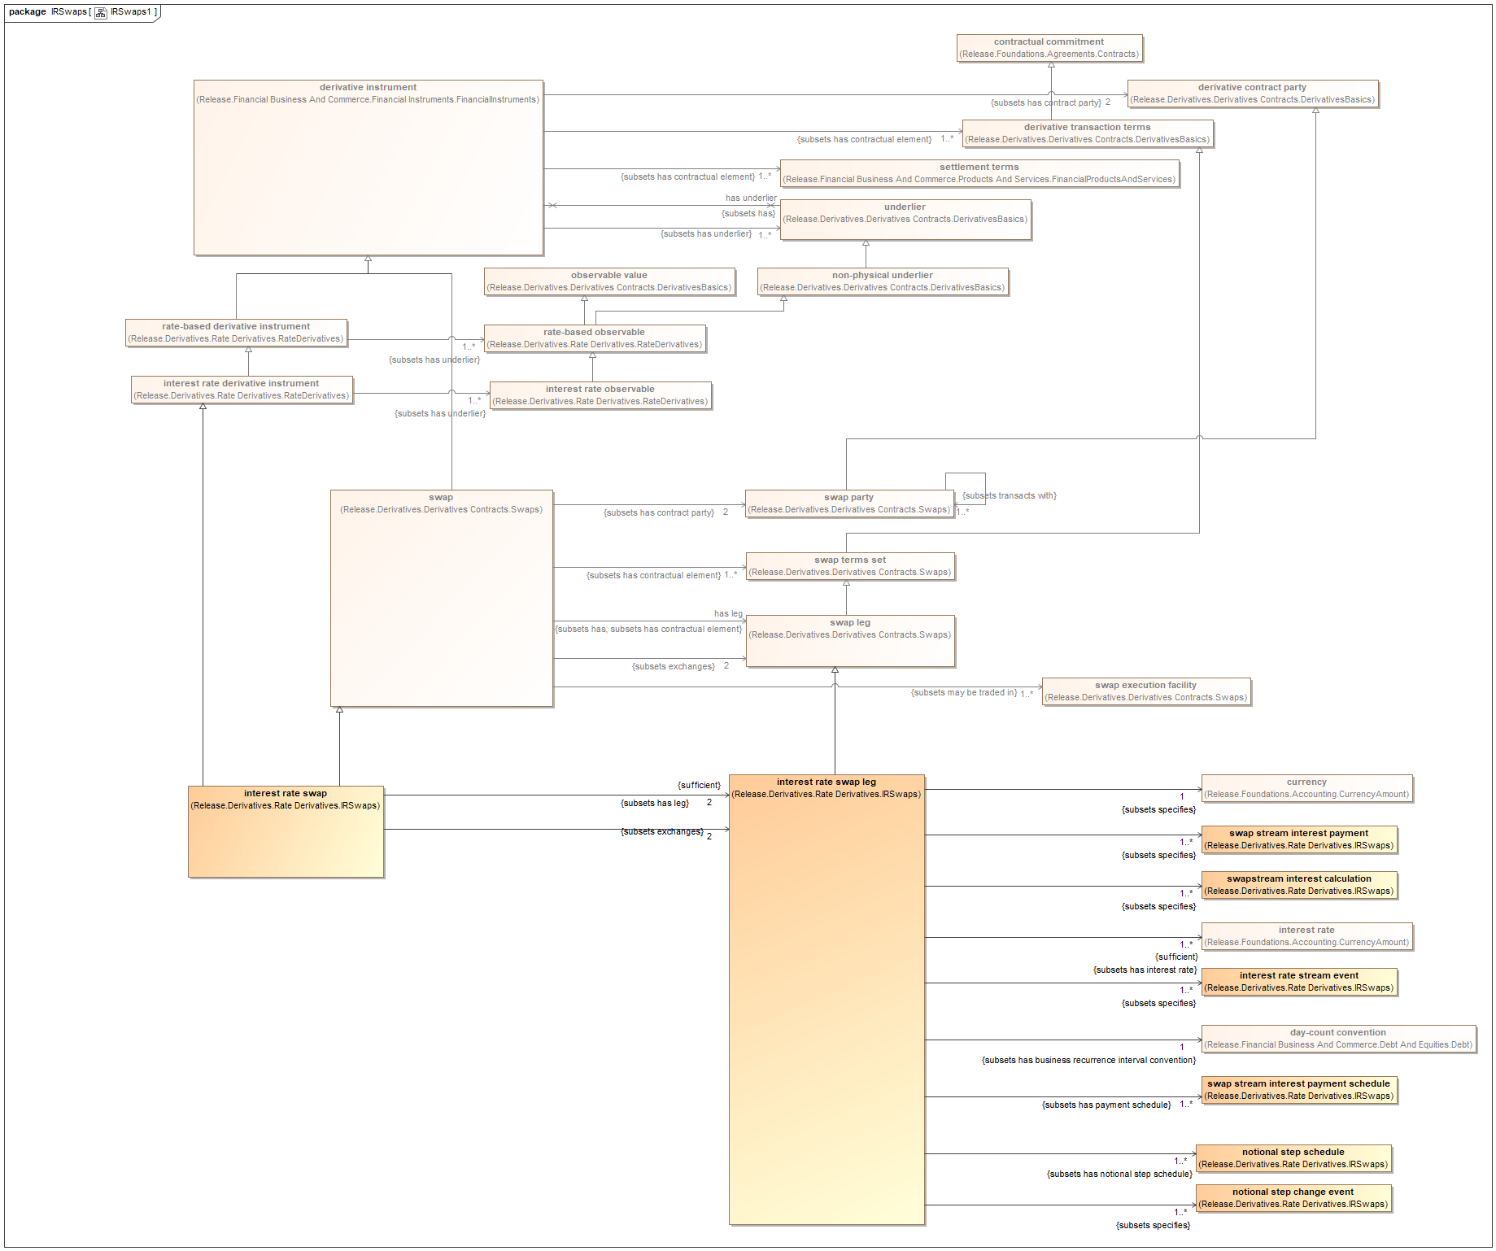
FIBO IR Swaps exploration
Showing locations
Most swap and IR terms inherited from more general contract types

Slide 63
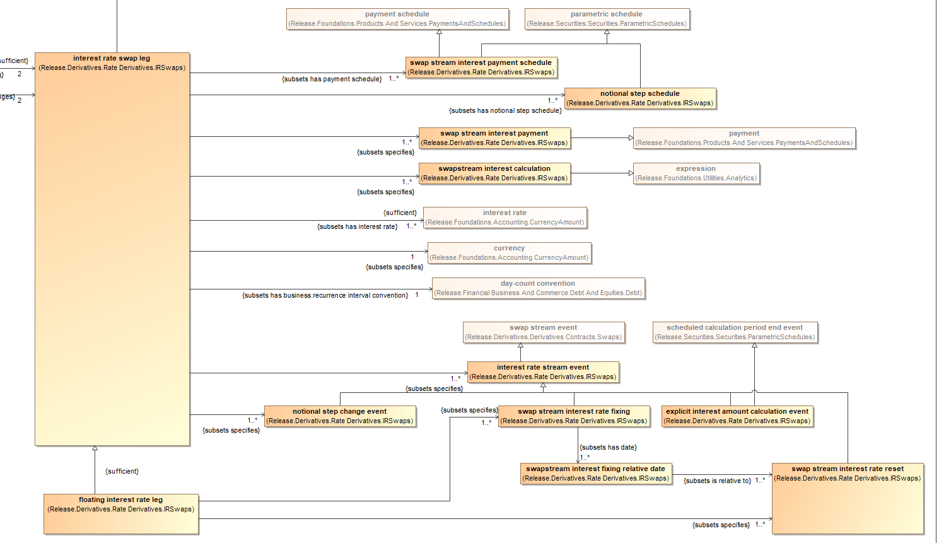
FIBO IR Swaps Local Terms

Slide 64
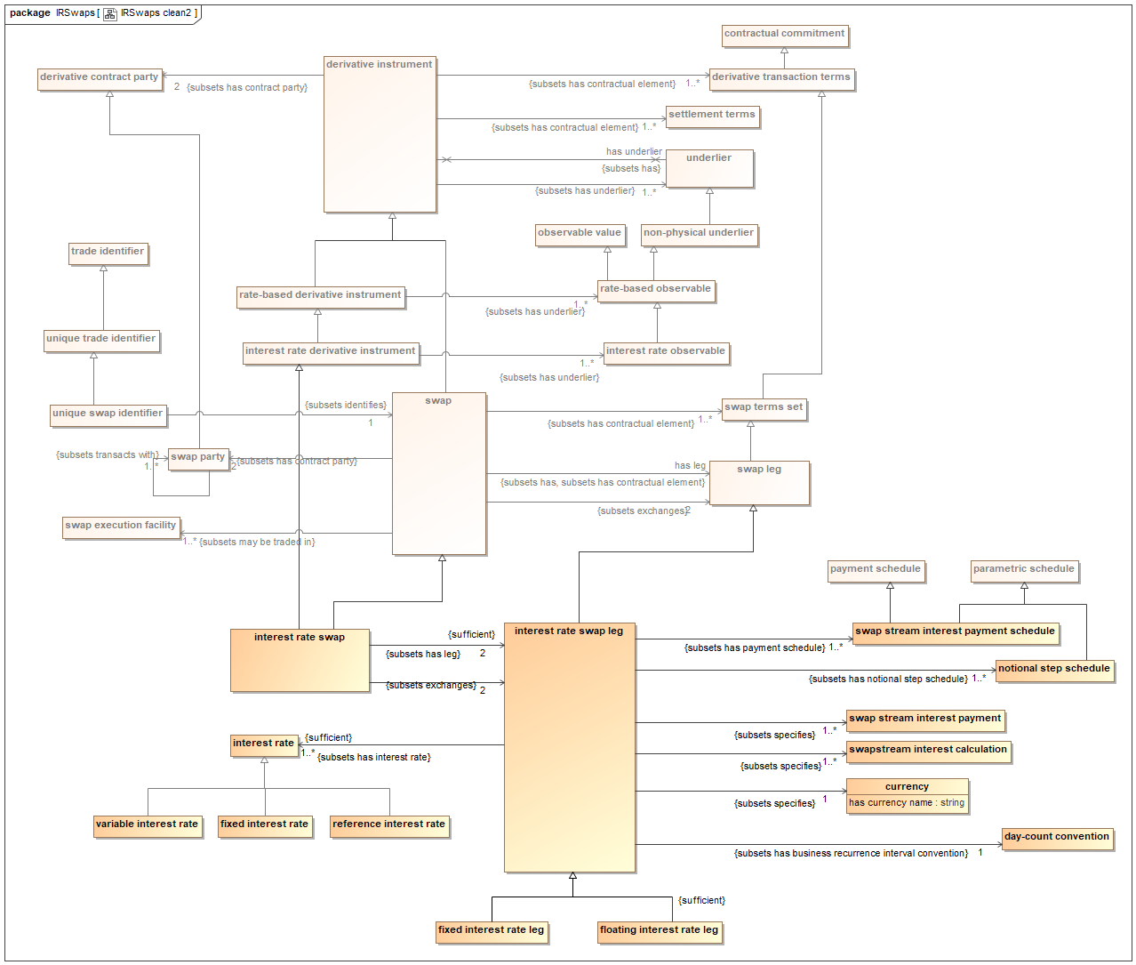
FIBO IR Swaps

Slide 65
Process Ontology with Occurrences

Slide 66
Process Ontology Closeup

Slide 67
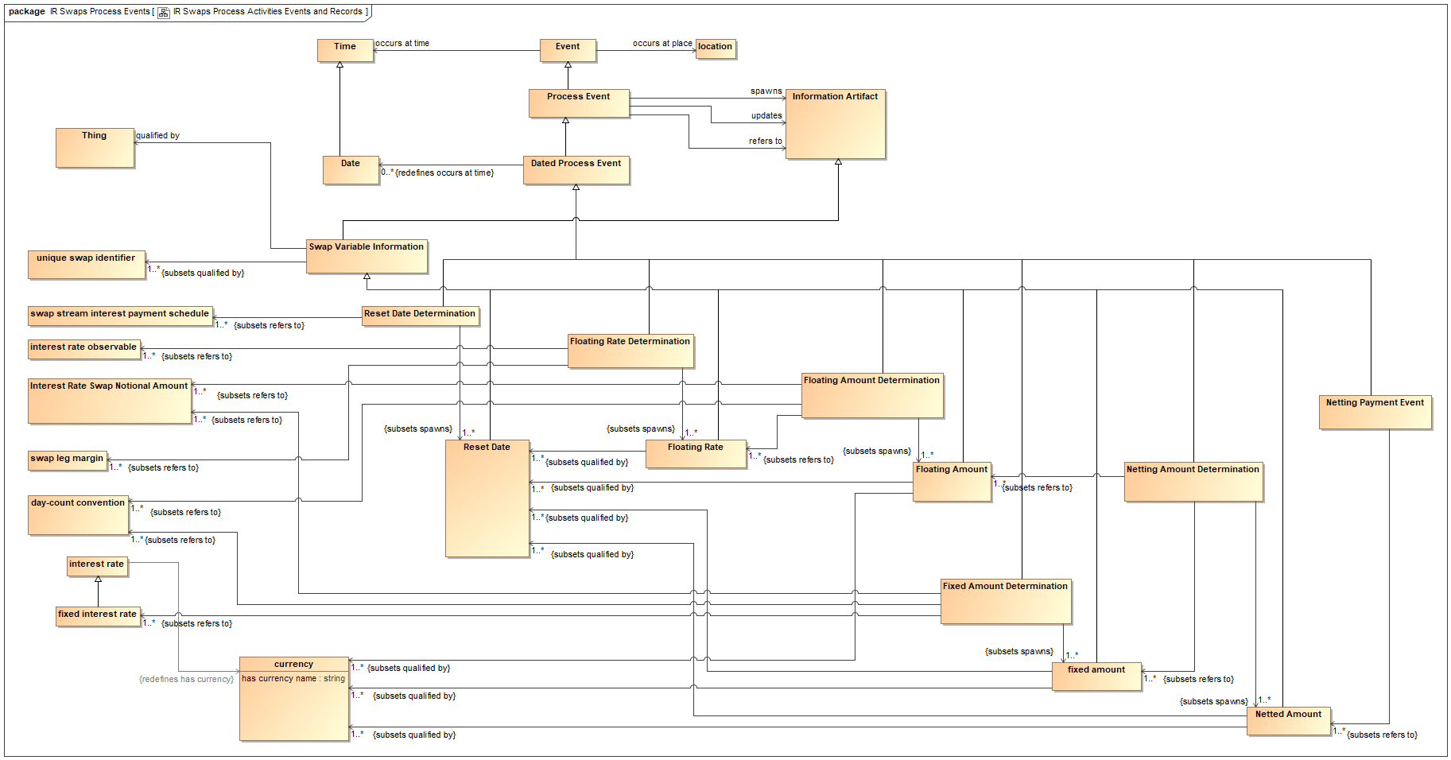
Information Records from Occurrences

Slide 68
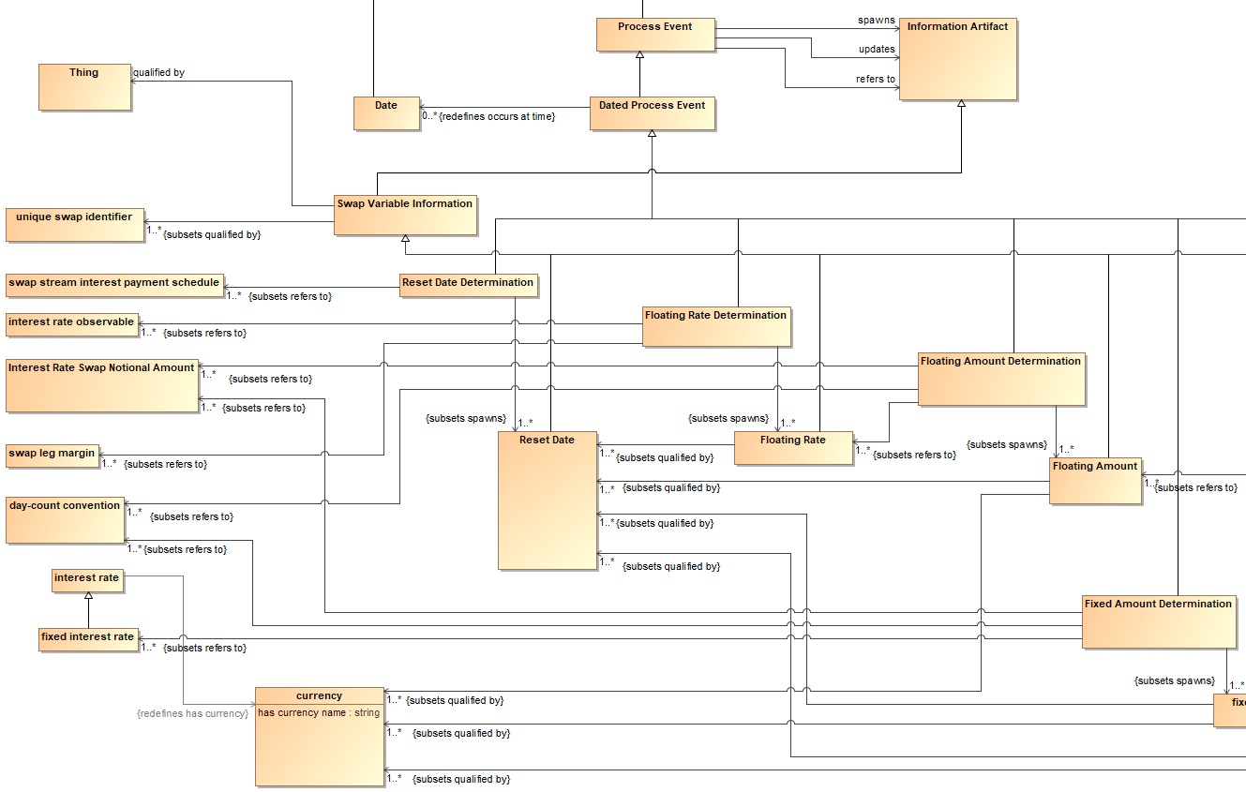
Zooming in…

Slide 69
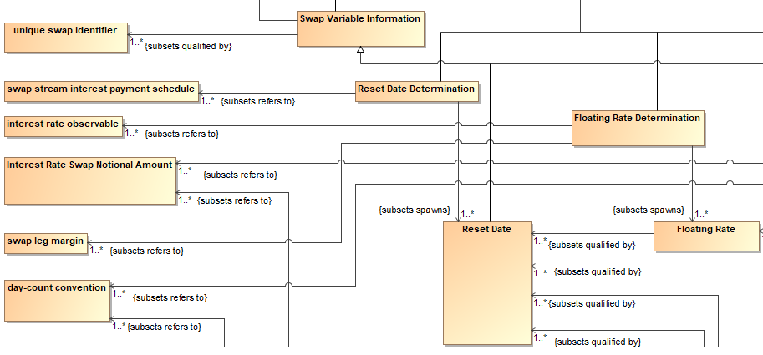
Records and Occurrences Closeup

Slide 70
Records and Occurrences Closeup
Occurrences of events make reference to IR Swaps terms

Slide 71
Records and Occurrences Closeup
Occurrences of events make reference to IR Swaps terms
Variable data qualified by specific other data

Slide 72
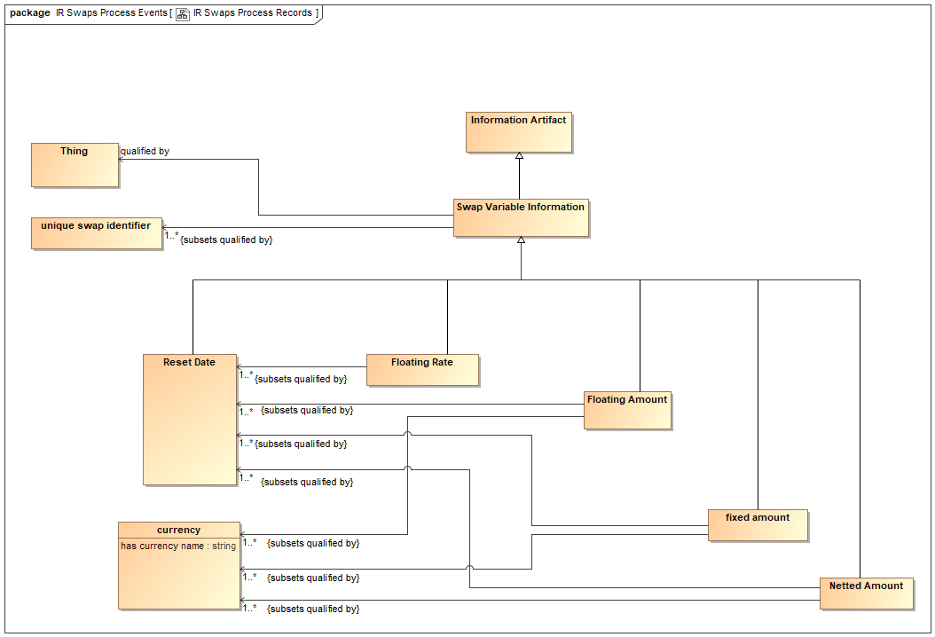
Variable Data Qualifying Information
This is the data accompanying each record that may get posted

Slide 73
Conclusions
We know what needs to be posted to [something e.g. Block] at any given point in the process
This is posted as a textual record
Where the text is XML and the XML is RDF
We are posting graphs!
Narrows the search for physical code in different languages and architectures

Slide 74
Smart Contracts Specification
The part where it posts something is now simple enough
RDF graph with the qualifying terms identified
The other part of the Smart Contracts is the calculations etc.
The calculations within the boxes are well enough understood
Ontology provides formal declaration of the concepts involved
There is also plain mathematics:
Interest rate = Base + Margin
Accrued amounts – as defined for Accrual Basis
Mathematics is another computationally independent way of saying things
Some things we can’t say in Ontology but we can declare the parameters used

Slide 75
Conclusions
Computationally independent representations
Formal process
Ontology
Mathematics
Ontology can represent processes, events and activities given the right upper ontology and semantics treatment
(the meaning of things that happen)
Ontology provides the connective glue into the mathematical content
FIBO provides the ontology of the contractual terms
Extend FIBO for additional concepts
Conceptual underpinnings for Smart Contracts
Architecturally agnostic

Slide 76
Take Aways
You need computationally independent models for complex developments like blockchain / Smart Contract
The more wild the technology, the more you need mature governance to get ahead and mitigate risk
Ontology provides ‘first order’ concept modeling
Semantic analysis yields process, events, records ontology
FIBO provides ontology of contract and trade terms sheet

Slide 77
Thank you!
Mike Bennett
mbennett@hypercube.co.uk
mbennett@edmcouncil.org
Twitter: @MikeHypercube

