Slide 1
SECM - Requirements Concepts - Review
John Watson
10/24/2016 Rev B

Slide 2
What’s Different
Slides 3 to 25 – Most recent updates

Slide 3
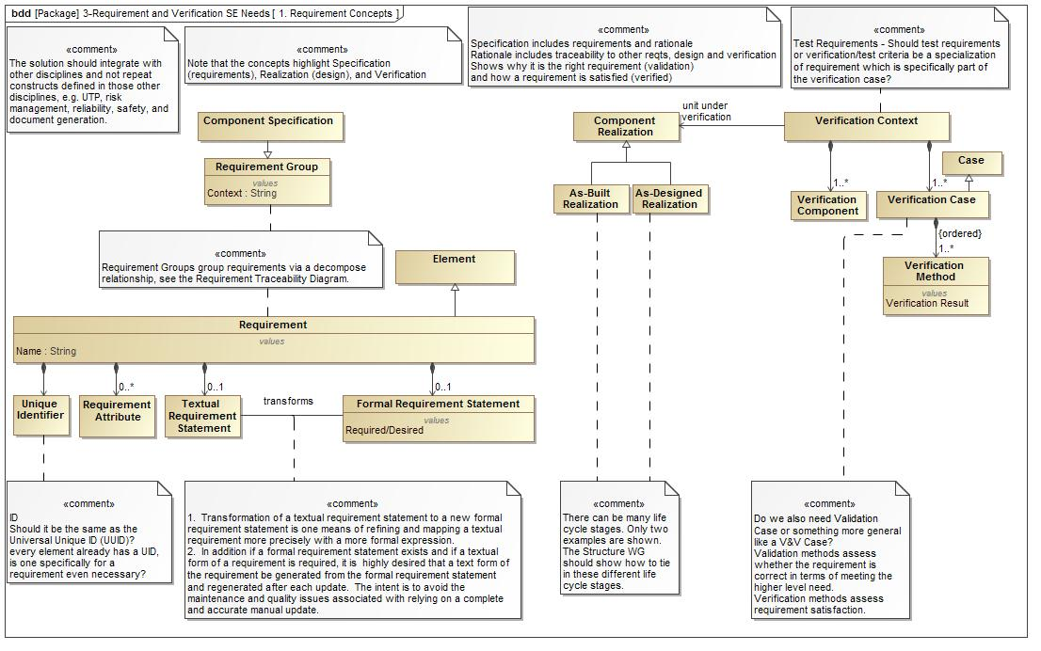
Requirement Concepts – 10/24/16

Slide 4
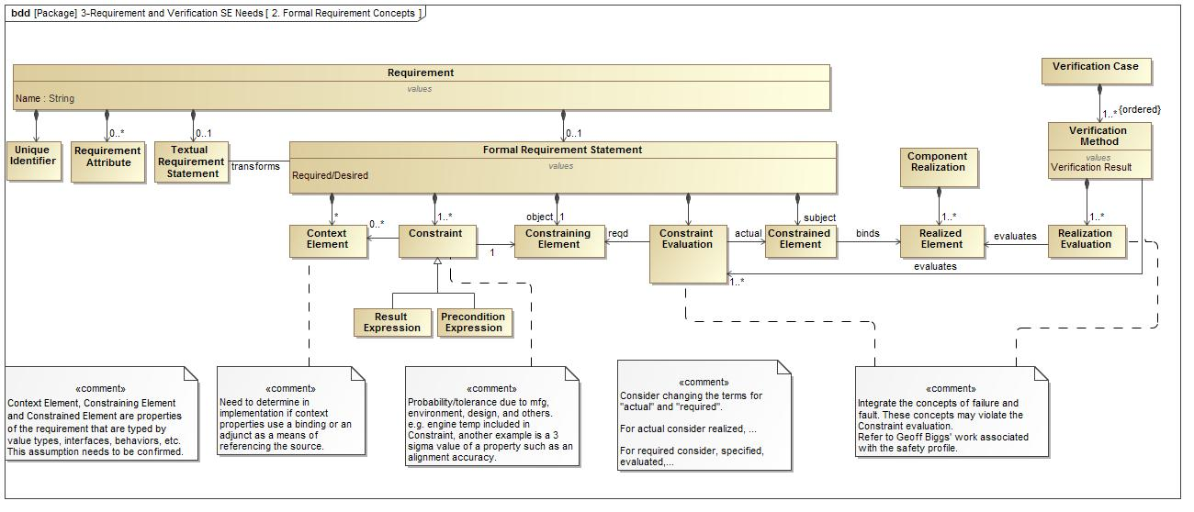
Formal Requirement Concepts –10/24/16

Slide 5
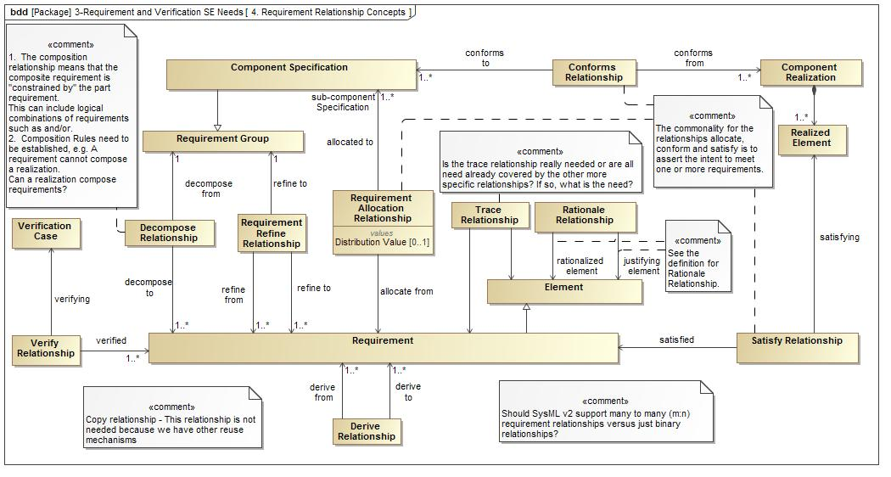
Requirement Relationship Concepts Diagram - 10/24/2016

Slide 6
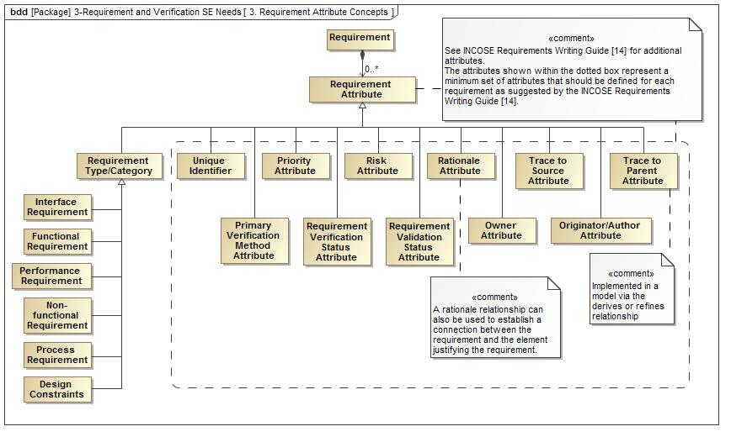
Requirements Attribute Concepts - 10/24/2016

Slide 7
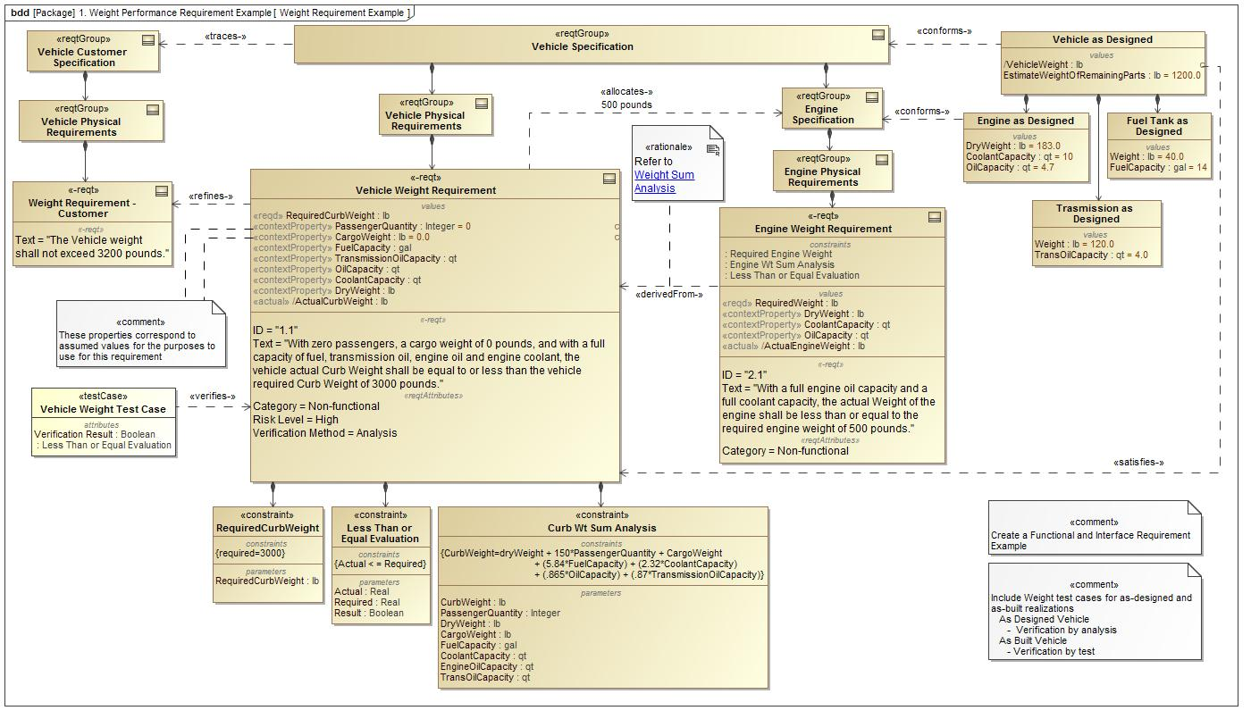
Vehicle Weight Performance Requirement Example - 10/24/2016

Slide 8
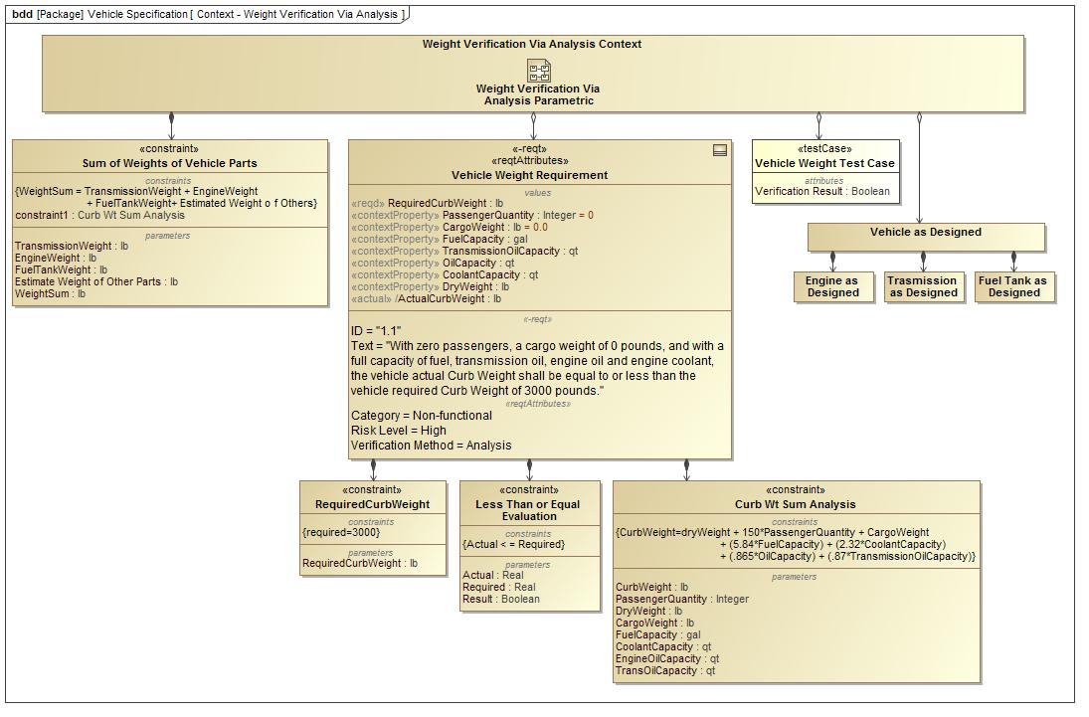
Analysis Context Diagram - Vehicle Weight Verification Via Analysis Example - 10/24/2016

Slide 9
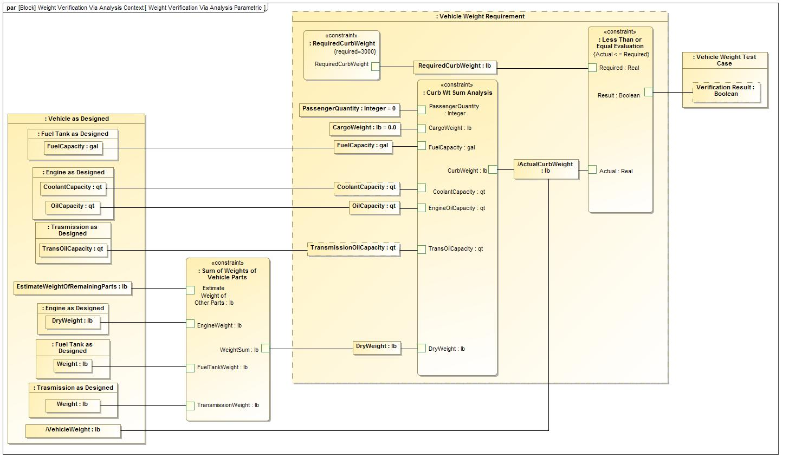
Analysis Parametric Diagram - Vehicle Weight Verification Via Analysis Example - 10/24/2016

Slide 10
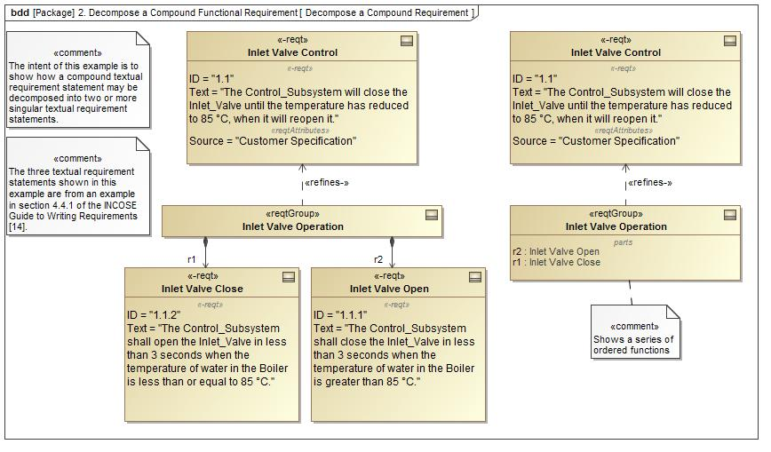
Decompose a Compound Text Based Requirement Example - 10/24/2016

Slide 11
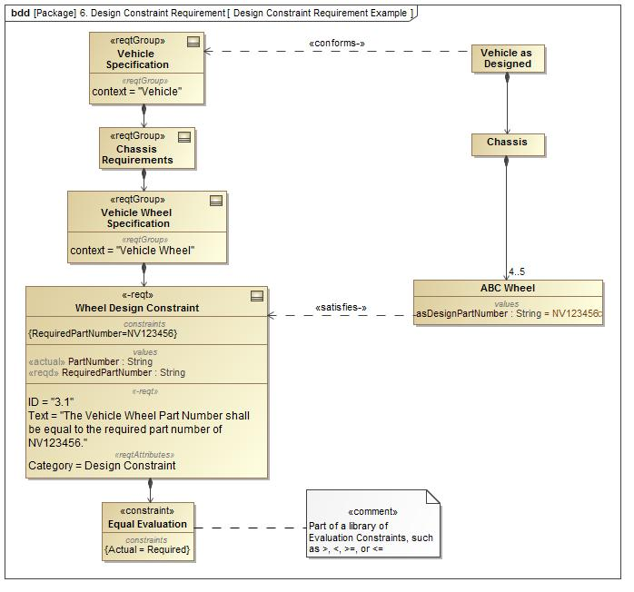
Design Constraint Requirement Example - 10/24/2016

Slide 12
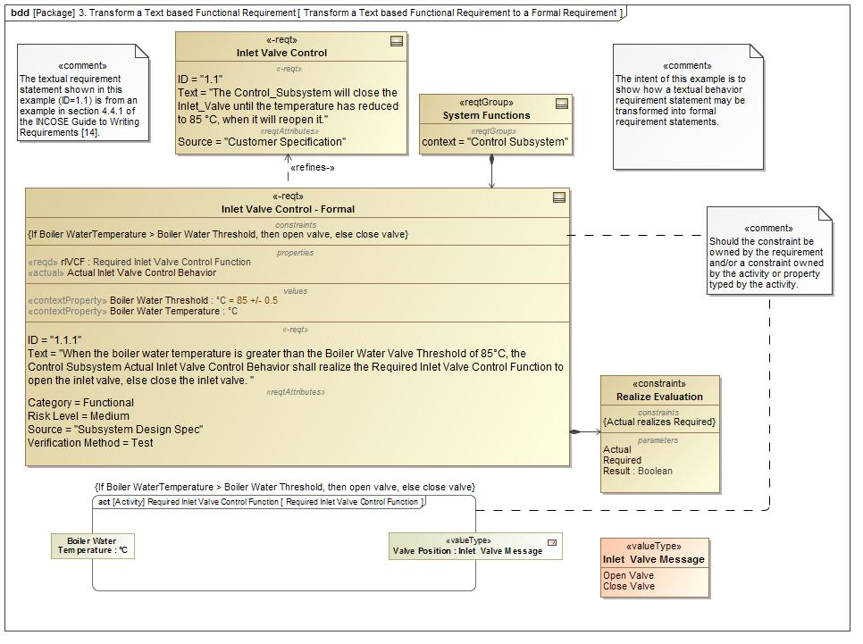
Transform a Text based Functional Requirement to a Formal Requirement Example - 10/24/2016

Slide 13
Functional Requirement Example -Updated 9/xx/2016

Slide 14
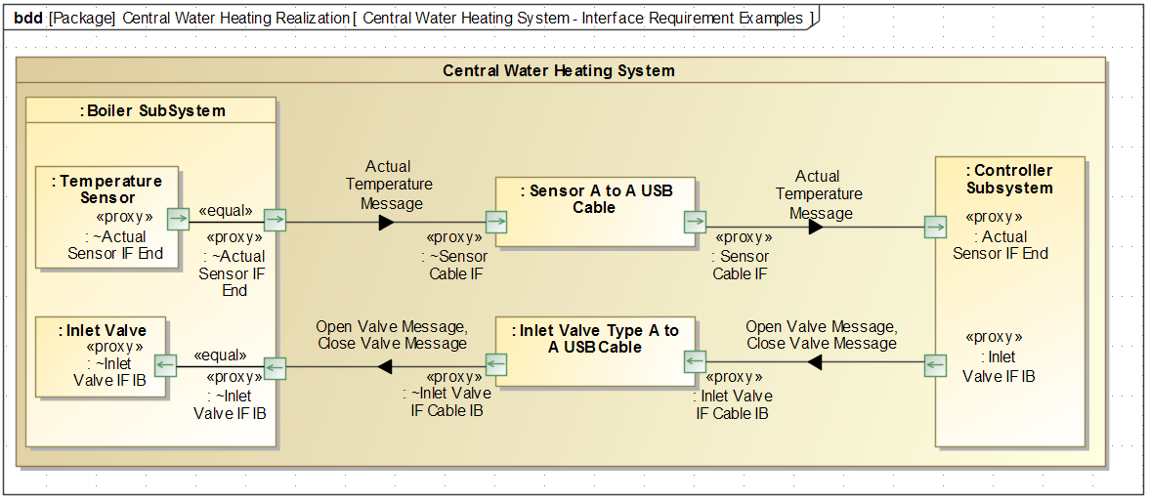
Interface Requirement Example, Central Heating System Context Realization -Updated 10/24/2016

Slide 15
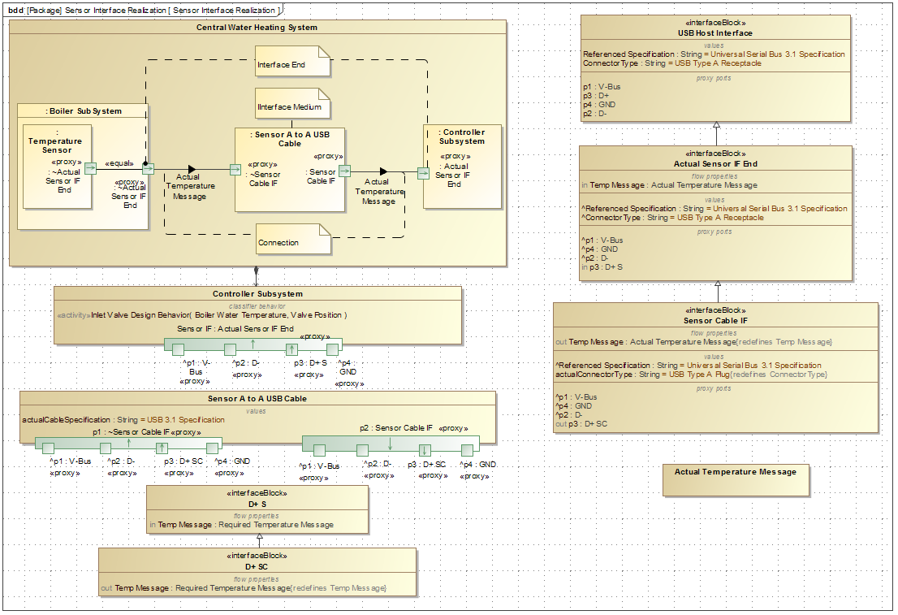
Controller-Sensor Interface Realization - 10/24/2016
15

Slide 16
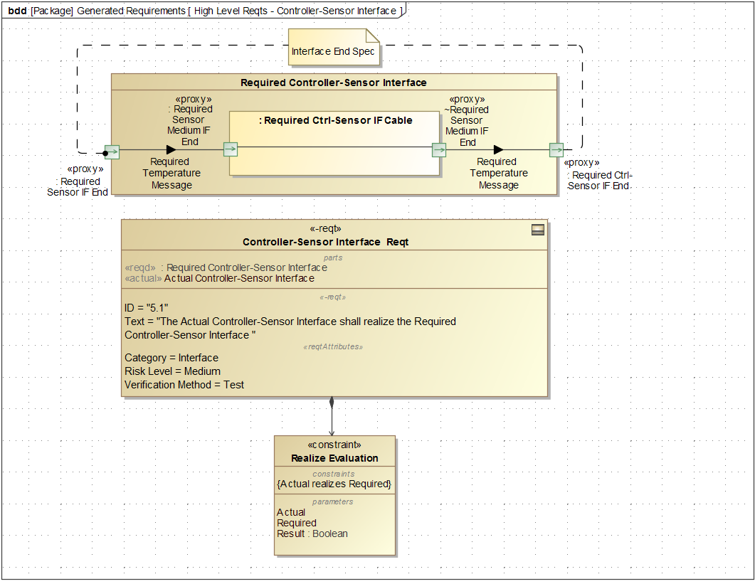
High Level Requirements - Controller-Sensor Interface Specification - 10/24/2016
16

Slide 17
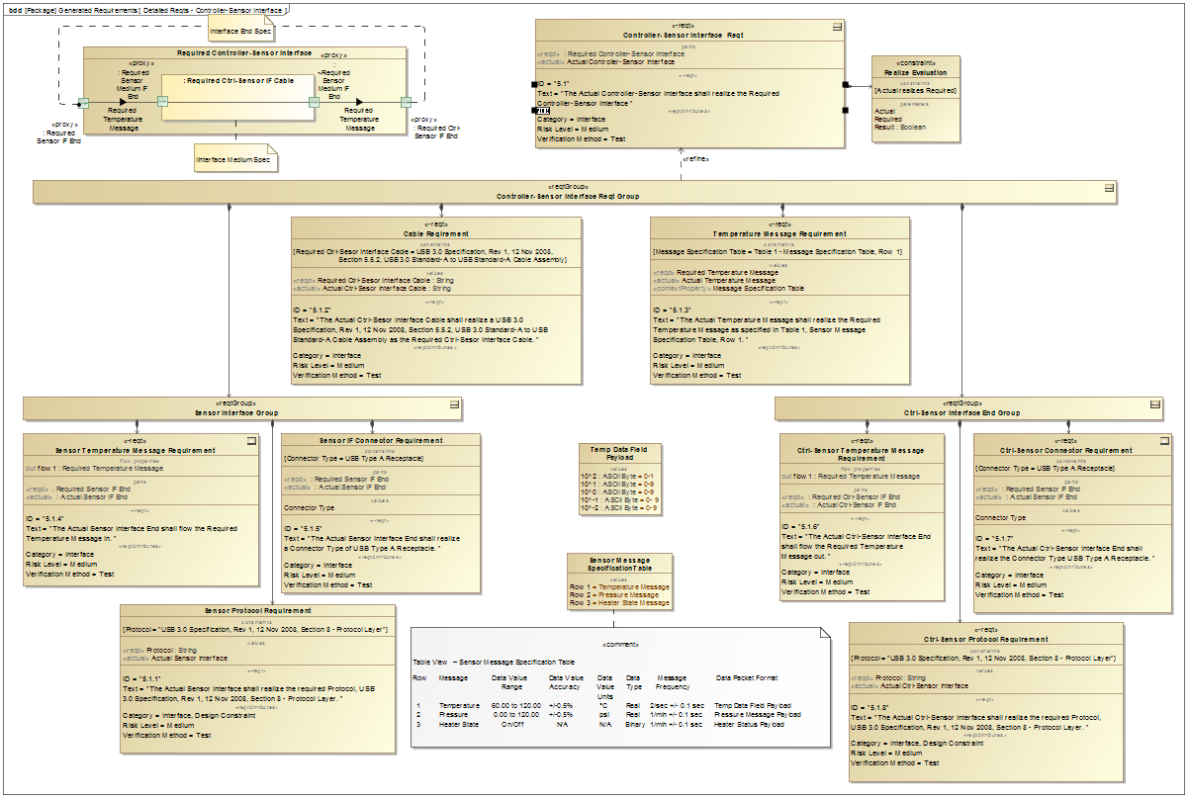
Detailed Requirements - Controller-Sensor Interface Specification - 10/24/2016
17

Slide 18
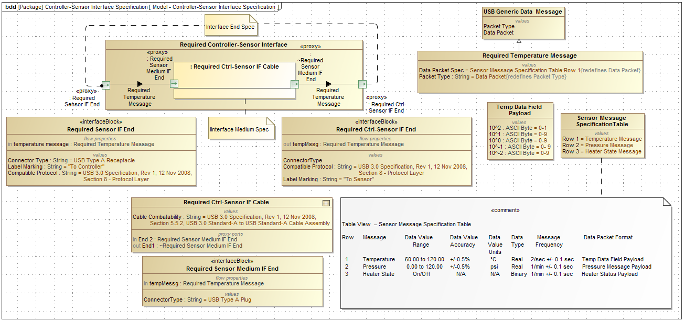
Controller-Sensor Interface Specification Model - 10/24/2016
18

Slide 19
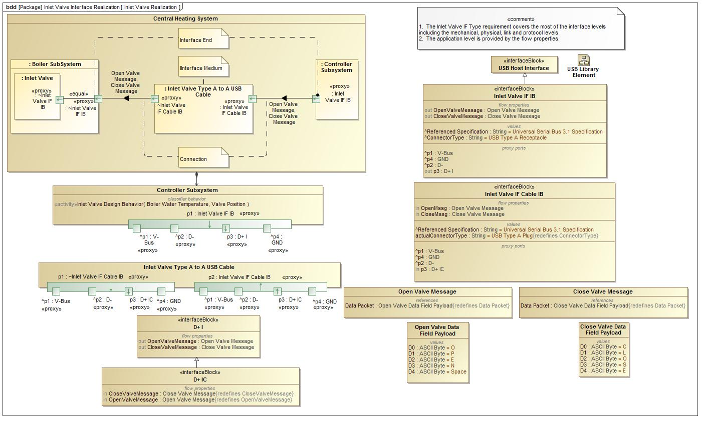
Controller-Inlet Valve Interface Realization - 10/24/2016

Slide 20
Controller-Inlet Valve Interface Specification –10/05/2016

Slide 21
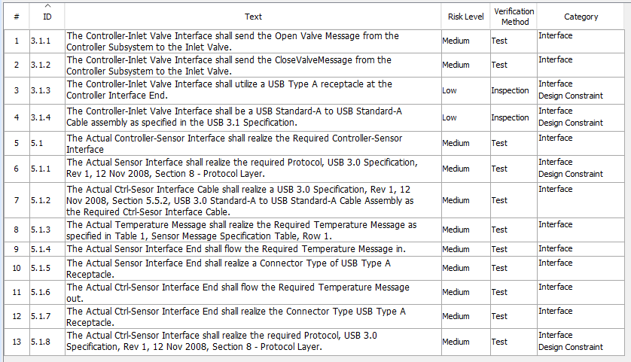
Controller-Sensor & Controller-Inlet Valve Requirement Table - 10/24/2016

Slide 22
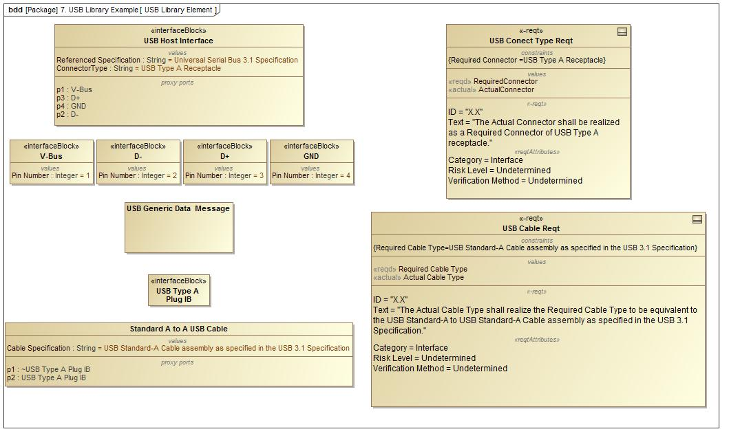
USB Library Example - 10/24/2016

Slide 23
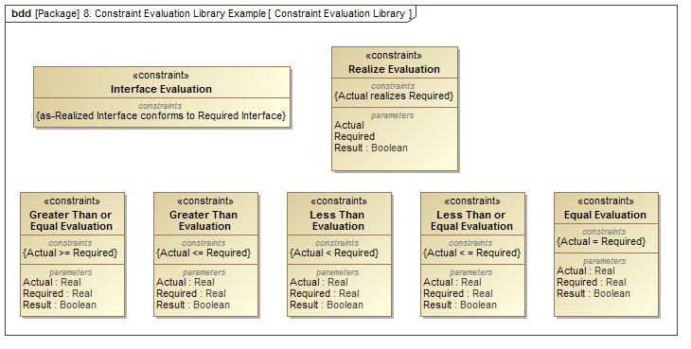
Constraint Evaluation Library Example -10/24/2016

Slide 24
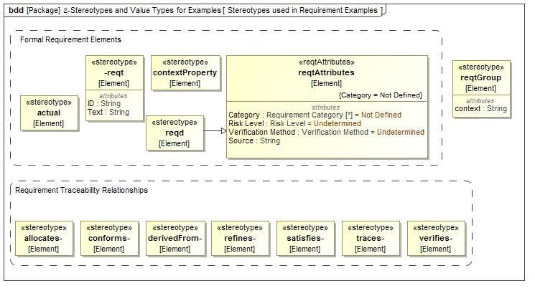
Stereotypes Types Used in Requirement Examples -10/24/2016

Slide 25
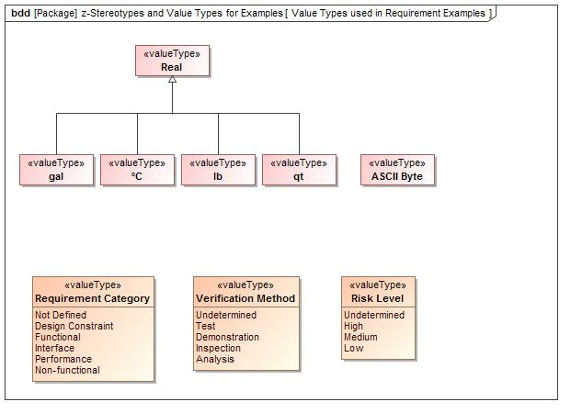
Value Types Used in Examples -10/24/2016

Slide 26
Derived Required Requirement Example Engine Power from Vehicle Weight & Vehicle Acceleration
Constraint can be reused for
defining the power requirement
and the weight requirement
Pwr-actual
Engine
Power
Pwr-reqd = k * Wt-reqd
Pwr-actual>Pwr-reqd
Accel = 0-60 in 10 sec
Wt-reqd
Vehicle Weight

Slide 27
Derived Desired Requirement Example Engine Power from Vehicle Weight & Vehicle Acceleration
Constraint can be reused for
defining the power requirement
and the weight requirement
Pwr-actual>Pwr-desired
Engine
Power
Pwr-reqd = k * Wt-reqd
Pwr-actual
Accel = 0-60 in 5 sec
Accel = 0-60 in 10 sec
Wt-reqd
Vehicle Weight

Slide 28
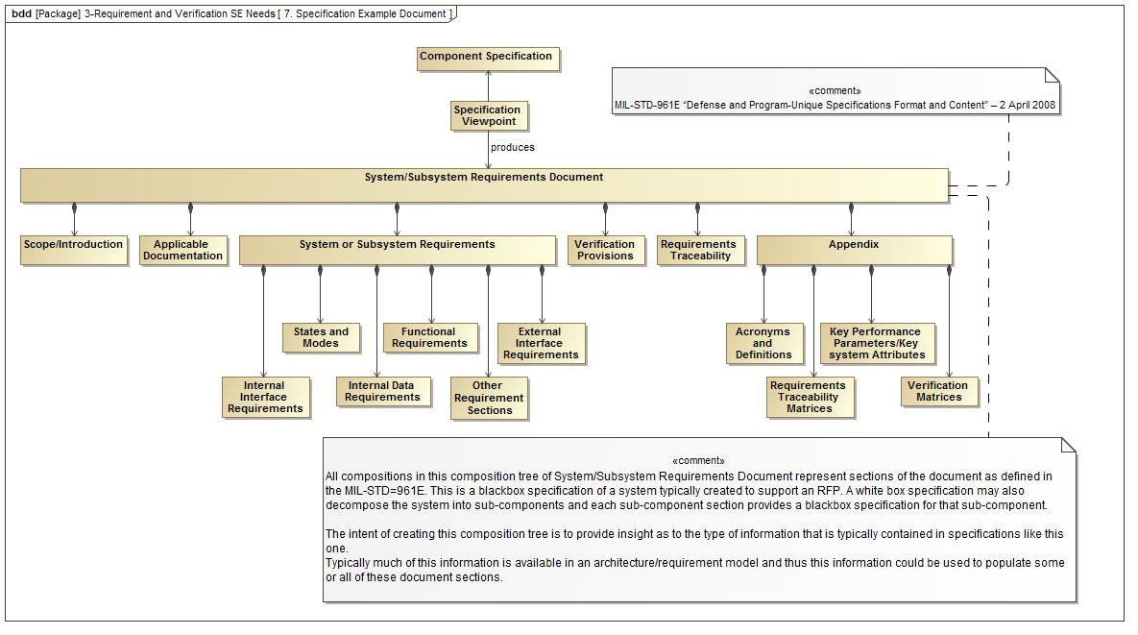
MIL-STD-961E Requirement Specification Example -10/13/2016

