Slide 1
Architecture for View Modeling in SysML
Auto-View Generation Working Group
Lead: Christopher Delp
NASA JPL

Slide 2
Outline
Concept of Views and Viewpoints
What’s in SysML today
What is the proposed change
Questions about views
Questions about expose
Questions about instances

Slide 3
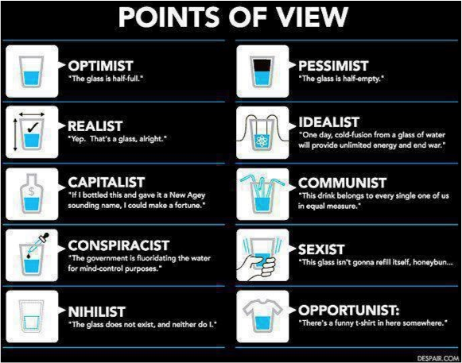
Engineer
“The glass is twice as big as it needs to be”

Slide 4
What’s in SysML now?

Slide 5
What is the proposed SysML pattern?

Slide 6
Constraints
The Viewpoint::method is defined as the method of the constructor of the base class
The method of the constructor of the base class must have access to the viewpoint stereotype properties
The View constructor may provide filtering
View base class is a subclass of viewpoint base class
Conform would extend Generalization
Supplier of the conform is the Viewpoint

Slide 7
Constraints:
The Viewpoint::method is defined as the method of the constructor of the base class
The method of the constructor of the base class must have access to the viewpoint stereotype properties
The View constructor may provide filtering
View base class is a subclass of viewpoint base class
Conform would extend Generalization
Supplier of the conform is the Viewpoint
<<Viewpoint>>
/method
presentation
<<Viewpoint>>
MyViewpoint
{abstract}
___________________
<<create>> MyView()
<<conform>>
<<View>>
MyView _____________________
myModelElement
<<expose>>
myGeneratedDoc.docx
Notes:
Alternative:
Creating a constructor in Viewpoint and making viewpoint abstract
View specializes viewpoint and then will redefines the constructor to work with exposed element and may provide filtering

Slide 8
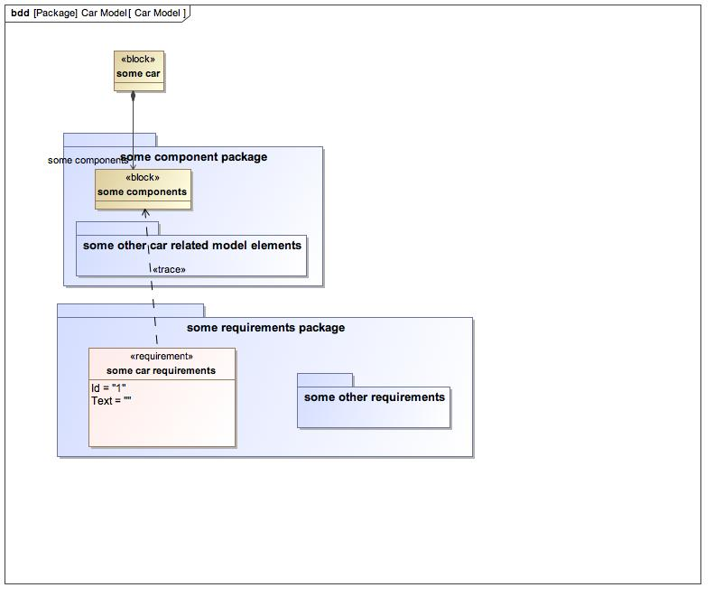
Trivial Example Car Model

Slide 9
View Hierarchies and Trees
How do I make an outline of views?
Using associations between views accomplishes this.
How do I name an included view according to the context I have used it in?
The property/association end accommodates this.
How do I order the views in the outline?
The includedView calculates the associated views and allows the model developer to order these views according to the desired read order.
What is the difference between a view generated by a method and the inclusion of another view that has its own method?
The key difference is centered on re-use. If a view is already developed, this view can simply be referenced. It is also possible to reuse the method in the viewpoint that the view conforms to.
What do Associations vs. composite/shared associations mean?
This depends on how the view tree is interpreted into a document or other artifact. Given the wide range of artifacts and transformations that could produce artifacts from view trees, we focus on using the well defined SysML associations to provide the foundation for how these transformations might be implemented.

Slide 10
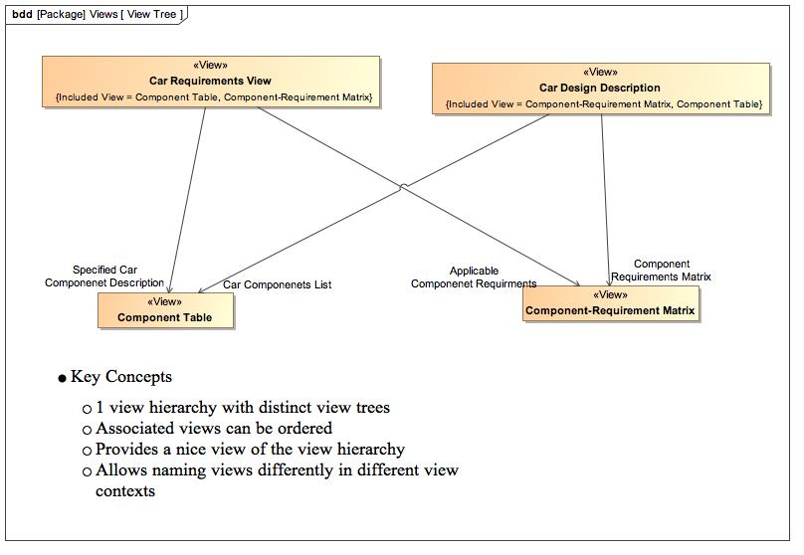
View Tree

Slide 11
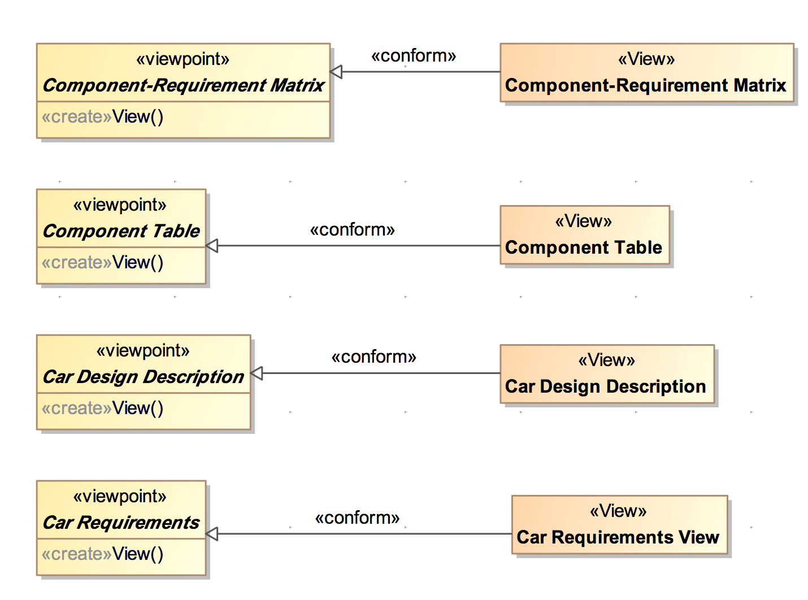
Viewpoints

Slide 12
Exposing the Model
How do I relate the view and the model?
The Expose relationship allows the view to be related to the parts of the model that represent the access points for what will be represented in the view.
How do the view and the expose relationships relate to the viewpoint method as an argument?
The view and the model elements specified by the expose relationship are arguments to the viewpoint method.
What compliments expose in terms of exclusions?
This is currently not addressed.

Slide 13
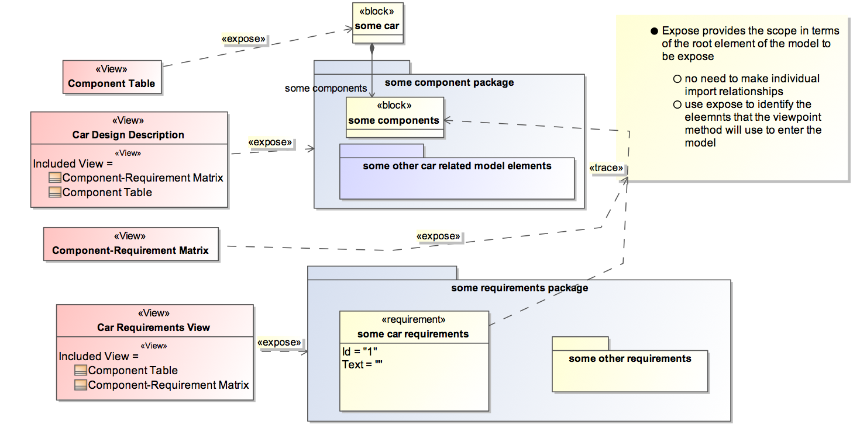
View Expose
Notes:
Access path, context for the method
View is invocation of the viewpoint method.
The expose relationship identifies the arguments of the viewpoint method.
Follow up on method argument link
Phils questions about view-level choices for presentation options and expose filtering
Roger and conrad – association issue
ordering

Slide 14
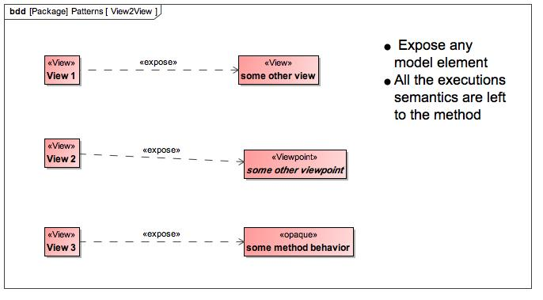
View2View

Slide 15
View Product
What are the instances of View?
The instances of views are the artifacts that are generated as the result of processing the view model into something like a document or other concrete product that allows the stakeholder to consume the information. Artifacts are not currently tied to any semantic such as UML artifact.
How flexible is the presentation property in viewpoint?
Just like the current viewpoint and view pattern, we have not entered into specifying the execution semantics. The URIs are optional given that different organizations may choose different languages to implement their viewpoint methods. Depending on if the language of the viewpoint can work with URIs and if the organization has these URI mechanisms set up then they would be able to use this common web technology. If not then they can write their own specification as a simple string describing these style properties. I think it is profoundly reasonable to expect any contemporary language to be able to deal with URIs. Adding this option opens the door for a powerful future-state capability.

Slide 16
Migration
How do I migrate behavior from current method string?
Just move the text into and opaque behavior or other behavior class and add the behavior to the method of the operation

