Slide 1
Status of the Systems Engineering Concept Model Kernel (SECM-Kernel)
Extended Concepts Pt.2: Features
Presenter: Charles Galey
Notes:
Quick Review
Discussion of open issues
Model acknowledge this is an issue
Version of model with questions
ValueSpec
Naming?
Is it a UML ValueSpec?
Can the UML Value Spec handle the issues
When manas presented analysis we need a better richer description of value than we currently have
Does the current concept of ValueSpec allow this richer description?
Do we
Relationship
Directed vs. undirected
Binary vs. n-ary
New version of the SECM composition tree
Animated w. original version
Add core vs extended
Add base concepts
Add extended concepts
Don’t make relationships between them
Add relationships
Extended
Global comment: We are reusing UML and SysML names to communicate intent, but we feel some of these names should be revisited
Classifier
Block
Behavior
ValueType (consider changing the name)
Requirement
ConstraintBlock (consider changing the name)
Interface
Event
Feature
Show model with the two types
Next Slide:
There are two kinds of features
Structural Feature
Behavioral Feature
Idea is that you can model with these untyped features and you are unconstrained (you can be completely free)
But once you type that feature you will have constraints that are imposed by the type (i.e. kind of relationships, what you can be instantiated as)
Backup slide: Suppose you have hardware and software and they are both domain concepts (subclass of Block like system) and I want to have a feature (Hardware Structural Feature) typed by those which have their own constraints

Slide 2
Kernel Concepts Pt. 3
Extended Concepts: Feature

Slide 3
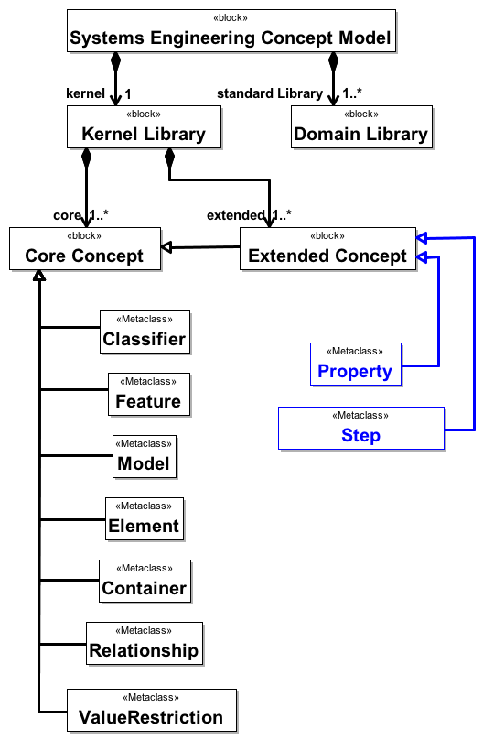
SECM Feature Concepts

Slide 4
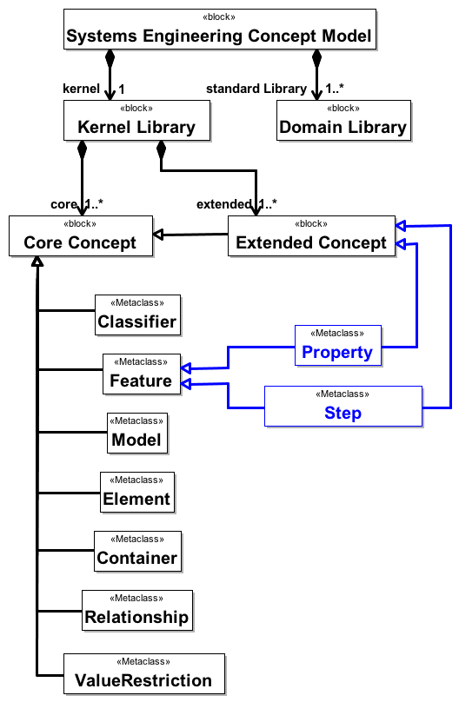
SECM Feature Concepts

Slide 5
SECM Feature Concepts
There are two specializations of feature
Property
Step
Idea is that you can model with these features un-typed and you are unconstrained (you can be completely free)
Once you type that feature you will have constraints that are imposed by the type (i.e. kind of relationships, what it can be instantiated as)

Slide 6
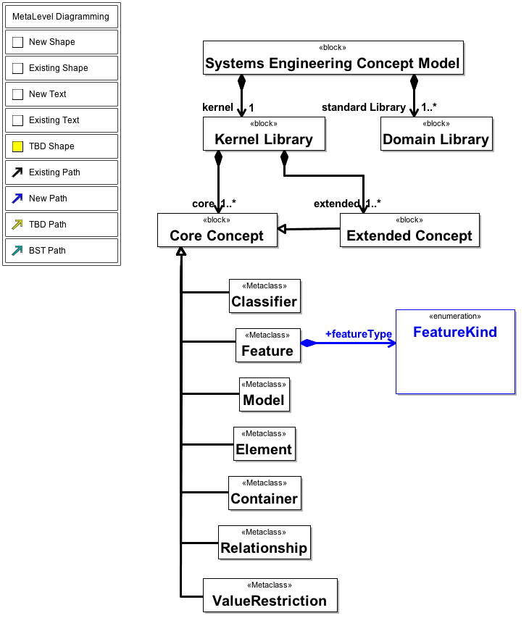
SECM Optional FeatureType

Slide 7
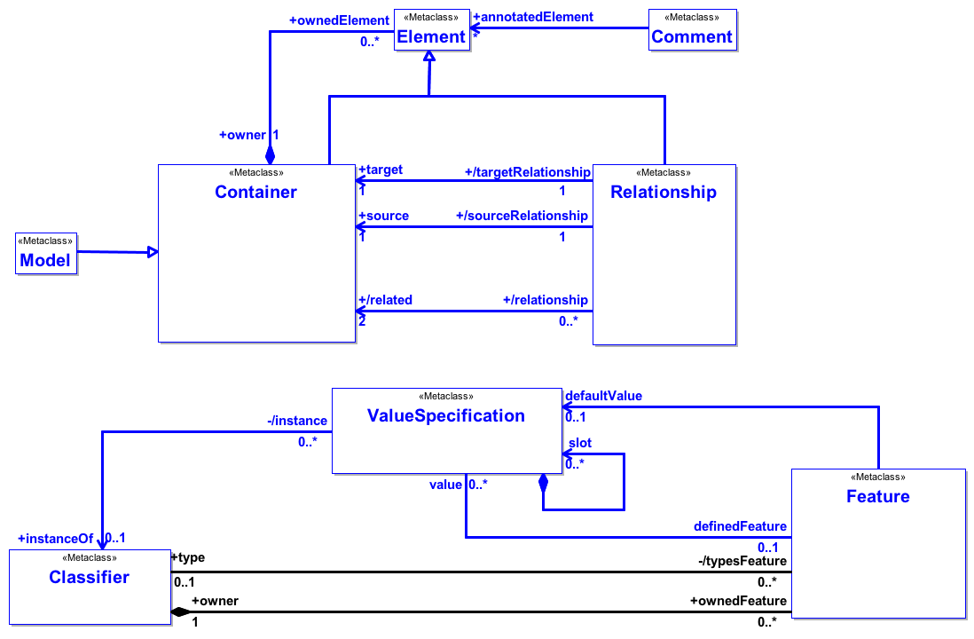
Kernel Base Concepts
Note that type is [0..1]

Slide 8
Backup

Slide 9
Backup slide: Suppose you have hardware and software and they are both domain concepts (subclass of Block like system) and I want to have a feature (Hardware Structural Feature) typed by those which have their own constraints

