Slide 1
SECM - 2015 Industry Reference Extracts (Draft)
John Watson
9/11/2016 Rev A
The following slides are provided for use in the INCOSE INSIGHT Article for December 2016

Slide 2
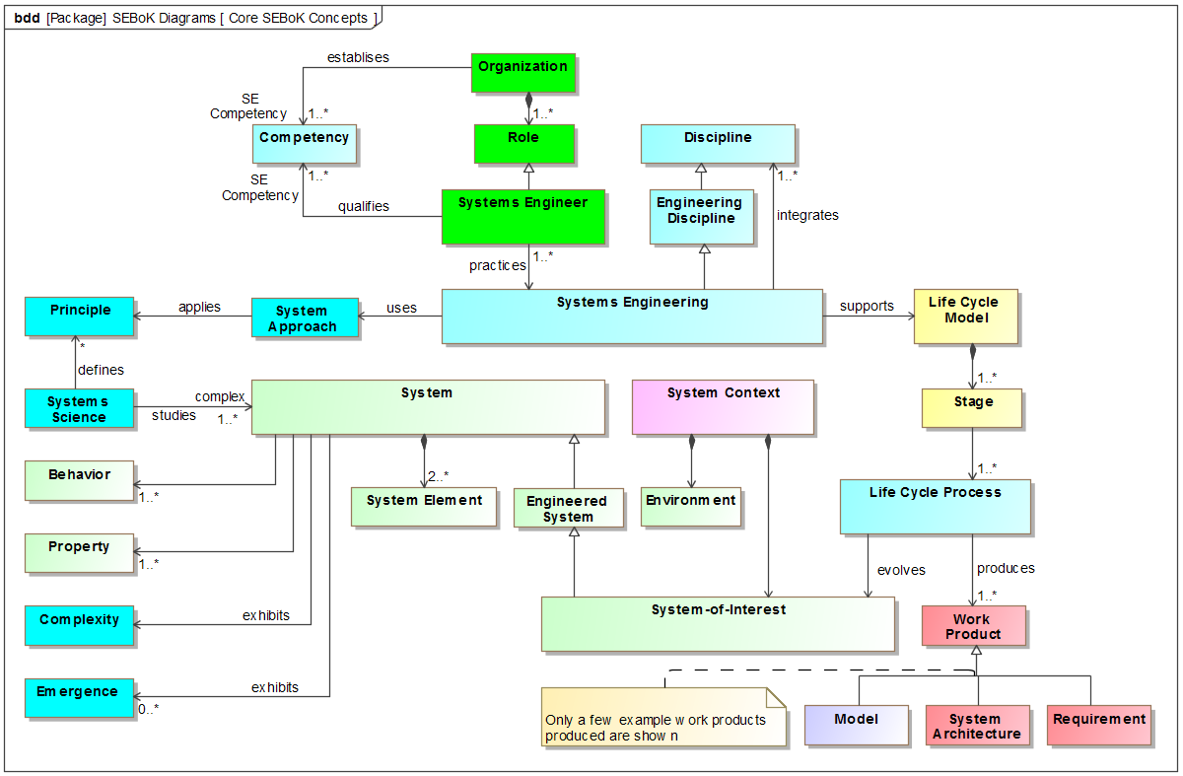

Slide 3
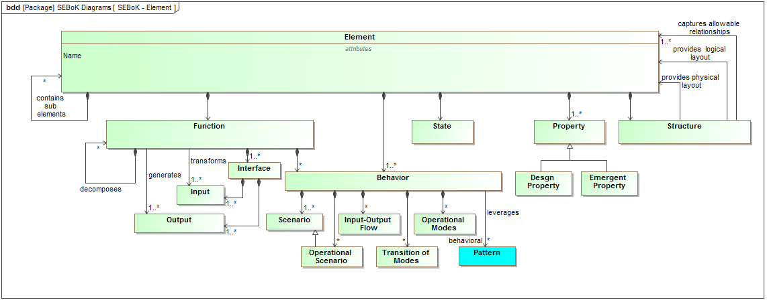

Slide 4
