Slide 1
Interface Needs Model Diagrams Review
John Watson
6/7/2016

Slide 2
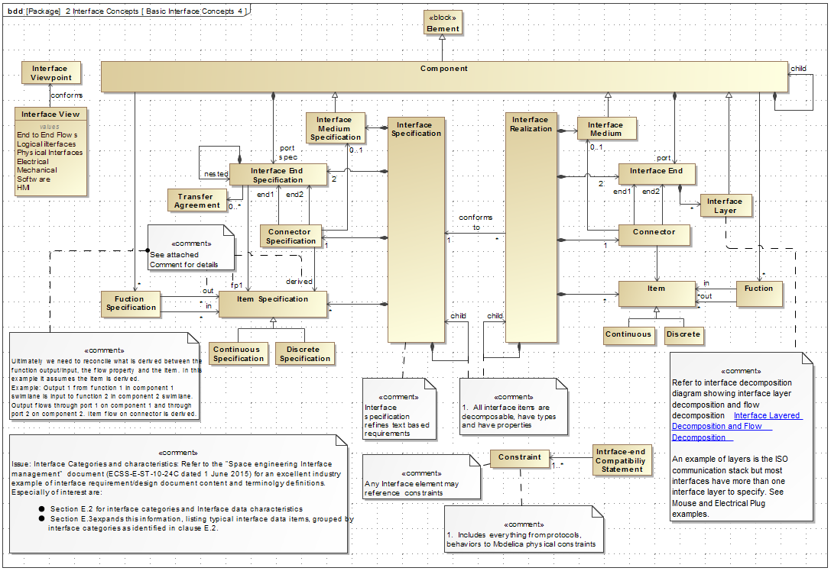

Slide 3
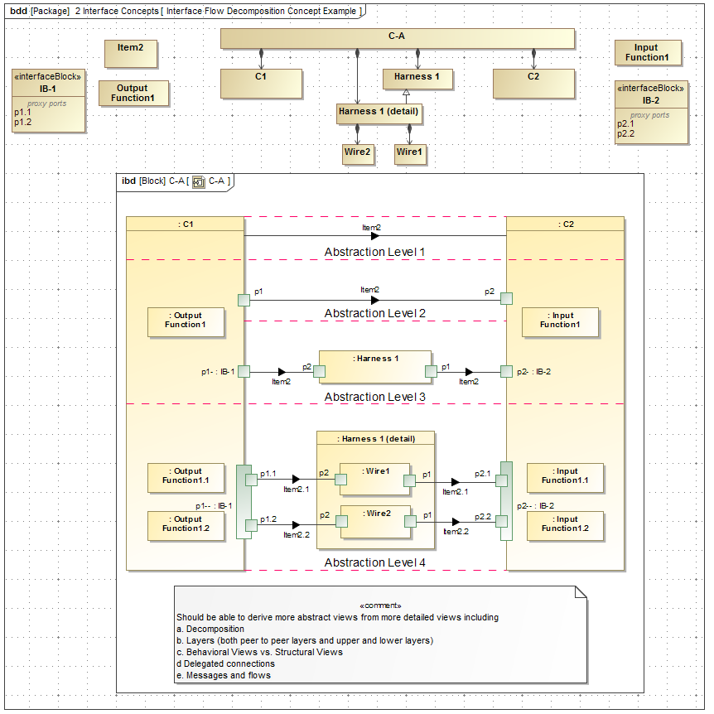

Slide 4
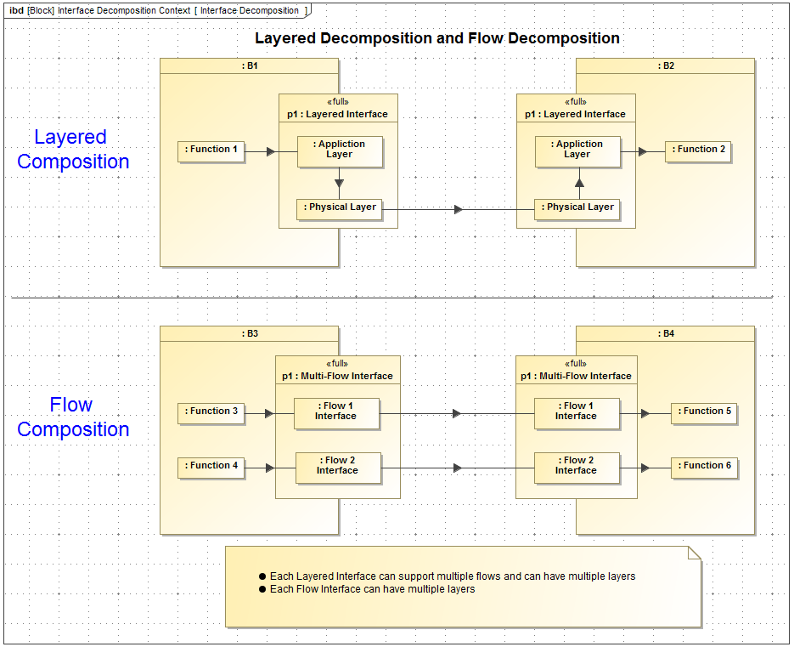

Slide 5
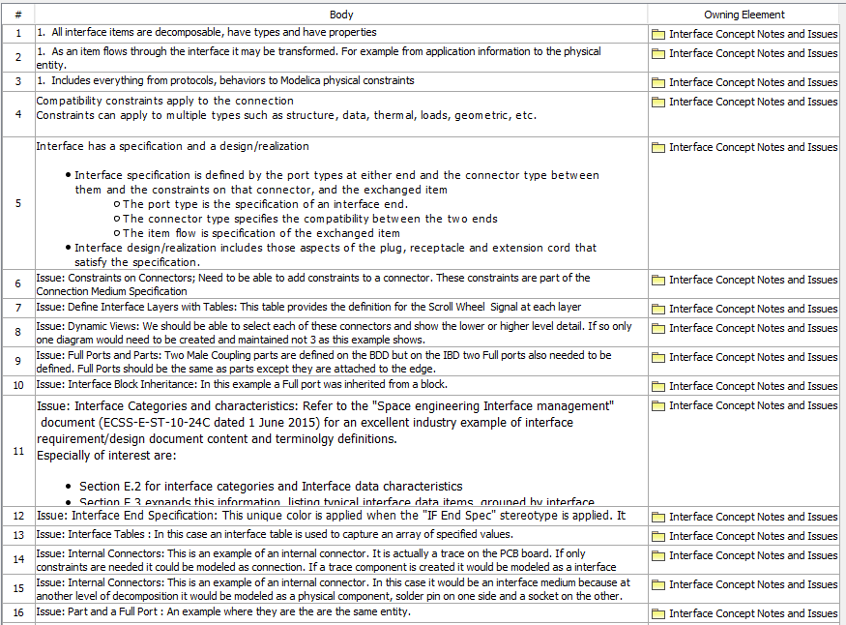
Note and Issues

Slide 6
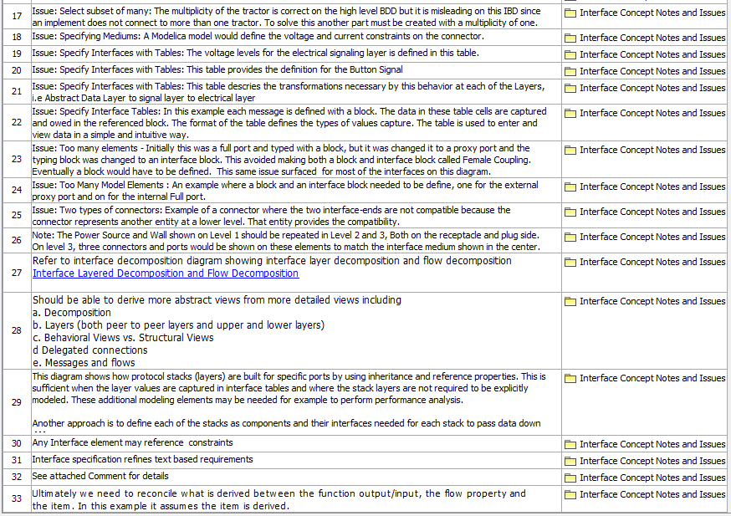
Note and Issues

Slide 7
1-Tractor/Implement Example

Slide 8
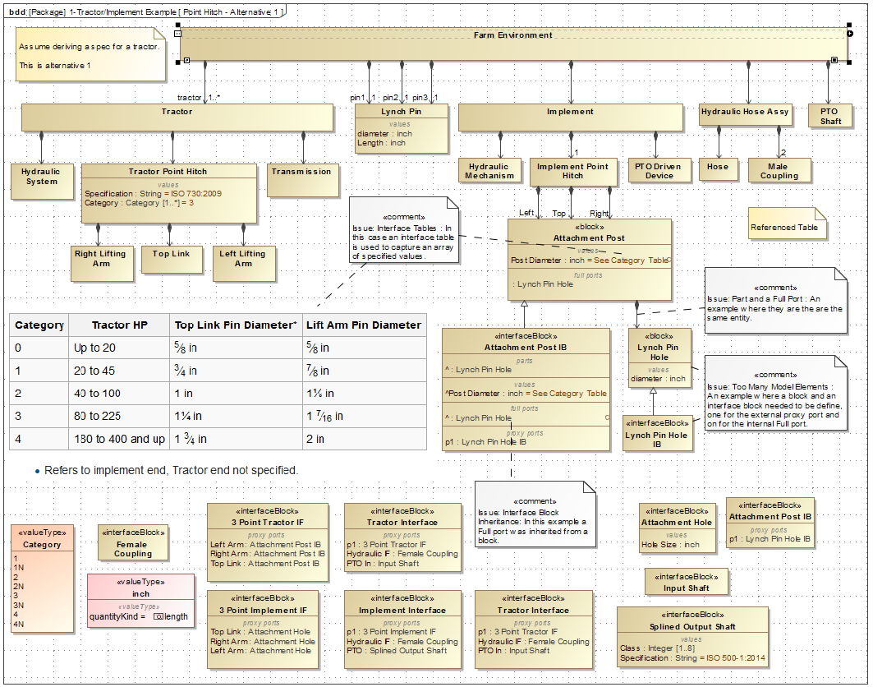

Slide 9
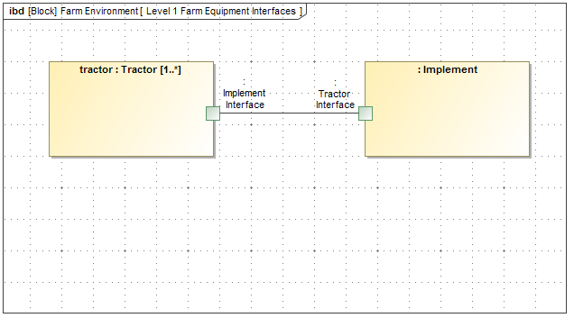

Slide 10
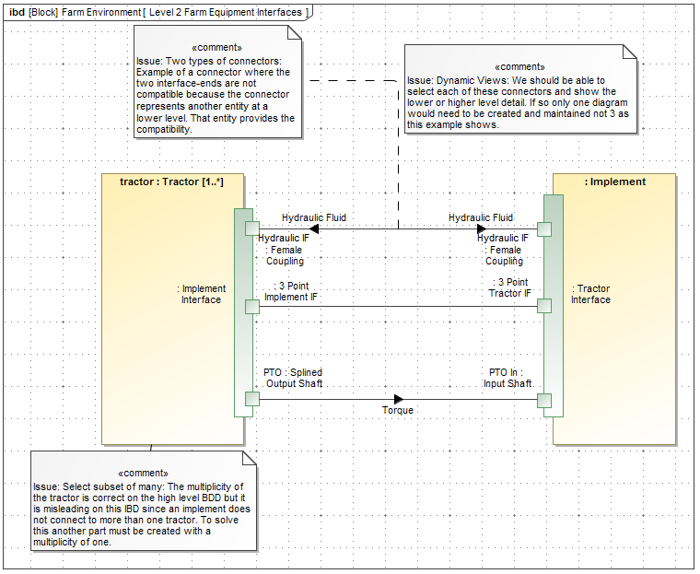

Slide 11
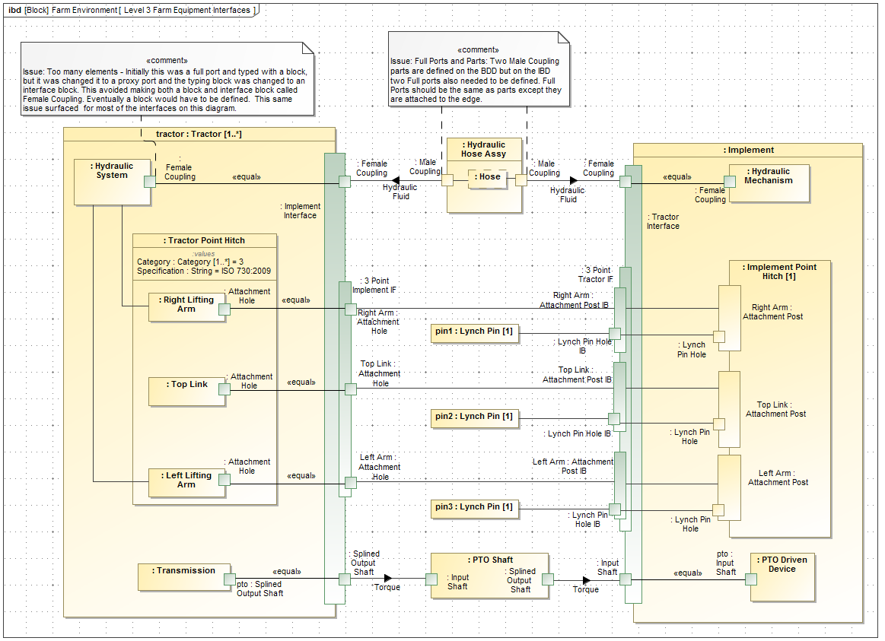

Slide 12
2-PC Mouse Example

Slide 13
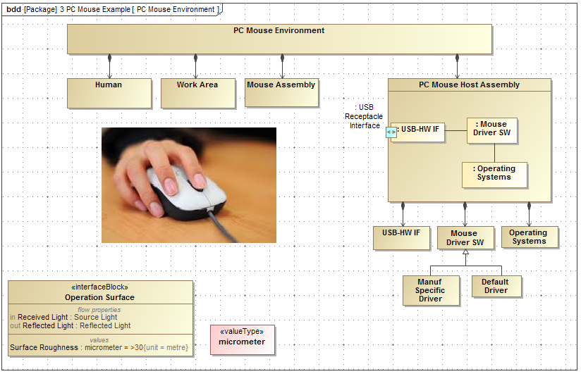

Slide 14
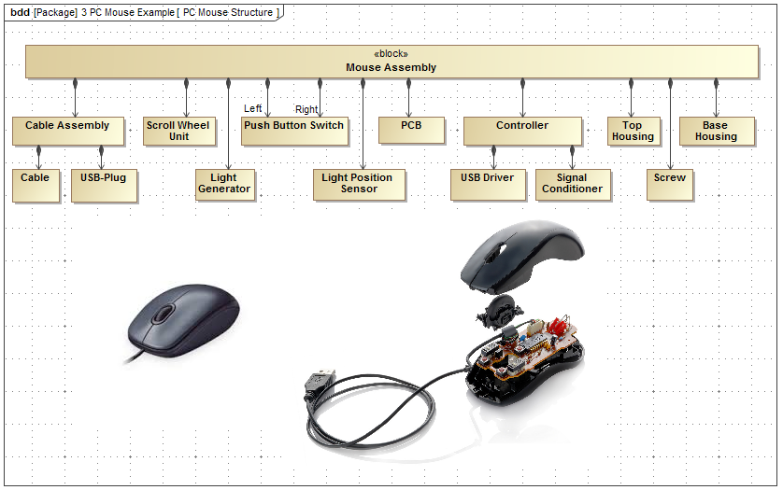

Slide 15
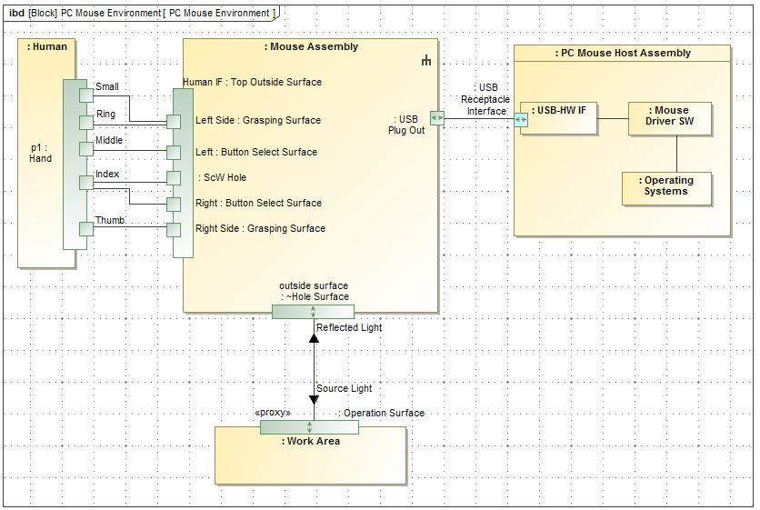

Slide 16
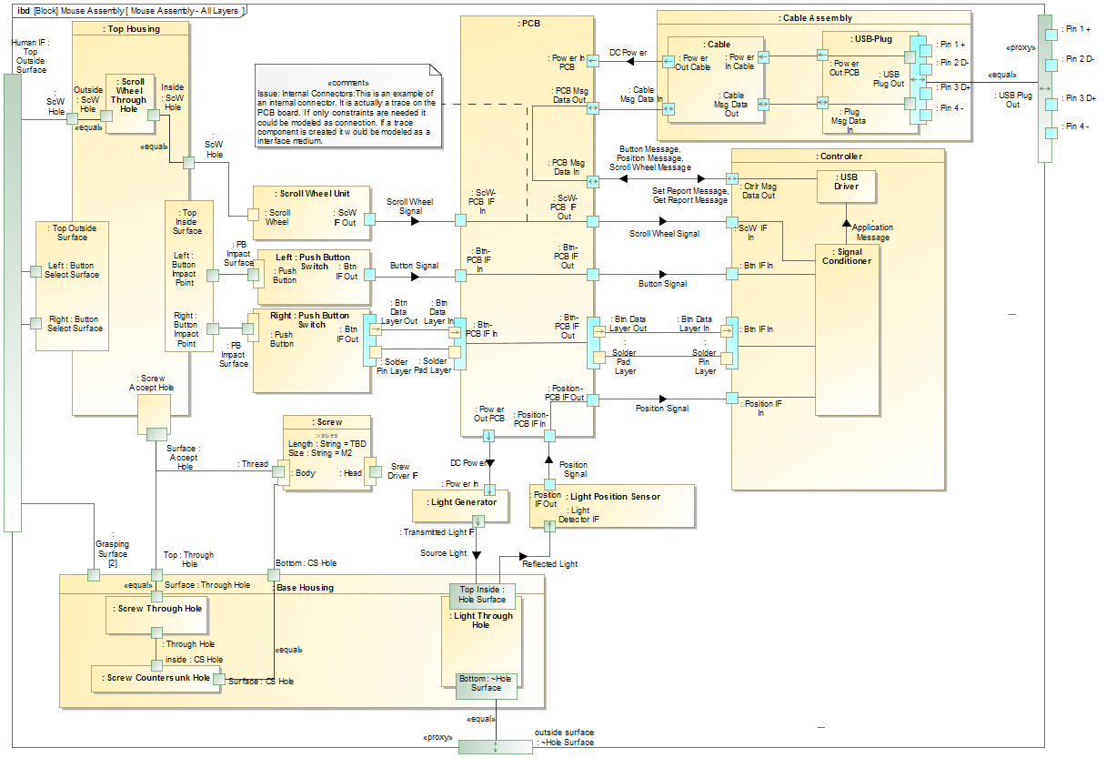

Slide 17
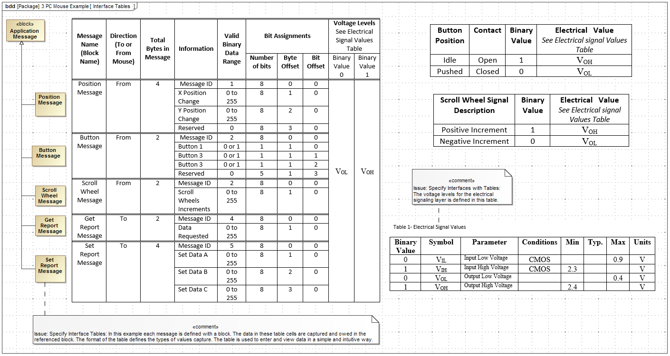

Slide 18
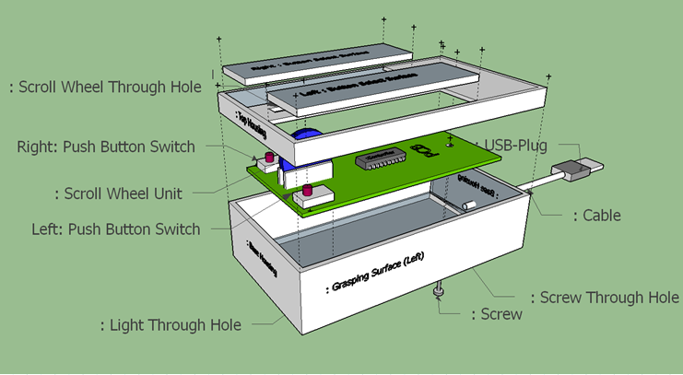

Slide 19
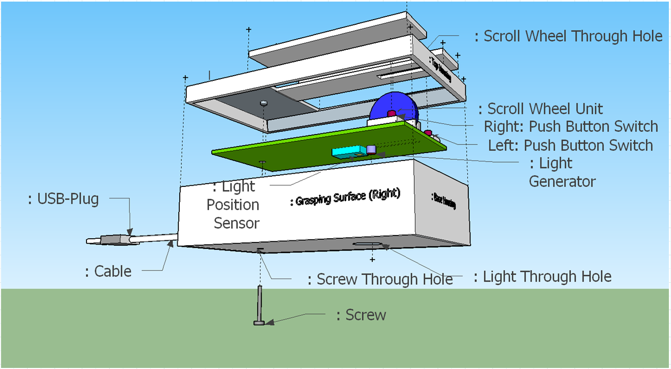

Slide 20
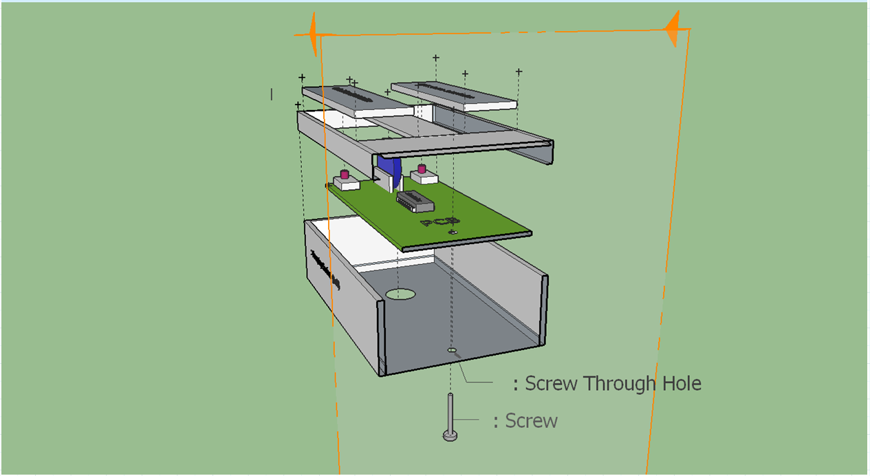

Slide 21
3- Interface Medium Power Plug Example

Slide 22
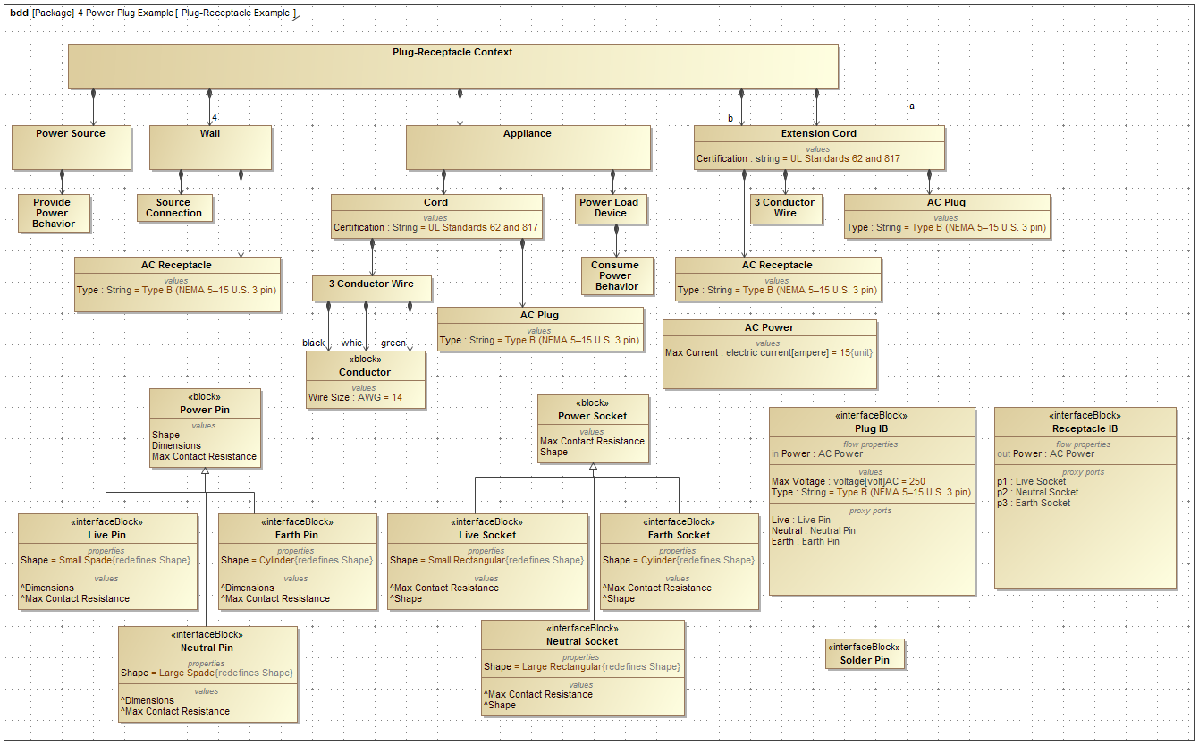

Slide 23
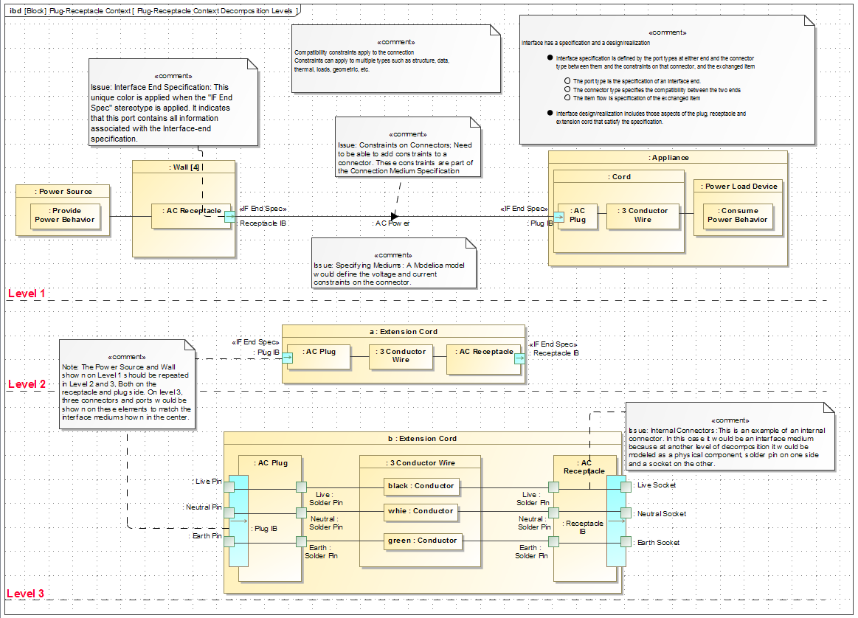

Slide 24
3- Interface Specification and Realization Power Plug Example

Slide 25
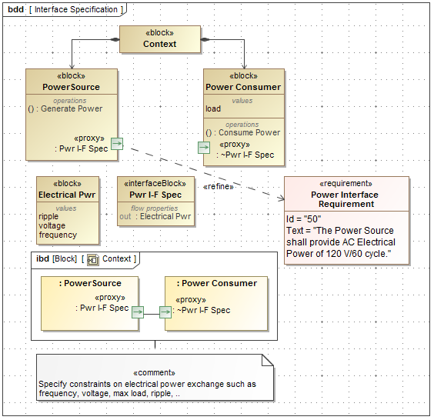

Slide 26
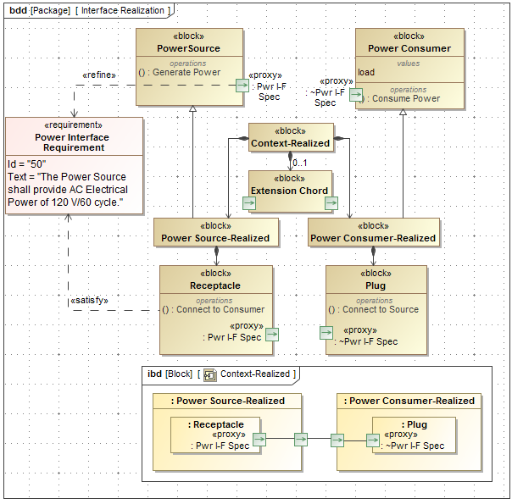

Slide 27
Plate and Bolt Example

Slide 28
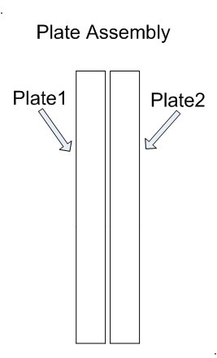
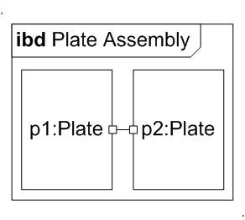
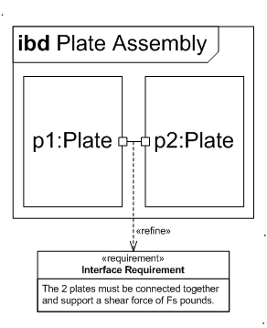
Specifying an Interface
4/19/16

Slide 29
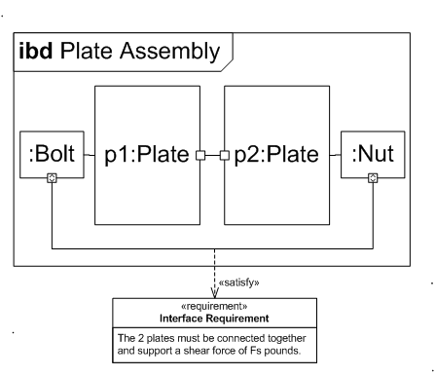
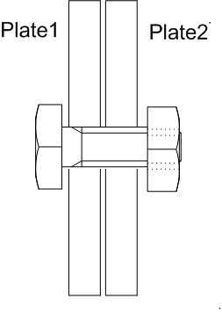
Realizing an Interface

Slide 30
TCP/IP Protocol Stack Example

Slide 31
Interface Example with Simplified End to End Flow
Specify the interfaces and the associated transformation from one interface to another for the end-to-end flow

Slide 32
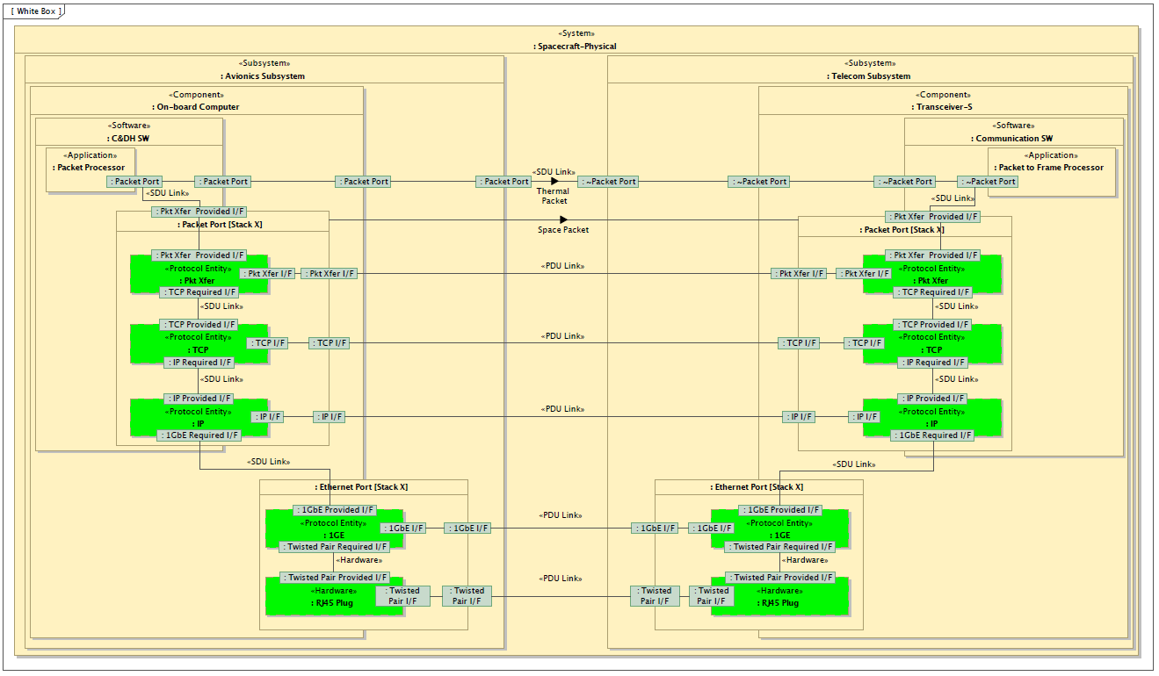
TCP/IP Protocol Stack Example
“A Representative Application of a Layered Interface Modeling Pattern”, Shames, Sarrel, Friedenthal

Slide 33
Backups

