Slide 1
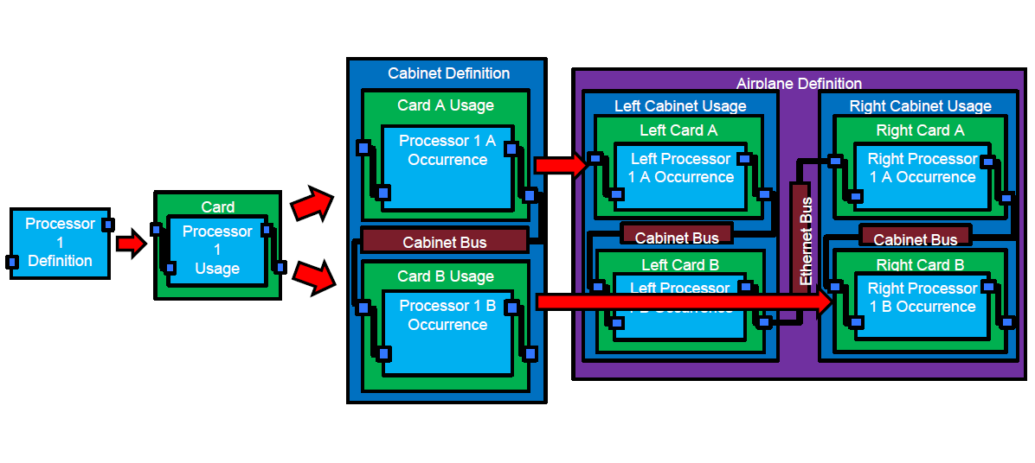
Use Case

Slide 2
Use Case

Slide 3
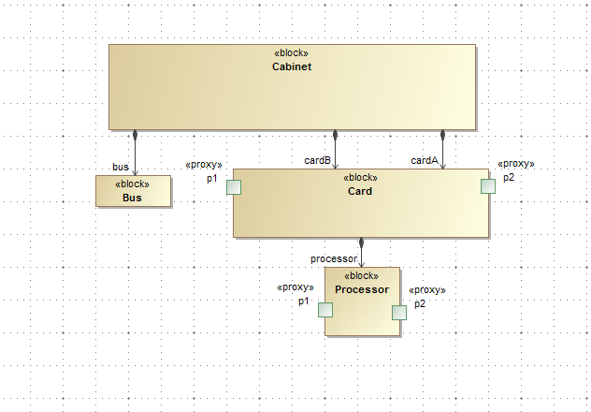
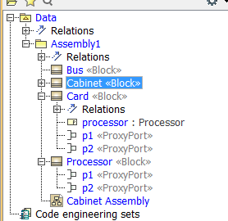
Cabinet Assembly - BDD

Slide 4
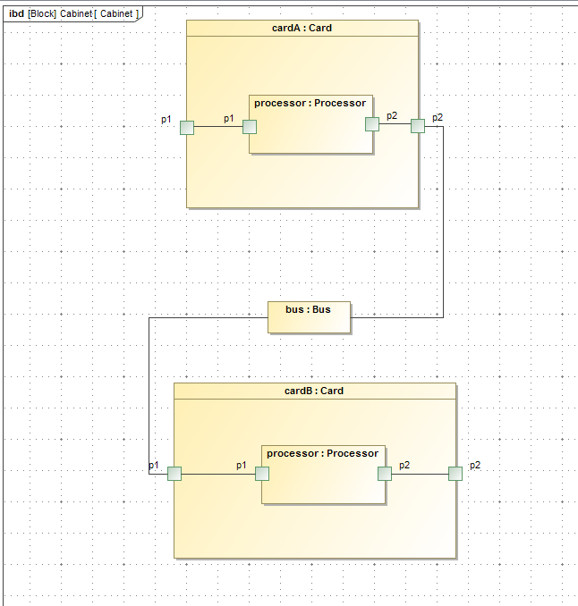
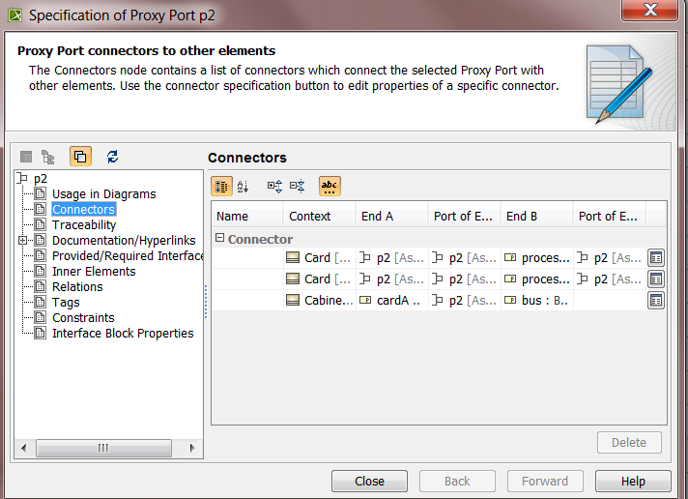
Cabinet Connectivity
Select the P2 port on Card B and it is connected to the Bus even in context of Card B P2 is not connected to the Bus
If a query is run to see what ports are connected to the Bus, P2 on Card will say it is connected.
However, this is intended to be true in the context of Card A not Card B…

Slide 5
There are a lot of ways to solve this, however, all add extra complexity and are harder to implement
Let’s look at one of the ways to implement this….

Slide 6
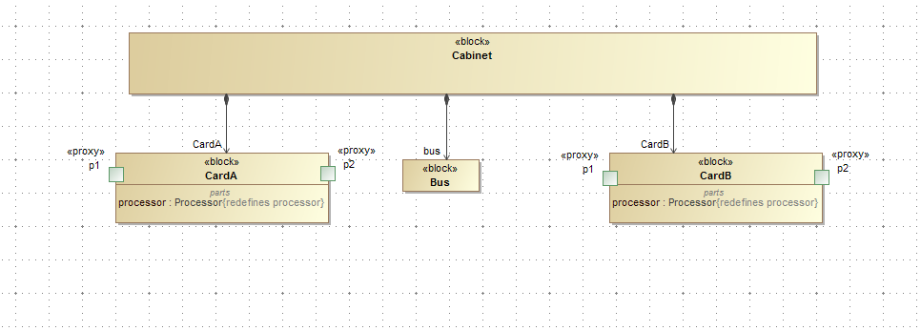
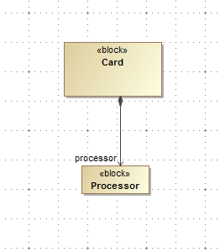
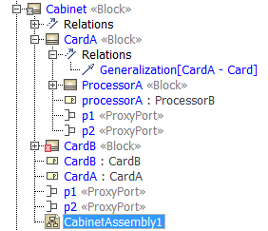
Cabinet Assembly
Block Usages are related back to the definition with a generalization link and the ports/parts are redefined at the lower assembly levels

Slide 7
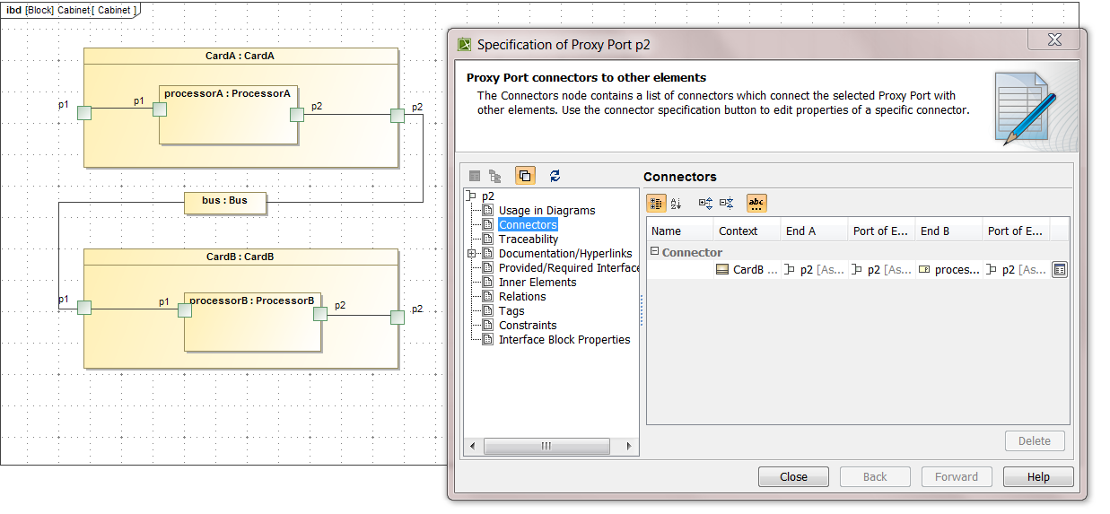
Card Connectivity
Select the P2 port on Card B and it is only connected to P2 on Processor B

