Slide 1
Properties and Expressions Core Team – Status Report
System Modeling Assessment and Roadmap Working Group
Wiki page: http://www.omgwiki.org/OMGSysML/doku.php?id=sysml-roadmap:property_modeling_core_team
Concept lead: Hans Peter de Koning

Slide 2
Team
Manas Bajaj (InterCAX)
Roger Burkhart (John Deere)
Hans Peter de Koning (European Space Agency)
Harald Eisenmann (Airbus Defence & Space)
Nerijus Jankevicius (No Magic)
Ilya Tolchinsky (Phoenix Integration)

Slide 3
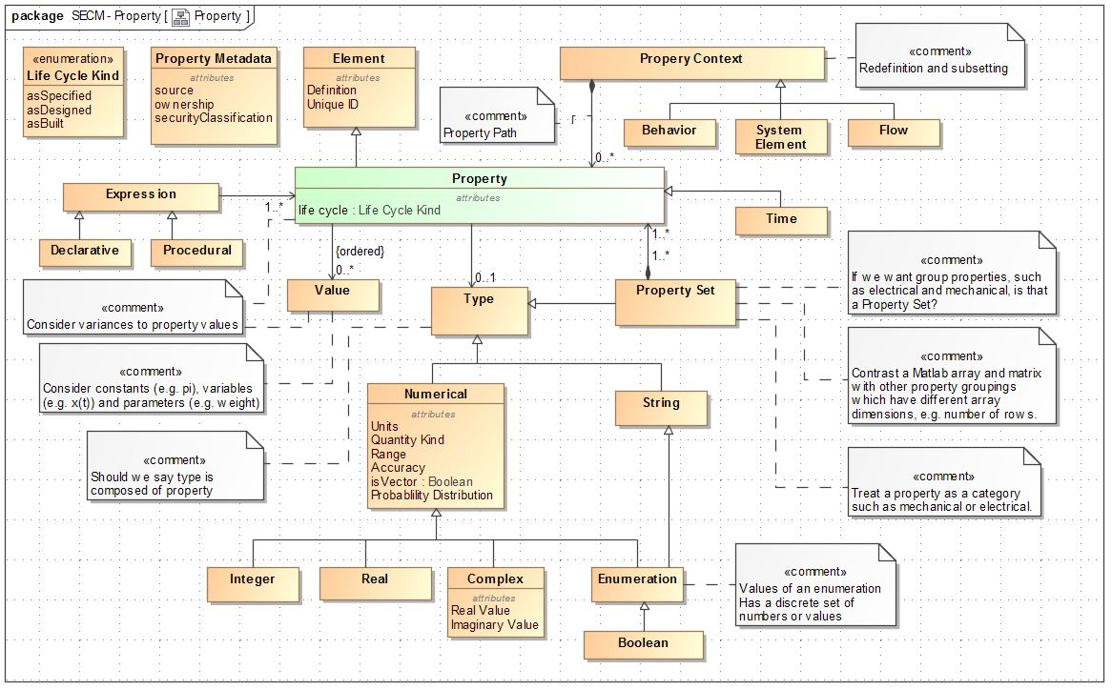
Scope / Starting Point
SysML v1.4 & v1.5, in particular:
Concepts ValueType and ValueProperty
Annex E.5, Model Library for Quantities, Units, Dimensions, and Values (QUDV)
Initial SECM - Property Thoughts R5 document by John Watson and Sandy Friedenthal

Slide 4
Limitations of current SysML (v1.x)
Limited support for compound value properties
e.g. computer data record, vector, matrix, n^{th}-order tensor, (fixed-length) array, quaternion, ...
No support for value (property) collections
a variable-length list (or sequence), set, bag, ordered set of a particular value type
Too simplistic support for measurement scales other than ratio scale (in QUDV)
No standard feature to constrain the range of a numerical value type
Complex meta-model (including QUDV) leads to implementation inefficiencies for tool vendors and usability issues for end-users
A (numerical) value type defines (and fixes) a selected measurement unit, but the actual measure scale in use (rather than unit) for a value property of a given value type should be selectable from a set of permissible measurement scales.
Ideally SysML implementations would be capable of doing automated scale conversion of numerical property values
however the meta-model (including QUDV) has insufficient information to do so in all cases
Limited support for tabular (discretely sampled) data
like time series, frequency spectra, temperature (pressure, enthalpy, ...) dependent material properties, etc.
Limited support for uncertainties and probability distributions / probability density functions.

Slide 5
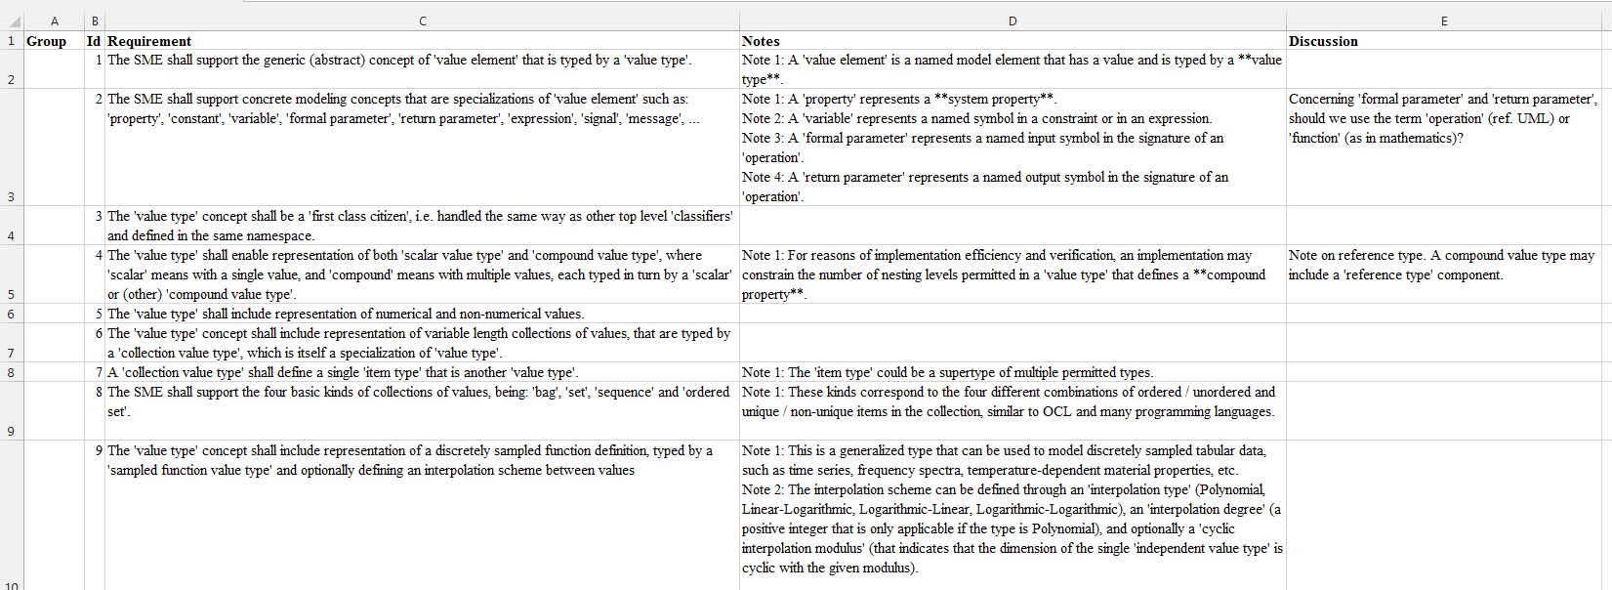
Draft Requirements for RFP
Established draft2 of the requirements in Excel workbook
http://www.omgwiki.org/OMGSysML/lib/exe/fetch.php?id=sysml-roadmap%3Aproperty_modeling_core_team&cache=cache&media=sysml-roadmap:sysml-v2-rfp-reqs-values-and-expressions-draft2.xlsx
Rather than go through the requirements one by one, illustrate approach through concept validation using UML
Still a work-in-progress

Slide 6
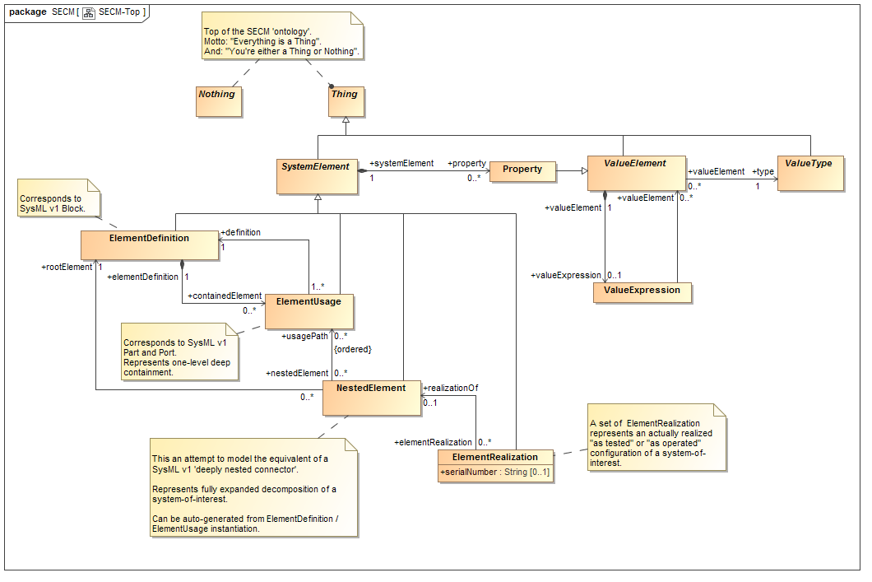
Basic Concepts

Slide 7
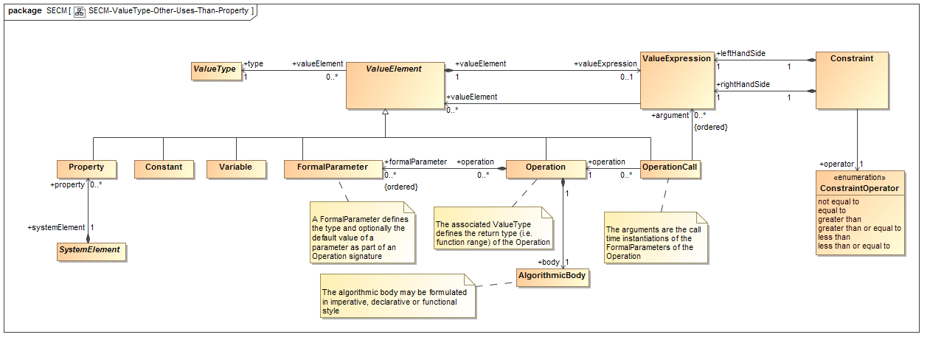
ValueElement – Other uses than Property

Slide 8
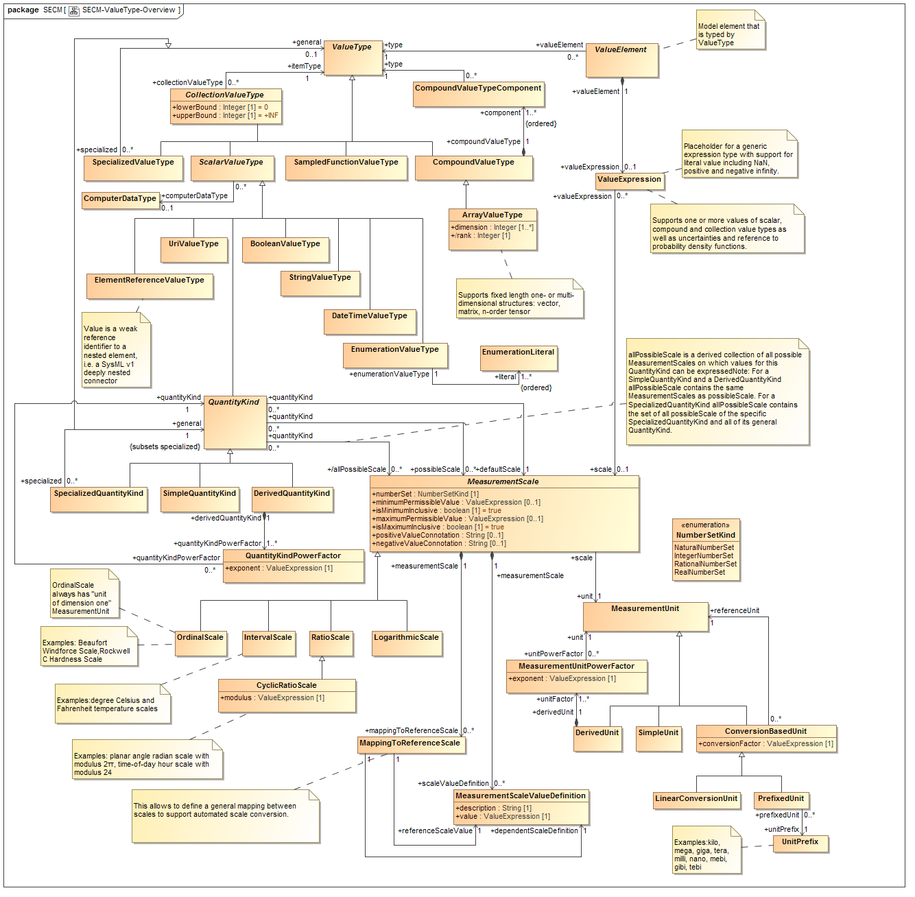
ValueType – Overview of the Different Subtypes

Slide 9
ValueType – QuantityKind, Measurement Unit and Scale

Slide 10
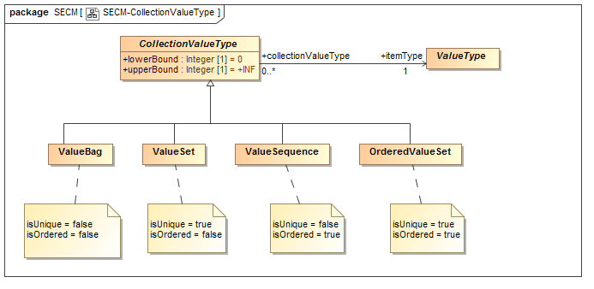
ValueType – Collection Types

Slide 11
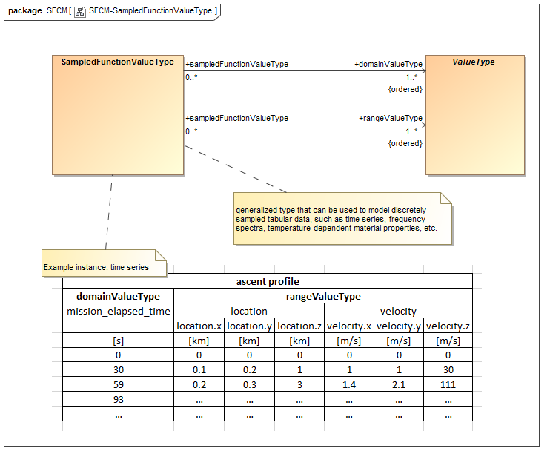
ValueType - SampledFunctionValueType

Slide 12
ValueExpression & Constraint
Proposed requirement: “The SME shall support a well-established system modeling language to define an 'expression', a 'constraint' and an 'algorithmic body' of an 'operation'.”
Rationale: developing yet another expression / constraint / algorithmic body language is very inefficient and
Potential candidate: Modelica language
See https://modelica.org/documents
And http://www.omgwiki.org/OMGSysML/doku.php?id=sysml-modelica:sysml_and_modelica_integration (2008 – 2015)
“MetaModelica” allows to model the expression and constraint language
Generic – not Modelica specific
Can generate executable programming language code
Modelica spec and OpenModelica are defined using MetaModelica: great starting point
https://openmodelica.org/svn/OpenModelica/tags/OPENMODELICA_1_9_0_BETA_3/doc/OpenModelicaMetaProgramming.pdf

Slide 13
Unification of Analysis | Simulation | Test | Operation
Concept | Analysis | Simulation “virtual” | Test | Operation “real”, “physical”
Facility | analysis or simulation tool / framework | test facility or operational context, including data acquisition
Model | idealization of structure and behavior of a system-of-interest and its operational environment (in general: acausal / non-directional) | digital representation of a test article or operational product and its relevant environment (BoM, topology and/or geometry, sensors, gauges, channels, …)
Case | particular analysis or simulation configuration “experiment” to be run, with objectives fixes independent and dependent variables (i.e. causality / directionality) defines initial conditions and profiles defines boundary / environment conditions / profiles defines expected results and evaluation criteria | particular test or operation configuration scenario to be run, with objectives defines conditions, profiles, stimulae, signals, … relevant to article or product defines environment conditions / profiles defines expected results and evaluation criteria
Run | time-stamped execution of a Model and a Case in a Facility
Result | predictions yielded by executed Run | observations yielded by executed Run
Note: In many existing engineering analysis or simulation tools there is not such a clear distinction between Model and Case

Slide 14
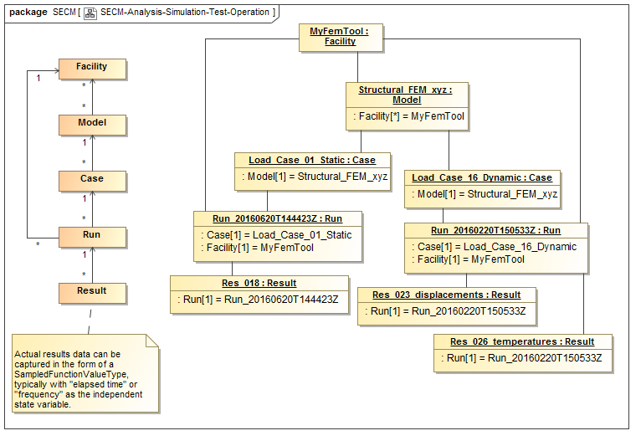
Structure and Example of Unified Analysis | Simulation | Test | Operation pattern

Slide 15
Heritage from ESA STEP-NRF Standard (1/2)
Note: STEP-NRF stands for “STEP-based Network-model and Results Format”
and was one of the main inputs for SysML QUDV
STEP-NRF was implemented by ESA
in generic pre- and post-processing tools for thermal analysis and testing
using the HDF5 data format and API from NCSA for scalability and high performance, allowing millions of observations on very large analysis and test models, handling multi-GB datasets in 2005
See https://www.hdfgroup.org/HDF5/

Slide 16
Heritage from ESA STEP-NRF Standard (2/2)

Slide 17
Advantages of Unifying ValueElement & ValueType and Analysis | Simulation | Test | Operation
Unifies approach to characterize, define and obtain results from analysis | simulation | test | operation, using a single typing approach
Can chain sequences of runs similar to Unix pipes
Result(s) of one run are input to next
Can support hardware-in-the-loop simulations and/or co-simulation with multiple concurrently running tools using one pattern
Simplifies / generalizes pre- and post-processing operations
Simplifies analysis model / test model correlation
Simplifies / generalizes configuration control and model management of virtual and physical models, cases and runs

Slide 18
Plans for Prototypes to Demonstrate Feasibility
For ValueType and QUDV
Show conceptual approaches using ESA Open Concurrent Design Tool, MagicDraw/SysML, …
Model HSUV example focusing on ValueTypes and ValueElements validation, including uncertainties and probabilistic aspects
Work with System Analysis WG to align approach
Assess potential meta-model / language architecture approaches for scalability and performance
Use MetaModelica to prototype and validate the expression and constraint language

Slide 19
Next Steps
Review and vet RFP requirements
Start integration of ValueType, ValueElement, …, concepts into central SECM model
Start on prototyping

