Slide 1
Interface Concepts Modeling Core Team
Status Update
Marc Sarrel, Steve Hetfield, Chas Galey
22Aug16

Slide 2
Introduction

Slide 3
Objectives
Improve Interface Modeling efficiency with more mature constructs
Improve Interface Modeling consistency across domains with Standard based rules
Update, clarify, mature System Modeling Language (SysML) related to Interface Concepts
Clarify, define tool implementation concepts for modeling Interfaces

Slide 4
Approach
Demonstrate current limitations with notes and issues
Derive requirements to address notes and issues
Ensure all kinds of interfaces are addressed: Electrical, Hydraulic, Pneumatic, Mechanical, Software, Human, etc.
Plate and Bolt Example
Tractor Implement Example
TCP/IP Protocol Stack Example
PC Mouse Example
Power Plug Example

Slide 5
Overview
Interface Specification/ Realization
Interface Abstraction Levels
Interface Layers
Interface Visualization of higher level abstraction
Interface Decomposition to lower level abstraction
Physical geometry
Interface Tables

Slide 6
Interface Specification/ Realization

Slide 7
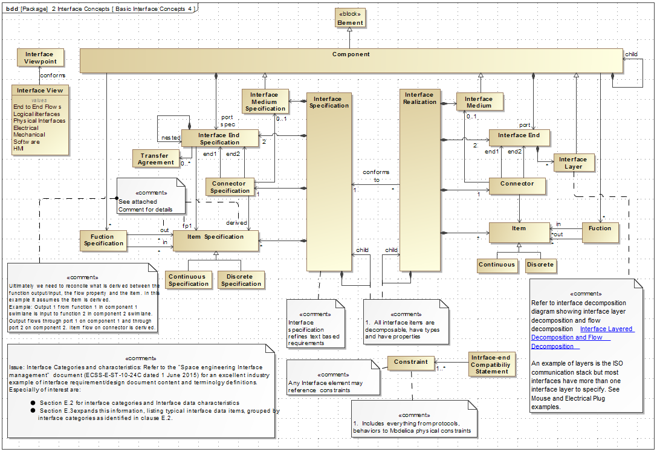

Slide 8
Plate and Bolt Example
Interface Specification/ Realization

Slide 9
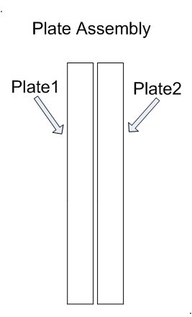
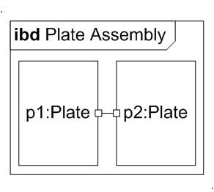
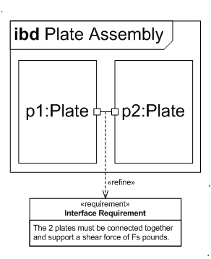
Specifying an Interface
4/19/16

Slide 10
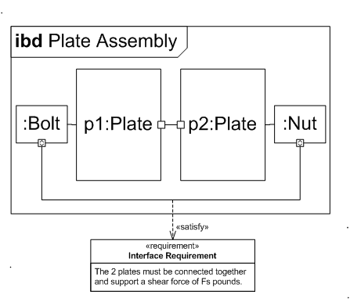
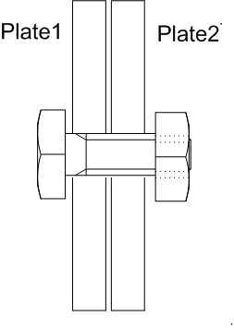
Realizing an Interface

Slide 11
Power Plug Example
Interface Specification/ Realization

Slide 12
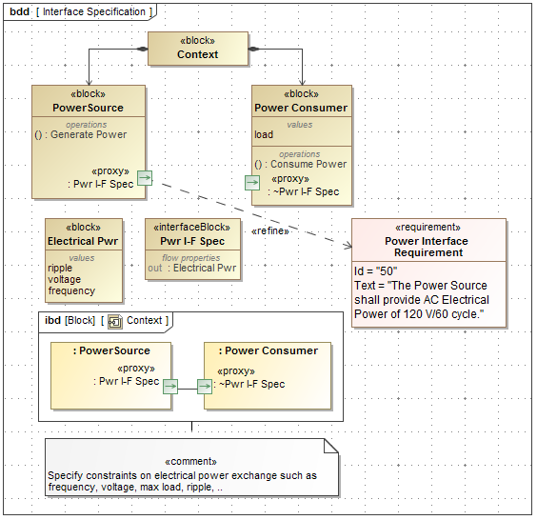

Slide 13
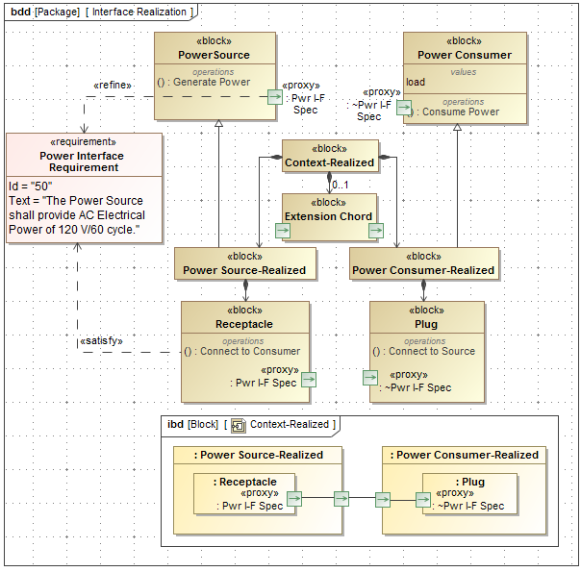

Slide 14
Interface Abstraction Levels

Slide 15
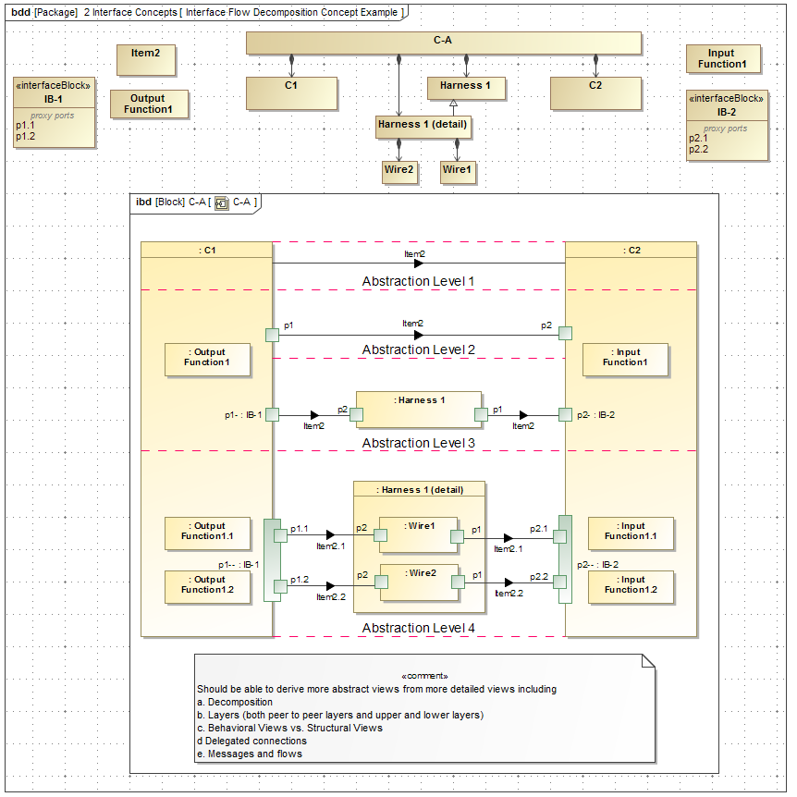

Slide 16
Tractor/Implement Example
Interface Abstraction Levels
Demonstrates 3 Levels of Interface Abstraction

Slide 17
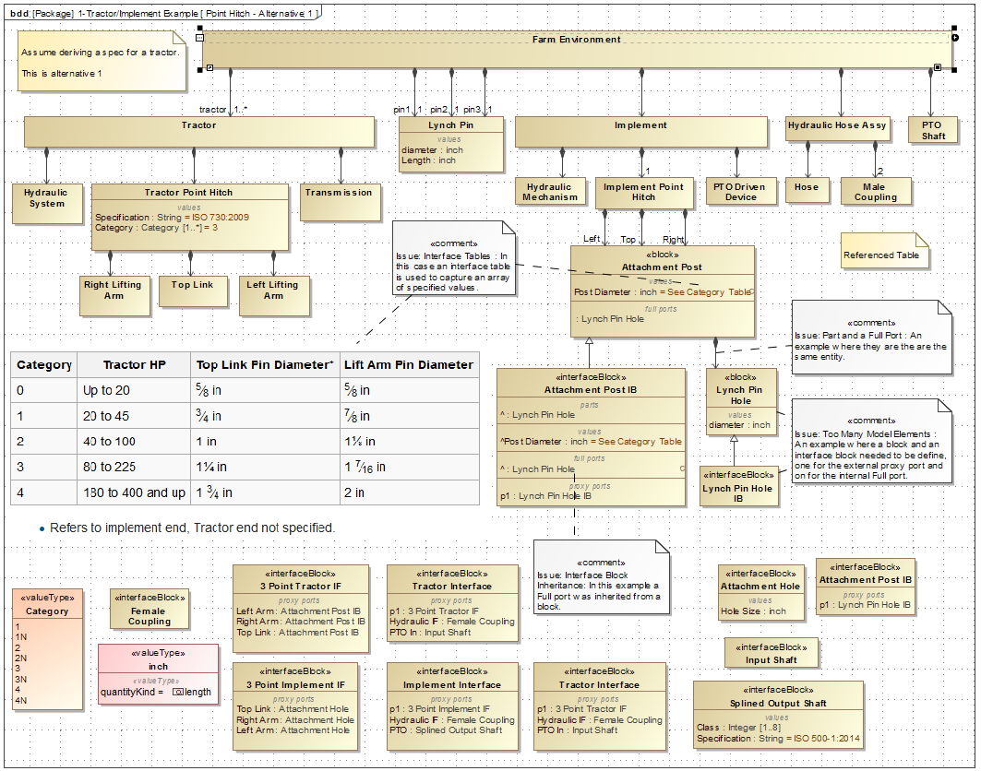

Slide 18
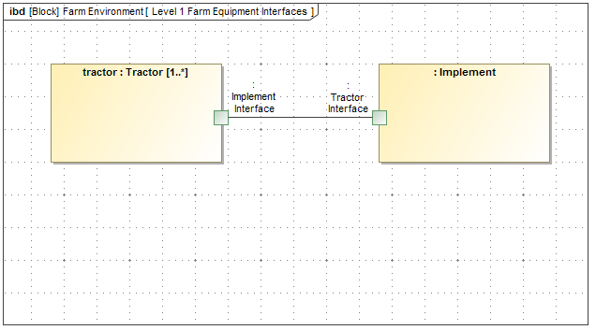

Slide 19
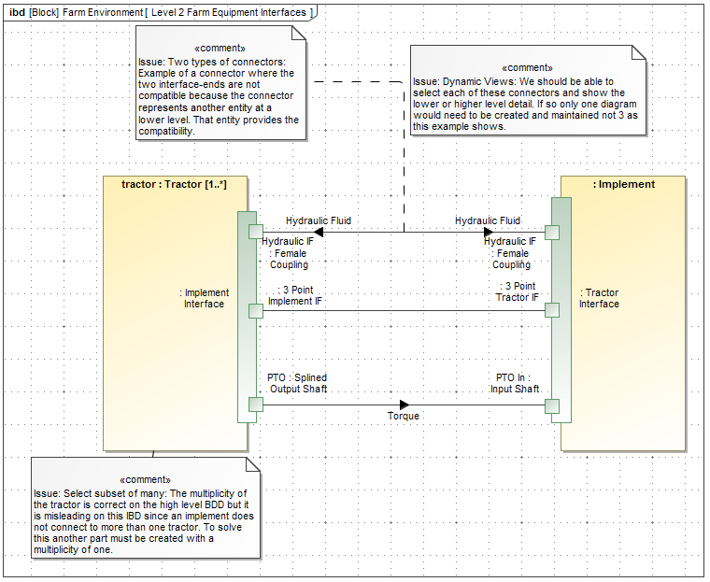

Slide 20
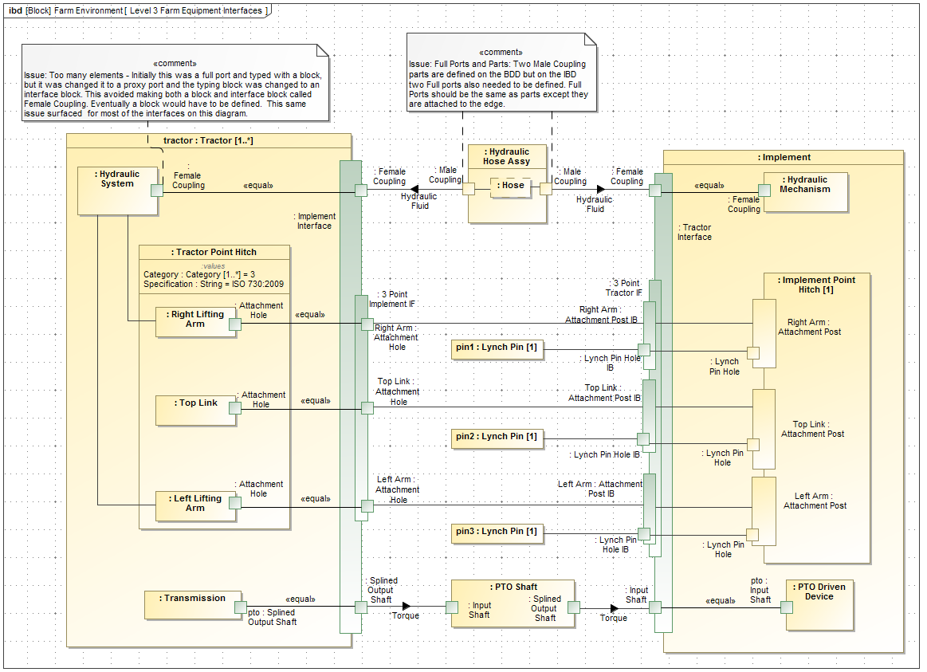

Slide 21
Interface Layers

Slide 22
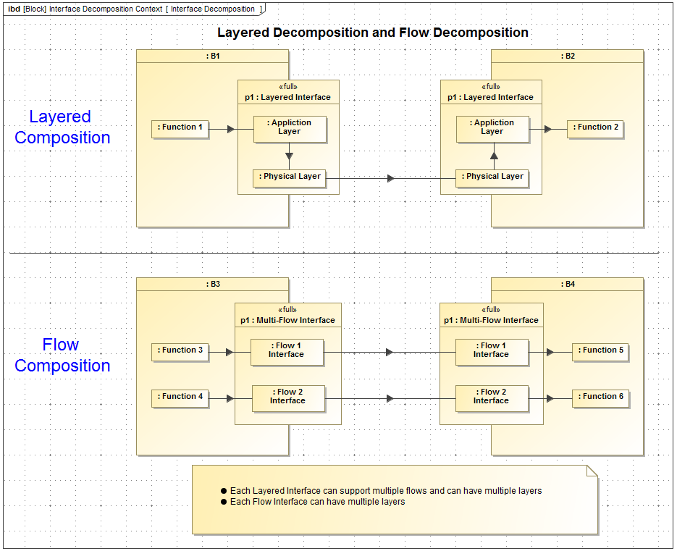

Slide 23
TCP/IP Protocol Stack Example
Interface Layers
Demonstrates Application – Physical Layers in a “Stack”

Slide 24
Interface Example with Simplified End to End Flow
Specify the interfaces and the associated transformation from one interface to another for the end-to-end flow

Slide 25
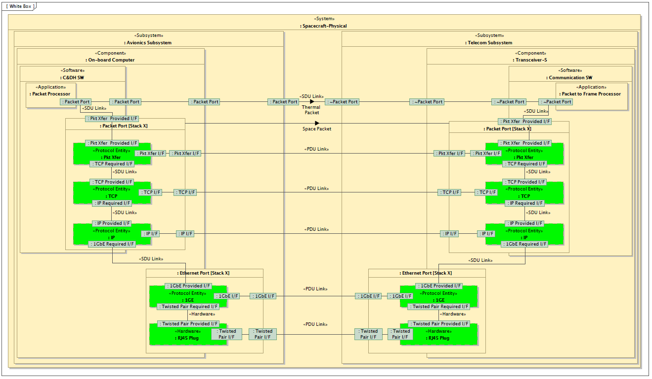
TCP/IP Protocol Stack Example
“A Representative Application of a Layered Interface Modeling Pattern”, Shames, Sarrel, Friedenthal

Slide 26
Interface Visualization of higher level abstraction

Slide 27
Power Plug Example - Interface Medium
Interface Visualization of higher level abstraction

Slide 28
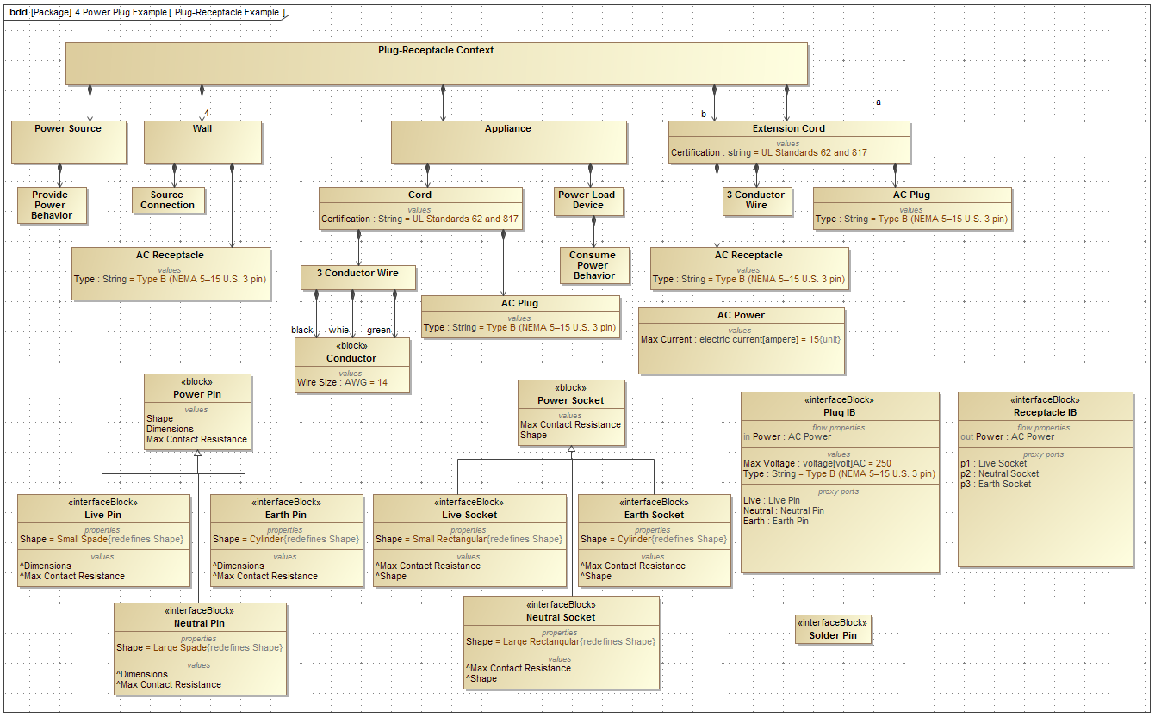

Slide 29
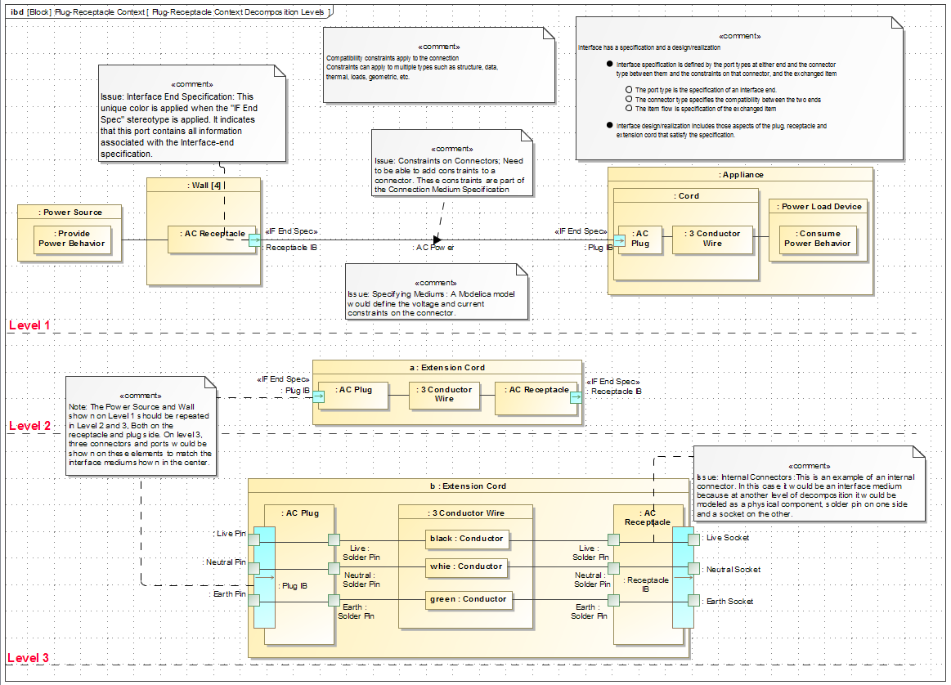

Slide 30
Interface Decomposition to lower level abstraction

Slide 31
PC Mouse Example
Interface Decomposition

Slide 32
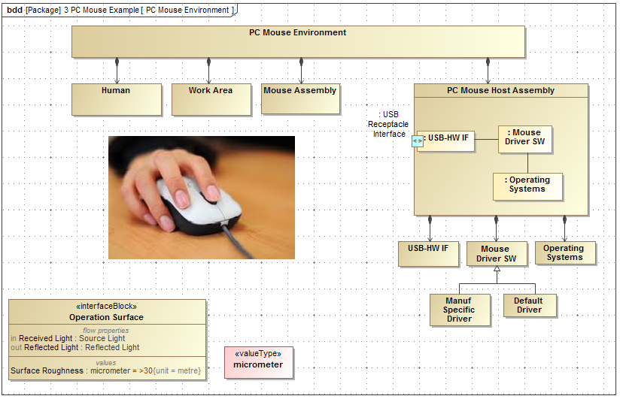

Slide 33
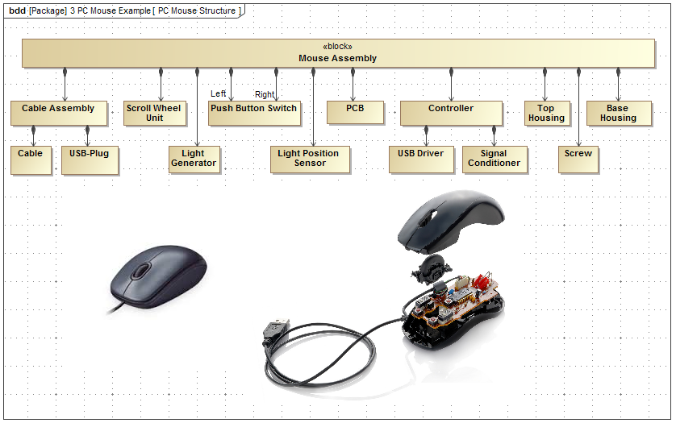

Slide 34
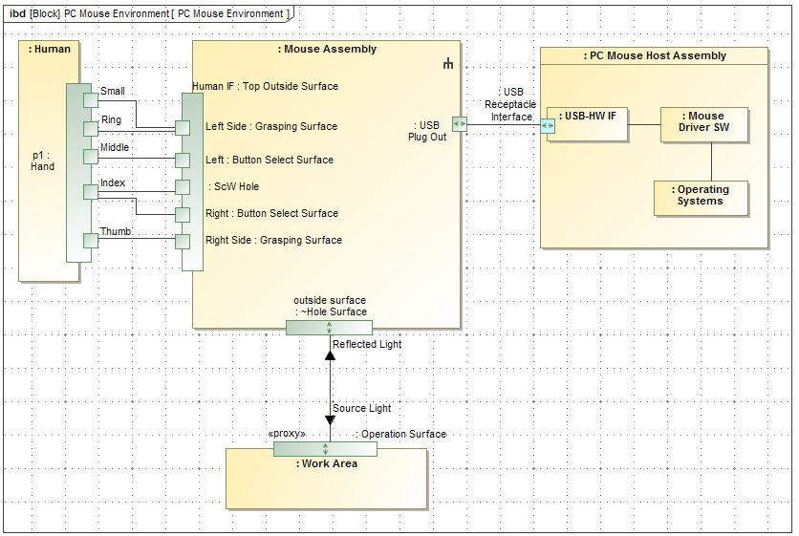

Slide 35
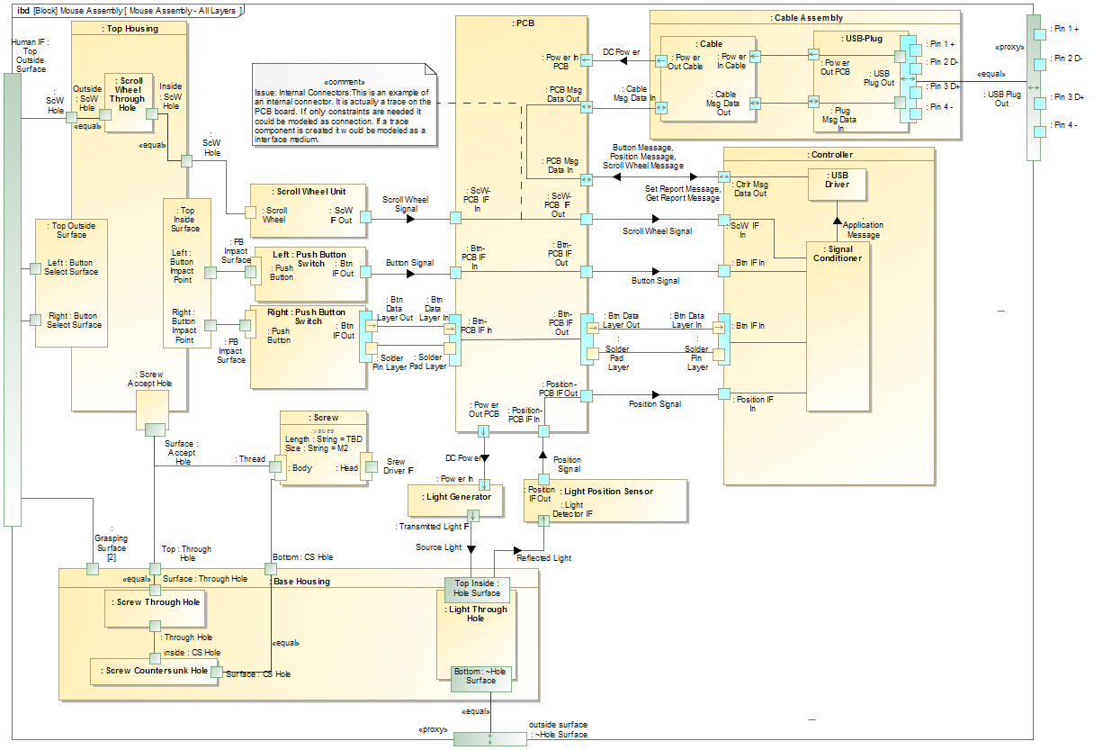

Slide 36
Physical Geometry

Slide 37
PC Mouse Example
Physical Geometry

Slide 38
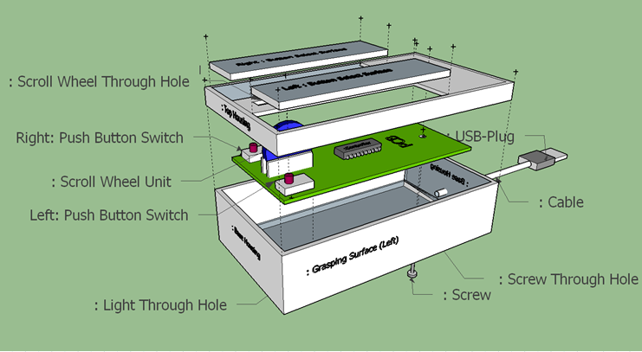

Slide 39
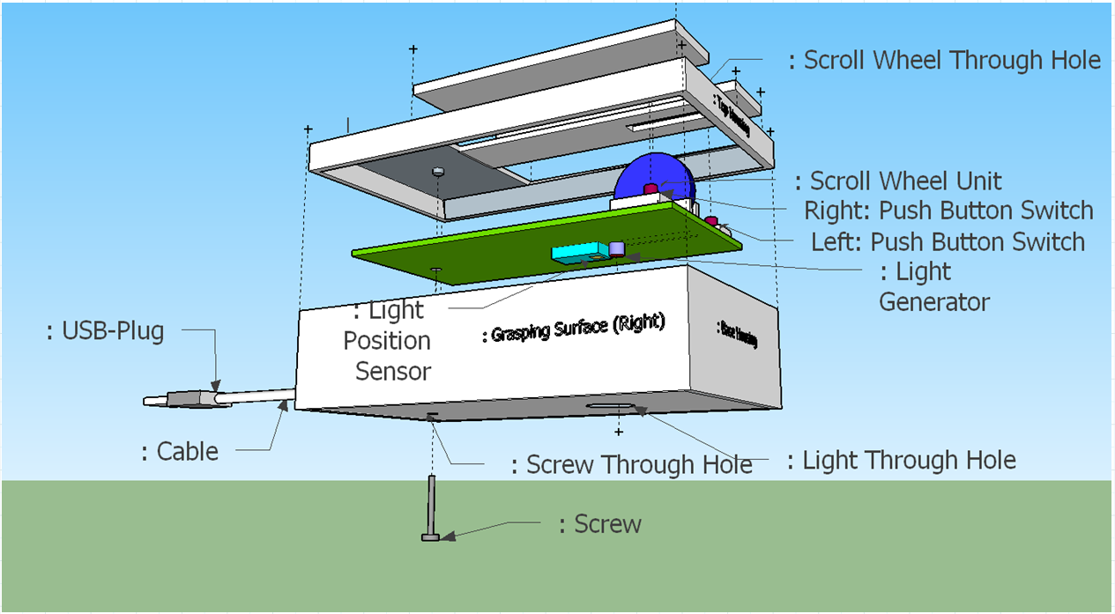

Slide 40
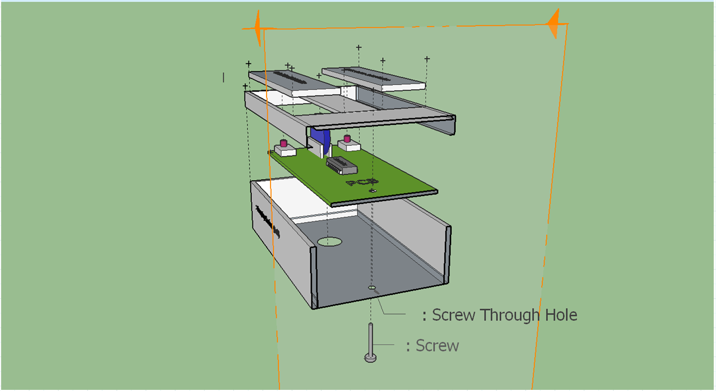

Slide 41
Interface Tables

Slide 42
PC Mouse Example
Interface Tables

Slide 43
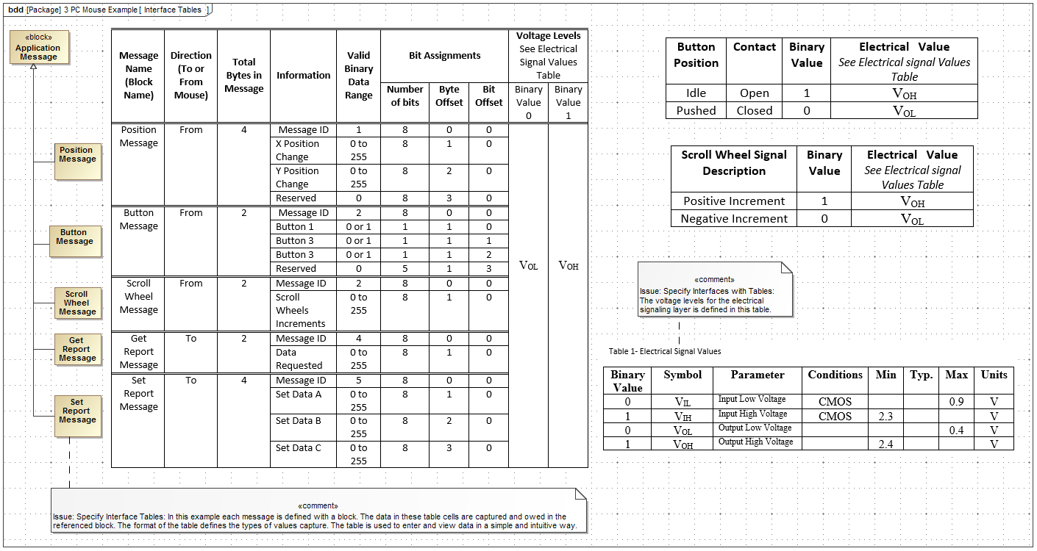

Slide 44
Notes and Issues

Slide 45
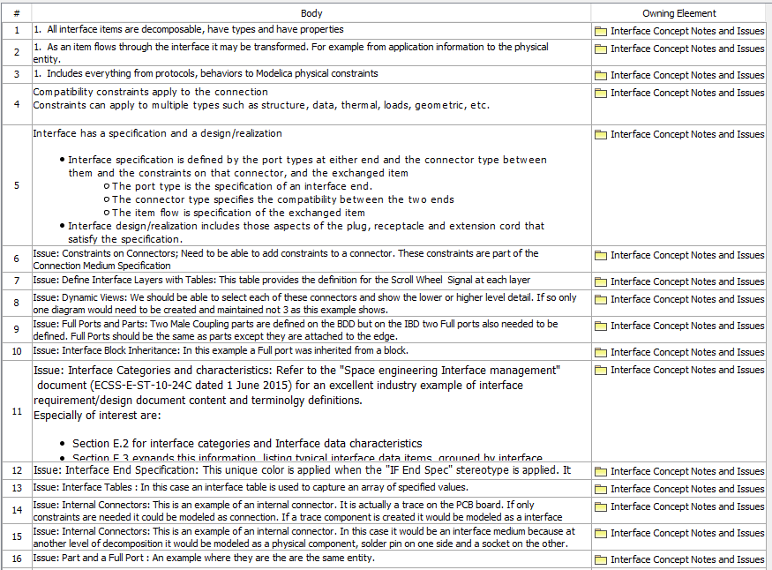
Note and Issues

Slide 46
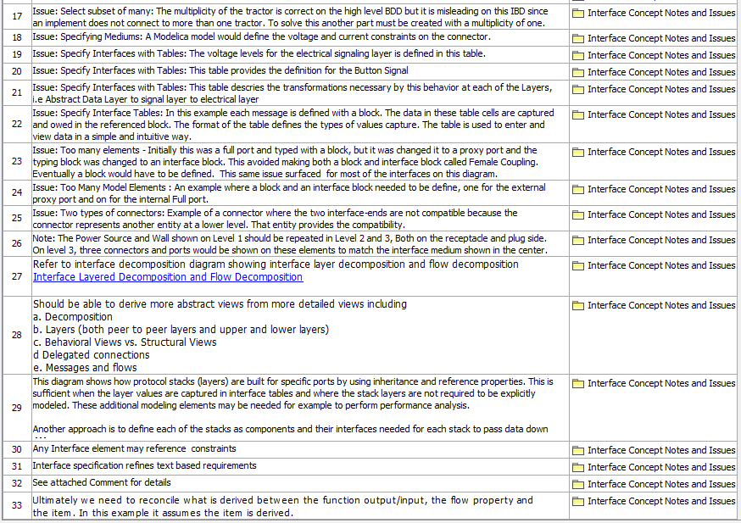
Note and Issues

Slide 47
Requirements

Slide 48
Backups

