Slide 1
Introduction to SysML v.2.0 Metamodel (KerML)
Charles Galey
Bjorn Cole
Conrad Bock

Slide 2
Agenda
What is the Kernel Model?
Motivation
Architectural Principles
As-is/To-be
Abstract Syntax
Examples
Python Sanity Check
Wrap-up

Slide 3
Kernel Modeling Language (KerML)
A computer program that is the core of a computer's operating system (wikipedia)

Slide 4
Kernel Modeling Language (KerML)
Started in 2014 as a part of the early development of the “Model Development Environment” a predecessor to today’s OpenMBEE
Informed by experience and implementation challenges from development of OpenMBEE and “K”
Began by identifying the basic set of concepts needed to create a simplified Systems Modeling Language
Evolved into a more standards focused effort informed by
Onto-Behavior Paper (Bock and Odell, 2011)
Tactical needs of JPL’s Europa Clipper project
”K” Language

Slide 5
Motivation
Address significant gaps in UML/SysML
Without disturbing existing implementations
Respond to SysML v.2 RFP

Slide 6
Motivation (2/2)
Reflect on what we have learned (successes and limitations)
Typed Language with nested hierarchies
View modeling
QUDV library
Variant modeling
More uniform structure and use of patterns
Emphasis on reasoning about systems
Adaptability to domain specific extensions
Ability to leverage technology advancements such as visualization, open source

Slide 7
Major Focus: Language Simplification
UML/SysML is unnecessarily complex
Redundancy
e.g. Classifier, Class, and Type
Multiple overlapping behavior models
Language hard to learn
Lack of precision needed for reliable analysis and execution
These problems make it hard for SysML to support primary systems engineering concerns
Analysis
Interface Definition
Testing/Verification

Slide 8
Architectural Principles
Simple and parsimonious
Patterns to ensure symmetry and consistency
Extensible
SE Domain concepts build on Kernel concepts
E.g., System sub-classes Block
Leverage Model Libraries
Formalize Semantics
Reduces Complexity
Provides Extensibility
Support queries
Notes:
This was emphasized in the original concept model by the way Oliver made the symantic dictionary
Grounding Points
It is sufficient to define the concepts alone
It outlines key goals for libraries

Slide 9
Approach
Bottoms up approach ”Onto”
Identify M0 things to be modeled (i.e a spacecraft to be built)
Create M1 Elements that model them (i.e the Class “Spacecraft”)
Identify common concepts needed to formalize M1 Elements (i.e. “Anything with weight”)
Add M2 elements as needed to simplify usage of M1 (i.e. Block etc.)
Apply this approach to areas of UML we identified as concerns
Introduce concepts to complete the picture
General and special classes (i.e. Element and ControlFlow) in order to not disturb implementations
Services model to support native Configuration Management

Slide 10
Measures of Effectiveness
Quantitative
SysML 1.x (Coverage/Issue Resolution)
UML 2.5.X (Coverage/Issue Resolution/Compatibility)
SysML 2.0 RFP (Requirements Satisfaction)
Qualitative
INCOSE Article MoE
Analyzers and reasoners (Compatibility)

Slide 11
Comparison between As-Is/To-Be
Status Quo (UML/SysML)
KerML
>200 metamodel elements
Primary extension mechanism is at M2
Multiple behavior models that are not integrated with structure
Complex abstract class terminology
No Configuration Management model to define service requirements for implementers
File based interoperability and separate verification tooling
<100 metamodel elements
Primary extension mechanism at M1
Unified structure and behavior model
More sensible abstract terminology
Configuration Management model to drive common service requirements
Modeled interoperability and verification

Slide 12
Status Quo Modeling Environment

Slide 13
KerML Modeling Environment

Slide 14
Implementation
Status Quo: UML/SysML
Over 200 concepts
There are many duplicates (4 or 5 variants of connector for example)
UML was designed for partial implementations
No tools actually did this
Systems modelers need all concepts
No tools implement only UML4SysML
KerML:
Less than 100 concepts
Reduces factoring in metamodel (eg, fewer duplicated concepts)
Focus on libraries to support language needs, with metamodel as needed
Larger common "unified behavior model" where existing behaviors are views of a unified behavior model
Object-behavior unification (diagrammatically and for model access to executions)

Slide 15
Domain Extension
Status Quo (UML/SysML):
Primary extension mechanism is at M2
Encourages unchecked language expansion (profiles of profiles)
No semantic extensions
KerML:
Primary extension mechanism is at M1 (Specialization of normative libraries)
Doesn't complicate the base language
Enables extension of semantics as well as the syntax

Slide 16
Analysis
Status Quo UML/SysML:
Multiple mappings/engines for analysis of each type of Behavior model
No formal specification of the legal instantiations/executions of user models
KerML:
Unified Behavior model requires only one mapping/engine
Normative Library to formally specify legal instantiations/executions of user models

Slide 17
Usage
Status Quo (UML/SysML):
Double bookkeeping between behavioral and structural models
Abstract class terminology discourages learning and encourages misuse (i.e. Element <- NamedElement <- Namespace <- Classifier <- StructuredClassifier <- EncapsulatedClassifier <- Class)
KerML:
Unified behavior and structure (no double bookkeeping)
More sensible abstract terminology (due to refactoring)

Slide 18
Interoperability: Status Quo
FILEZ!?
DinoML

Slide 19
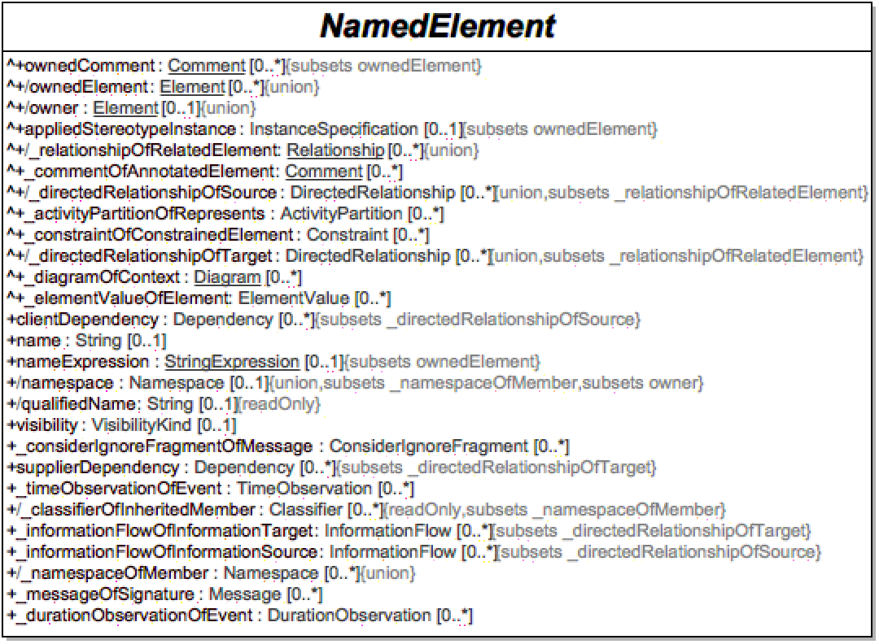
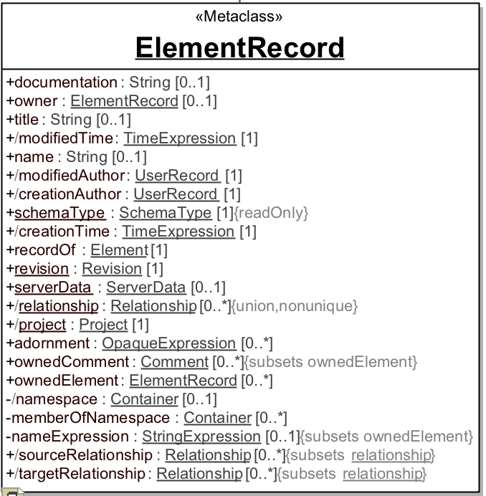
Interoperability: KerML
User Defined Mapping
UML
KerML

Slide 20
Structure/Behavior Unification Example
https://mms.openmbee.org/alfresco/mmsapp/mms.html#/projects/PROJECT-d9ff6adf-53e5-44e5-8f6b-fb5b71687f0c/master/documents/_18_5_2_71301a1_1506459873916_424306_36453/views/_18_5_2_71301a1_1506459916025_770253_36523

Slide 21
Wrap-up
Coverage of SysML v2.0 Requirements
Coverage of UML 2.5.X
Next steps

Slide 22
KerML Statistics for July draft RFP Req’s
Total Req’s ~ 270
Covered by KerML core concepts ~ 75
Coverable by user libraries defined against KerML ~ 123
Key aspects of support:
Unified structure and behavior
Classification / individual approach
Supports abstract to concrete, semantics for formal definition and constraints
Jumping-off point for executable semantics
Procedural (construction of instances, moving a “cursor” around the model for queries)
Declarative (legal instances to create, requirements, constraints)
Need math connection

Slide 23
Coverage of UML
In the process of an exercise to evaluate UML concepts vs. KerML concepts
Evaluating based on the following criteria:
Integrated
Merged
Moved to M1 Library
Compatible but not Integrated
TBD

Slide 24
Next-steps
Continue evaluation of work done so far (UML Coverage)
Export of completed work to View Editor
Specification format for Abstract Syntax
Complete definitions for all Types and Properties
Slide Deck replication
Language Tasks
State Machines (In Progress)
Input/Output and Ports (In Progress)
Sequence Diagrams
Instance/ValueRestrictions

Slide 25
Python Sanity Check

Slide 26
Backup

Slide 27
INCOSE Article MoE
Expressive: Ability to express the system concepts
Precise: Representation is unambiguous and concise
Presentation/communication: Ability to effectively communicate with diverse stakeholders
Model construction: Ability to efficiently and intuitively construct models
Interoperable: Ability to exchange and transform data with other models and structured data
Manageable: Ability to efficiently manage change to models
Usable: Ability for stakeholders to efficiently and intuitively leverage the modeling environment and modeling artifacts
Adaptable/Customizable: Ability to extend models to support domain specific concepts and terminology

Slide 28
Example of Service Data Model

