Slide 1
SECM - Requirements Concepts - Review
John Watson
08 Feb 2017 Rev A

Slide 2
Changes to Review
Slides 3, 4 and 6 –
Changed the Requirement concept to reflect the more general concepts of Definition and Usage, i.e. Requirement Definition and Requirement, respectively.
There is more work to be done to fully integrate the concepts of Definition and Usage into the requirements concepts. A note was added on slide 6 to remind us to this.

Slide 3
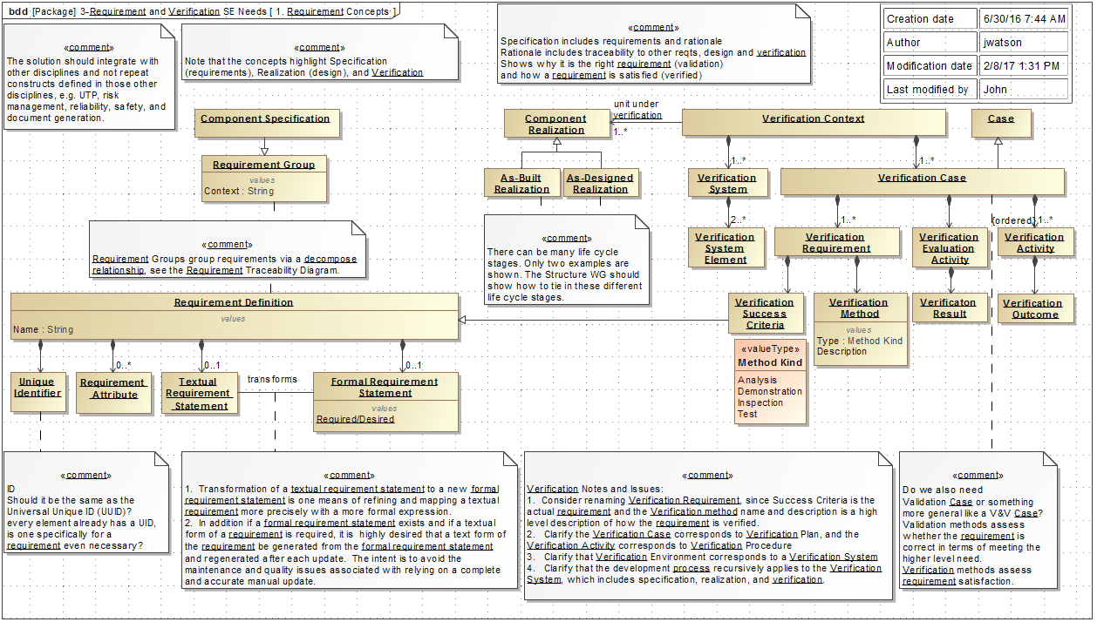
Requirement Concepts

Slide 4
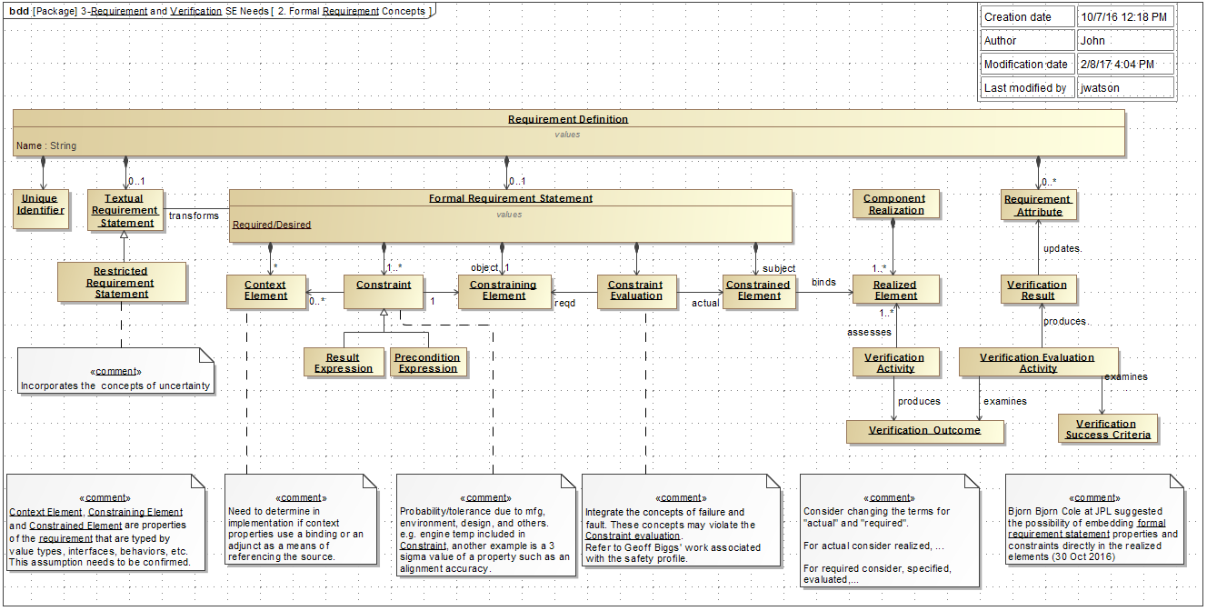
Formal Requirement Concepts

Slide 5
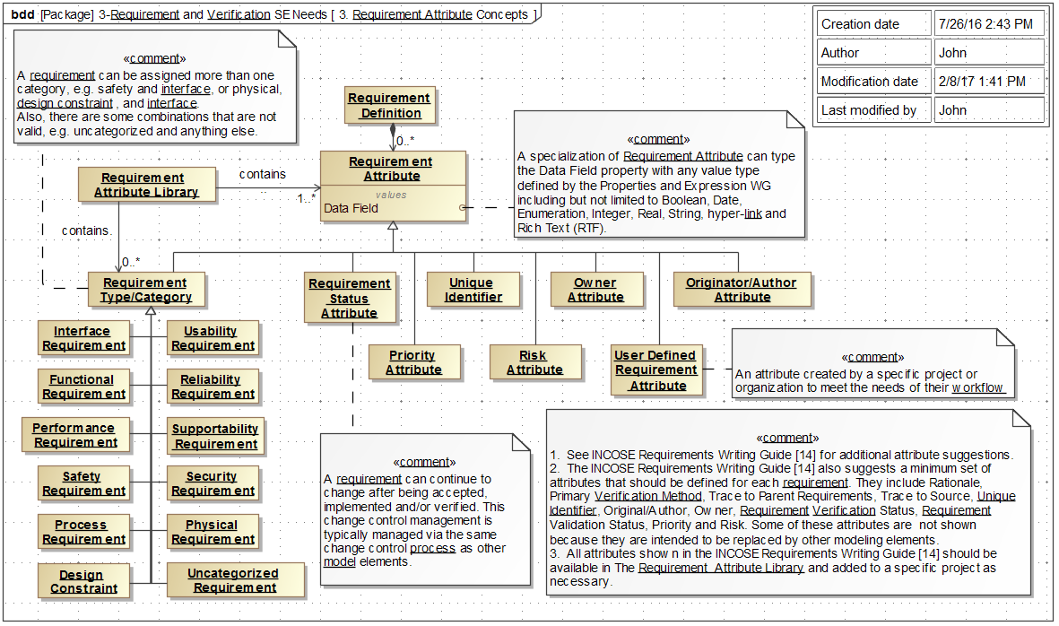
Requirements Attribute Concepts

Slide 6
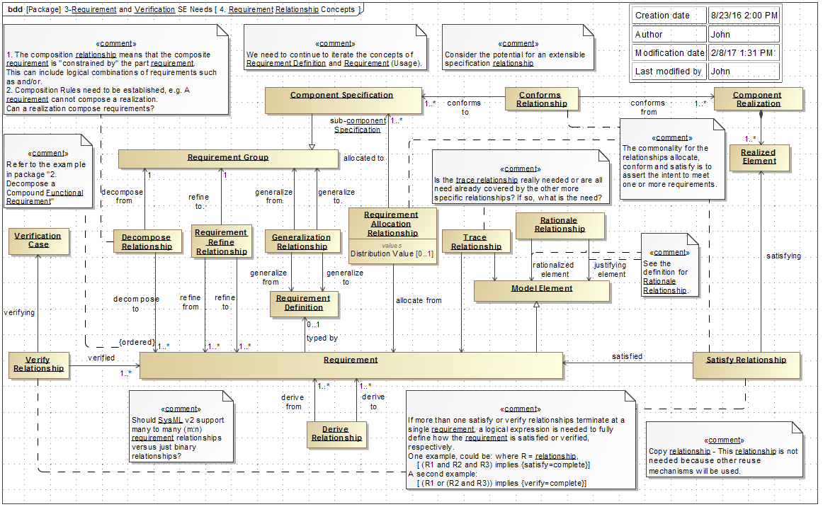
Requirement Relationship Concepts Diagram

Slide 7
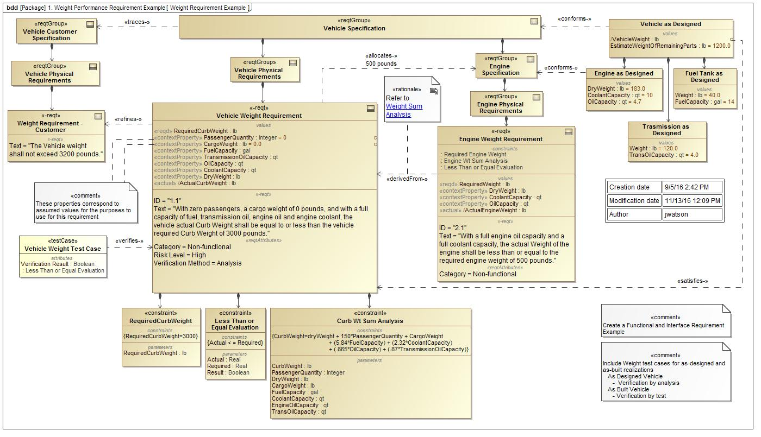
Vehicle Weight Performance Requirement Example

Slide 8
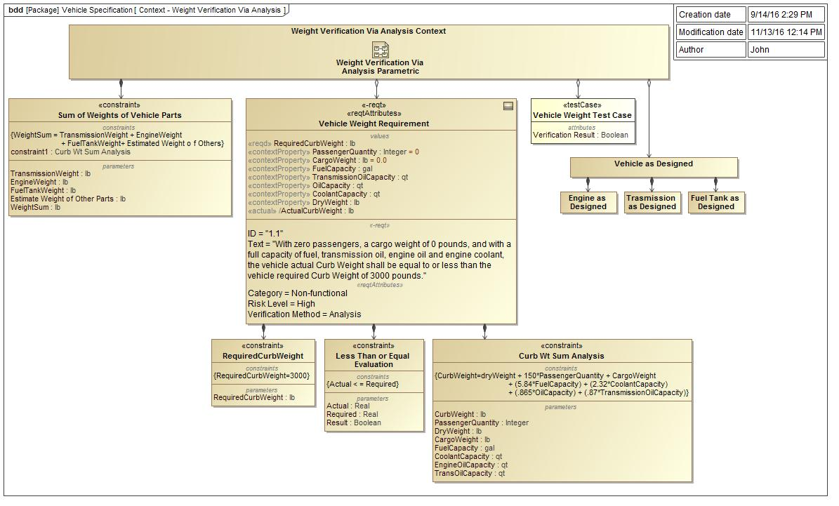
Analysis Context Diagram - Vehicle Weight Verification Via Analysis Example

Slide 9
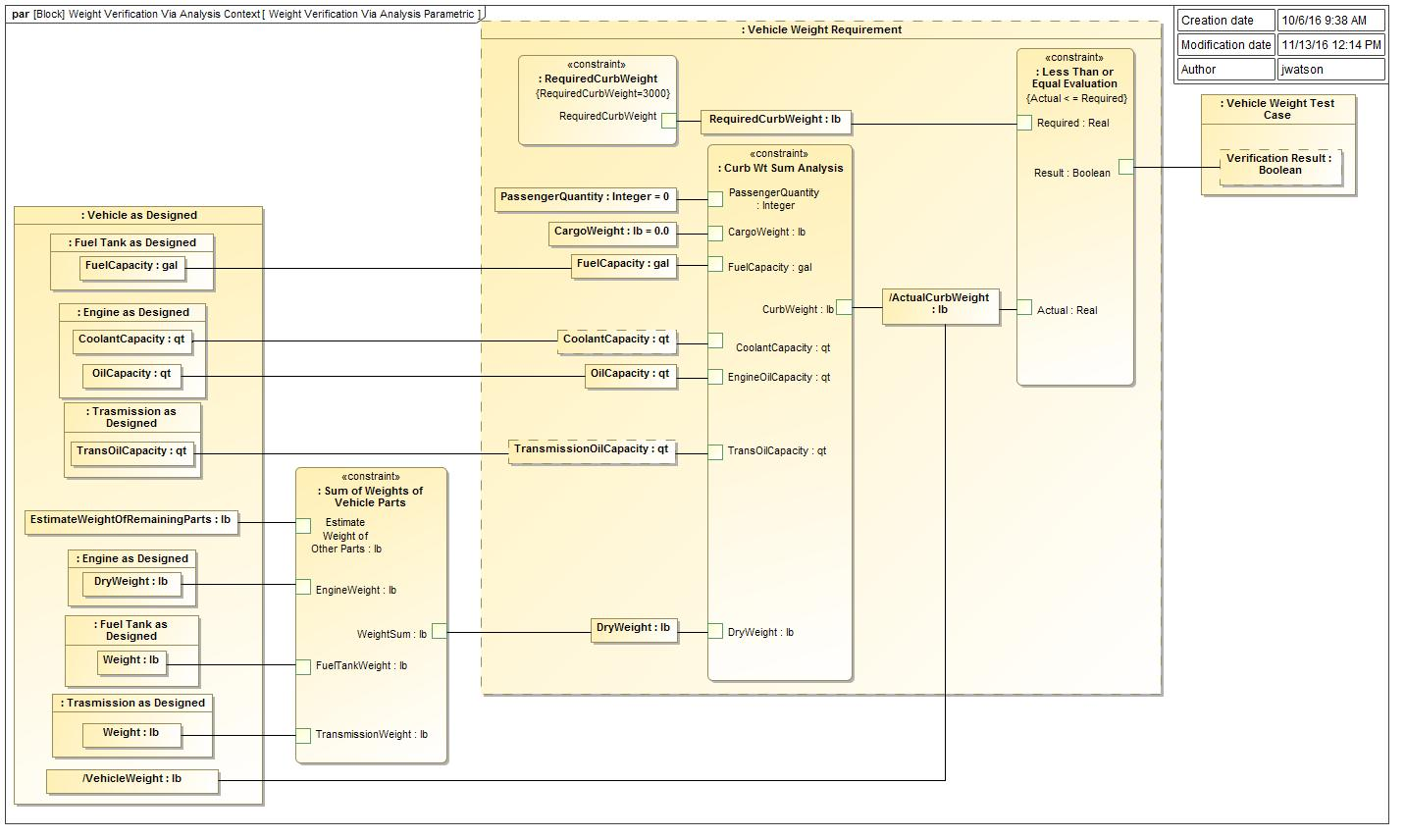
Analysis Parametric Diagram - Vehicle Weight Verification Via Analysis Example

Slide 10
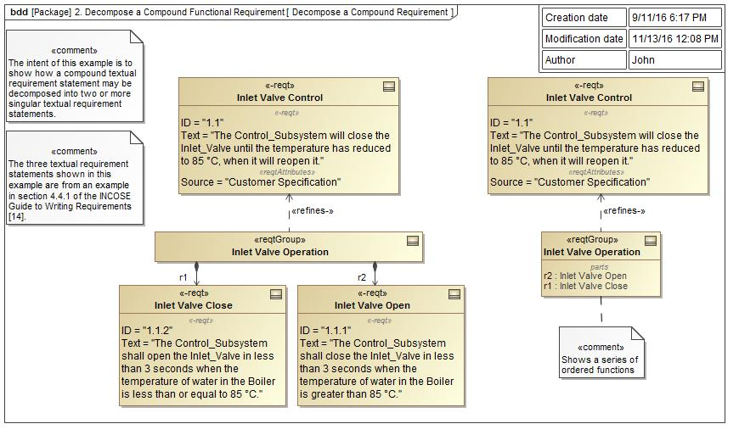
Decompose a Compound Text Based Requirement Example

Slide 11
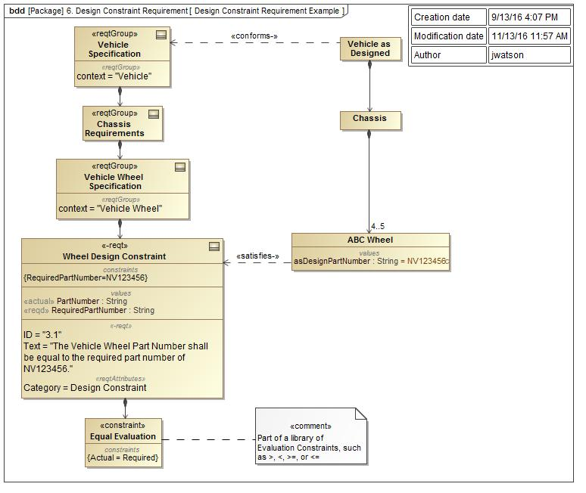
Design Constraint Requirement Example

Slide 12
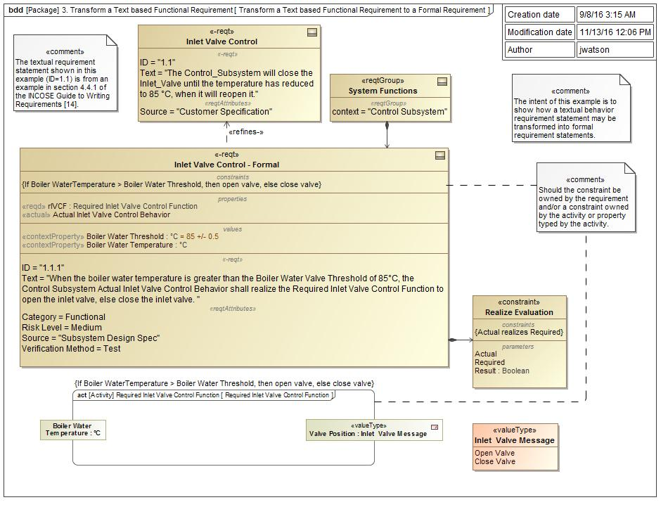
Transform a Text based Functional Requirement to a Formal Requirement Example

Slide 13
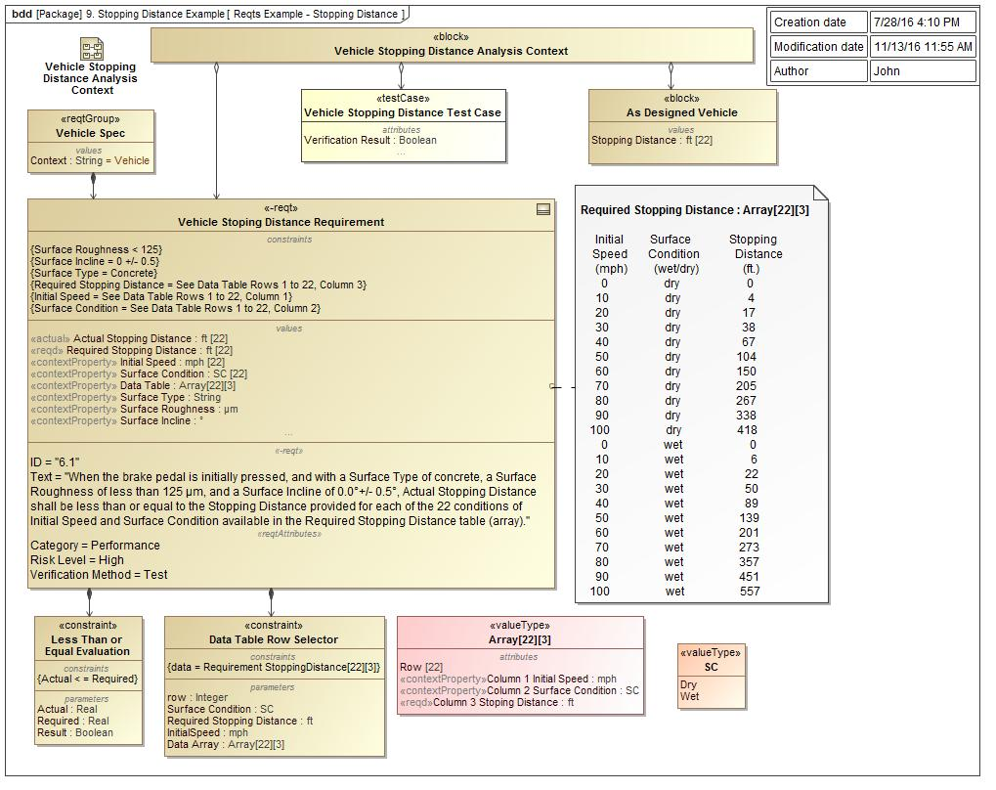
Vehicle Stopping Distance Example

Slide 14
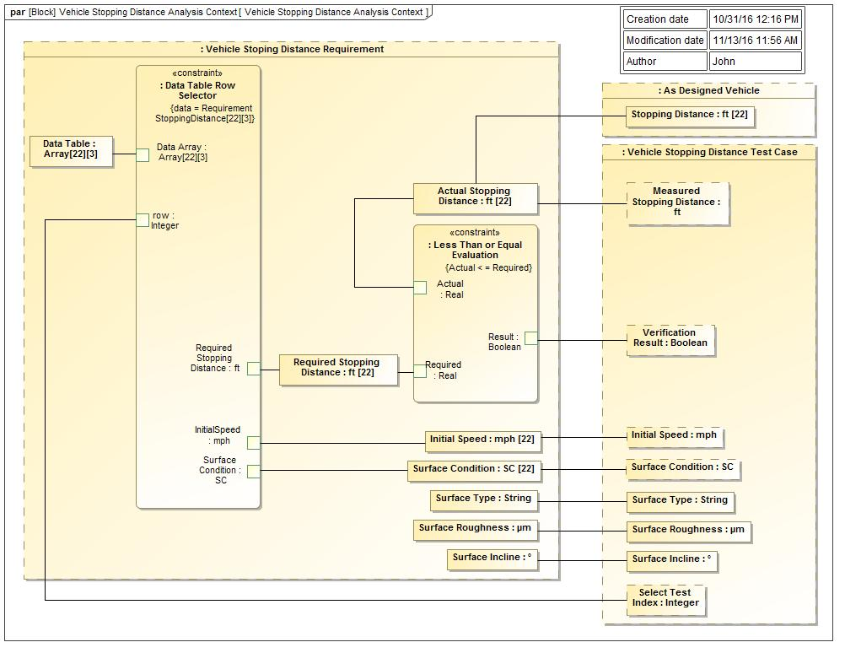
Vehicle Stopping Distance Parametric Diagram

Slide 15
Functional Requirement Example -Updated 9/xx/2016

Slide 16
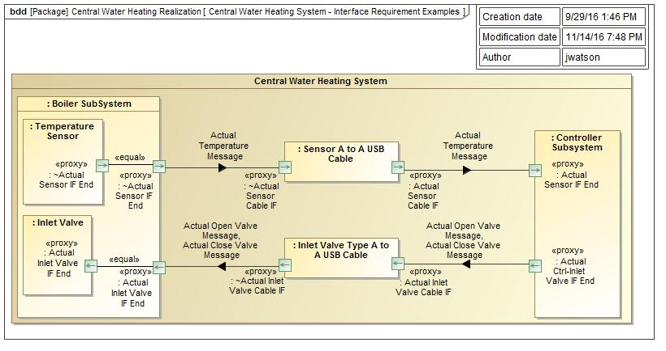
Interface Requirement Example, Central Heating System Context Realization

Slide 17
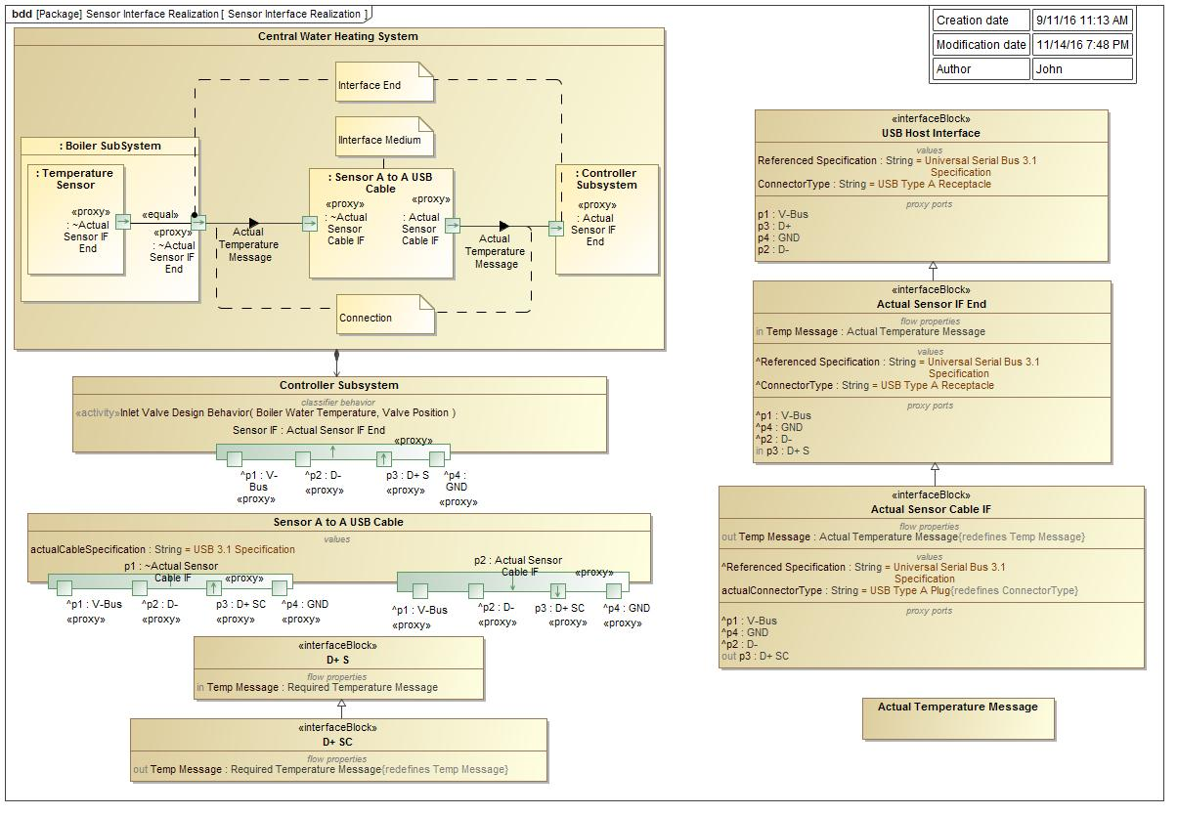
Controller-Sensor Interface Realization
17

Slide 18
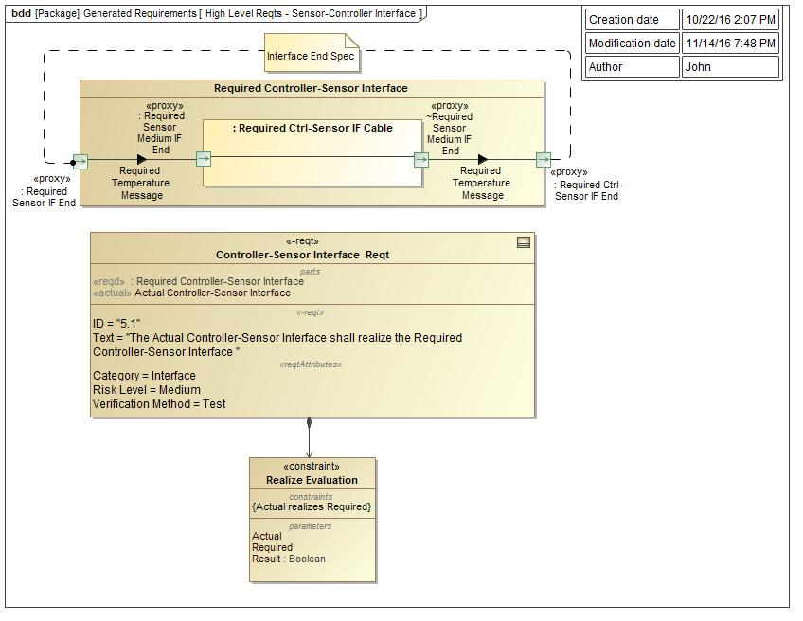
High Level Requirements - Controller-Sensor Interface Specification
18

Slide 19
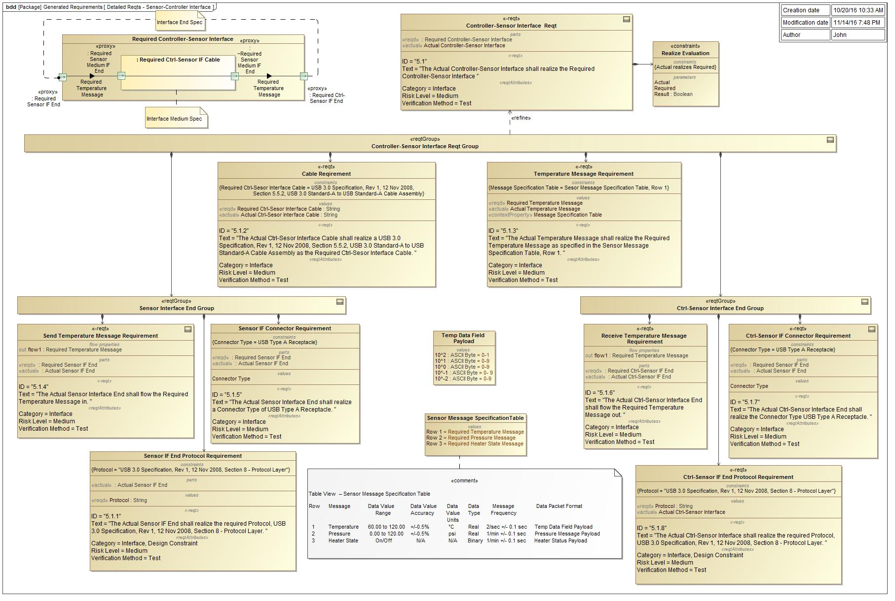
Detailed Requirements - Controller-Sensor Interface Specification
19

Slide 20
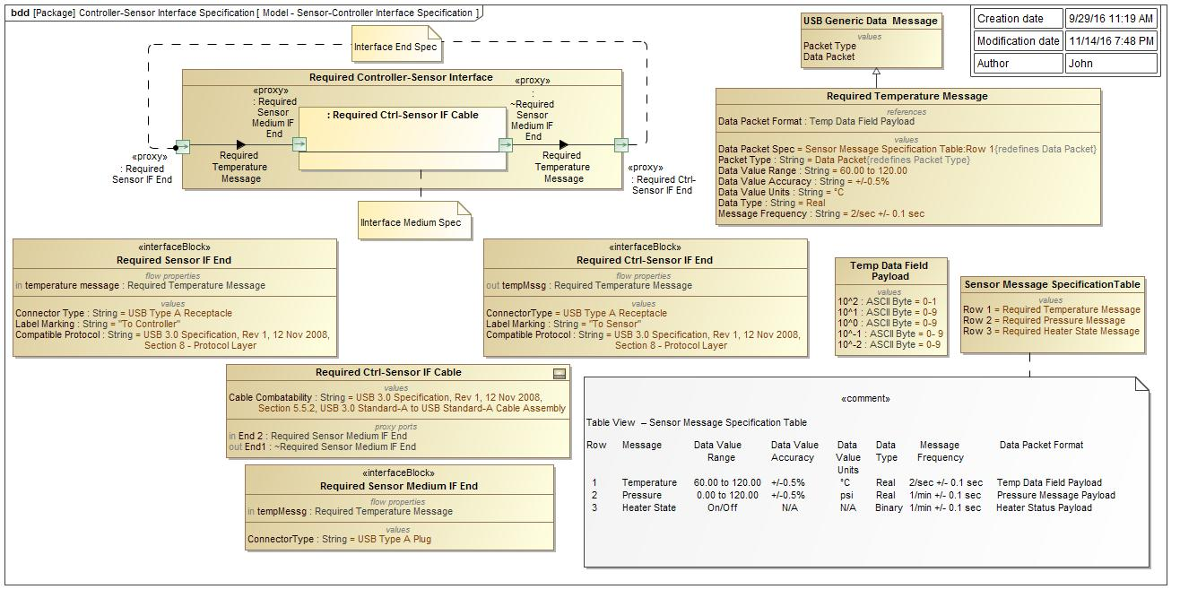
Controller-Sensor Interface Specification Model
20

Slide 21
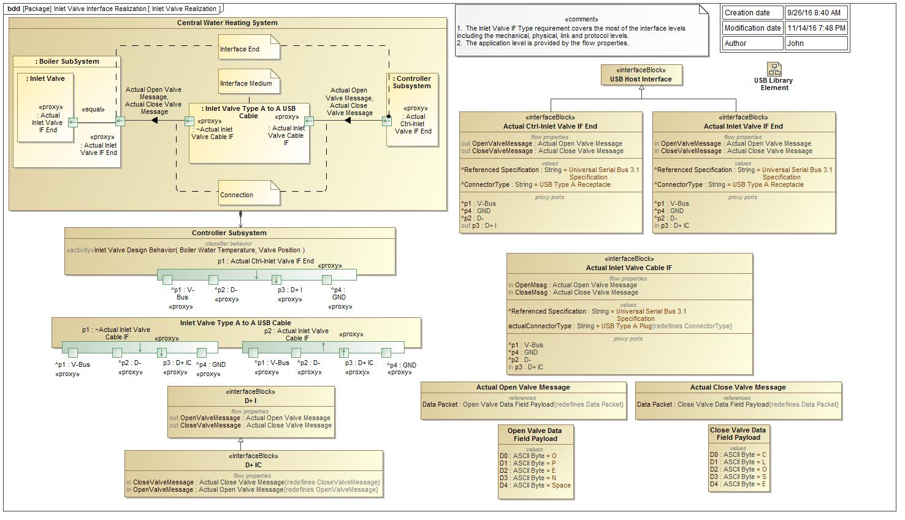
Controller-Inlet Valve Interface Realization

Slide 22
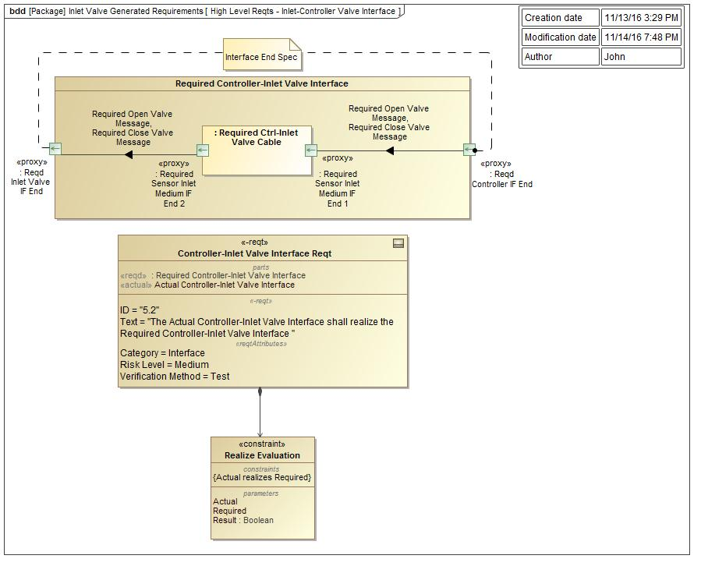
Controller-Inlet Valve Interface High Level Specification

Slide 23
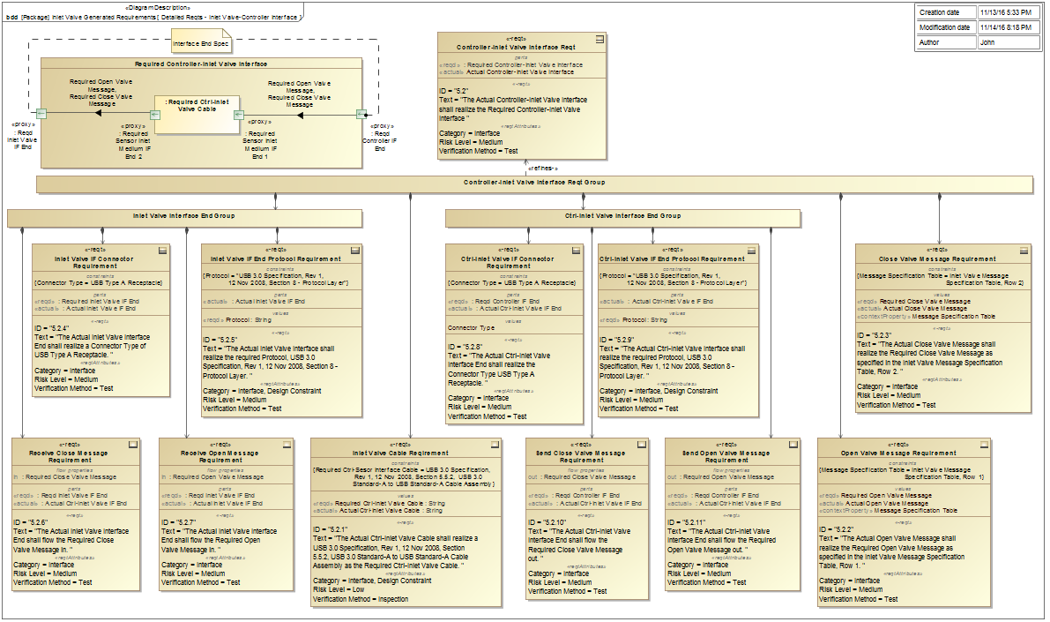
Controller-Inlet Valve Interface Detailed Generated Requirements

Slide 24
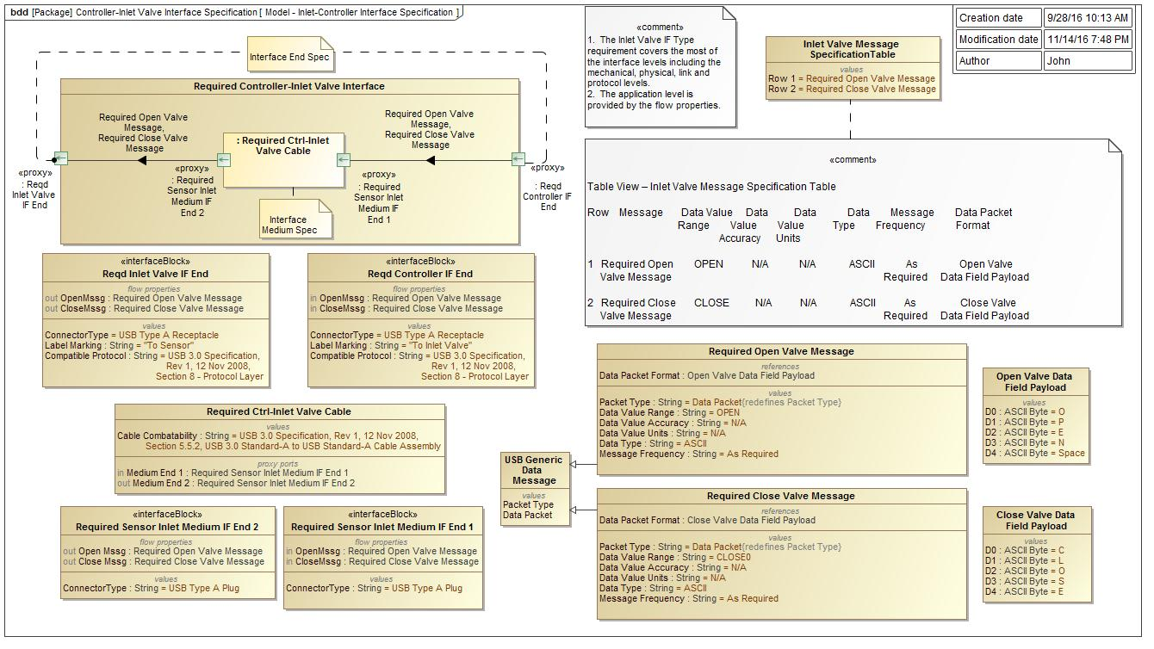
Controller-Inlet Valve Interface Specification Model

Slide 25
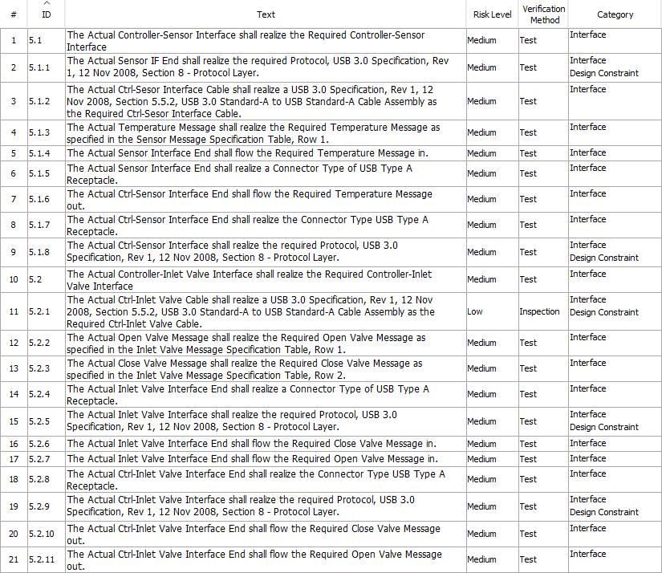
Controller-Sensor & Controller-Inlet Valve Requirement Table - 11/13/2016

Slide 26
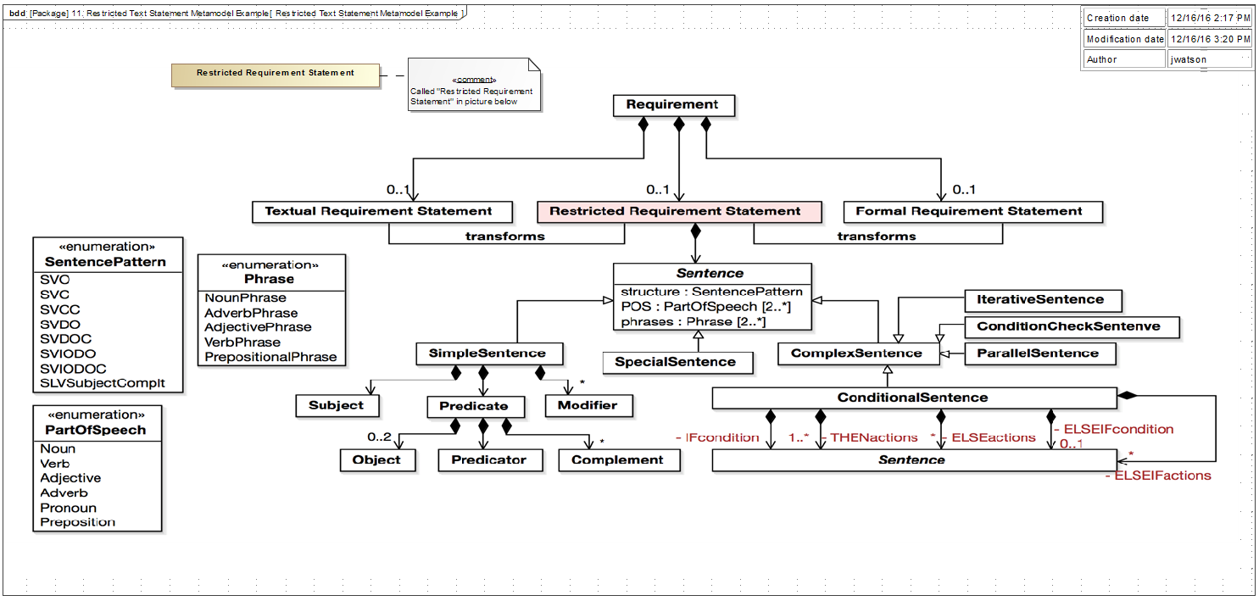
Restricted Text Statement Metamodel Example

Slide 27
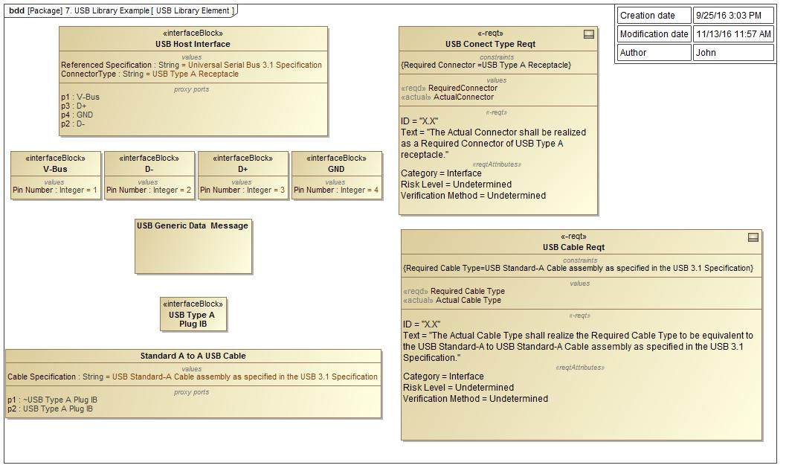
USB Library Example

Slide 28
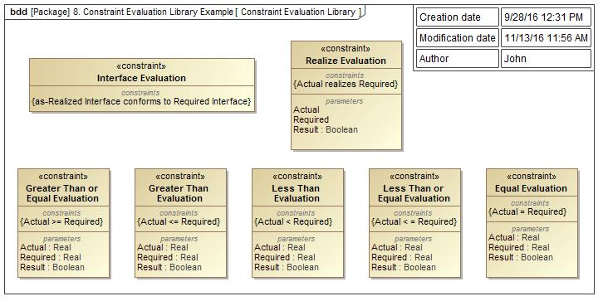
Constraint Evaluation Library Example

Slide 29
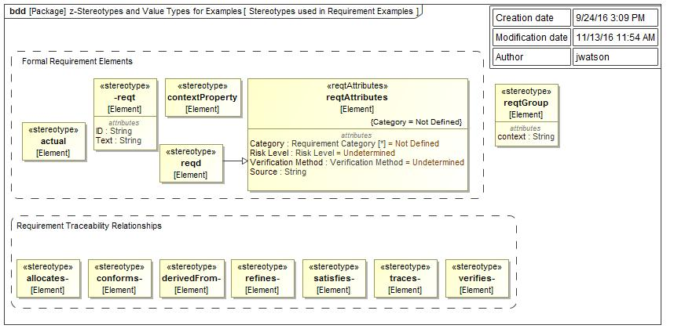
Stereotypes Types Used in Requirement Examples

Slide 30
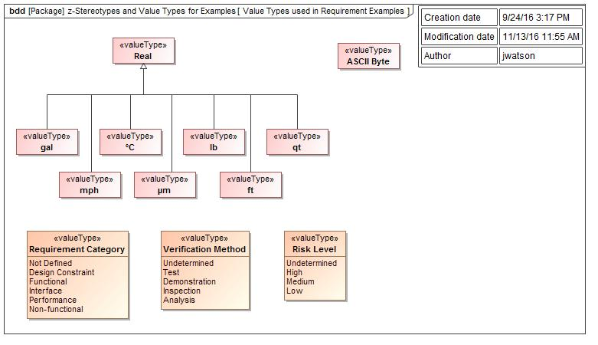
Value Types Used in Examples

Slide 31
Derived Required Requirement Example Engine Power from Vehicle Weight & Vehicle Acceleration
Constraint can be reused for
defining the power requirement
and the weight requirement
Pwr-actual
Engine
Power
Pwr-reqd = k * Wt-reqd
Pwr-actual>Pwr-reqd
Accel = 0-60 in 10 sec
Wt-reqd
Vehicle Weight

Slide 32
Derived Desired Requirement Example Engine Power from Vehicle Weight & Vehicle Acceleration
Constraint can be reused for
defining the power requirement
and the weight requirement
Pwr-actual>Pwr-desired
Engine
Power
Pwr-reqd = k * Wt-reqd
Pwr-actual
Accel = 0-60 in 5 sec
Accel = 0-60 in 10 sec
Wt-reqd
Vehicle Weight

Slide 33
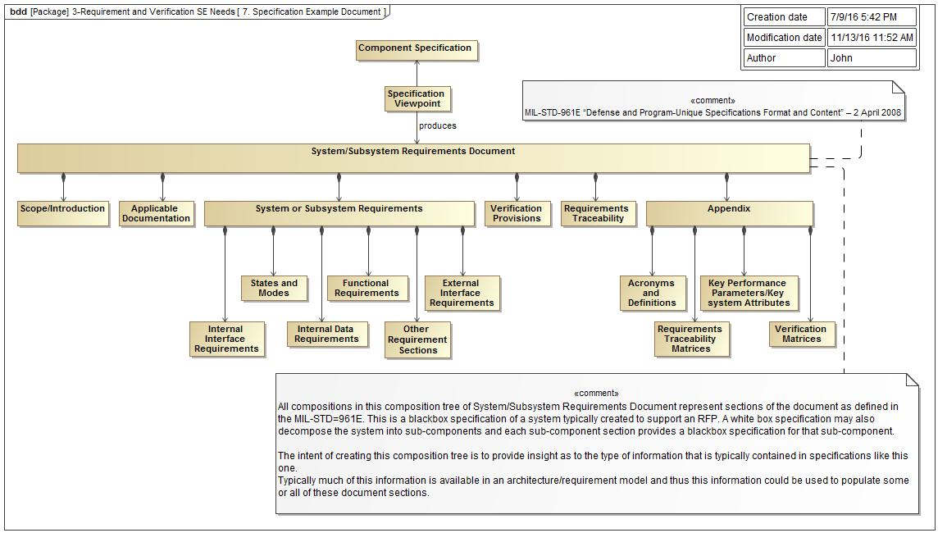
MIL-STD-961E Requirement Specification Example

