Slide 1
SysML v2 RFP Model-based Specification Approach
OMG Technical Conference, Reston VA
John Watson, Robert Karban
21 March 2017 Rev A

Slide 2
Overview
SECM Support for MBSE Document Generation
SECM organization to support SysML v2 RFP
Specific content to be used for the SysML v2 RFP
SysML v2 RFP Auto-generation Process (Robert Karban)

Slide 3
The Environment
System Modeler 18.1 Client
Teamwork Server
18.1
System Modeler 18.1 Client
25 Users have access
Projects:
SECM-Domain
OMG-SysML20-RFP
Moving SECM to version 18.5 at the end of March
Notes:
Environment allows multiple users to access remotely and update the SECM, Lock, update and unlock parts of the model

Slide 4
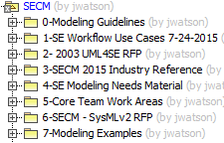
SECM Model High Level Content
Notes:
Uses Magic Draw using a Teamwork Server provided my No Magic

Slide 5
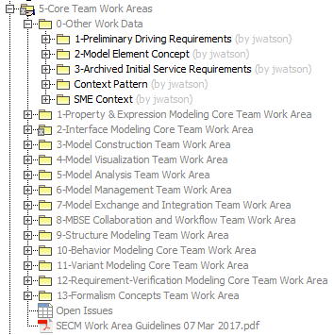
Core Team Work Areas
Staging area for developing:
RFP content information:
Requirements
Glossary Terms
Other informative Information:
SE Concept Development
Examples
Traceability to Concepts and Driving Requirements
Manage Follow-up Issues
SECM Work Area Guidelines
Notes:
Once the Requirements and Glossary terms are stable, they are moved to the SysML v2 RFP area

Slide 6
SECM Work Area Guidelines
Goal
Make it easy to transition Requirements and Glossary Terms from the work areas to the SysML v2 RFP Area
Location – Core Team Work Area Package
Guidance Contents
Naming Conventions
Creating RFP Glossary Terms
Creating RFP Requirements
Capturing Follow-up Issues

Slide 7
SECM – SysML v2 RFP
Notes:
Uses Magic Draw using a Teamwork Server provided my No Magic

Slide 8
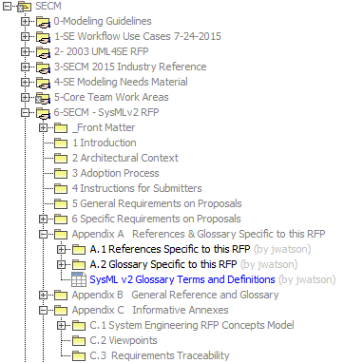
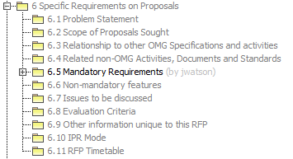
SECM – SysML v2 RFP Model Organization

Slide 9
Requirements
140 Requirements have been created
Requirement attributes include:
Unique ID
3 letter prefix identifying the type of requirement
Followed by a number, e.g. VER 4.2.3
Name
SysML 1.X – Was this feature available in SysML 1.X?
Yes, No, Partial
Status
Draft, Proposed, Ready for Review, Accepted, Rejected, Implemented, Verified
Owner – Identifying the Core Team work center creator

Slide 10
Requirement Groups
25 Requirement Groups have been created to date
A Group uses a Requirement Construct with a unique stereotype
Used to Organize Requirements (Containment as in SysML 1.X)
They do not contain a “shall” statement
Can contain supporting text

Slide 11
Glossary Terms
149 Glossary Terms exist
Each contain:
At least one textual definition
A source reference
Owner tag identifying the Core Team Workgroup
24 References have been used across the 149 terms

Slide 12
Questions?

Slide 13
Backup Slides

